Slide 1
Style-aware Mid-level Representation for Discovering Visual Connections in Space and Time
Yong Jae Lee, Alexei A. Efros, and Martial Hebert
Carnegie Mellon University / UC Berkeley
ICCV 2013

Slide 2

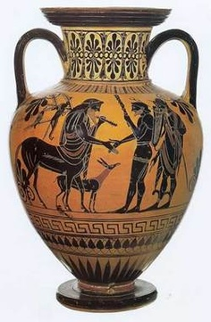
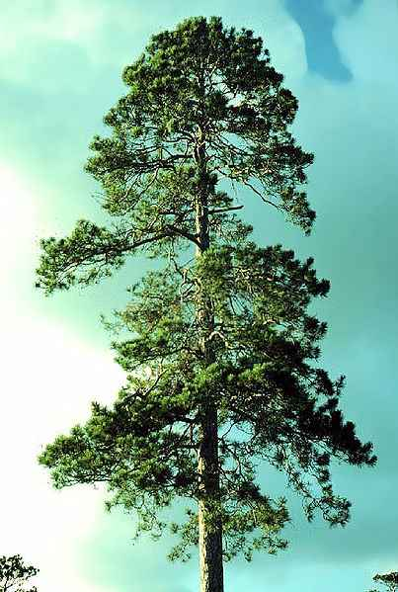
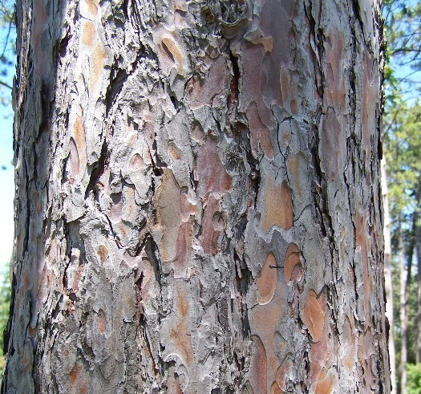
Long before the age of “data mining” …
when?
(historical dating)
where?
(botany, geography)

Slide 3
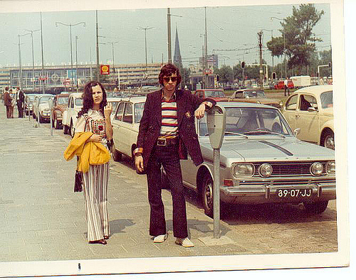
when?
1972

Slide 4
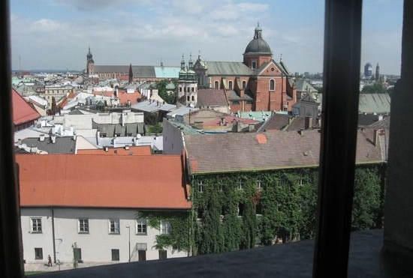


where?
Krakow, Poland
Church of Peter & Paul
“The View From Your Window” challenge

Slide 5
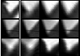
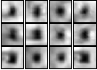
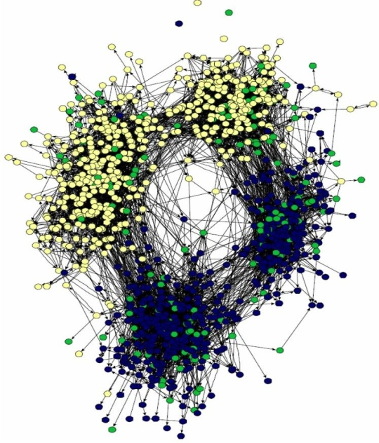

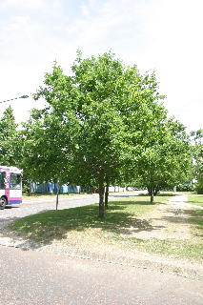
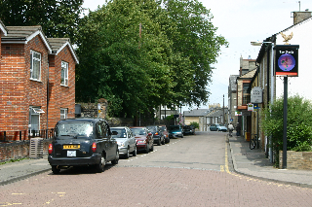
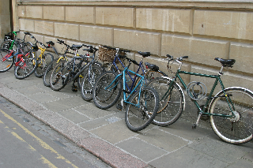
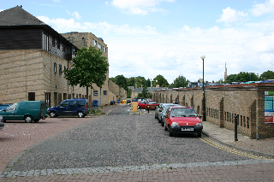

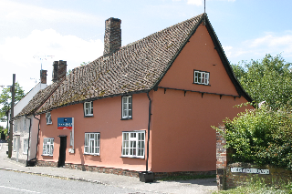
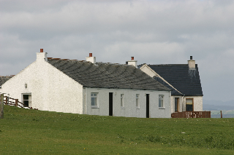
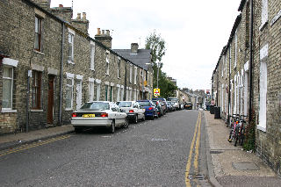
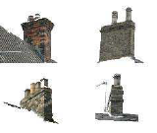




Visual data mining in Computer Vision
Low-level “visual words”
[Sivic & Zisserman 2003, Laptev & Lindeberg 2003, Czurka et al. 2004, …]
Visual world
Object category discovery
[Sivic et al. 2005, Grauman & Darrell 2006, Russell et al. 2006, Lee & Grauman 2010, Payet & Todorovic, 2010, Faktor & Irani 2012, Kang et al. 2012, …]
Most approaches mine globally consistent patterns

Slide 6
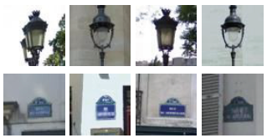
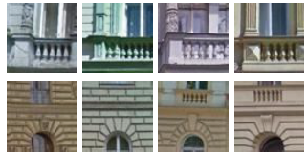
Visual data mining in Computer Vision
Paris
Paris
non-Paris
Prague
Visual world
Mid-level visual elements
[Doersch et al. 2012, Endres et al. 2013, Juneja et al. 2013, Fouhey et al. 2013, Doersch et al. 2013]
Recent methods discover specific visual patterns

Slide 7
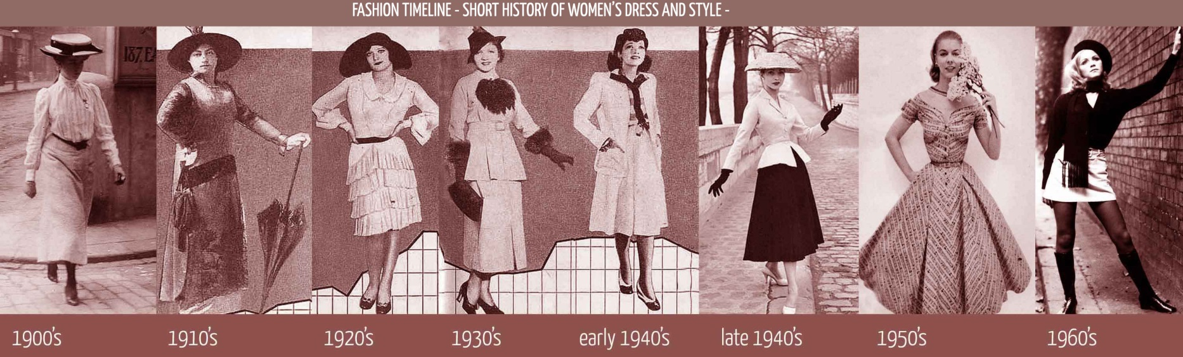





Problem
Much in our visual world undergoes a gradual change
Temporal:
1887-1900
1900-1941
1941-1969
1958-1969
1969-1987

Slide 8
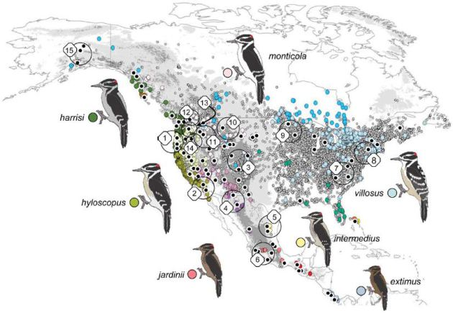
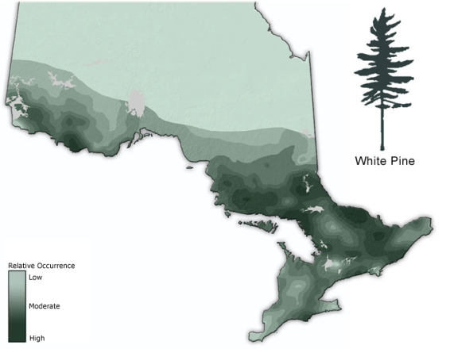
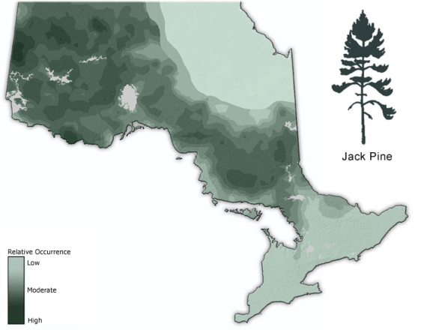
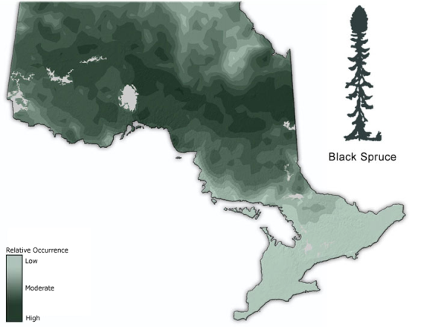
Much in our visual world undergoes a gradual change
Spatial:

Slide 9
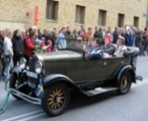
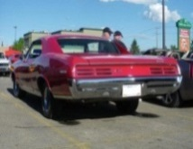
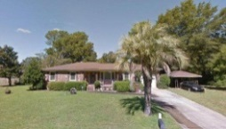
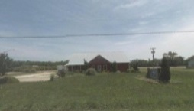
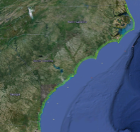
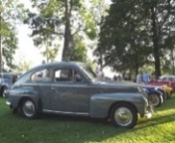
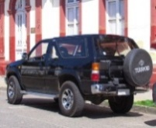
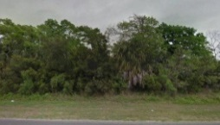
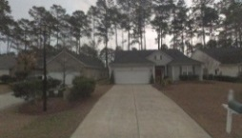
Our Goal
Mine mid-level visual elements in temporally- and spatially-varying data and model their “visual style”
1920
1940
1960
1980
2000
year
when?
Historical dating of cars
where?
Geolocalization of StreetView images
[Kim et al. 2010, Fu et al. 2010, Palermo et al. 2012]
[Cristani et al. 2008, Hays & Efros 2008, Knopp et al. 2010, Chen & Grauman. 2011, Schindler et al. 2012]

Slide 10
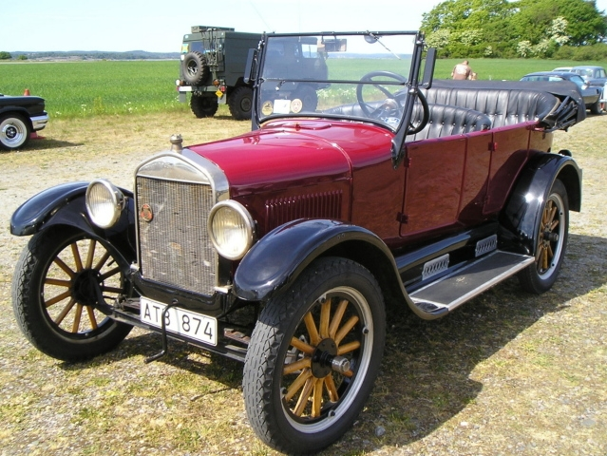
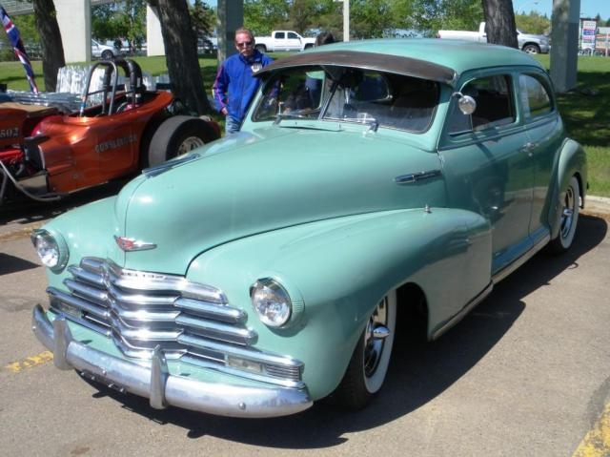
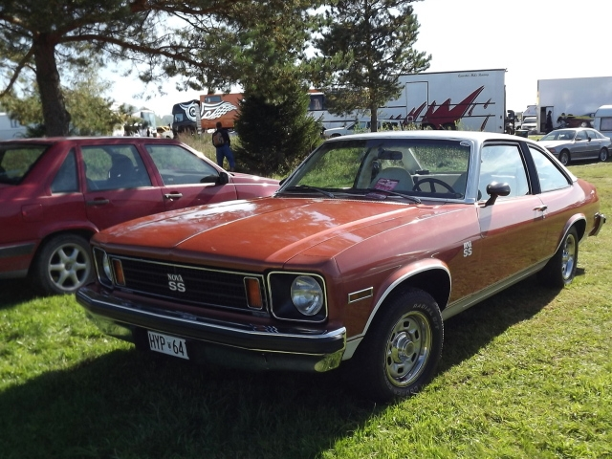



Key Idea
1) Establish connections
1926
1947
1975
“closed-world”
1926
1947
1975
2) Model style-specific differences

Slide 11
Approach

Slide 12

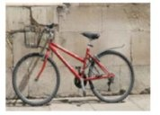
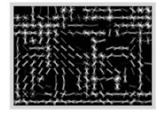
Mining style-sensitive elements
Sample patches and compute nearest neighbors
[Dalal & Triggs 2005, HOG]

Slide 13
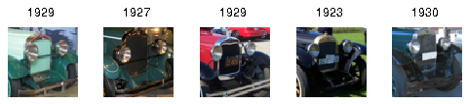
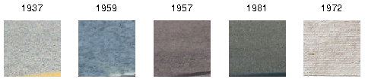
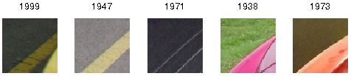
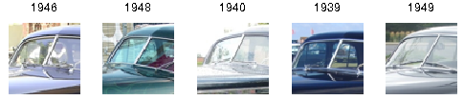
Mining style-sensitive elements
Patch
Nearest neighbors

Slide 14
Mining style-sensitive elements
Patch
Nearest neighbors
style-sensitive

Slide 15
Mining style-sensitive elements
Patch
Nearest neighbors
style-insensitive

Slide 16
Mining style-sensitive elements
Patch
Nearest neighbors
1929
1927
1929
1923
1930
1937
1959
1957
1981
1972
1999
1947
1971
1938
1973
1946
1948
1940
1939
1949

Slide 17
Mining style-sensitive elements
Patch
Nearest neighbors
1929
1927
1929
1923
1930
tight
1937
1959
1957
1981
1972
uniform
1999
1947
1971
1938
1973
1946
1948
1940
1939
1949

Slide 18
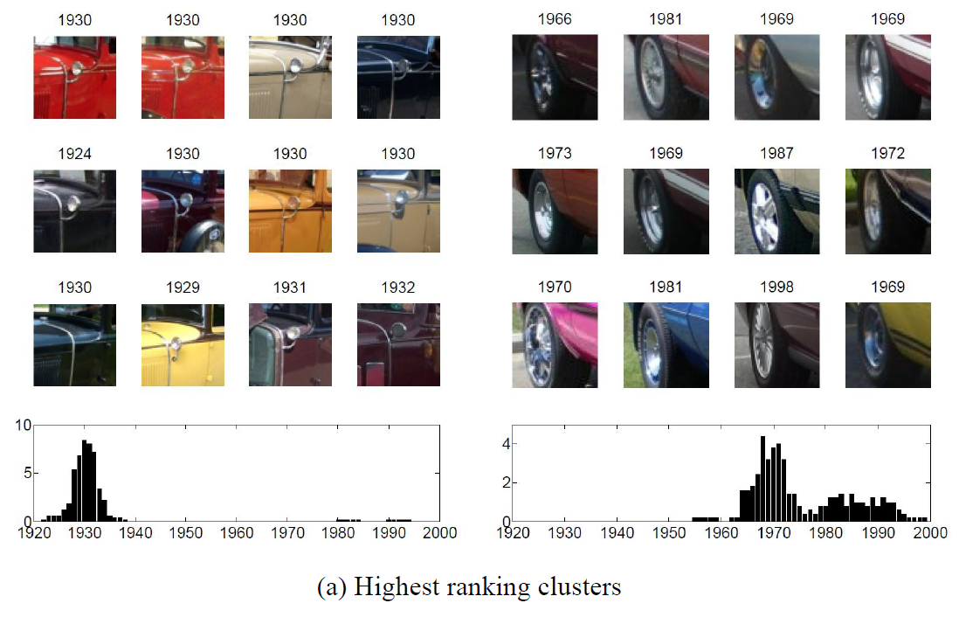
Mining style-sensitive elements
1930
1930
1930
1930
1966
1981
1969
1969
1924
1930
1930
1930
1973
1969
1987
1972
1930
1929
1931
1932
1970
1981
1998
1969
(a) Peaky (low-entropy) clusters

Slide 19
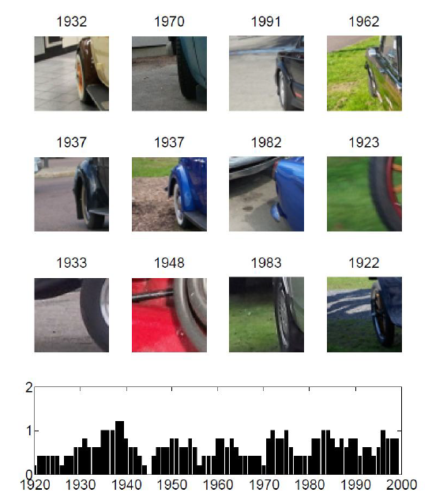
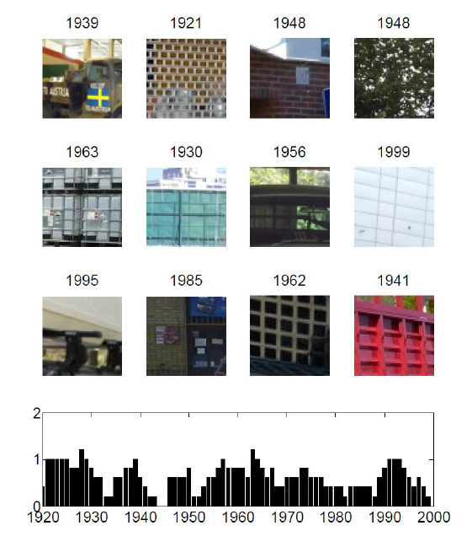
Mining style-sensitive elements
1932
1970
1991
1962
1939
1921
1948
1948
1937
1937
1982
1923
1963
1930
1956
1999
1933
1948
1983
1922
1995
1985
1962
1941
(b) Uniform (high-entropy) clusters

Slide 20
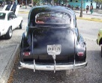

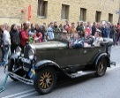
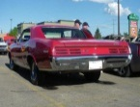
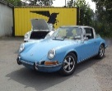
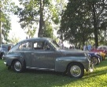
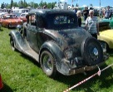
















Making visual connections
Take top-ranked clusters to build correspondences
1920s
1920s – 1990s
Dataset
1940s
1920s – 1990s

Slide 21


Making visual connections
Train a detector (HoG + linear SVM) [Singh et al. 2012]
1920s
Natural world “background” dataset

Slide 22






Making visual connections
1920s
1930s
1940s
1950s
1960s
1970s
1980s
1990s
Top detection per decade
[Singh et al. 2012]

Slide 23


Making visual connections
We expect style to change gradually…
1920s
1930s
1940s
Natural world “background” dataset

Slide 24





Making visual connections
1920s
1930s
1940s
1950s
1960s
1970s
1980s
1990s
Top detection per decade

Slide 25



Making visual connections
1920s
1930s
1940s
1950s
1960s
1970s
1980s
1990s
Top detection per decade

Slide 26


Making visual connections
Initial model (1920s)
Final model
Initial model (1940s)
Final model

Slide 27


Results: Example connections

Slide 28
Training style-aware regression models
Regression model 1
Regression model 2
Support vector regressors with Gaussian kernels
Input: HOG, output: date/geo-location

Slide 29





Training style-aware regression models
detector
regression output
detector
regression output
Train image-level regression model using outputs of visual element detectors and regressors as features

Slide 30
Results

Slide 31








Results: Date/Geo-location prediction
Crawled from www.cardatabase.net
Crawled from Google Street View
13,473 images
Tagged with year
1920 – 1999
4,455 images
Tagged with GPS coordinate
N. Carolina to Georgia

Slide 32
Results: Date/Geo-location prediction
Crawled from www.cardatabase.net
Crawled from Google Street View
 | Ours | Doersch et al. ECCV, SIGGRAPH 2012 | Spatial pyramid matching | Dense SIFT bag-of-words
Cars | 8.56 (years) | 9.72 | 11.81 | 15.39
Street View | 77.66 (miles) | 87.47 | 83.92 | 97.78
Mean Absolute Prediction Error

Slide 33

Results: Learned styles
Average of top predictions per decade

Slide 34
Extra: Fine-grained recognition
Mean classification accuracy on Caltech-UCSD Birds 2011 dataset
Ours | Zhang et al. CVPR 2012 | Berg, Belhumeur CVPR 2013
41.01 | 28.18 | 56.89
weak-supervision
Zhang et al. ICCV 2013 | Chai et al. ICCV 2013 | Gavves et al. ICCV 2013
50.98 | 59.40 | 62.70
strong-supervision

Slide 35
Conclusions
Models visual style: appearance correlated with time/space
First establish visual connections to create a closed-world, then focus on style-specific differences

Slide 36


Thank you!
Code and data will be available at www.eecs.berkeley.edu/~yjlee22

