Slide 1
Protein Structure Prediction

Slide 2
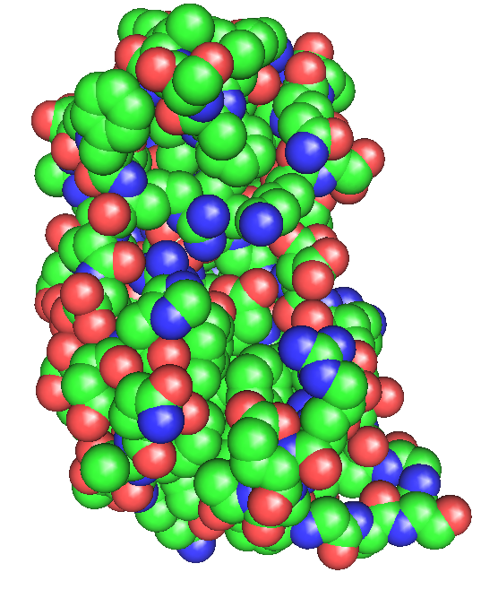
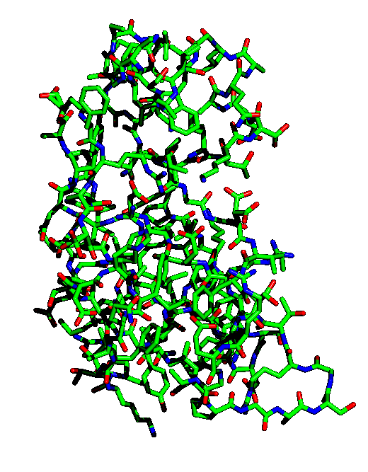
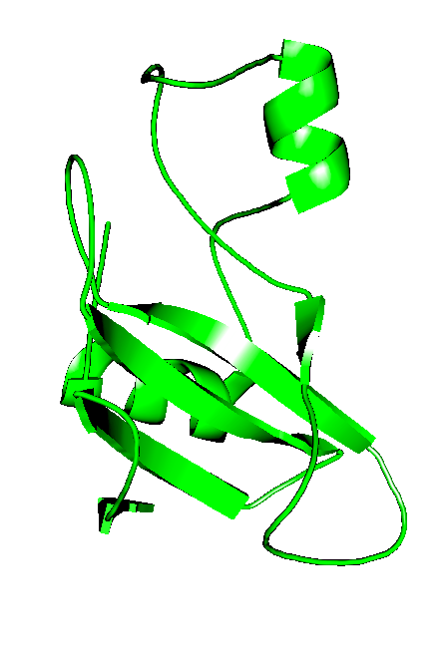
Protein Structure Representation
CPK: hard sphere model
Ball-and-stick
Cartoon

Slide 3
Degrees of Freedom in Proteins
Dihedral angle
Bond length
Bond angle
1
2
1
3
4
2
+

Slide 4
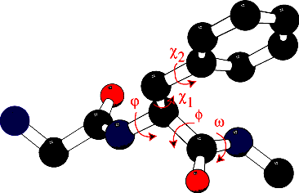
Protein Structure Representation
Backbone: 3 angles per residue : ϕ, φ and ω
Sidechain: 1 to 7 angles, χ; each χ has 3 favored values: 60º, -60º, 180º.

Slide 5
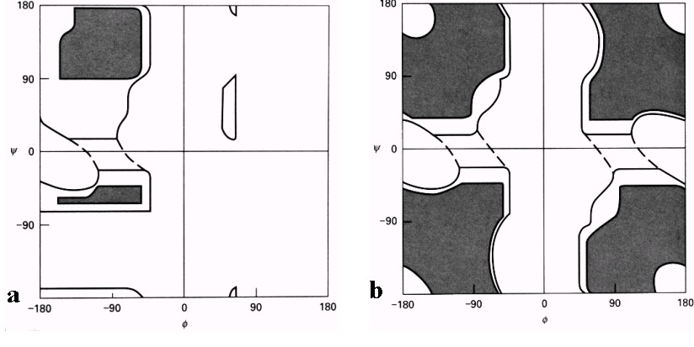
Ramachandran Plots
y
y
f
f
All residues, but glycine
Glycine
Acta Cryst. (2002). D58, 768-776

Slide 6
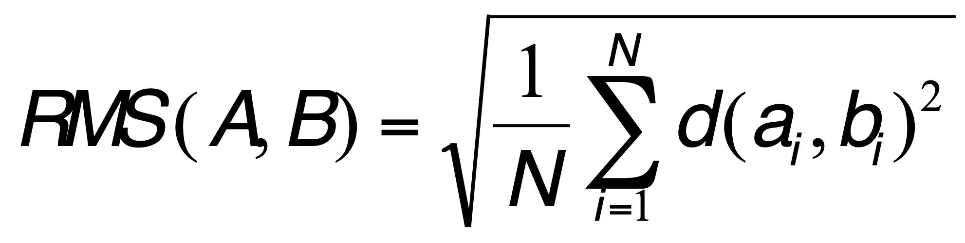
Root Mean Square Distance (RMSD)
To compare two sets of points (atoms) A={a₁, a₂, …a_{N}} and B={b₁, b₂, …,b_{N}}:
Define a 1-to-1 correspondence between A and B
for example, a_{i} corresponds to b_{i}, for all i in [1,N]
Compute RMS as:
d(A_{i},B_{i}) is the Euclidian distance between a_{i} and b_{i}.

Slide 7
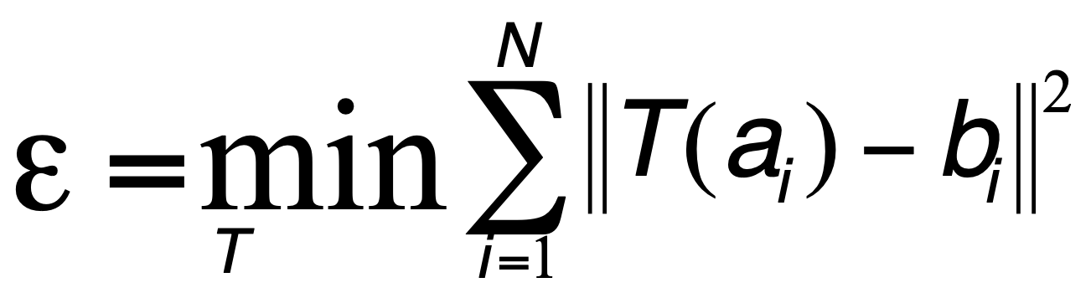
Root Mean Square Distance (RMSD)
Simplified problem: we know the correspondence between set A and set B
We wish to compute the rigid transformation T that best align a₁ with b₁, a₂ with b₂, …, a_{N} with b_{N}
The error to minimize is defined as:
Old problem, solved in Statistics,
Robotics, Medical Image Analysis,
…

Slide 8
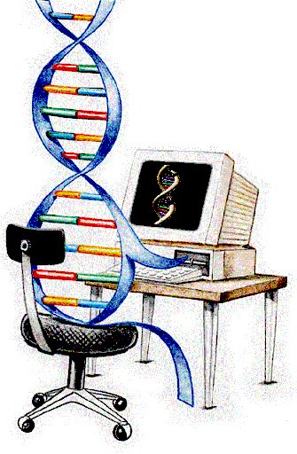
Structural Bioinformatics: Proteins
Proteins: Sources of Structure Information
Proteins: Homology Modeling
Proteins: Secondary structure prediction

Slide 9
Structural Bioinformatics: Proteins
Proteins: Sources of Structure Information
Proteins: Homology Modeling
Proteins: Secondary structure prediction
Proteins: Ab initio prediction

Slide 10
Proteins: Finding the Primary Structure
Methods for finding the sequence of a protein:
Translating gene sequence
  For proteins from prokaryotes, direct translation
  For proteins from eukaryotes, we need the sequence of
  mRNA or cDNA
Edman degradation
  limited to “small” proteins, up to 50 amino acids
  for automated sequencer
Mass spectrometry

Slide 11
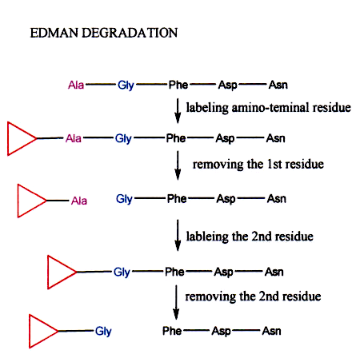
Proteins: Finding the Primary Structure
(Phenyl isothiocyanate or PITC)
(Trifluoroacetic acid, TFA)
(http://en.wikibooks.org/wiki/Structural_Biochemistry/Proteins/Protein_sequence_determination_techniques)

Slide 12
Proteins: Finding the Tertiary Structure
Methods for finding the 3D structure of a protein:
Circular Dichroism
  (low resolution; provides information on secondary structure)
X-ray crystallography
(high resolution; finds structure of a protein in a crystal)
NMR spectroscopy
(high resolution; finds structure of a protein in solution)

Slide 13
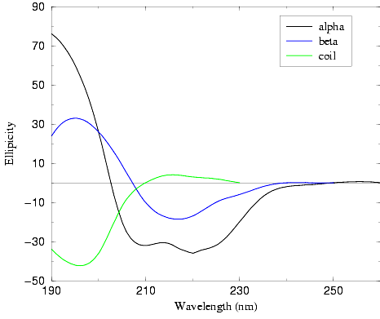
Proteins: Circular Dichroism
Circular dichroism (CD) spectroscopy
measures differences in the absorption
of left-handed polarized light versus
right-handed polarized light which
arise due to structural asymmetry.
Different secondary structures in
proteins have different CD spectra
as they have different asymmetry.
CD therefore can detect secondary
structures in protein

Slide 14
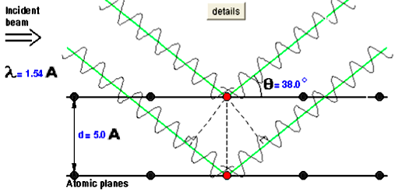
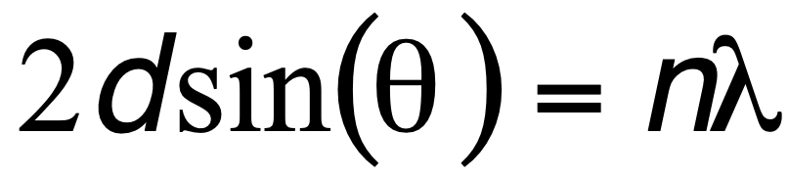
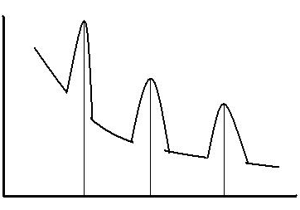
Proteins: X-ray Crystallography
Bragg’s Law:
dsin(θ)
From the “pattern of
diffraction”, i.e. the maximum
of intensities observed, we
can find the angles of
diffraction and for each
angle we get the corresponding d
using Bragg’s law
Intensity
Angle

Slide 15
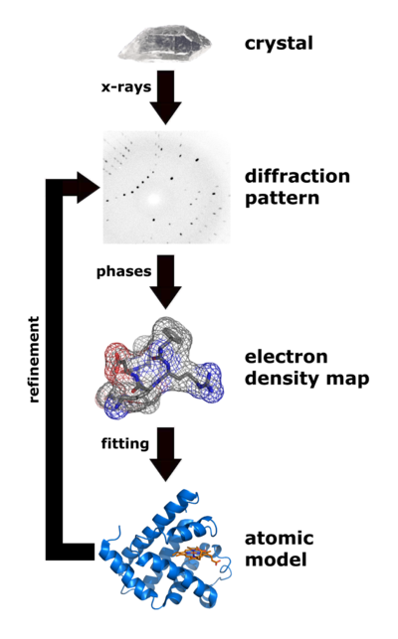
General principle of X-ray
crystallography applied to
proteins:
We need a crystal
From the diffraction pattern,
we get the crystal organization
From the diffraction intensities,
we get the electron densities
4) Once the electron density map
we fit a structure that matches
with this density
From the atomic model, we
can compute a theoretical
diffraction map; if it matches
with the experimental one,
we are done; otherwise refine

Slide 16
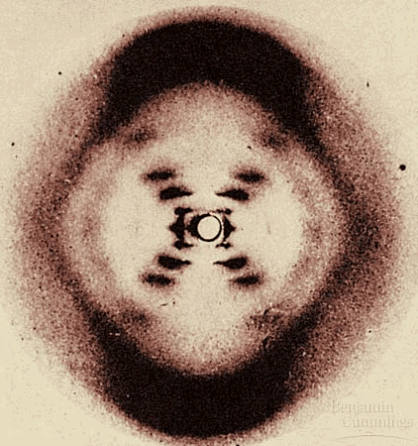
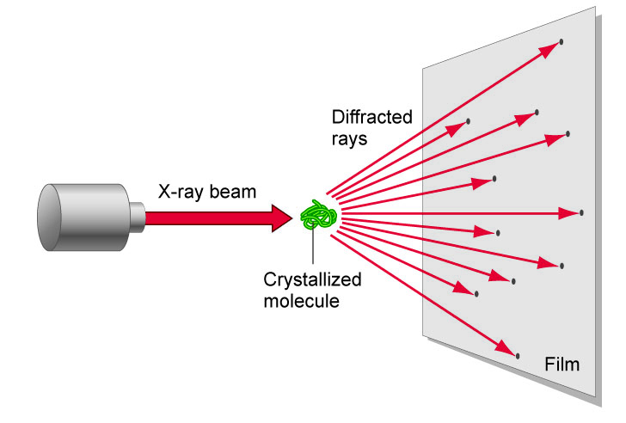
Getting the Diffraction Pattern
Rosalyn Franklin:
Diffraction pattern for DNA

Slide 17
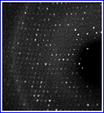
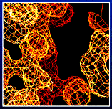
From Diffraction to Electron Density Map
3D Fourier Transform
One hidden problem: diffraction patterns provide intensities; for
Fourier transform, need intensity and phase. A significant step in
X-ray crystallography is the solve the “phase problem”.

Slide 18
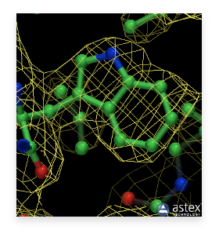
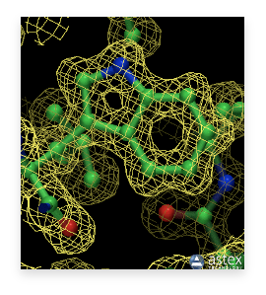
Fitting the structure:
Influence of the resolution
2.6 Å resolution
1.2 Å resolution

Slide 19
Resolution of X-ray structures
Resolution (Å) Meaning
>4.0 Individual coordinates meaningless
3.0 - 4.0 Fold possibly correct, but errors are very likely.
2.5 - 3.0 Fold likely correct except that some surface loops might be mismodelled.
2.0 - 2.5 Many small errors can normally be detected. Fold normally correct and number of errors in surface loops is small.
Water molecules and small ligands become visible.
1.5 - 2.0 Many small errors can normally be detected.
Folds are extremely rarely incorrect, even in surface loops.
0.5 - 1.5 In general, structures have almost no errors at this resolution. geometry studies are made from these structures.
(http://en.wikipedia.org/wiki/Resolution_(electron_density)

Slide 20
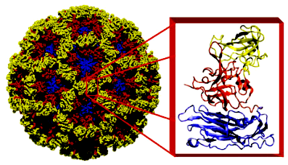
Large molecular assemblies:
X-ray crystallography and Cryo-EM
X-ray structure
(180 copies of
the same protein)
(Norwalk virus: http://www.bcm.edu/molvir/norovirus)

Slide 21
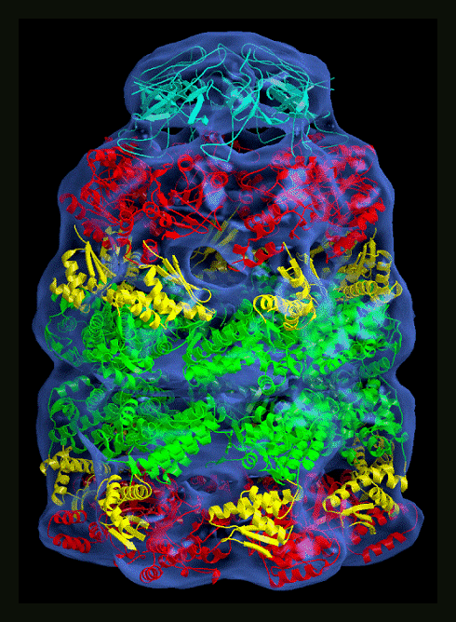
Large molecular assemblies:
X-ray crystallography and Cryo-EM
Cryo-EM:
Microscopy technique;
as such, do not need crystal
(closer to physiological
conditions)
Not high-resolution enough
to provide atomic details;
used in combination with
modeling

Slide 22
Structural Bioinformatics: Proteins
Proteins: Sources of Structure Information
Proteins: Homology Modeling
Proteins: Secondary structure prediction

Slide 23
Why we need Homology Modeling?
Aim to solve the structure of all proteins: this is too much work experimentally!
Solve enough structures so that the remaining structures can be inferred from those experimental structures
The number of experimental structures needed depend on our abilities to generate a model.

Slide 24
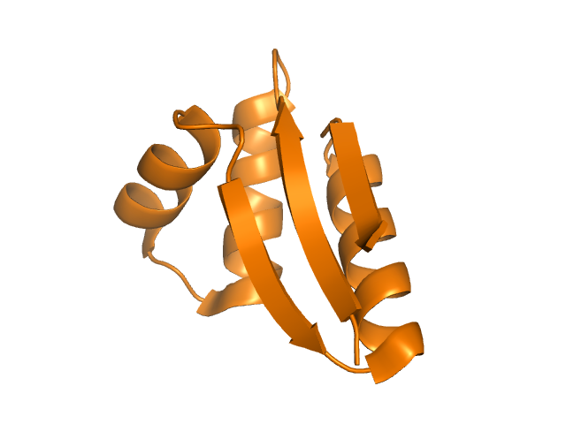
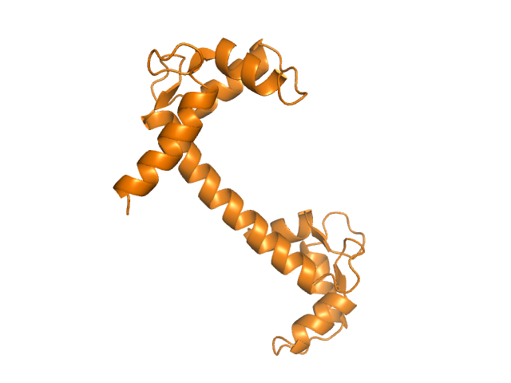
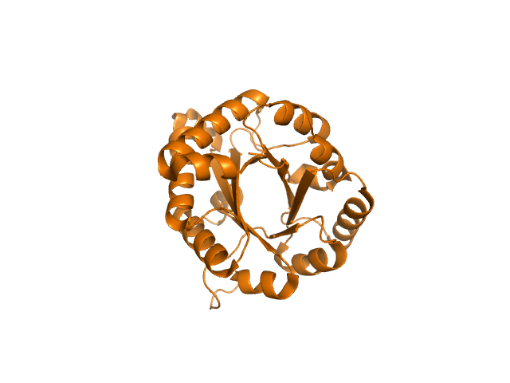
Sequence Space
Structure Space

Slide 25
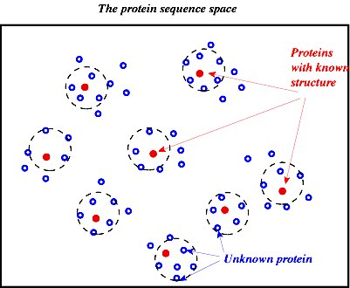
Why we need Homology Modeling?
Proteins
with
known
structures
Unknown proteins

Slide 26
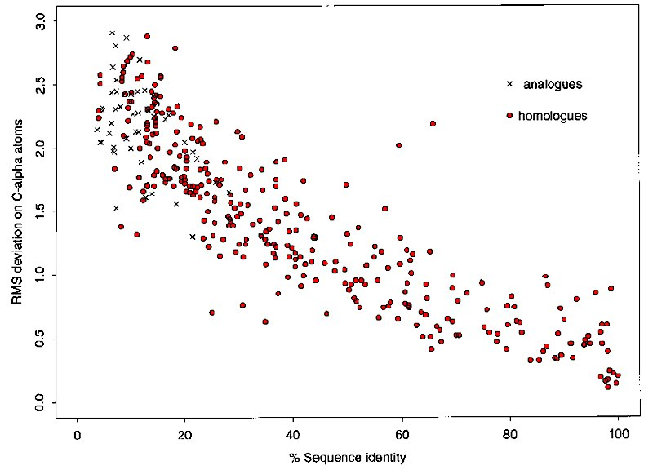
Why does Homology Modeling Work?
High sequence
identity
High structure
similarity
Russell et al. (1997) J Mol Biol 269: 423-439

Slide 27
Homology Modeling:
How it works

Slide 28
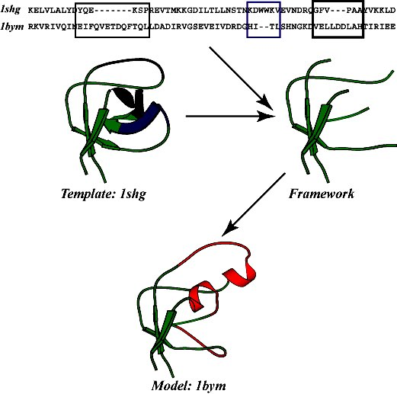
Homology Modeling: How it works
Find template
Align target sequence
with template
Generate model:
- add loops
- add sidechains
Refine model

Slide 29
Homology Modeling: Input
The query, also called target sequence
The template structure and sequence
(need high quality structure)
The sequence alignment between query and template sequence
(Probably the most important input!)

Slide 30
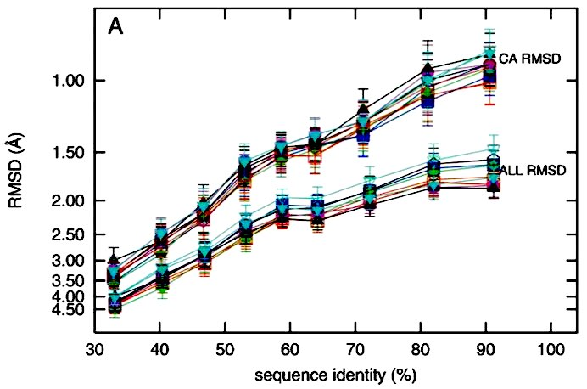
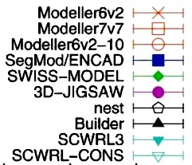
Homology Modeling: Which program to use?
Wallner B, Elofsson A.
All are not equal: a benchmark of different homology modeling programs.
Protein Sci. 2005 14(5):1315-27.

Slide 31
Homology Modeling: Which program to use?
1) Web service: SwissModel
http://swissmodel.expasy.org/
3 modes:
- fully automatic
- “Alignment mode”: you provide your own target-template
alignment
- “Project mode”: provides an environment to edit alignment
2) Software: Modeller
http://www.salilab.org/modeller/
Probably the best maintained software the homology modeling

Slide 32
Do not start a homology modeling project
before checking…
  Swiss-Model repository
  (http://swissmodel.expasy.org/repository/)
    Companion to the Swiss-Model tools – over 2.0 million models of protein domains
  ModBase
  (http://modbase.compbio.ucsf.edu/)
    Companion to Modeller

Slide 33
Structural Bioinformatics: Proteins
Proteins: Sources of Structure Information
Proteins: Homology Modeling
Proteins: Secondary structure prediction

Slide 34
Secondary Structure Prediction
Given a protein sequence a₁a₂…a_{N}, secondary structure prediction aims at defining the state of each amino acid ai as being either H (helix), E (extended=strand), or O (other) (Some methods have 4 states: H, E, T for turns, and O for other).
The quality of secondary structure prediction is measured with a “3-state accuracy” score, or Q₃. Q₃ is the percent of residues that match “reality” (X-ray structure).

Slide 35
Secondary Structure Assignment
Determine Secondary Structure positions in known protein
structures using DSSP or STRIDE:
Kabsch and Sander. Dictionary of Secondary Structure in Proteins: pattern
recognition of hydrogen-bonded and geometrical features.
Biopolymer 22: 2571-2637 (1983) (DSSP)
Frischman and Argos. Knowledge-based secondary structure assignments.
Proteins, 23:566-571 (1995) (STRIDE)

Slide 36
Early methods for Secondary Structure Prediction
Chou and Fasman
(Chou and Fasman. Prediction of protein conformation. Biochemistry, 13: 211-245, 1974)
GOR
(Garnier, Osguthorpe and Robson. Analysis of the accuracy and implications of simple methods for predicting the secondary structure of globular proteins. J. Mol. Biol., 120:97- 120, 1978)

Slide 37
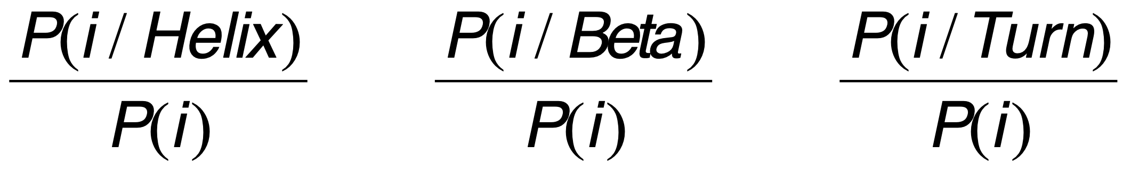
Chou and Fasman
Start by computing amino acids propensities to belong to a given type of secondary structure:
Propensities > 1 mean that the residue type I is likely to be found in the
Corresponding secondary structure type.

Slide 38
Chou and Fasman
Amino Acid α-Helix β-Sheet Turn
Ala 1.29 0.90 0.78
Cys 1.11 0.74 0.80
Leu 1.30 1.02 0.59
Met 1.47 0.97 0.39
Glu 1.44 0.75 1.00
Gln 1.27 0.80 0.97
His 1.22 1.08 0.69
Lys 1.23 0.77 0.96
Val 0.91 1.49 0.47
Ile 0.97 1.45 0.51
Phe 1.07 1.32 0.58
Tyr 0.72 1.25 1.05
Trp 0.99 1.14 0.75
Thr 0.82 1.21 1.03
Gly 0.56 0.92 1.64
Ser 0.82 0.95 1.33
Asp 1.04 0.72 1.41
Asn 0.90 0.76 1.23
Pro 0.52 0.64 1.91
Arg 0.96 0.99 0.88
Favors
a-Helix
Favors
b-strand
Favors
turn

Slide 39
Chou and Fasman
Predicting helices:
- find nucleation site: 4 out of 6 contiguous residues with P(α)>1
- extension: extend helix in both directions until a set of 4 contiguous
residues has an average P(α) < 1 (breaker)
- if average P(α) over whole region is >1, it is predicted to be helical
Predicting strands:
- find nucleation site: 3 out of 5 contiguous residues with P(β)>1
- extension: extend strand in both directions until a set of 4 contiguous
residues has an average P(β) < 1 (breaker)
- if average P(β) over whole region is >1, it is predicted to be a strand

Slide 40
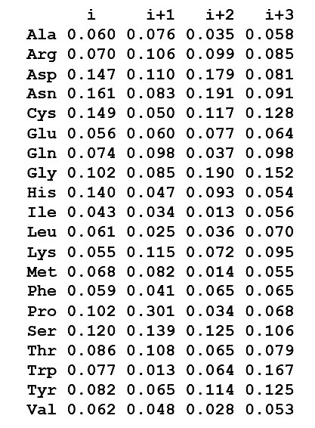
Chou and Fasman
f(i) f(i+1) f(i+2) f(i+3)
Position-specific parameters
for turn:
Each position has distinct
amino acid preferences.
Examples:
At position 2, Pro is highly
preferred; Trp is disfavored
At position 3, Asp, Asn and Gly
are preferred
At position 4, Trp, Gly and Cys
preferred

Slide 41
Chou and Fasman
Predicting turns:
- for each tetrapeptide starting at residue i, compute:
- P_{Turn} (average propensity over all 4 residues)
- F = f(i)*f(i+1)*f(i+2)*f(i+3)
- if P_{Turn} > Pα and P_{Turn} > Pβ and P_{Turn} > 1 and F>0.000075
tetrapeptide is considered a turn.
Chou and Fasman prediction:
http://fasta.bioch.virginia.edu/fasta_www/chofas.htm

Slide 42
Neural Networks
The most successful methods for predicting secondary structure
are based on neural networks. The overall idea is that neural
networks can be trained to recognize amino acid patterns in
known secondary structure units, and to use these patterns to
distinguish between the different types of secondary structure.
Neural networks classify “input vectors” or “examples” into
categories (2 or more).
They are loosely based on biological neurons.

Slide 43
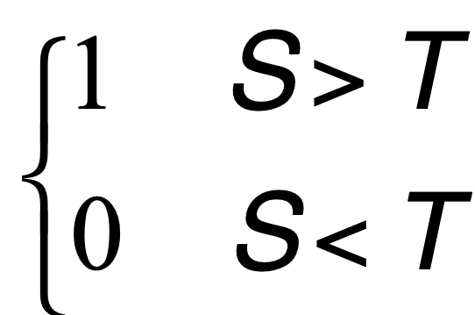
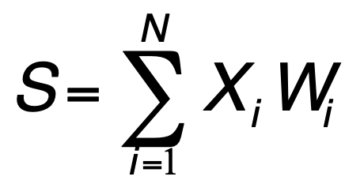
The perceptron
X1
w1
T
X2
w2
wN
XN
Input
Threshold Unit
Output
The perceptron classifies the input vector X into two categories.
If the weights and threshold T are not known in advance, the perceptron
must be trained. Ideally, the perceptron must be trained to return the correct
answer on all training examples, and perform well on examples it has never seen.
The training set must contain both type of data (i.e. with “1” and “0” output).

Slide 44
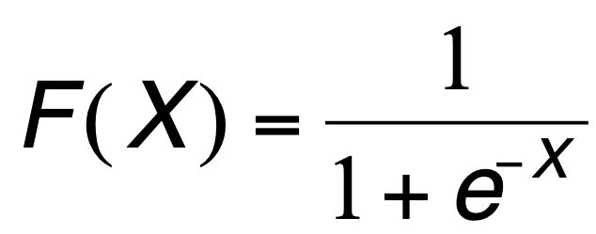
The perceptron
Notes:
- The input is a vector X and the weights can be stored in another
vector W.
- the perceptron computes the dot product S = X.W
- the output F is a function of S: it is often set discrete (i.e. 1 or
0), in which case the function is the step function.
For continuous output, often use a sigmoid:
1
1/2
0
0
- Not all perceptrons can be trained ! (famous example: XOR)

Slide 45
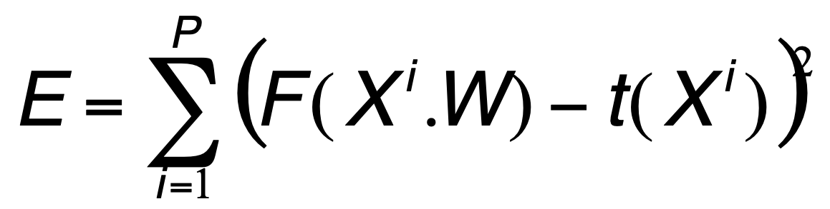
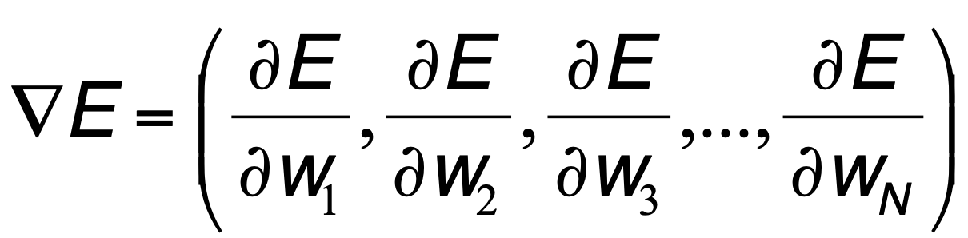

The perceptron
Training a perceptron:
Find the weights W that minimizes the error function:
P: number of training data
X^{i}: training vectors
F(W.X^{i}): output of the perceptron
t(X^{i}) : target value for X^{i}
Use steepest descent:
- compute gradient:
- update weight vector:
- iterate
(e: learning rate)

Slide 46
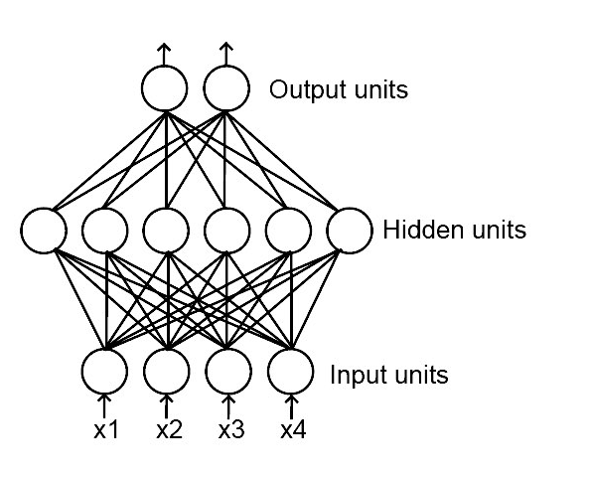
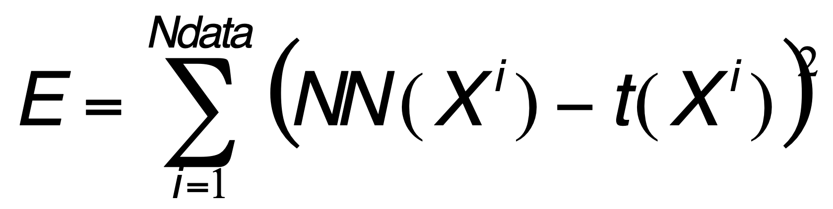
Neural Network
A complete neural network
is a set of perceptrons
interconnected such that
the outputs of some units
becomes the inputs of other
units. Many topologies are
possible!
Neural networks are trained just like perceptron, by minimizing an error function:

Slide 47
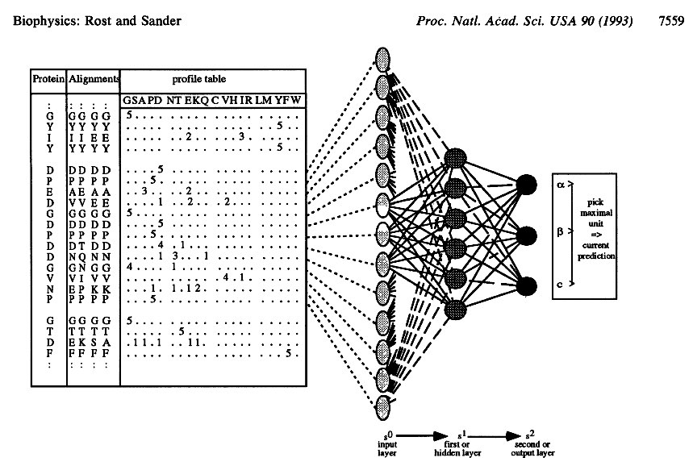
PHD: Secondary structure prediction using NN

Slide 48
PHD: Input
For each residue, consider
a window of size 13:
13x20=260 values

Slide 49
PHD: Network 1
Sequence Structure
13x20 values
3 values
Network1
Pα(i) Pβ(i) Pc(i)

Slide 50
PHD: Network 2
Structure Structure
For each residue, consider
a window of size 17:
3 values
3 values
17x3=51 values
Network2
Pα(i) Pβ(i) Pc(i)
Pα(i) Pβ(i) Pc(i)

Slide 51
Protein Structure Prediction
One popular model for protein folding assumes a sequence of events:
  Hydrophobic collapse
  Local interactions stabilize secondary structures
  Secondary structures interact to form motifs
  Motifs aggregate to form tertiary structure

Slide 52
Protein Structure Prediction
A physics-based approach:
- find conformation of protein corresponding to a thermodynamics minimum (free energy minimum)
- cannot minimize internal energy alone! Needs to include solvent
- simulate folding…a very long process!
Folding time are in the ms to second time range; however, Folding simulations at best run 1 ns in one day…

Slide 53
PHD: Secondary structure prediction using NN
Sequence-Structure network: for each amino acid aj, a window of 13 residues aj-6…aj…aj+6 is considered. The corresponding rows of the sequence profile are fed into the neural network, and the output is 3 probabilities for aj: P(aj,alpha), P(aj, beta) and P(aj,other)
Structure-Structure network: For each aj, PHD considers now a window of 17 residues; the probabilities P(ak,alpha), P(ak,beta) and P(ak,other) for k in [j-8,j+8] are fed into the second layer neural network, which again produces probabilities that residue aj is in each of the 3 possible conformations
Jury system: PHD has trained several neural networks with different training sets; all neural networks are applied to the test sequence, and results are averaged
Prediction: For each position, the secondary structure with the highest average score is output as the prediction

