Slide 1
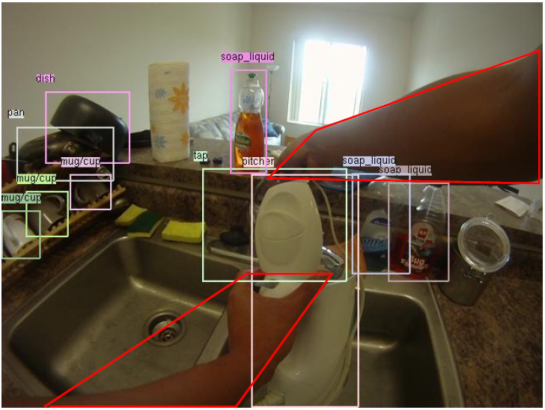
Detecting Activities of Daily Living in First-person Camera Views
Hamed Pirsiavash, Deva Ramanan
Computer Science Department, UC Irvine
Notes:
Hi, my name is Hamed. I’ll talk about detecting activities of daily living in first person camera views. This is a joint work with my advisor Deva Ramanan at UC Irvine.

Slide 2
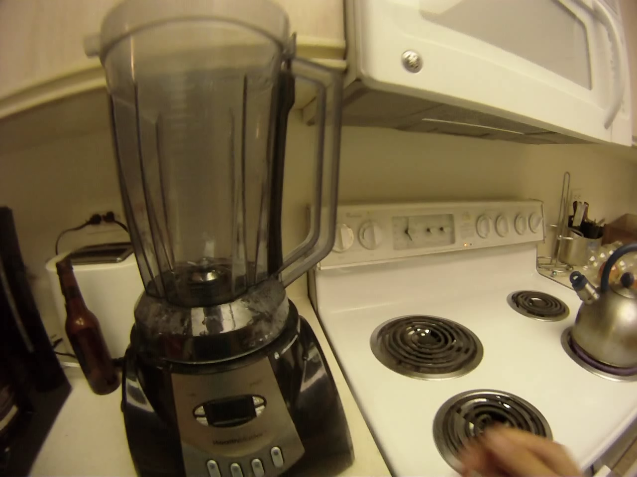
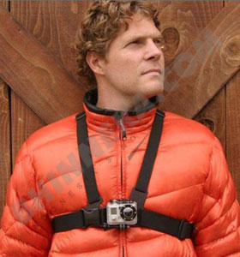
Motivation
A sample video of Activities of Daily Living
Notes:
This is a sample video of activities we are interested in detecting.
This video is captured by a wearable camera mounted on the person’s chest.
These are activities of daily living like making coffee, brushing teeth, and drinking juice from fridge.

Slide 3
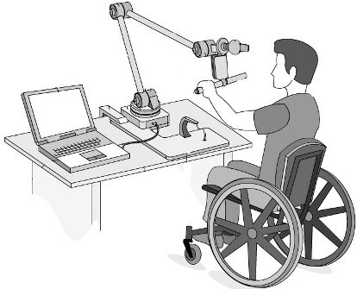
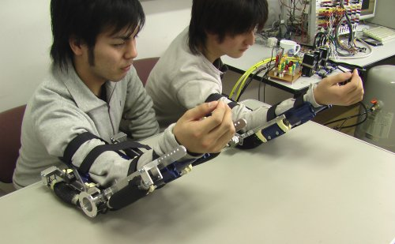
Applications
Tele-rehabilitation
Long-term at-home monitoring
Kopp et al,, Arch. of Physical Medicine and Rehabilitation. 1997.
Catz et al, Spinal Cord 1997.
Notes:
So why do we want to do this?
ADL detection has variety of applications
In rehabilitative or geriatric healthcare, physicians are interested in monitoring the progress of a patient’s motor ability for everyday, functional tasks. For instance, they are interested in knowing if a patient can move his arms sufficiently to say, eat a sandwich.
Currently, this monitoring is done in a limited basis in the hospital. Imagine wearing a camera and detecting the activities automatically. This can lead to long-term at-home monitoring, which could revolutionize the rehabilitative process.

Slide 4
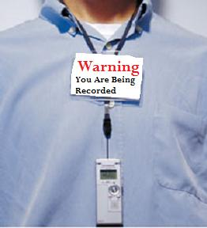
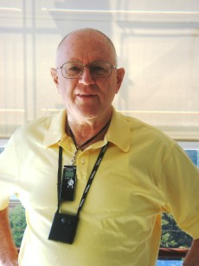
Applications
Life-logging
So far, mostly “write-only” memory!
This is the right time for computer vision community to get involved.
Gemmell et al, “MyLifeBits: a personal database for everything.” Communications of the ACM 2006.
Hodges et al, “SenseCam: A retrospective memory aid”, UbiComp, 2006.
Notes:
Another application is life-logging.
Products such as the Sensecam allow one to record everything a person sees over months or even years. This has been shown to be useful in reducing memory loss in Alzeimer’s patients. Life-logging also allows us to ask questions like: have I been adequately following my diet, or what was the first moment I ever saw my wife?
Thus far, such “visual diaries” have served mostly as write-only memory because there does not exist a good machinery to go back and process such captured data. We believe this is the right time for computer vision to get involved in addressing such retrieval and recognition problems. Indeed, growing interest in this field is evident by the recent workshops on egocentric vision, and even associated papers in this conference.
We are interested in these application. However …

Slide 5
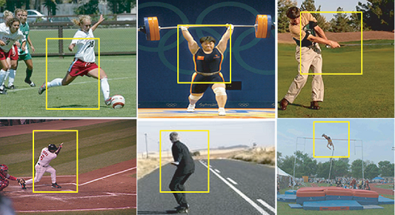
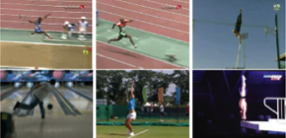
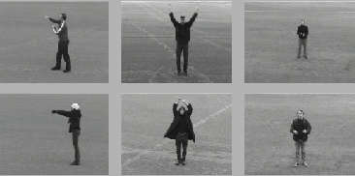
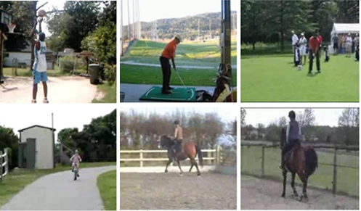
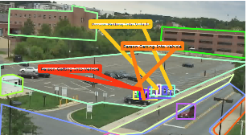


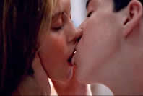

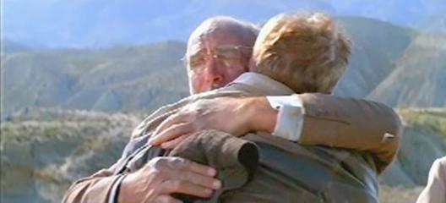

Related work: action recognition
There are quite a few video benchmarks for action recognition.
Collecting interesting but natural video is surprisingly hard.
It is difficult to define action categories outside “sports” domain
UCF sports, CVPR’08
KTH, ICPR’04
Olympics sport, BMVC’10
Hollywood, CVPR’09
UCF Youtube, CVPR’08
VIRAT, CVPR’11
5
Notes:
There has been much work in computer vision on the related problem of action recognition. Here, we survey datasets that are commonly used. We see two recurring themes.
First, collecting interesting but natural videos of people is surprisingly hard. Many datasets are either staged like KTH or professionally-made like Hollywood.
Second, it is difficult to define domain-independent action categories. For example, many datasets focus on sports because it is easier to define natural categories in such domains.
We address both these issues by ….

Slide 6
Wearable ADL detection
It is easy to collect natural data
6
Notes:
We are addressing both the problems by:
First, using wearable cameras. This way, it is very easy to collect natural data. We can simply give the camera to a person and ask him to wear it for a while. There is no camera-man and real setup required.
Second, …

Slide 7
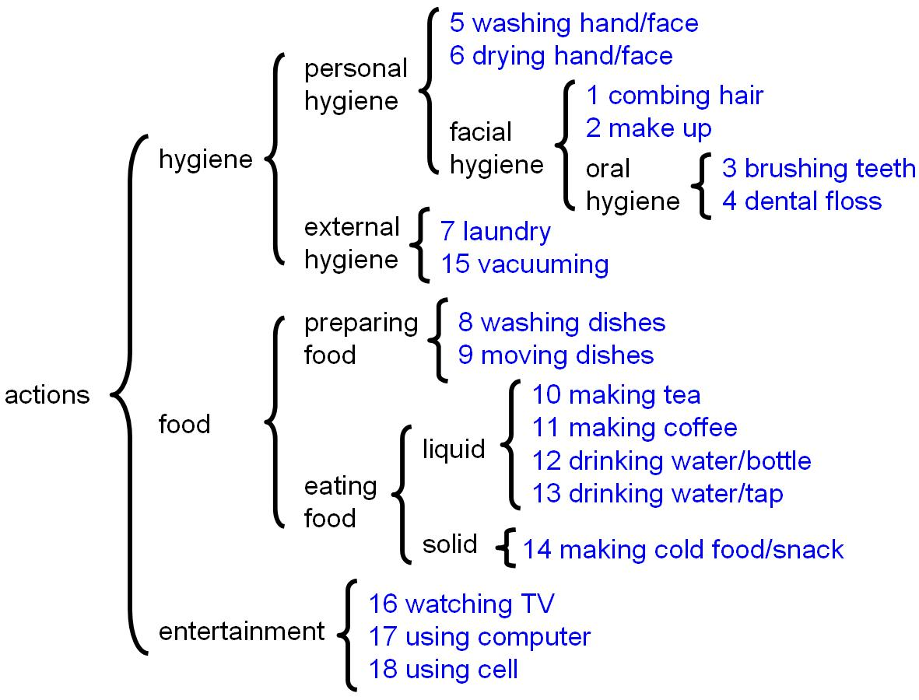
Wearable ADL detection
It is easy to collect natural data
ADL actions derived from medical literature on patient rehabilitation
7
Notes:
Second, we define ADL-categories adopted from the medical literature. Examples include making coffee and washing hands. Again, these are everyday tasks that a typical person must be able to do to function at home.

Slide 8
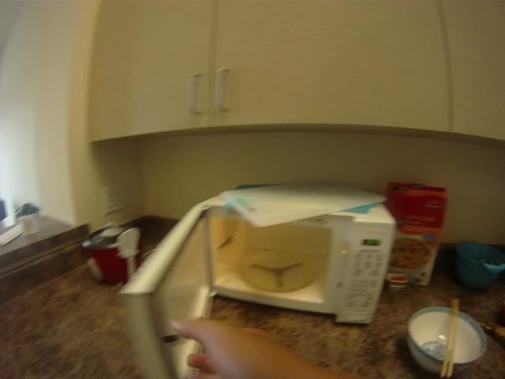

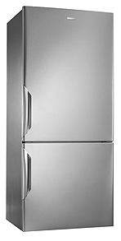

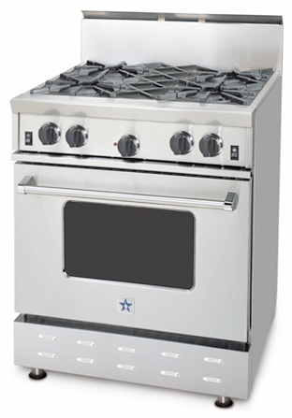

Outline
Challenges
  What features to use?
  Appearance model
  Temporal model
Our model
  “Active” vs “passive” objects
  Temporal pyramid
Dataset
Experiments
8
Notes:
8
Let’s see the challenges in applying current computer vision algorithms on this problem…

Slide 9
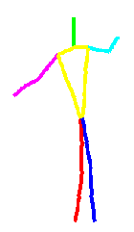
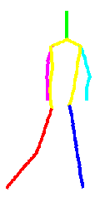
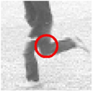
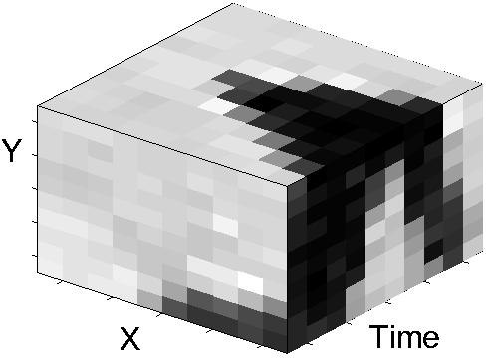
Challenges
What features to use?
Low level features
(Weak semantics)
High level features
(Strong semantics)
Space-time interest points
Laptev, IJCV’05
Human pose
Difficulties of pose:
Detectors are not accurate enough
Not useful in first person camera views
Notes:
In recognition, we usually use some appearance features. Many previous action recognition algorithms use low-level features like space-time interest points. These features can do well but they are low-level, often lacking a clear semantic meaning. Ideally, one would use a high-level feature such as human pose. However, human pose is not particularly useful for wearable data since the person is behind the camera and not seen.

Slide 10
Challenges
What features to use?
Low level features
(Weak semantics)
High level features
(Strong semantics)
Space-time interest points
Laptev, IJCV’05
Human pose
Object-centric features
Difficulties of pose:
Detectors are not accurate enough
Not useful in first person camera views
Notes:
Instead, we focus on objects as an alternative set of high-level features for wearable ADL recognition.
Now, to successfully use such features, we need accurate object detectors…

Slide 11
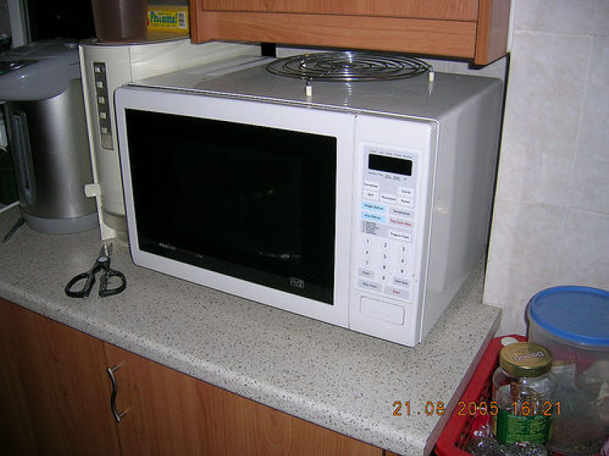
Challenges
Occlusion / Functional state
“Classic” data
Notes:
Can we detect this objects? The answer is yes! Recently ,we had good progress in building object detectors, so we do a good job in detecting these objects.
But what about these?

Slide 12
Challenges
Occlusion / Functional state
“Classic” data
Wearable data
Notes:
These are the instances of the same objects that appear in wearable camera views. They may be occluded by the person’s hand of the other objects included in the interaction OR the objects may be in a different functional state like a microwave with an open door.
It appears to be very difficult for current object detectors to handle this large variation in the appearance.
Interestingly, these instances are the most important instances in this application, since as soon as we detect the laundry machine in interaction, we know right a way that the person is doing his laundry.

Slide 13

Challenges long-scale temporal structure
“Classic” data: boxing
Notes:
Traditionally, we have worked on detecting short term activities like boxing, jumping and so on. We have a lot of classic data on these actions like KTH.
But in detecting ADLs,

Slide 14
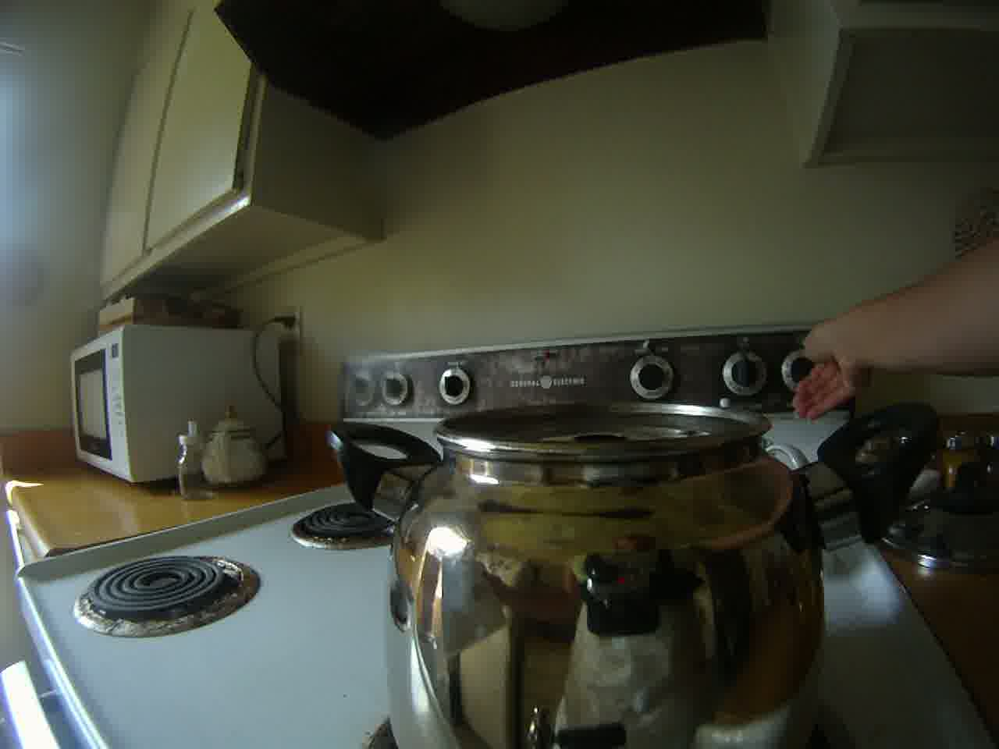
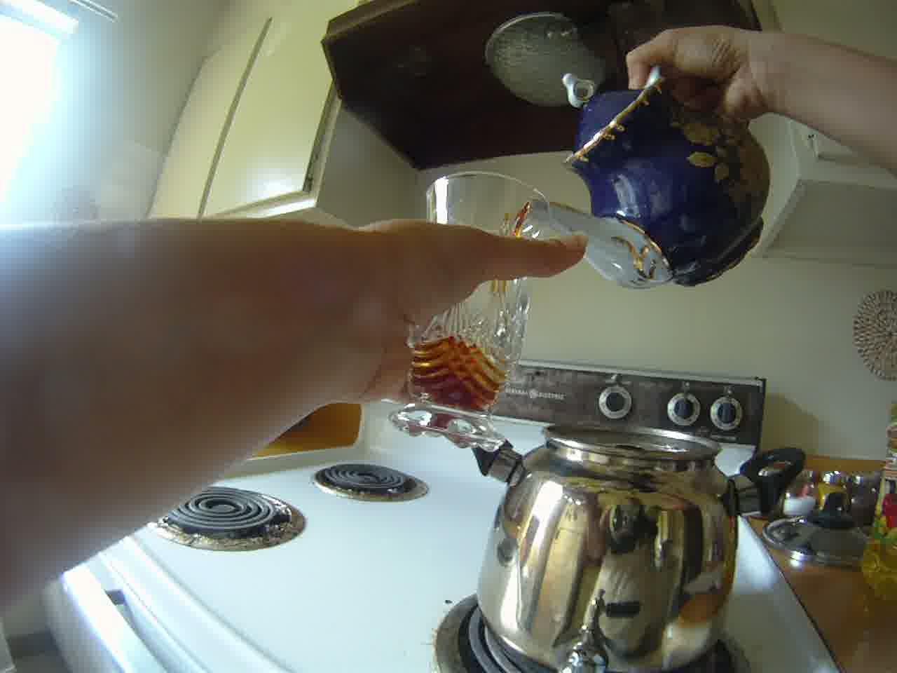
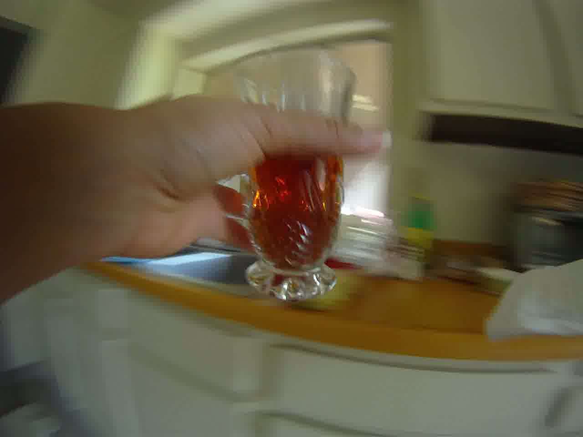
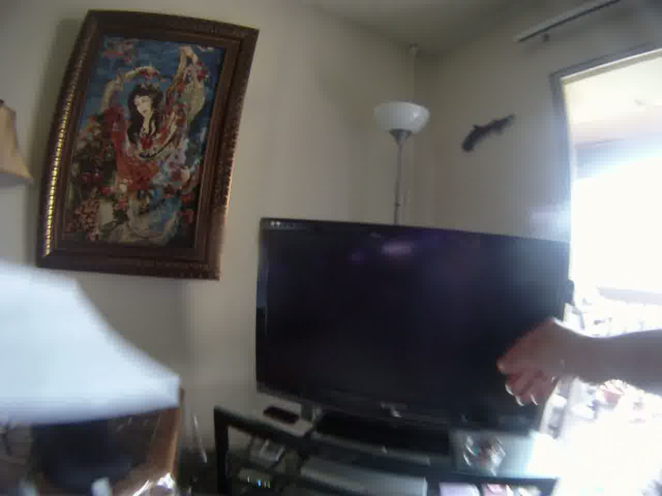
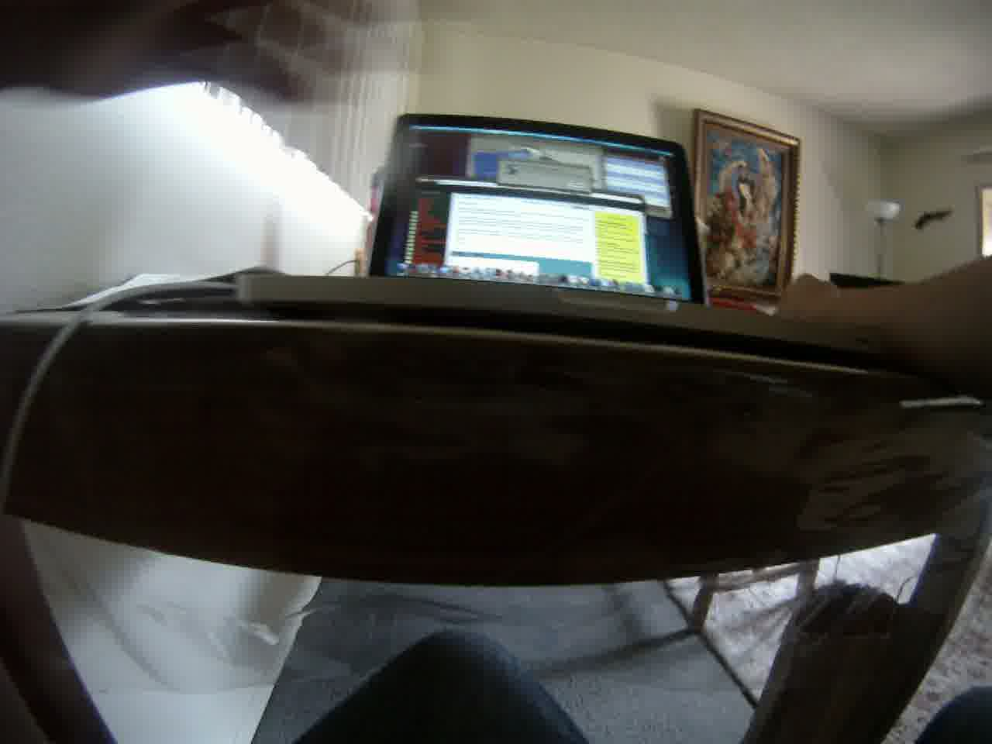
Challenges long-scale temporal structure
“Classic” data: boxing
Wearable data: making tea
Start boiling water
Do other things (while waiting)
Pour in cup
Drink tea
time
Difficult for HMMs to capture long-term temporal dependencies
Notes:
But in detecting ADLs, we are interested in long term activities like making tea. It starts with boiling water, waiting for a while, pouring it into a cup and then drinking it. These are different sub-actions of a long term action. It is difficult for classic temporal models such as HMMs to model this long-term temporal dependency.
[Pause]
So, we need a representation that captures the long-term temporal structure of such actions.

Slide 15
Outline
Challenges
  What features to use?
  Appearance model
  Temporal model
Our model
  “Active” vs “passive” objects
  Temporal pyramid
Dataset
Experiments
15
Notes:
15
Now that we’ve outlined the challenges, let’s look at our solutions…

Slide 16
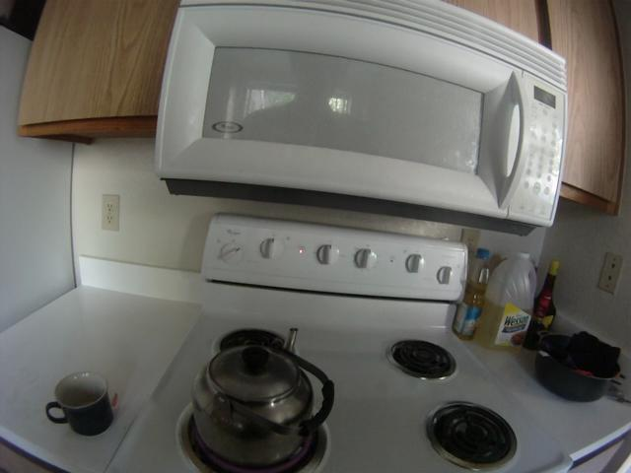
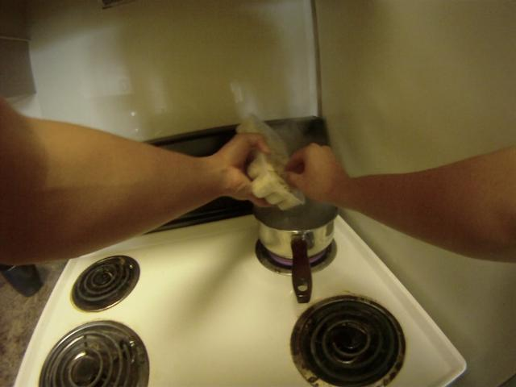
“Passive” vs “active” objects
Passive
Active
Notes:
To model different functional states of objects, we build separate models for active objects that are being interacted with, and passive objects that are not being directly manipulated. Here we see an instance of an active stove. Since, they are in interaction, we see person’s hands and even some other objects like a pan in the view.

Slide 17
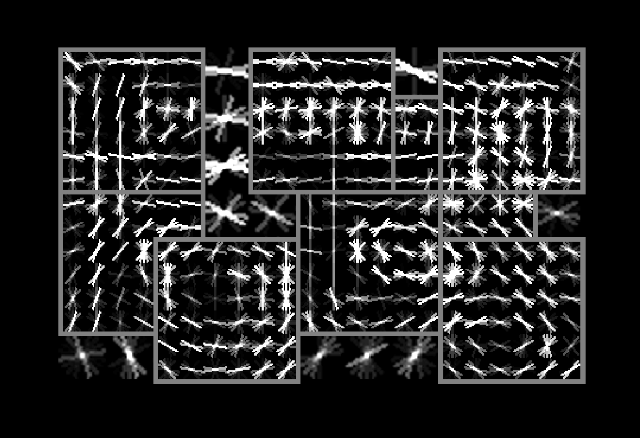
“Passive” vs “active” objects
Passive
Active
Notes:
We split our training data to active and passive sets and train a separate model for each…

Slide 18
“Passive” vs “active” objects
Passive
Active
Better object detection (visual phrases CVPR’11)
Better features for action classification (active vs passive)
Notes:
In building the active object model, we treat the object and hands as a composite object. This approach is reminiscent of visual phrases, presented in cvpr last year. This produces more accurate object detections.
However, we also use the estimated active/passive label as an explicit feature for action recognition. We are more likely to be cooking if the stove is being actively interacted with.
Now that we have good object detectors, we will describe our object-centric features for action recognition….

Slide 19
Appearance feature: bag of objects
fridge
stove
TV
SVM classifier
fridge
stove
TV
Video clip
Bag of detected objects
Notes:
For a given video clip, we build a bag of detected objects descriptor, which is a histogram of what objects are present. We have a bin for each object, such as a Fridge, Stove and so on. We use a soft histogram where the value of a bin is the confidence, or score, of that associated object detector.
To capture active vs passive cues…

Slide 20
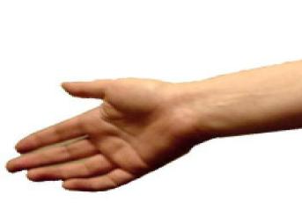
Appearance feature: bag of objects
Active fridge
Passive fridge
Active stove
SVM classifier
Active fridge
Passive fridge
Active stove
Video clip
Bag of detected objects
Notes:
To capture active vs passive cues, we simply separately bin active and passive objects, treating each as a separate object category in our bag-of-objects model.
Thus far, our bag model has ignored the temporal structure of a video clip. For instance, it doesn’t matter for this model if the fridge Is seen in the beginning or the end of the action.
To model long-term temporal structure ...

Slide 21
Temporal pyramid
Coarse to fine correspondence matching with a multi-layer pyramid
Inspired by “Spatial Pyramid” CVPR’06 and “Pyramid Match Kernels” ICCV’05
SVM classifier
Video clip
Temporal pyramid descriptor
time
Notes:
To model long-term temporal structure, we use a temporal pyramid. Inspired by the success of a spatial pyramid, we build histograms at multiple resolutions and concatenate them all together. Multi-resolution descriptors are a way of encoding approximate correspondence when matching a model to a video clip. For example, when making tea, we boil the water and pour out tea leaves, but the precise time of and order of these sub-actions can vary. This constraint might be hard to encode with an HMM.
Finally, we obtain an action class label by classifying this multi-resolution descriptor with an SVM.

Slide 22
Outline
Challenges
  What features to use?
  Appearance model
  Temporal model
Our model
  “Active” vs “passive” objects
  Temporal pyramid
Dataset
Experiments
22
Notes:
22
Now, that we’ve talked about our model, let’s collect some data …

Slide 23
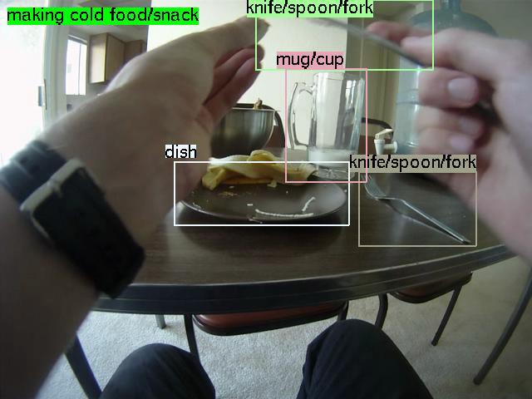
Sample video with annotations
Notes:
This is a sample of data we’ve collected. We annotated bounding boxes for objects and also action labels. Here, the person eats some food and then moves to the kitchen to make some tea.

Slide 24
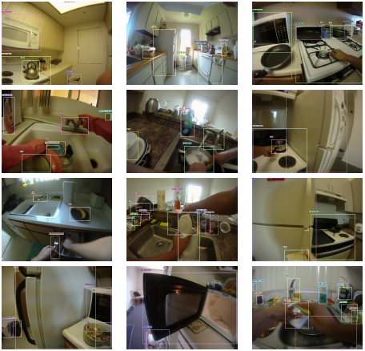
Wearable ADL data collection
20 persons
20 different apartments
10 hours of HD video
170 degrees of viewing angle
Annotated
  Actions
  Object bounding boxes
  Active-passive objects
  Object IDs
Prior work:
Lee et al, CVPR’12
Fathi et al, CVPR’11, CVPR’12
Kitani et al, CVPR’11
Ren et al, CVPR’10
24
Notes:
We simply gave the camera to 20 different people and asked them to capture their some daily activities. Videos are collected in different apartments so there is a large intra-class variation. This is one of the nice characteristics of our dataset that separates it from the datasets in the prior work. For instance here, we see 12 different kitchen scenes from this dataset. They look very different since they are from different apartments with different objects and appliances.
Another nice characteristic of this dataset is that …

Slide 25
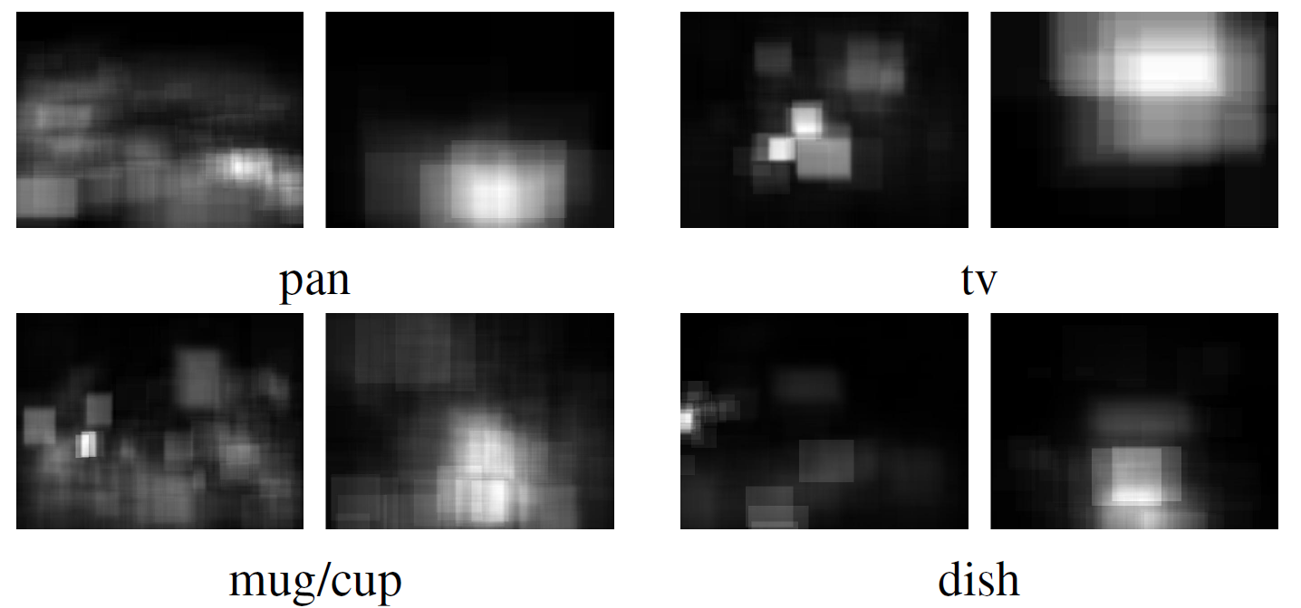
Average object locations
Passive
Active
Active objects tend to appear on the right hand side and closer
  Right-handed people are dominant
  We cannot mirror-flip images in training
Passive
Active
Passive
Active
Notes:
If we plot average object locations, active objects tend to appear closer to the camera and slightly shifted to the right. The reason being that most people are right-handed.
For instance we are used to mirror-flipping images in training, but here it won’t work well.

Slide 26
Outline
Challenges
  What features to use?
  Appearance model
  Temporal model
Our model
  “Active” vs “passive” objects
  Temporal pyramid
Dataset
Experiments
26
Notes:
26
Let’s see how our model works on this dataset.

Slide 27
Experiments
Baseline
Space-time interest points (STIP) Laptev et al, BMVC’09
Our model
Object-centric features
24 object categories
Low level features
High level features
Notes:
We use space-time interest points as a baseline for appearance features. We are comparing them to our high-level object-centric features. In building our object centric features, we use part based models for 24 household objects. With the distinction between passive and active objects, we get a 48 dimensional feature in the bag of objects model.

Slide 28
Accuracy on 18 action categories
  Our model: 40.6%
  STIP baseline: 22.8%
Notes:
This is the confusion matrix of our model on 18 action categories. The average accuracy of our model is about 40% which is almost twice as the accuracy of STIP features using the same temporal structure model.

Slide 29
Accuracy on 18 action categories
  Our model: 40.6%
  STIP baseline: 22.8%
Notes:
Interestingly, we make mistakes on functionally related categories like brushing teeth and flossing them. We believe the reason is that functionally-related actions occur in similar scenes; people brush their teeth and floss in the bathroom. Our bag-of-objects descriptor acts as a coarse scene-descriptor, and hence tends to make such reasonable mistakes. If one was penalizing mistakes based on their functional relevance, we might do even better.

Slide 30
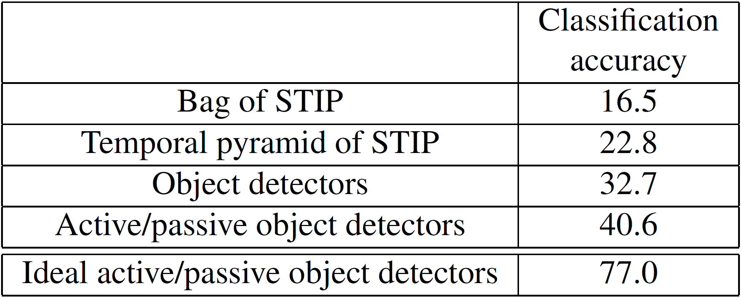
Classification accuracy
Temporal model helps
30
Notes:
Here we compare the bag model with the temporal pyramid model. We see 6% improvement in using our temporal pyramid with the baseline appearance features.
Now, if we use object-centric features …

Slide 31
Classification accuracy
Temporal model helps
Our object-centric features outperform STIP
31
Notes:
The performance improves by 10%.
And it improves more …

Slide 32
Classification accuracy
Temporal model helps
Our object-centric features outperform STIP
Visual phrases improves accuracy
32
Notes:
by differentiating between active and passive objects, and using their functional label as an additional cue for classification, performance jumps to 40%.
One could ask are we limited by our representation or by our object detectors. To answer this,

Slide 33
Classification accuracy
Temporal model helps
Our object-centric features outperform STIP
Visual phrases improves accuracy
Ideal object detectors double the performance
33
Notes:
We consider the performance of our model using ideal object detection annotations. It almost doubles the performance. This huge gap suggests that we still have a long ways to go to go to improve our object detectors for these types of applications.

Slide 34
Classification accuracy
Temporal model helps
Our object-centric features outperform STIP
Visual phrases improves accuracy
Ideal object detectors double the performance
Results on temporally continuous video and taxonomy loss are included in the paper
34
Notes:
So far we showed results on pre-segmented videos. Results on temporally continuous videos are also included in the paper.

Slide 35
Summary
Data and code will be available soon!
Notes:
In summary, we introduced algorithms for recognizing activities of daily living from wearable cameras and we have built a large-scale dataset with large intra-class variation.

Slide 36
Summary
Data and code will be available soon!
Notes:
We have described an object-centric representation that reasons about functional use with discrimination between active and passive objects.

Slide 37
Summary
Data and code will be available soon!
Notes:
We also introduced long-scale temporal structure using very simple but effective techniques.
We think wearable ADL recognition is an exciting application of action recognition. We hope others agree and take advantage of our dataset for further research.

Slide 38
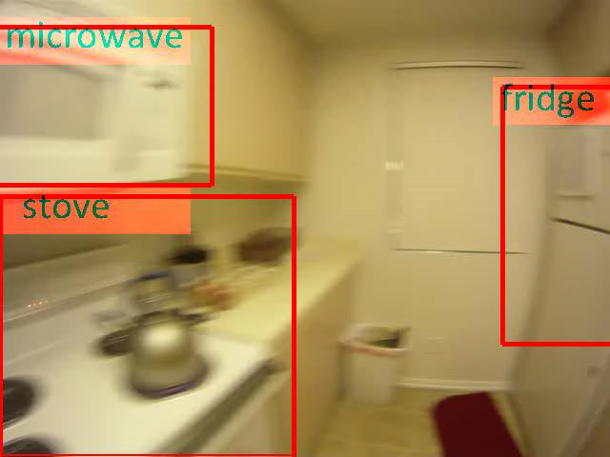
Thanks!

