Slide 1

Local features and image matching
May 9th, 2017
Yong Jae Lee
UC Davis

Slide 2
Announcement
Distinguished Lecture Series
Prof. Alexei A. Efros from UC Berkeley
5/11 (Thurs), 3 pm in Kemper 1127

Slide 3
Last time
RANSAC for robust fitting
  Lines, translation
Image mosaics
  Fitting a 2D transformation
    Homography

Slide 4


Today
Mosaics recap:
How to warp one image to the other, given H?
How to detect which features to match?

Slide 5

Motivation for feature-based alignment:
Image mosaics
Image from http://graphics.cs.cmu.edu/courses/15-463/2010_fall/

Slide 6
Projective Transformations
Projective transformations:
  Affine transformations, and
  Projective warps
Parallel lines do not necessarily remain parallel

Slide 7
How to stitch together a panorama (a.k.a. mosaic)?
Basic Procedure
  Take a sequence of images from the same position
    Rotate the camera about its optical center
  Compute transformation between second image and first
  Transform the second image to overlap with the first
  Blend the two together to create a mosaic
  (If there are more images, repeat)
Source: Steve Seitz

Slide 8
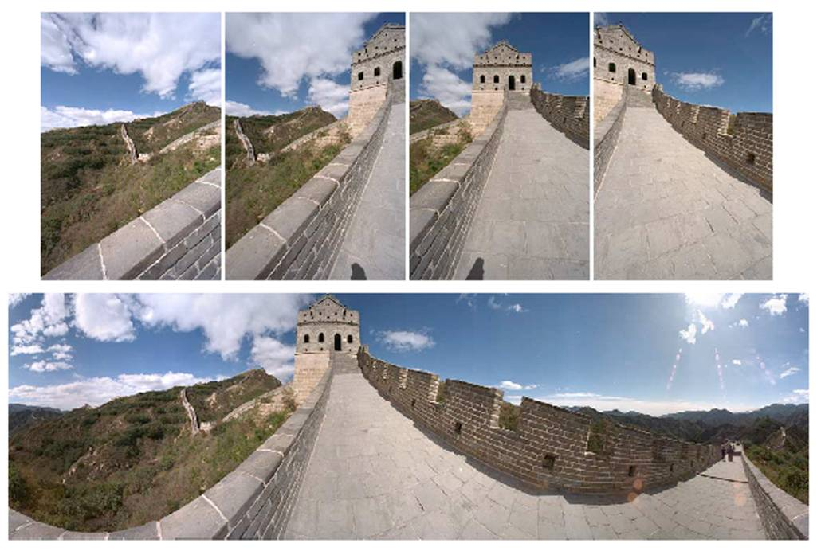
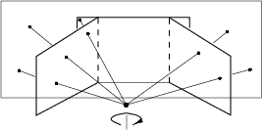
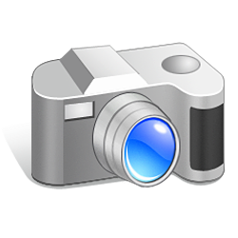
Mosaics
. . .
image from S. Seitz
Obtain a wider angle view by combining multiple images.

Slide 9
How to stitch together a panorama (a.k.a. mosaic)?
Basic Procedure
  Take a sequence of images from the same position
    Rotate the camera about its optical center
  Compute transformation between second image and first
  Transform the second image to overlap with the first
  Blend the two together to create a mosaic
  (If there are more images, repeat)
…but wait, why should this work at all?
  What about the 3D geometry of the scene?
  Why aren’t we using it?
Source: Steve Seitz

Slide 10
Image reprojection
Basic question
  How to relate two images from the same camera center?
    how to map a pixel from PP1 to PP2
PP2
Answer
  Cast a ray through each pixel in PP1
  Draw the pixel where that ray intersects PP2
Observation:
Rather than thinking of this as a 3D reprojection, think of it as a 2D image warp from one image to another.
PP1
Source: Alyosha Efros

Slide 11
Image reprojection: Homography
A projective transform is a mapping between any two PPs with the same center of projection
  rectangle should map to arbitrary quadrilateral
  parallel lines aren’t preserved
  but must preserve straight lines
called Homography
PP2
PP1
p’
H
p
Source: Alyosha Efros

Slide 12
Homography
…
…
To compute the homography given pairs of corresponding points in the images, we need to set up an equation where the parameters of H are the unknowns…

Slide 13
Solving for homographies
p’ = Hp
Defined up to a scale factor.
Constrain Frobenius norm of H to be 1.
Problem to be solved:
where vector of unknowns h = [h₀₀,h₀₁,h₀₂,h₁₀,h₁₁,h₁₂,h₂₀,h₂₁,h₂₂]^{T}
Adapted from Devi Parikh
Notes:
There is a whole set of solution homographies with variation across scale that represent the same geometrical transformation

Slide 14




Solving for homographies
There are 9 variables h₀₀,…,h₂₂.
Are there 9 degrees of freedom?
No. We can multiply all h_{ij} by nonzero scalar k without changing the equations:
Notes:
There is a whole set of solution homographies with variation across scale that represent the same geometrical transformation
DOF: number of variables that are free to vary

Slide 15




Enforcing 8 DOF
One approach: set h₂₂ = 1
Second approach: impose unit vector constraint
Subject to:
Notes:
However, if h_22=0 this approach fails
Also poor results if h_22 close to zero; thus, not recommended

Slide 16


Solving for homographies

Slide 17


Solving for homographies
A
h
0
2n × 9
9
2n
Defines a least squares problem:
Since h is only defined up to scale, solve for unit vector ĥ
Solution: ĥ = eigenvector of A^{T}A with smallest eigenvalue
Works with 4 or more points

Slide 18


Projective: # correspondences?
?
T(x,y)
y
y’
x
x’
How many correspondences needed for projective?
Source: Alyosha Efros

Slide 19
Homography
To apply a given homography H
  Compute p’ = Hp (regular matrix multiply)
  Convert p’ from homogeneous to image coordinates
p’
H
p
Slide credit: Kristen Grauman

Slide 20

Image warping
T(x,y)
y
y’
x
x’
f(x,y)
g(x’,y’)
Given a coordinate transform and a source image f(x,y), how do we compute a transformed image g(x’,y’) = f(T(x,y))?
Slide from Alyosha Efros, CMU

Slide 21
Forward warping
T(x,y)
y
y’
x
x’
f(x,y)
g(x’,y’)
Send each pixel f(x,y) to its corresponding location
(x’,y’) = T(x,y) in the second image
Q: what if pixel lands “between” two pixels?
Slide from Alyosha Efros, CMU

Slide 22
Forward warping
T(x,y)
y
y’
x
x’
f(x,y)
g(x’,y’)
Send each pixel f(x,y) to its corresponding location
(x’,y’) = T(x,y) in the second image
Q: what if pixel lands “between” two pixels?
A: distribute color among neighboring pixels (x’,y’)
  Known as “splatting”
Slide from Alyosha Efros, CMU

Slide 23
Inverse warping
T⁻¹(x,y)
y
y’
x
x
x’
f(x,y)
g(x’,y’)
Get each pixel g(x’,y’) from its corresponding location
(x,y) = T⁻¹(x’,y’) in the first image
Q: what if pixel comes from “between” two pixels?
Slide from Alyosha Efros, CMU

Slide 24
Inverse warping
T⁻¹(x,y)
y
y’
x
x
x’
f(x,y)
g(x’,y’)
Get each pixel g(x’,y’) from its corresponding location
(x,y) = T⁻¹(x’,y’) in the first image
Q: what if pixel comes from “between” two pixels?
A: Interpolate color value from neighbors
  nearest neighbor, bilinear…
Slide from Alyosha Efros, CMU

Slide 25





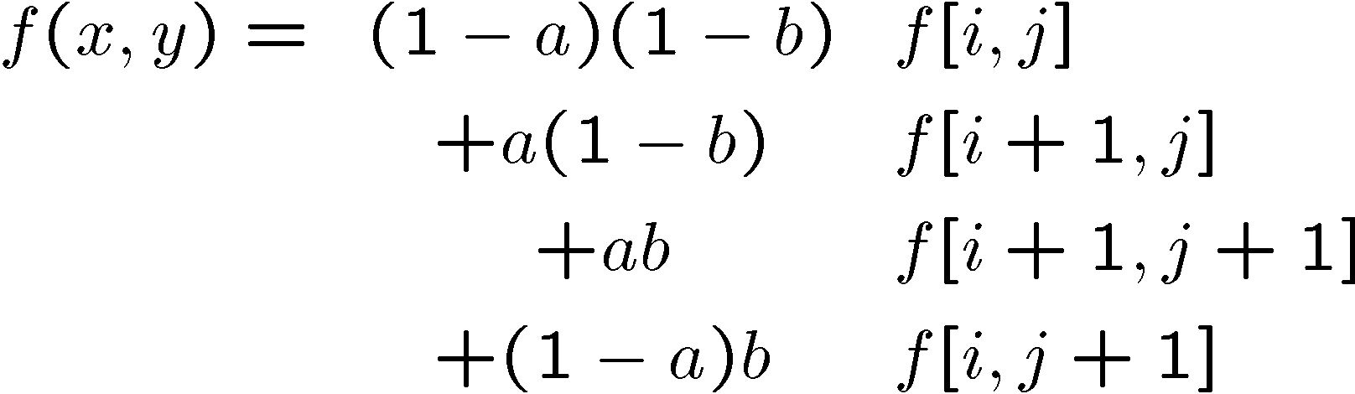
Bilinear interpolation
Sampling at f(x,y):
Slide from Alyosha Efros, CMU

Slide 26


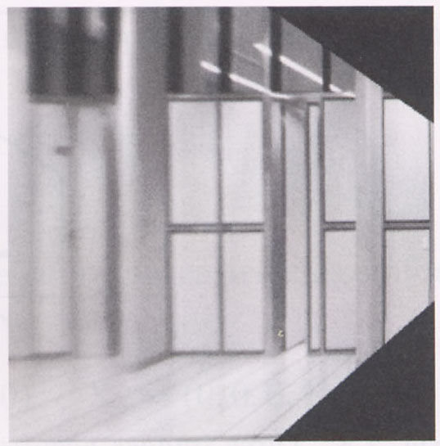
Image warping with homographies
image plane in front
image plane below
black area
where no pixel
maps to
Source: Steve Seitz

Slide 27
Image rectification
p’
p

Slide 28
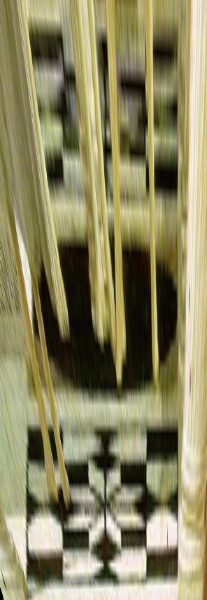
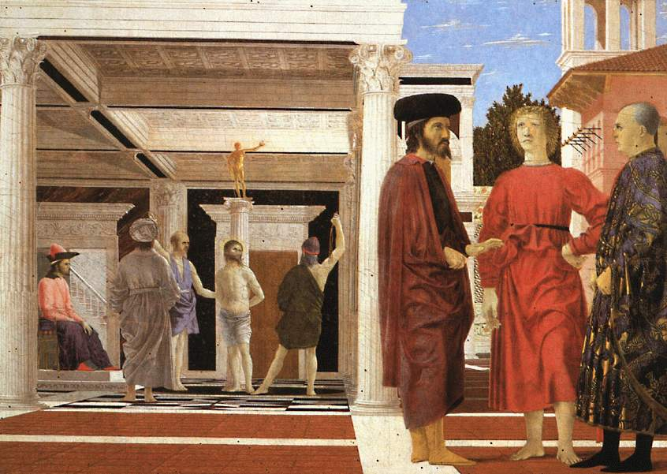

Analysing patterns and shapes
What is the shape of the b/w floor pattern?
Homography
The floor (enlarged)
Automatically
rectified floor
Slide from Antonio Criminisi

Slide 29
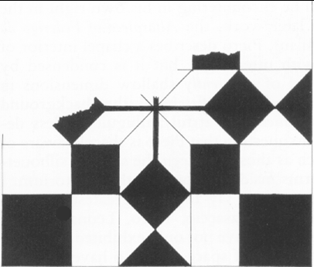
Analysing patterns and shapes
Automatic rectification
From Martin Kemp The Science of Art
(manual reconstruction)
Slide from Antonio Criminisi

Slide 30
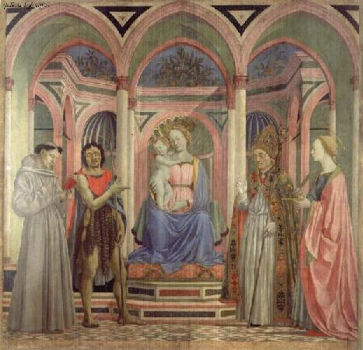
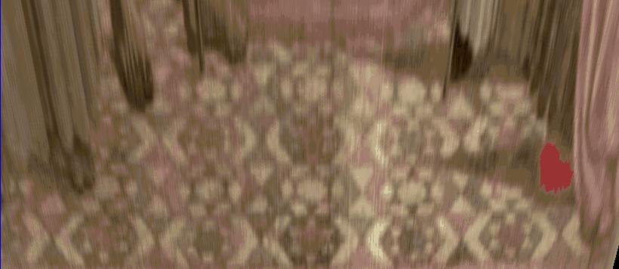
Analysing patterns and shapes
What is the (complicated)
shape of the floor pattern?
Automatically rectified floor
St. Lucy Altarpiece, D. Veneziano
Slide from Criminisi

Slide 31
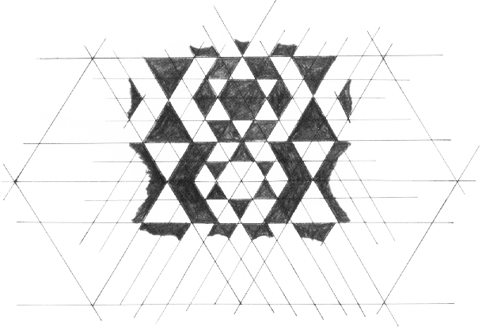
Analysing patterns and shapes
Automatic
rectification
From Martin Kemp, The Science of Art
(manual reconstruction)
Slide from Criminisi

Slide 32
Changing camera center
Does it still work?
synthetic PP
PP1
PP2
Source: Alyosha Efros

Slide 33
Recall: same camera center
real
camera
synthetic
camera
Can generate synthetic camera view
as long as it has the same center of projection.
Source: Alyosha Efros

Slide 34

…Or: Planar scene (or far away)
PP3
PP1
PP2
PP3 is a projection plane of both centers of projection, so we are OK!
This is how big aerial photographs are made
Source: Alyosha Efros

Slide 35
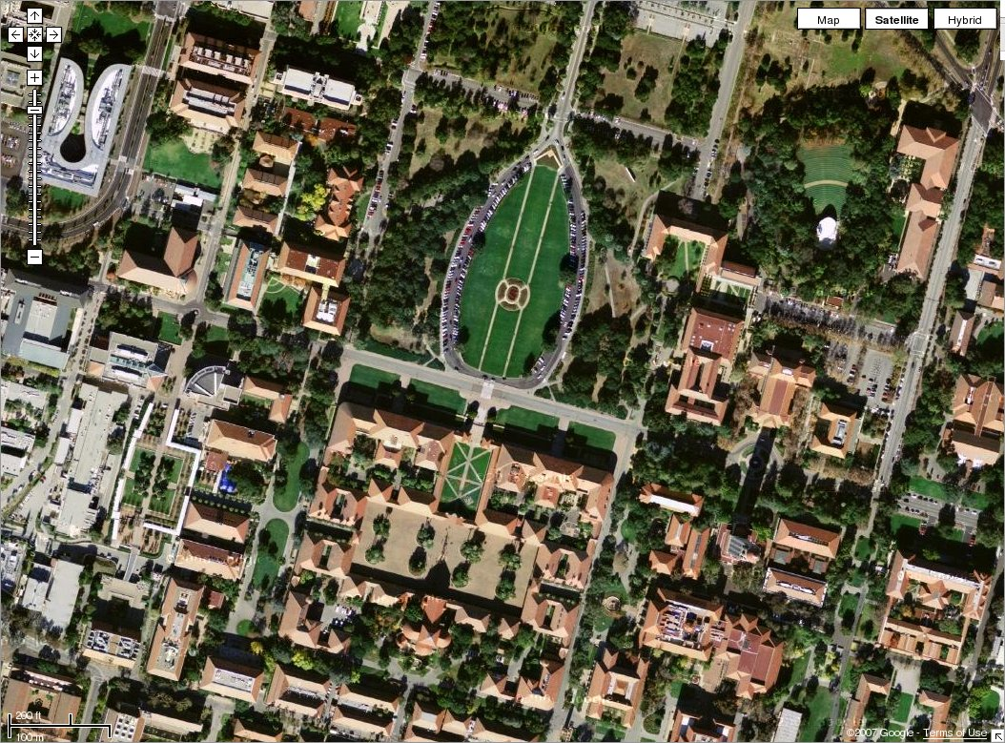

Slide 36
RANSAC for estimating homography
RANSAC loop:
1. Select four feature pairs (at random)
2. Compute homography H (exact)
3. Compute inliers where SSD(p_{i}’, Hp_{i})< ε
4. Keep largest set of inliers
5. Re-compute least-squares H estimate on all of the inliers
Slide credit: Steve Seitz

Slide 37


Robust feature-based alignment
Source: L. Lazebnik

Slide 38
Robust feature-based alignment
Extract features
Source: L. Lazebnik

Slide 39
Robust feature-based alignment
Extract features
Compute putative matches
Source: L. Lazebnik

Slide 40
Robust feature-based alignment
Extract features
Compute putative matches
Loop:
  Hypothesize transformation T (small group of putative matches that are related by T)
Source: L. Lazebnik

Slide 41
Robust feature-based alignment
Extract features
Compute putative matches
Loop:
  Hypothesize transformation T (small group of putative matches that are related by T)
  Verify transformation (search for other matches consistent with T)
Source: L. Lazebnik

Slide 42

Robust feature-based alignment
Extract features
Compute putative matches
Loop:
  Hypothesize transformation T (small group of putative matches that are related by T)
  Verify transformation (search for other matches consistent with T)
Source: L. Lazebnik

Slide 43
Summary: alignment & warping
  Write 2d transformations as matrix-vector multiplication (including translation when we use homogeneous coordinates)
  Fitting transformations: solve for unknown parameters given corresponding points from two views (affine, projective (homography)).
  Perform image warping (forward, inverse)
  Mosaics: uses homography and image warping to merge views taken from same center of projection.

Slide 44
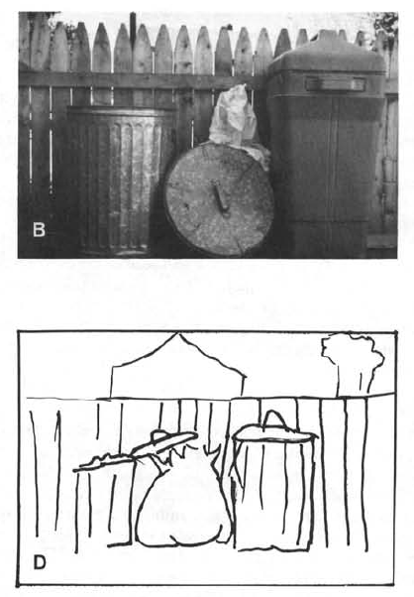
Boundary extension
Wide-Angle Memories of Close-Up Scenes, Helene Intraub and Michael Richardson, Journal of Experimental Psychology: Learning, Memory, and Cognition, 1989, Vol. 15, No. 2, 179-187
Notes:
Subjects were shown a picture to look at for 15 seconds. Then, two days later, they were asked to draw the picture from memory.

Slide 45
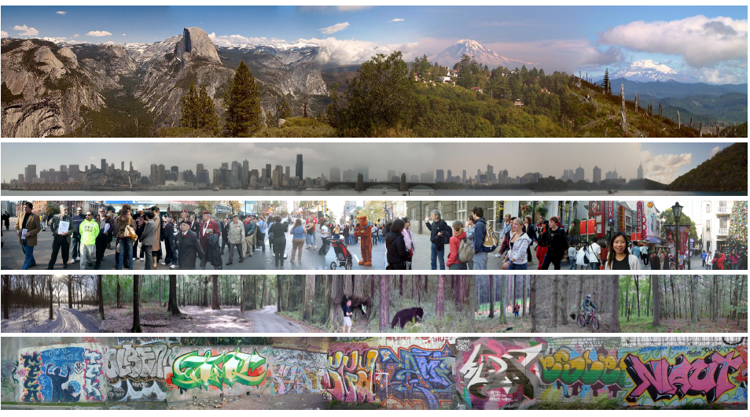
Creating and Exploring a Large Photorealistic Virtual Space
Josef Sivic, Biliana Kaneva, Antonio Torralba, Shai Avidan and William T. Freeman, Internet Vision Workshop, CVPR 2008.
http://www.youtube.com/watch?v=E0rboU10rPo
Notes:
a collection of several million images
downloaded from Flickr and broken into themes that consist
of a few hundred thousand images each

Slide 46
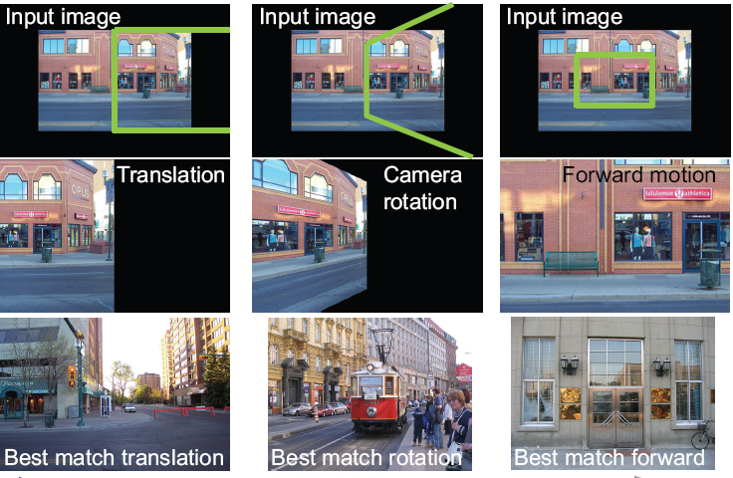
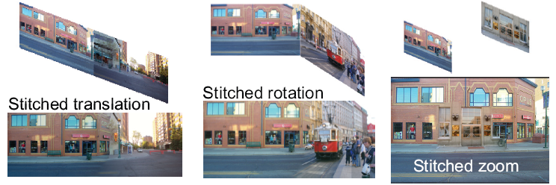
Creating and Exploring a Large Photorealistic Virtual Space
Current view, and desired view in green
Synthesized view from new camera
Induced camera motion
Notes:
Scene matching with camera view transformations.
First row: The input image with the desired camera view overlaid in green.
Second row: The synthesized view from the new camera. The goal is to find images which can fill-in the unseen portion of the image (shown in black) while matching the visible portion.
Third row: the top matching image found in the dataset of street scenes for each motion.
Fourth row: induced camera motion between the two pictures.
Final row: composite after Poisson blending

Slide 47
Today
Mosaics recap:
How to warp one image to the other, given H?
How to detect which features to match?

Slide 48
Detecting local invariant features
Detection of interest points
  Harris corner detection
  (Scale invariant blob detection: LoG)
(Next time: description of local patches)

Slide 49
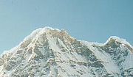

Local features: main components
Detection: Identify the interest points
Description: Extract vector feature descriptor surrounding each interest point.
Matching: Determine correspondence between descriptors in two views
Kristen Grauman

Slide 50
Local features: desired properties
Repeatability
  The same feature can be found in several images despite geometric and photometric transformations
Saliency
  Each feature has a distinctive description
Compactness and efficiency
  Many fewer features than image pixels
Locality
  A feature occupies a relatively small area of the image; robust to clutter and occlusion

Slide 51
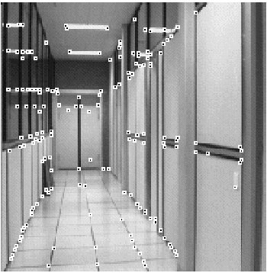
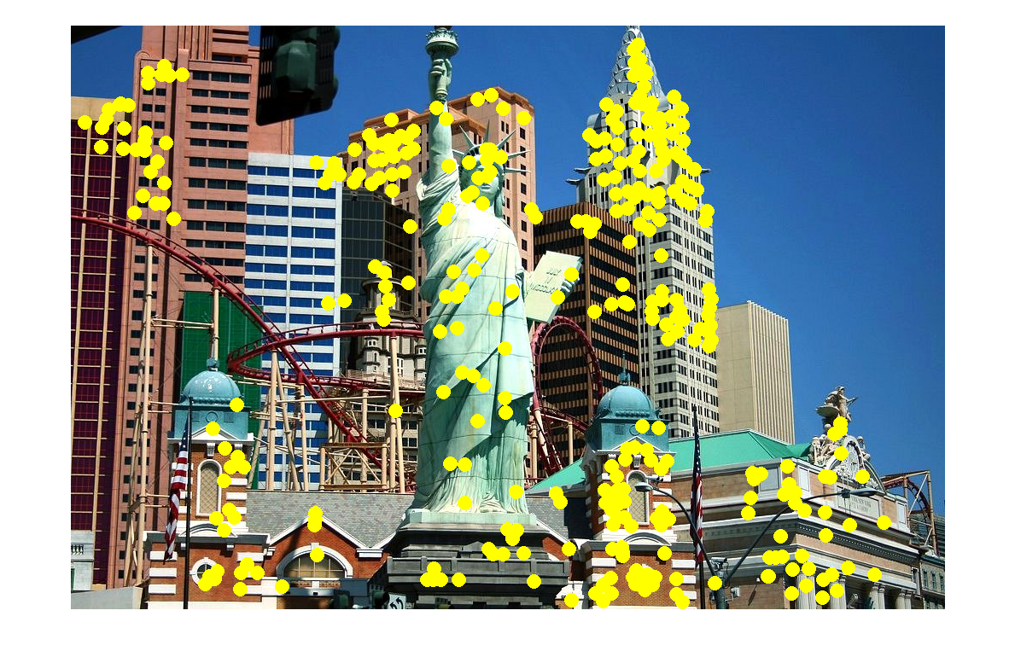
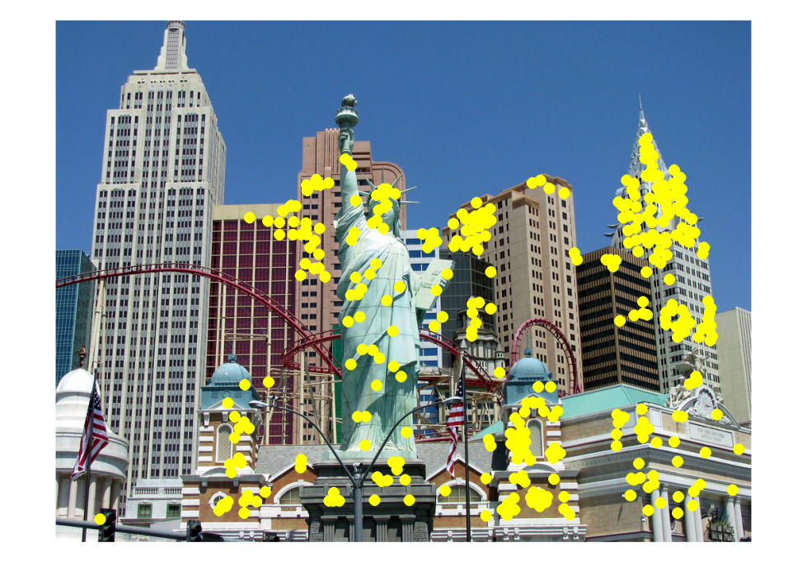
Applications
Local features are used for:
  Image alignment
  3D reconstruction
  Motion tracking
  Robot navigation
  Indexing and database retrieval
  Object recognition
Lana Lazebnik

Slide 52


A hard feature matching problem
NASA Mars Rover images

Slide 53


Answer below (look for tiny colored squares…)
NASA Mars Rover images
with SIFT feature matches
Figure by Noah Snavely

Slide 54
Goal: interest operator repeatability
We want to detect (at least some of) the same points in both images.
Yet we have to be able to run the detection procedure independently per image.
No chance to find true matches!
Notes:
54

Slide 55
Goal: descriptor distinctiveness
We want to be able to reliably determine which point goes with which.
Must provide some invariance to geometric and photometric differences between the two views.
?

Slide 56
Local features: main components
Detection: Identify the interest points
Description:Extract vector feature descriptor surrounding each interest point.
Matching: Determine correspondence between descriptors in two views

Slide 57
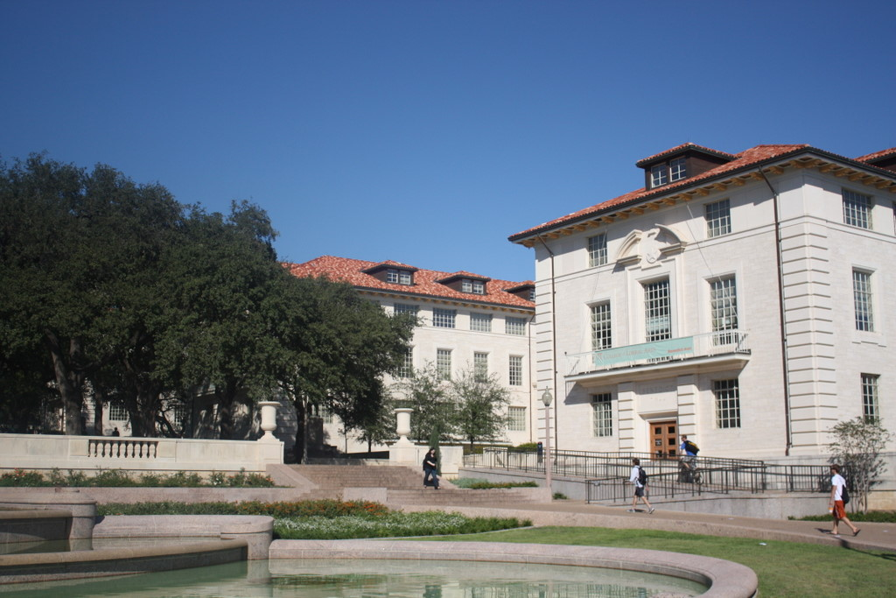
What points would you choose?

Slide 58

Corners as distinctive interest points
We should easily recognize the point by looking through a small window
Shifting a window in any direction should give a large change in intensity
“flat” region:
no change in all directions
“edge”:
no change along the edge direction
“corner”:
significant change in all directions
Slide credit: Alyosha Efros, Darya Frolova, Denis Simakov

Slide 59


Corners as distinctive interest points
2 x 2 matrix of image derivatives (averaged in neighborhood of a point).
Notation:

Slide 60
What does this matrix reveal?
First, consider an axis-aligned corner:

Slide 61
What does this matrix reveal?
First, consider an axis-aligned corner:
This means dominant gradient directions align with x or y axis
Look for locations where both λ’s are large.
If either λ is close to 0, then this is not corner-like.
What if we have a corner that is not aligned with the image axes?

Slide 62
What does this matrix reveal?
Since M is symmetric, we have
(Eigenvalue decomposition)
The eigenvalues of M reveal the amount of intensity change in the two principal orthogonal gradient directions in the window.

Slide 63
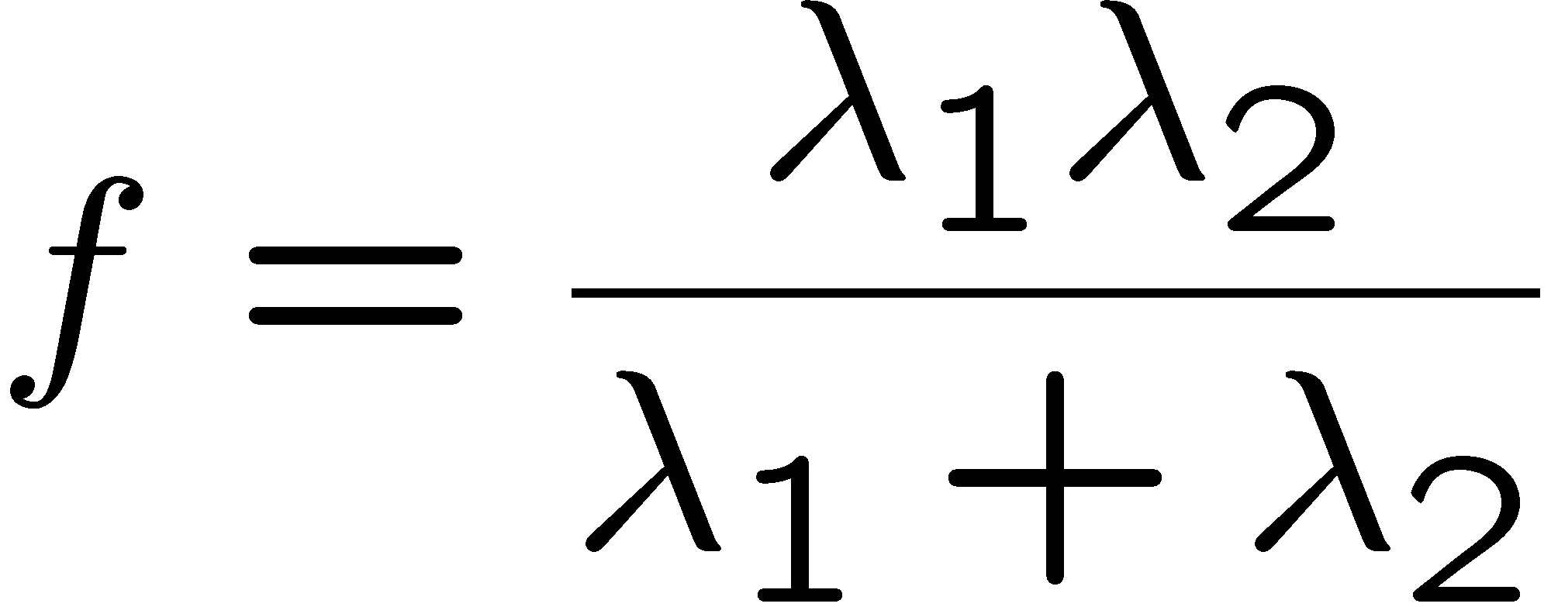
Corner response function
“edge”:
“corner”:
“flat” region
λ₁ >> λ₂
λ₁ and λ₂ are large,
λ₁ ~ λ₂;
λ₁ and λ₂ are small;
λ₂ >> λ₁

Slide 64
Harris corner detector
Compute M matrix for each image window to get their cornerness scores.
Find points whose surrounding window gave large corner response (f > threshold)
Take the points of local maxima, i.e., perform non-maximum suppression
Notes:
64

Slide 65
Example of Harris application
Kristen Grauman

Slide 66
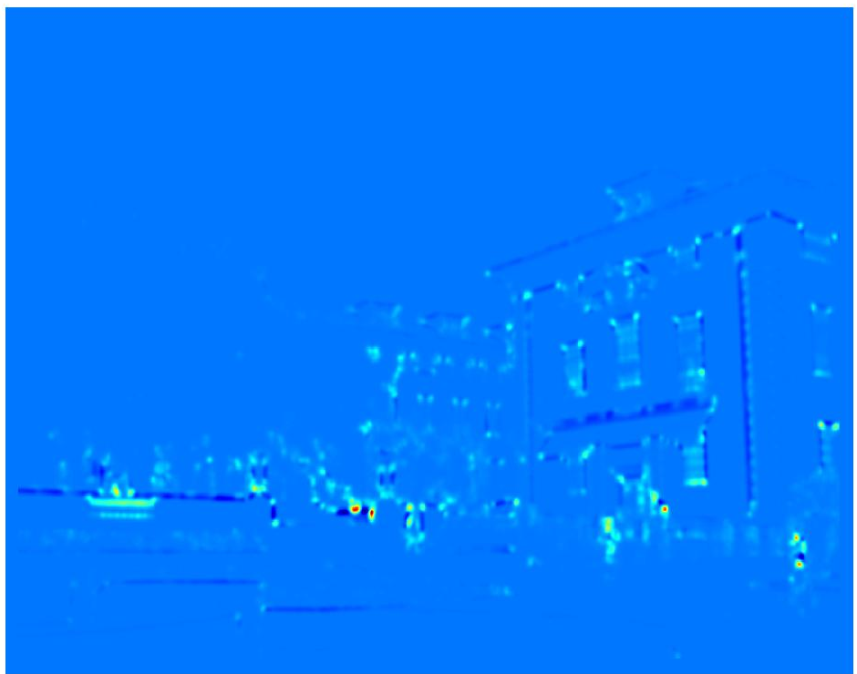
Example of Harris application
Compute corner response at every pixel.
Kristen Grauman

Slide 67
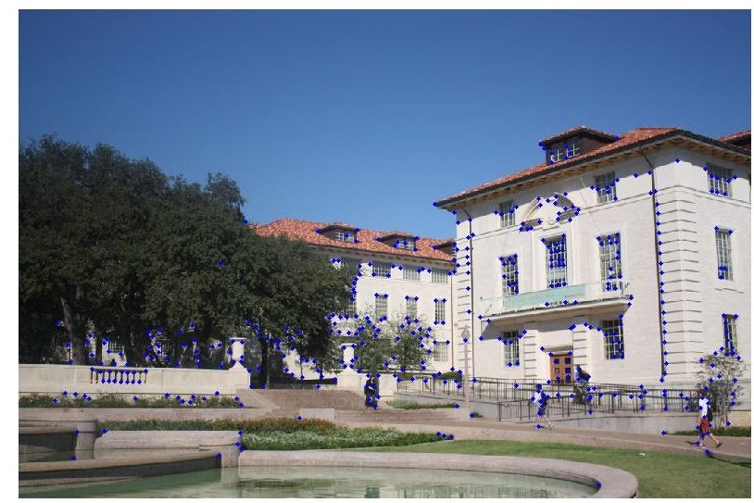
Example of Harris application
Kristen Grauman
Notes:
Only non-maxes exceeding average (thresholded)

Slide 68
Properties of the Harris corner detector
Rotation invariant?
Yes

Slide 69
Properties of the Harris corner detector
Rotation invariant?
Translation invariant?
Yes
Yes

Slide 70
Properties of the Harris corner detector
Rotation invariant?
Translation invariant?
Scale invariant?
Yes
Yes
No
All points will be classified as edges
Corner !

Slide 71
Summary
Image warping to create mosaic, given homography
Interest point detection
  Harris corner detector
  Next time:
    Laplacian of Gaussian, automatic scale selection

