Slide 1

Indexing local features and instance recognition
May 16th, 2017
Yong Jae Lee
UC Davis

Slide 2
Announcements
PS2 due next Monday 11:59 am

Slide 3
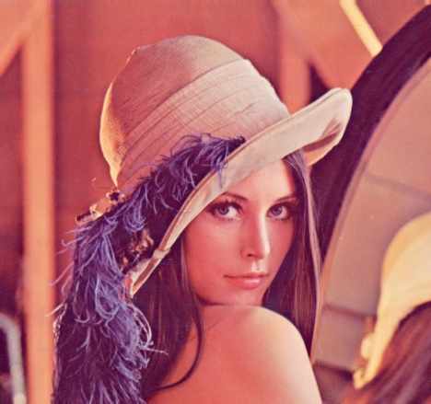
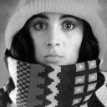

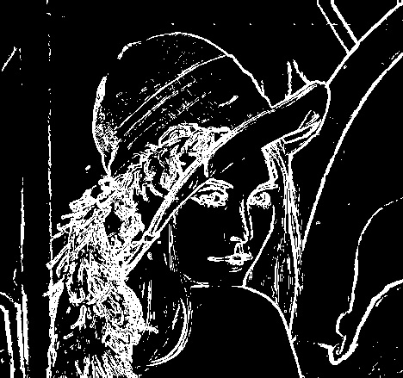
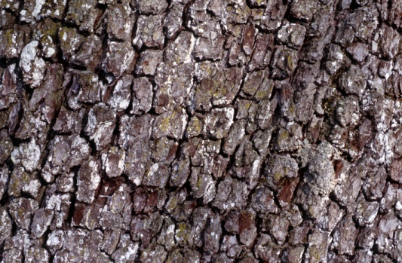

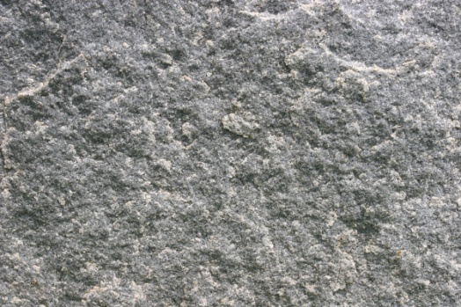
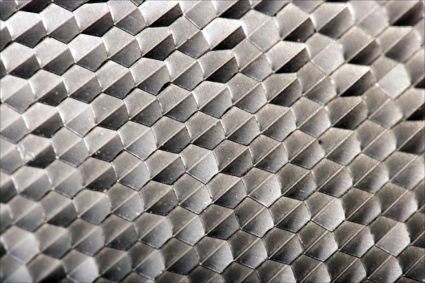
Recap: Features and filters
Transforming and describing images; textures, edges
Kristen Grauman

Slide 4
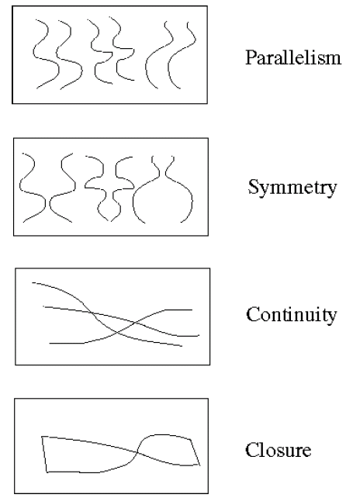
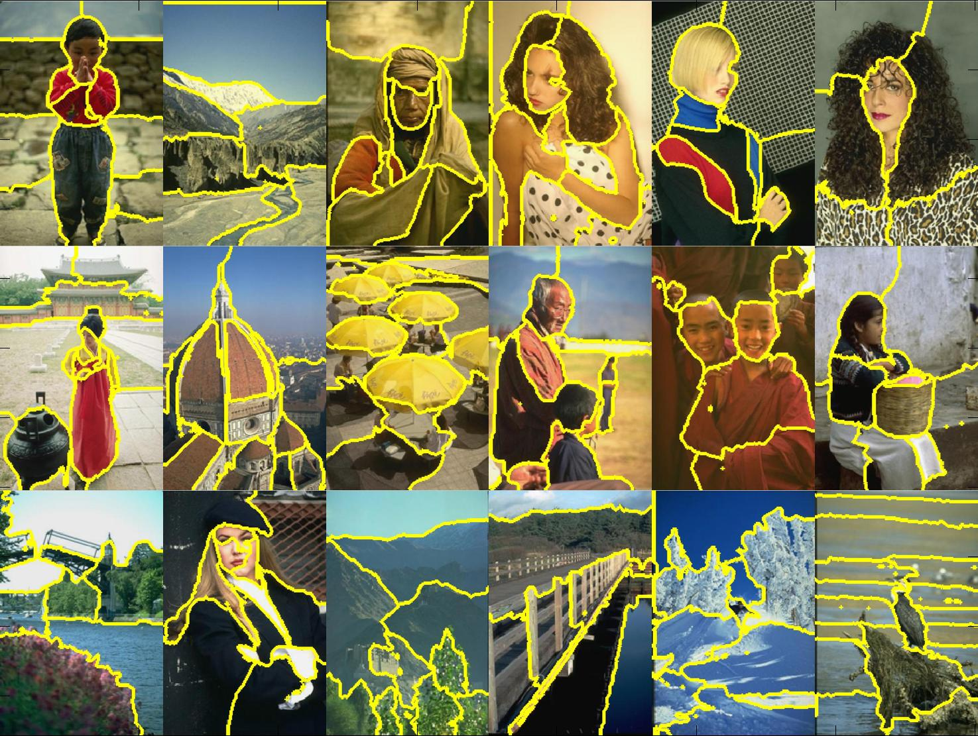
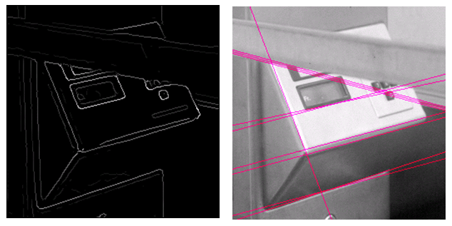
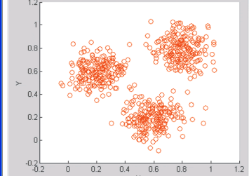
Recap: Grouping & fitting
Clustering, segmentation, fitting; what parts belong together?
[fig from Shi et al]
Kristen Grauman

Slide 5
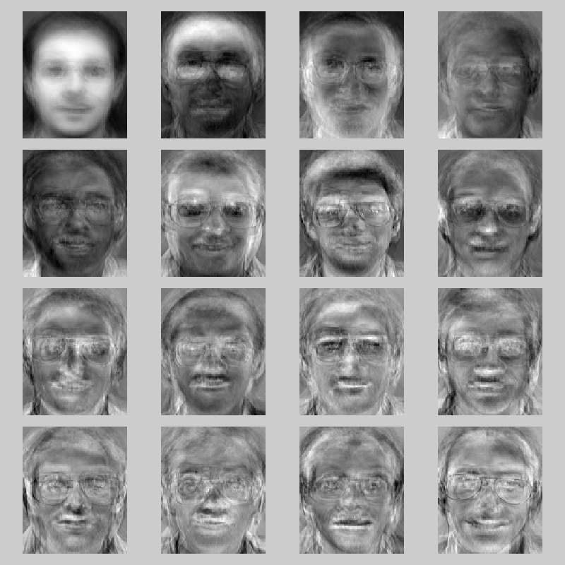
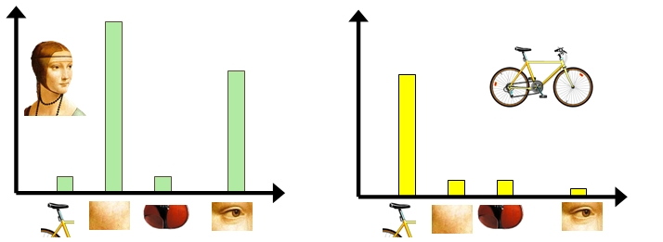

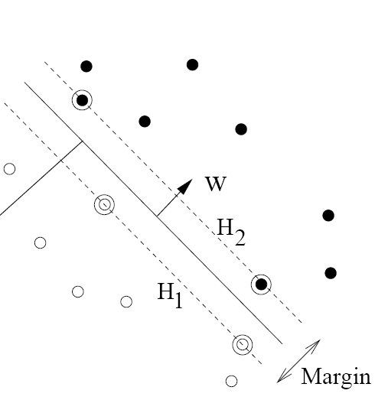
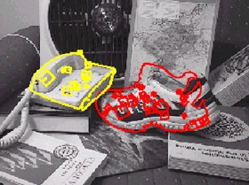
Recognition and learning
Recognizing objects and categories, learning techniques
Kristen Grauman

Slide 6
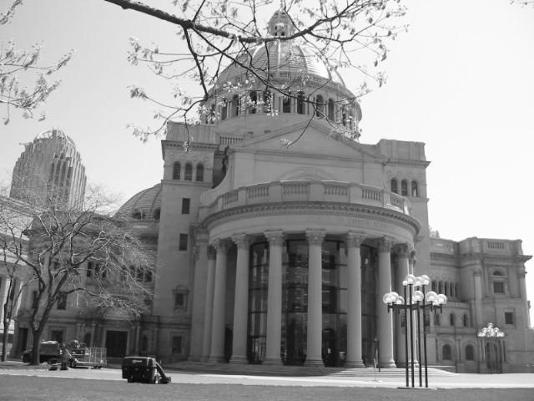
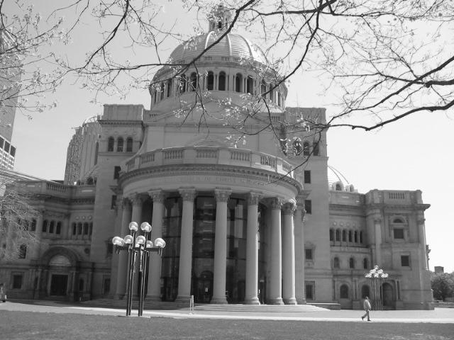
Matching local features
Kristen Grauman

Slide 7
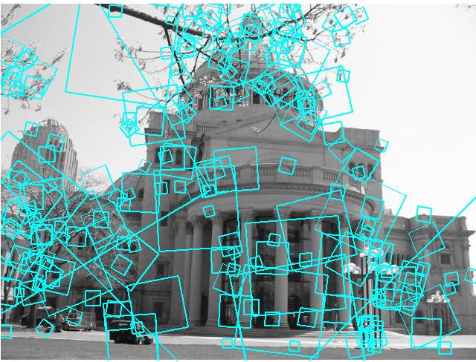
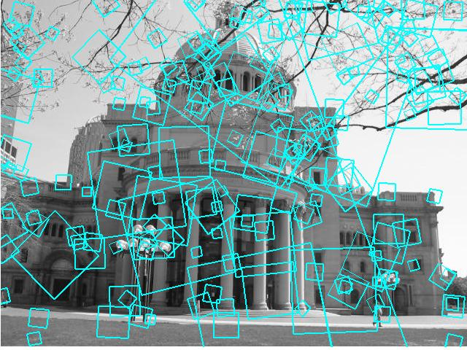
Matching local features
?
Image 1
Image 2
To generate candidate matches, find patches that have the most similar appearance (e.g., lowest SSD)
Simplest approach: compare them all, take the closest (or closest k, or within a thresholded distance)
Kristen Grauman

Slide 8
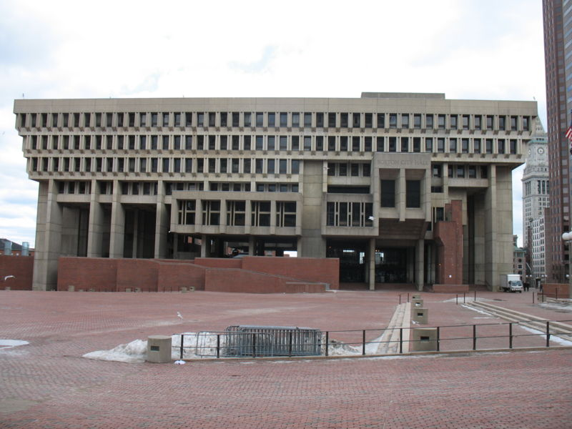
Indexing local features
…
Kristen Grauman
Notes:
Map local descriptors to discrete tokens, and then “match” them by simply looking up features assigned to identical tokens.

Slide 9
Indexing local features
Each patch / region has a descriptor, which is a point in some high-dimensional feature space (e.g., SIFT)
Descriptor’s feature space
Kristen Grauman
Notes:
9

Slide 10
Indexing local features
When we see close points in feature space, we have similar descriptors, which indicates similar local content.
Query image
Descriptor’s feature space
Database images
Kristen Grauman

Slide 11
Indexing local features
With potentially thousands of features per image, and hundreds to millions of images to search, how to efficiently find those that are relevant to a new image?
Kristen Grauman
Notes:
11

Slide 12
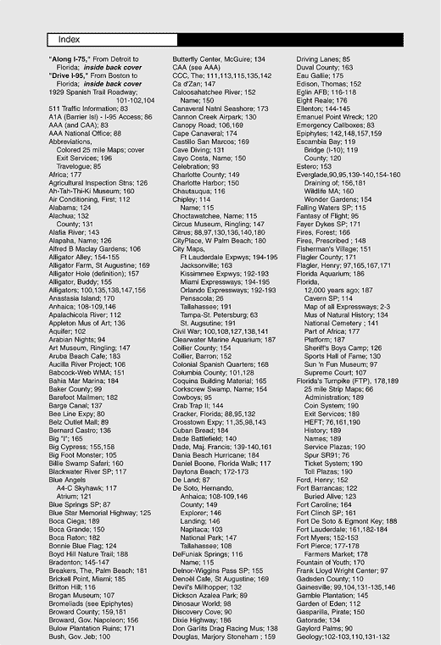
Indexing local features: inverted file index
For text documents, an efficient way to find all pages on which a word occurs is to use an index…
We want to find all images in which a feature occurs.
To use this idea, we’ll need to map our features to “visual words”.
Kristen Grauman

Slide 13
Text retrieval vs. image search
What makes the problems similar, different?
Kristen Grauman
Notes:
Text words are discrete “tokens”, whereas local image descriptors are high-dimensional, real-valued feature points. Need to quantize the visual features into discrete visual words.

Slide 14
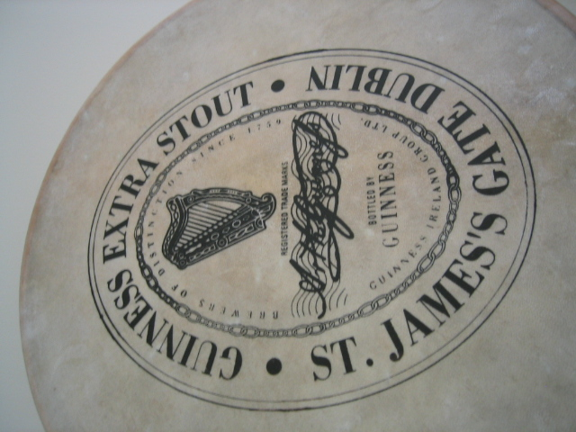
Visual words: main idea
Extract some local features from a number of images …
e.g., SIFT descriptor space: each point is 128-dimensional
Slide credit: D. Nister, CVPR 2006

Slide 15
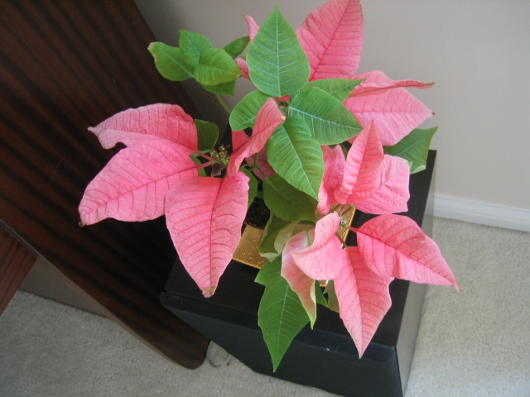
Visual words: main idea

Slide 16
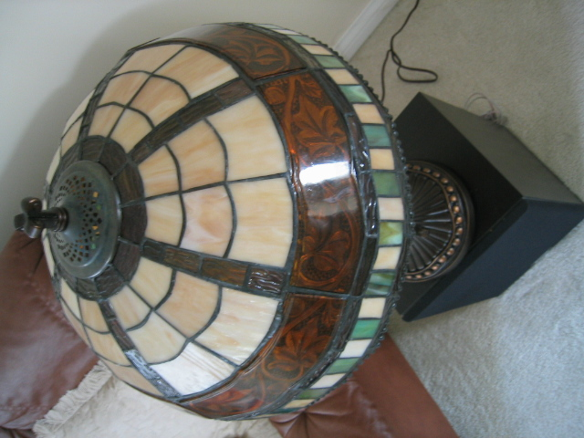
Visual words: main idea

Slide 17

Visual words: main idea

Slide 18
Each point is a local descriptor, e.g. SIFT vector.

Slide 20
Visual words
Map high-dimensional descriptors to tokens/words by quantizing the feature space
Quantize via clustering, let cluster centers be the prototype “words”
Word #2
Determine which word to assign to each new image region by finding the closest cluster center.
Descriptor’s feature space
Kristen Grauman

Slide 21
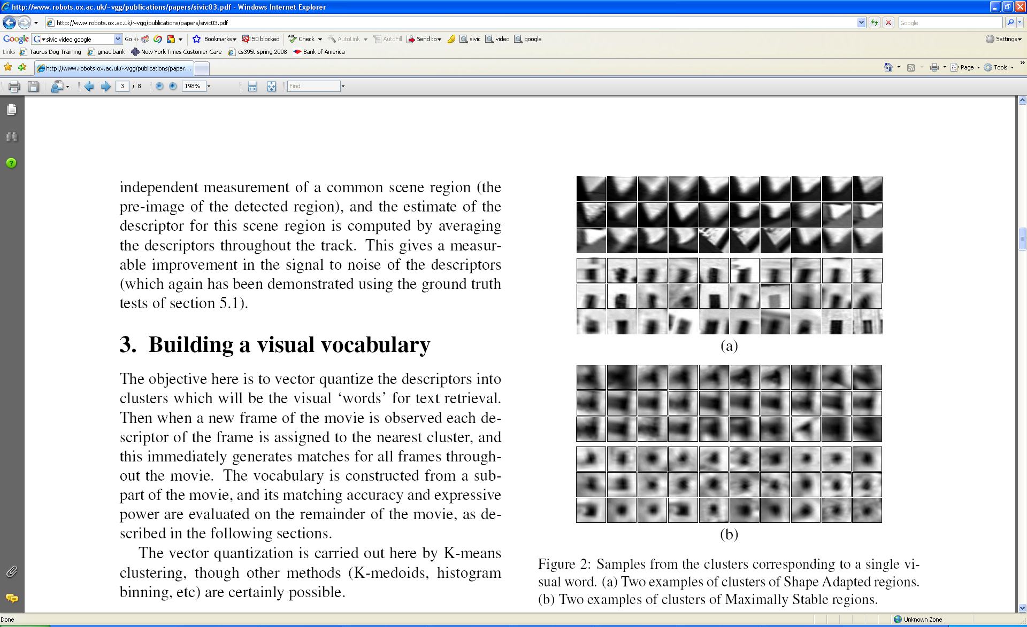
Visual words
Example: each group of patches belongs to the same visual word
Figure from Sivic & Zisserman, ICCV 2003
Kristen Grauman

Slide 22
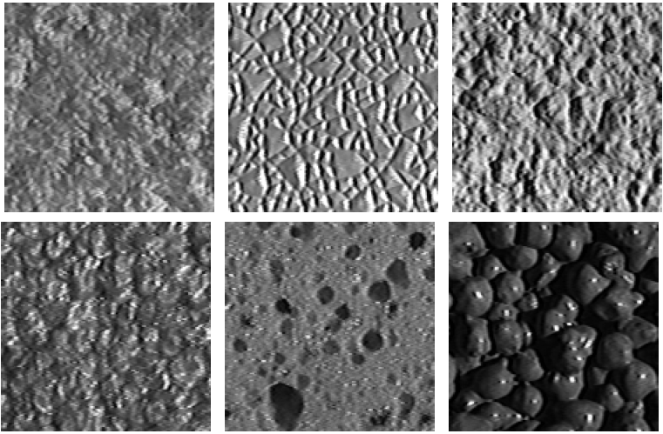
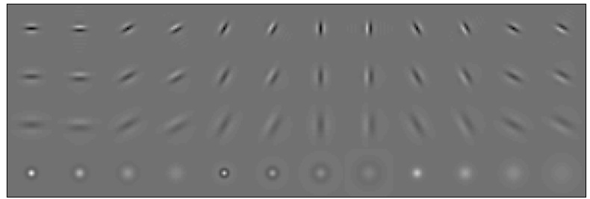
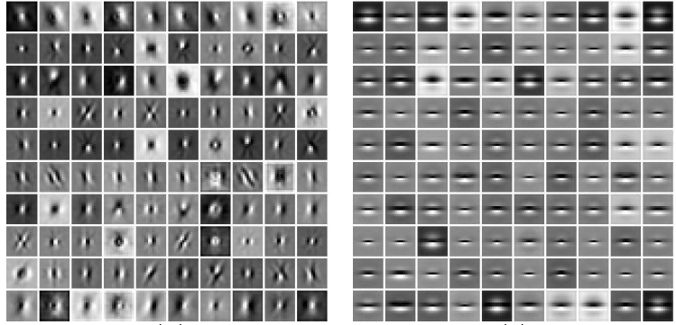
Visual words and textons
First explored for texture and material representations
Texton = cluster center of filter responses over collection of images
Describe textures and materials based on distribution of prototypical texture elements.
Leung & Malik 1999; Varma & Zisserman, 2002
Kristen Grauman

Slide 23
Recall: Texture representation example
Windows with primarily horizontal edges
Both
 | mean d/dx value | mean d/dy value
Win. #1 | 4 | 10
Win.#2 | 18 | 7
Win.#9 | 20 | 20
Dimension 2 (mean d/dy value)
Dimension 1 (mean d/dx value)
…
statistics to summarize patterns in small windows
…
Windows with small gradient in both directions
Windows with primarily vertical edges
Kristen Grauman

Slide 24
Visual vocabulary formation
Issues:
Sampling strategy: where to extract features?
Clustering / quantization algorithm
Unsupervised vs. supervised
What corpus provides features (universal vocabulary?)
Vocabulary size, number of words
Kristen Grauman

Slide 25
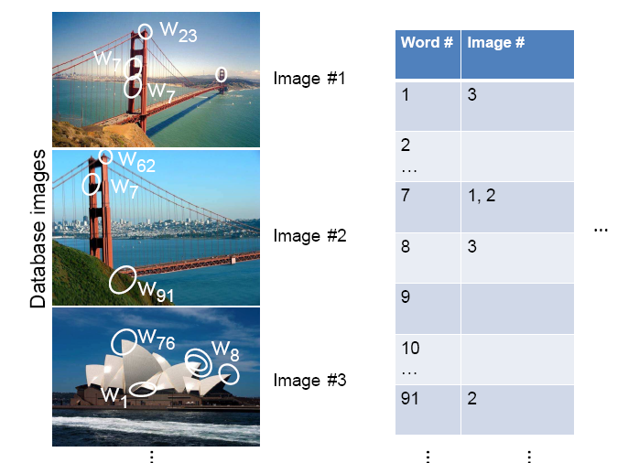
Inverted file index
Database images are loaded into the index mapping words to image numbers
Kristen Grauman

Slide 26
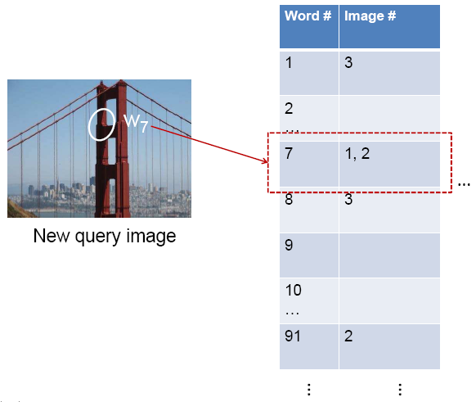
Inverted file index
When will this give us a significant gain in efficiency?
New query image is mapped to indices of database images that share a word.
Kristen Grauman

Slide 27
If a local image region is a visual word, how can we summarize an image (the document)?

Slide 28

Analogy to documents
Of all the sensory impressions proceeding to the brain, the visual experiences are the dominant ones. Our perception of the world around us is based essentially on the messages that reach the brain from our eyes. For a long time it was thought that the retinal image was transmitted point by point to visual centers in the brain; the cerebral cortex was a movie screen, so to speak, upon which the image in the eye was projected. Through the discoveries of Hubel and Wiesel we now know that behind the origin of the visual perception in the brain there is a considerably more complicated course of events. By following the visual impulses along their path to the various cell layers of the optical cortex, Hubel and Wiesel have been able to demonstrate that the message about the image falling on the retina undergoes a step-wise analysis in a system of nerve cells stored in columns. In this system each cell has its specific function and is responsible for a specific detail in the pattern of the retinal image.
China is forecasting a trade surplus of $90bn (£51bn) to $100bn this year, a threefold increase on 2004's $32bn. The Commerce Ministry said the surplus would be created by a predicted 30% jump in exports to $750bn, compared with a 18% rise in imports to $660bn. The figures are likely to further annoy the US, which has long argued that China's exports are unfairly helped by a deliberately undervalued yuan. Beijing agrees the surplus is too high, but says the yuan is only one factor. Bank of China governor Zhou Xiaochuan said the country also needed to do more to boost domestic demand so more goods stayed within the country. China increased the value of the yuan against the dollar by 2.1% in July and permitted it to trade within a narrow band, but the US wants the yuan to be allowed to trade freely. However, Beijing has made it clear that it will take its time and tread carefully before allowing the yuan to rise further in value.
sensory, brain,
visual, perception,
retinal, cerebral cortex,
eye, cell, optical
nerve, image
Hubel, Wiesel
China, trade,
surplus, commerce,
exports, imports, US,
yuan, bank, domestic,
foreign, increase,
trade, value
ICCV 2005 short course, L. Fei-Fei

Slide 29





Slide 30
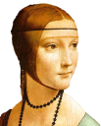






Bags of visual words
Summarize entire image based on its distribution (histogram) of word occurrences.
Analogous to bag of words representation commonly used for documents.
Notes:
30

Slide 31
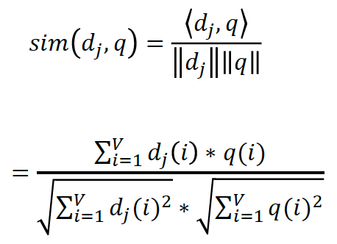





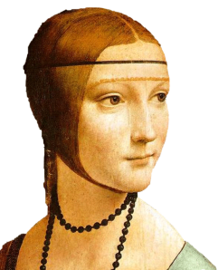
Comparing bags of words
Rank frames by normalized scalar product between their occurrence counts---nearest neighbor search for similar images.
[1 8 1 4]
[5 1 1 0]
for vocabulary of V words
Kristen Grauman
Notes:
(possibly weighted)
Cosine similarity

Slide 32
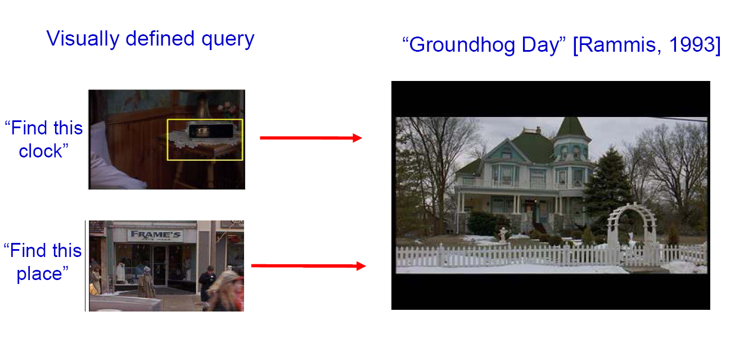
Bags of words for content-based image retrieval
Slide from Andrew Zisserman
Sivic & Zisserman, ICCV 2003

Slide 33
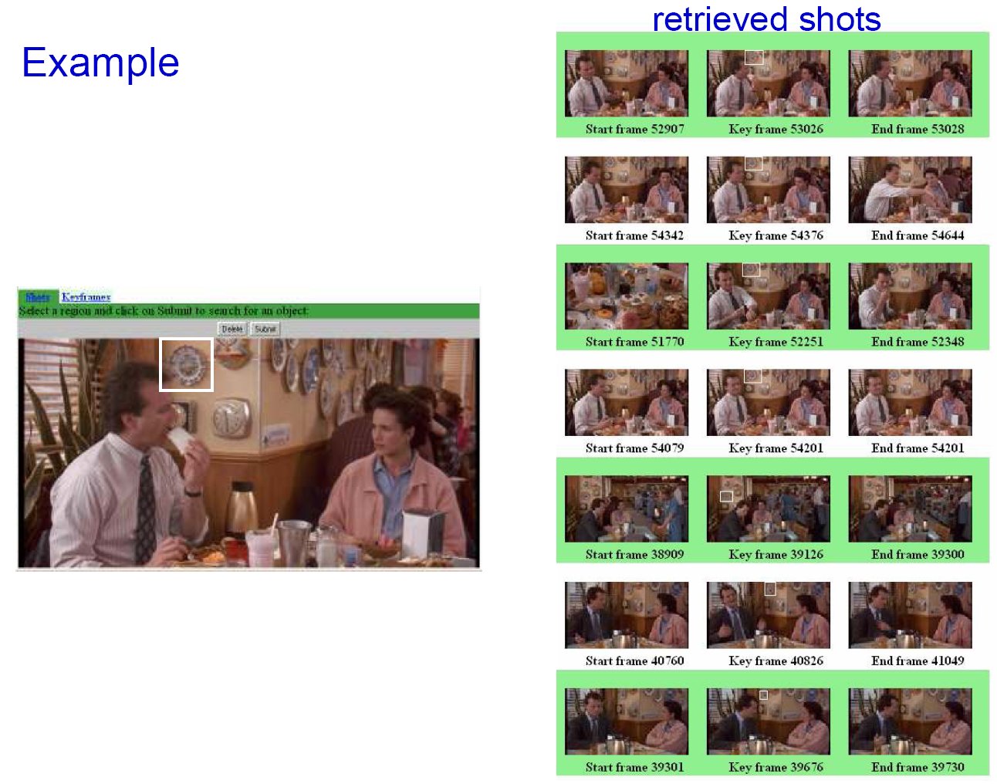
Slide from Andrew Zisserman
Sivic & Zisserman, ICCV 2003

Slide 34
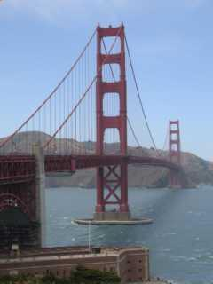
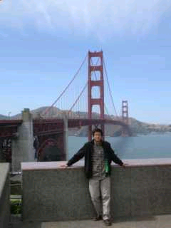
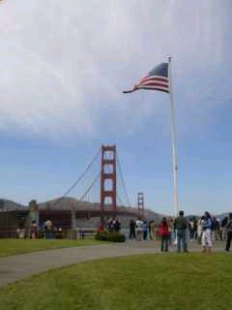
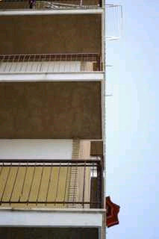
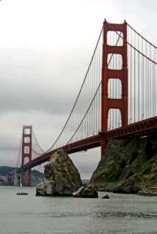
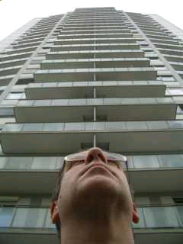
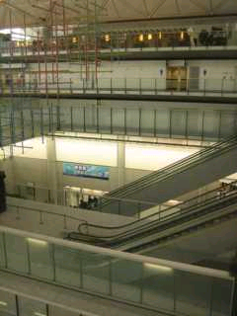
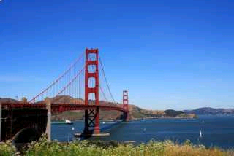
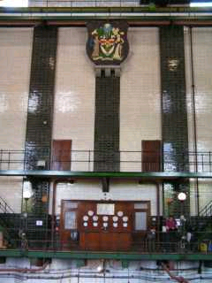
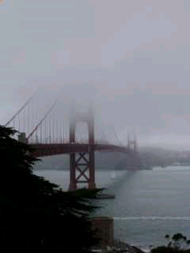
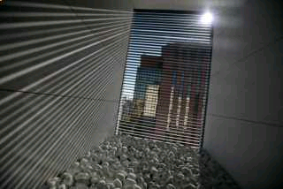
Scoring retrieval quality
Results (ordered):
Database size: 10 images
Relevant (total): 5 images
Query
precision = #relevant / #returned
recall = #relevant / #total relevant
1
0.8
0.6
precision
0.4
0.2
0
0
0.2
0.4
0.6
0.8
1
recall
Slide credit: Ondrej Chum

Slide 35
Vocabulary Trees: hierarchical clustering for large vocabularies
[Nister & Stewenius, CVPR’06]
Slide credit: David Nister
Tree construction:

Slide 36
Vocabulary Tree
[Nister & Stewenius, CVPR’06]
Slide credit: David Nister
Training: Filling the tree

Slide 37
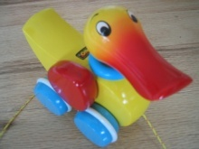

Vocabulary Tree
[Nister & Stewenius, CVPR’06]
Slide credit: David Nister
Training: Filling the tree

Slide 38
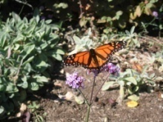

Vocabulary Tree
[Nister & Stewenius, CVPR’06]
Slide credit: David Nister
Training: Filling the tree

Slide 39
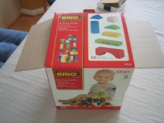

Vocabulary Tree
[Nister & Stewenius, CVPR’06]
Slide credit: David Nister
Training: Filling the tree

Slide 40
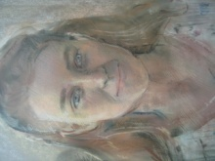

Vocabulary Tree
[Nister & Stewenius, CVPR’06]
Slide credit: David Nister
Training: Filling the tree

Slide 41
What is the computational advantage of the hierarchical representation bag of words, vs. a flat vocabulary?
Notes:
Logarithmic vs. linear

Slide 42
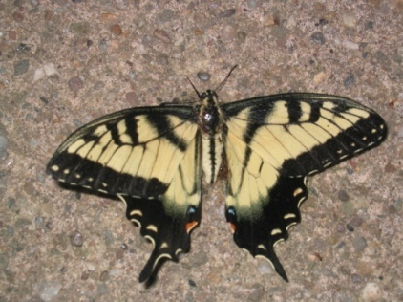
Vocabulary Tree
RANSAC
verification
[Nister & Stewenius, CVPR’06]
Slide credit: David Nister
Recognition

Slide 43
Bags of words: pros and cons
+ flexible to geometry / deformations / viewpoint
+ compact summary of image content
+ provides vector representation for sets
+ good results in practice
basic model ignores geometry – must verify afterwards, or encode via features
background and foreground mixed when bag covers whole image
optimal vocabulary formation remains unclear
Notes:
43

Slide 44
Summary So Far
Matching local invariant features: useful to provide matches to find objects and scenes.
Bag of words representation: quantize feature space to make discrete set of visual words
Inverted index: pre-compute index to enable faster search at query time

Slide 45
Instance recognition
Motivation – visual search
Visual words
  quantization, index, bags of words
Spatial verification
  affine; RANSAC, Hough
Other text retrieval tools
  tf-idf, query expansion
Example applications

Slide 46
Instance recognition: remaining issues
How to summarize the content of an entire image? And gauge overall similarity?
How large should the vocabulary be? How to perform quantization efficiently?
Is having the same set of visual words enough to identify the object/scene? How to verify spatial agreement?
How to score the retrieval results?
Kristen Grauman

Slide 47
Instance recognition: remaining issues
How to summarize the content of an entire image? And gauge overall similarity?
How large should the vocabulary be? How to perform quantization efficiently?
Is having the same set of visual words enough to identify the object/scene? How to verify spatial agreement?
How to score the retrieval results?
Kristen Grauman

Slide 48
Instance recognition: remaining issues
How to summarize the content of an entire image? And gauge overall similarity?
How large should the vocabulary be? How to perform quantization efficiently?
Is having the same set of visual words enough to identify the object/scene? How to verify spatial agreement?
How to score the retrieval results?
Kristen Grauman

Slide 49


Vocabulary size
Results for recognition task with 6347 images
Branching factors
Nister & Stewenius, CVPR 2006
Kristen Grauman

Slide 50
Instance recognition: remaining issues
How to summarize the content of an entire image? And gauge overall similarity?
How large should the vocabulary be? How to perform quantization efficiently?
Is having the same set of visual words enough to identify the object/scene? How to verify spatial agreement?
How to score the retrieval results?
Kristen Grauman

Slide 51


Spatial Verification
Query
Query
DB image with high BoW similarity
DB image with high BoW similarity
Both image pairs have many visual words in common.
Slide credit: Ondrej Chum

Slide 52


Spatial Verification
Query
Query
DB image with high BoW similarity
DB image with high BoW similarity
Only some of the matches are mutually consistent
Slide credit: Ondrej Chum

Slide 53
Spatial Verification: two basic strategies
RANSAC
  Typically sort by BoW similarity as initial filter
  Verify by checking support (inliers) for possible transformations
    e.g., “success” if find a transformation with > N inlier correspondences
Generalized Hough Transform
  Let each matched feature cast a vote on location, scale, orientation of the model object
  Verify parameters with enough votes
Kristen Grauman

Slide 54
RANSAC verification

Slide 55
Recall: Fitting an affine transformation
Approximates viewpoint changes for roughly planar objects and roughly orthographic cameras.

Slide 56
RANSAC verification

Slide 57










Video Google System
Query region
Collect all words within query region
Inverted file index to find relevant frames
Compare word counts
Spatial verification
Sivic & Zisserman, ICCV 2003
Demo online at : http://www.robots.ox.ac.uk/~vgg/research/vgoogle/index.html
Retrieved frames
Kristen Grauman
Notes:
57

Slide 58


Example Applications
Aachen Cathedral
Mobile tourist guide
Self-localization
Object/building recognition
Photo/video augmentation
[Quack, Leibe, Van Gool, CIVR’08]

Slide 59

Application: Large-Scale Retrieval
Query
Results from 5k Flickr images (demo available for 100k set)
[Philbin CVPR’07]

Slide 60

Web Demo: Movie Poster Recognition
50’000 movie
posters indexed
Query-by-image
from mobile phone
available in Switzer-
land
http://www.kooaba.com/en/products_engine.html#

Slide 61


Notes:
http://www.google.com/mobile/goggles

Slide 62
Spatial Verification: two basic strategies
RANSAC
  Typically sort by BoW similarity as initial filter
  Verify by checking support (inliers) for possible transformations
    e.g., “success” if find a transformation with > N inlier correspondences
Generalized Hough Transform
  Let each matched feature cast a vote on location, scale, orientation of the model object
  Verify parameters with enough votes
Kristen Grauman

Slide 63

Voting: Generalized Hough Transform
If we use scale, rotation, and translation invariant local features, then each feature match gives an alignment hypothesis (for scale, translation, and orientation of model in image).
Model
Novel image
Adapted from Lana Lazebnik

Slide 64
Voting: Generalized Hough Transform
A hypothesis generated by a single match may be unreliable,
So let each match vote for a hypothesis in Hough space
Model
Novel image

Slide 65
Gen Hough Transform details (Lowe’s system)
Training phase: For each model feature, record 2D location, scale, and orientation of model (relative to normalized feature frame)
Test phase: Let each match btwn a test SIFT feature and a model feature vote in a 4D Hough space
  Use broad bin sizes of 30 degrees for orientation, a factor of 2 for scale, and 0.25 times image size for location
  Vote for two closest bins in each dimension
Find all bins with at least three votes and perform geometric verification
  Estimate least squares affine transformation
  Search for additional features that agree with the alignment
David G. Lowe. "Distinctive image features from scale-invariant keypoints.” IJCV 60 (2), pp. 91-110, 2004.
Slide credit: Lana Lazebnik

Slide 66




Example result
Background subtract for model boundaries
Objects recognized,
Recognition in spite of occlusion
[Lowe]

Slide 67
Recall: difficulties of voting
Noise/clutter can lead to as many votes as true target
Bin size for the accumulator array must be chosen carefully
In practice, good idea to make broad bins and spread votes to nearby bins, since verification stage can prune bad vote peaks.

Slide 68
Gen Hough vs RANSAC
GHT
Single correspondence -> vote for all consistent parameters
Represents uncertainty in the model parameter space
Linear complexity in number of correspondences and number of voting cells; beyond 4D vote space impractical
Can handle high outlier ratio
RANSAC
Minimal subset of correspondences to estimate model -> count inliers
Represents uncertainty in image space
Must search all data points to check for inliers each iteration
Scales better to high-d parameter spaces
Kristen Grauman

Slide 69
Questions?
See you Thursday!

