Slide 1

Generic object recognition
May 18th, 2017
Yong Jae Lee
UC Davis

Slide 2
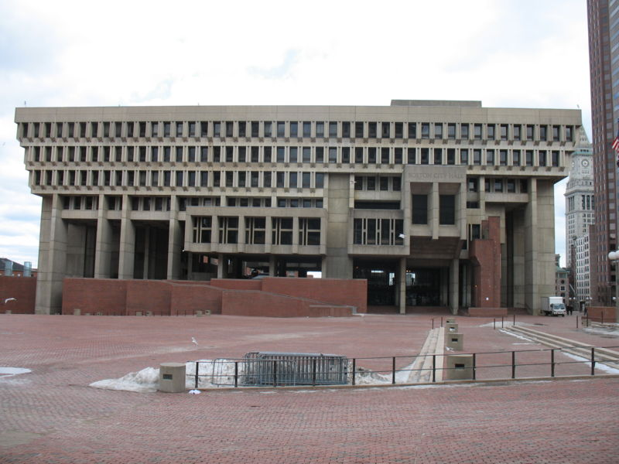
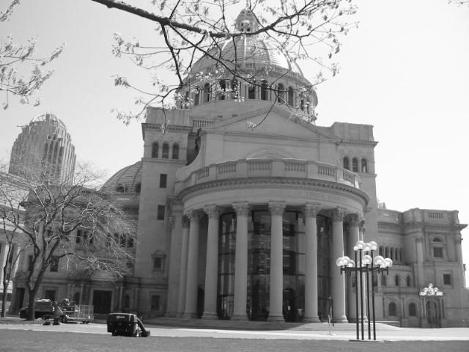
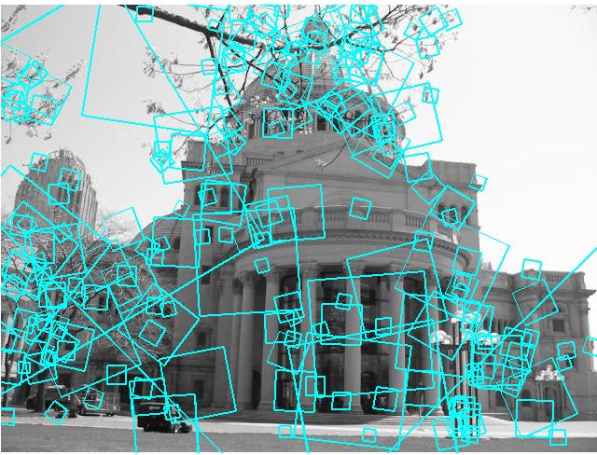
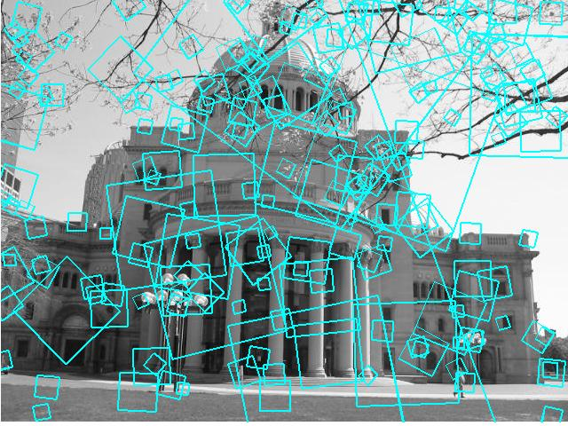
Indexing local features
…
Kristen Grauman

Slide 3
Visual words
Map high-dimensional descriptors to tokens/words by quantizing the feature space
Quantize via clustering, let cluster centers be the prototype “words”
Word #2
Determine which word to assign to each new image region by finding the closest cluster center.
Descriptor’s feature space
Kristen Grauman

Slide 4
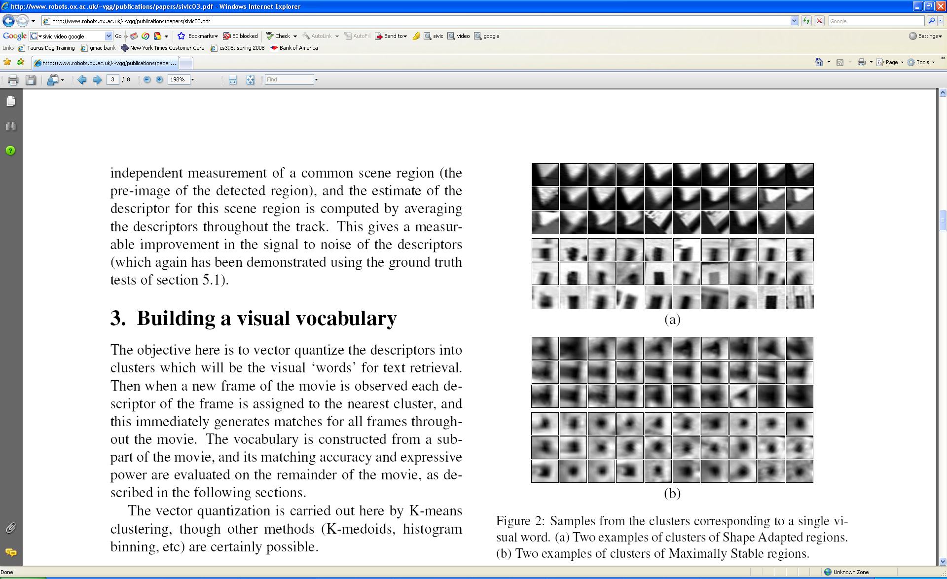
Visual words
Example: each group of patches belongs to the same visual word
Figure from Sivic & Zisserman, ICCV 2003
Kristen Grauman

Slide 5
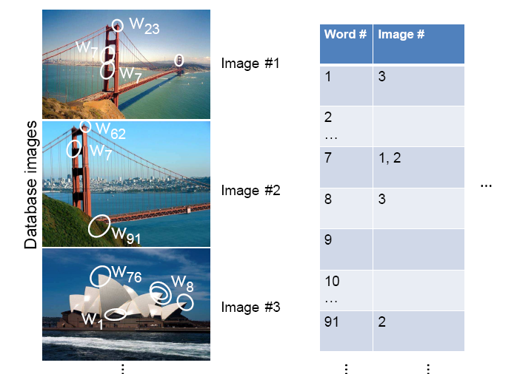
Inverted file index
Database images are loaded into the index mapping words to image numbers
Kristen Grauman

Slide 6
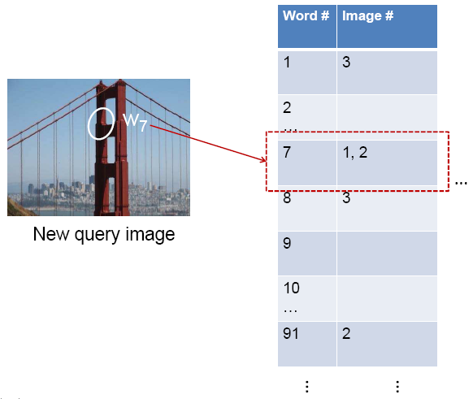
Inverted file index
New query image is mapped to indices of database images that share a word.
Kristen Grauman

Slide 7
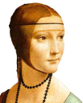









Bags of visual words
Summarize entire image based on its distribution (histogram) of word occurrences.
Analogous to bag of words representation commonly used for documents.
Notes:
7

Slide 8





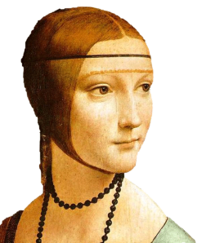
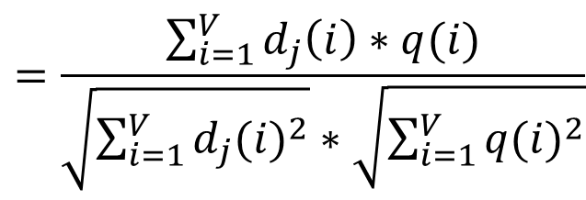
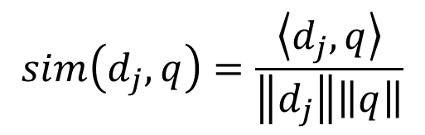
Comparing bags of words
Rank frames by normalized scalar product between their (possibly weighted) occurrence counts---nearest neighbor search for similar images.
[1 8 1 4]
[5 1 1 0]
$$sim\left(d_{j},q\right)=\frac{\left\langle d_{j},q\right\rangle }{\left\|d_{j}\right\|\left\|q\right\|}$$
$$=\frac{\sum_{i=1}^{V}{d_{j}\left(i\right)∗q(i)}}{\sqrt{\sum_{i=1}^{V}{{d_{j}(i)}^{2}}}∗\sqrt{\sum_{i=1}^{V}{{q(i)}^{2}}}}$$
for vocabulary of V words
Kristen Grauman

Slide 9
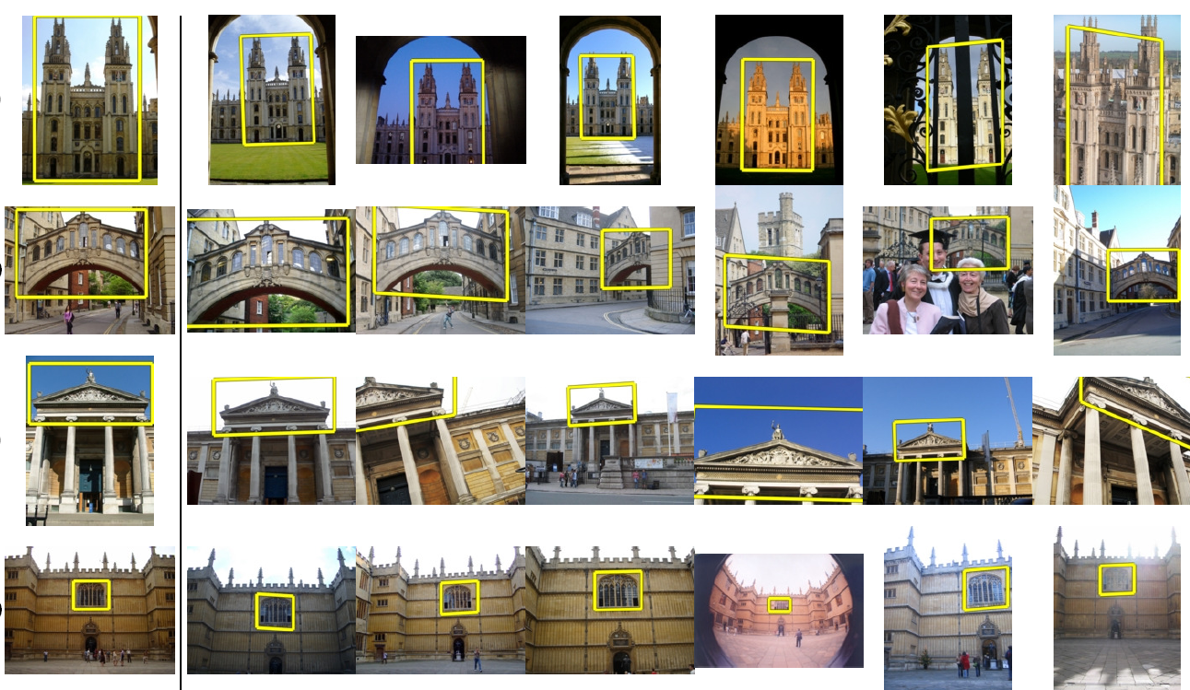
Application: Large-Scale Retrieval
Query
Results from 5k Flickr images (demo available for 100k set)
[Philbin CVPR’07]

Slide 10
Spatial Verification: two basic strategies
RANSAC
  Typically sort by BoW similarity as initial filter
  Verify by checking support (inliers) for possible transformations
    e.g., “success” if find a transformation with > N inlier correspondences
Generalized Hough Transform
  Let each matched feature cast a vote on location, scale, orientation of the model object
  Verify parameters with enough votes
Kristen Grauman

Slide 11
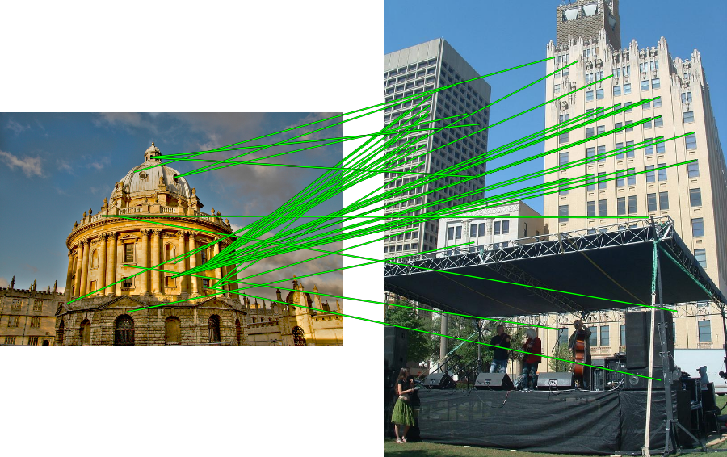
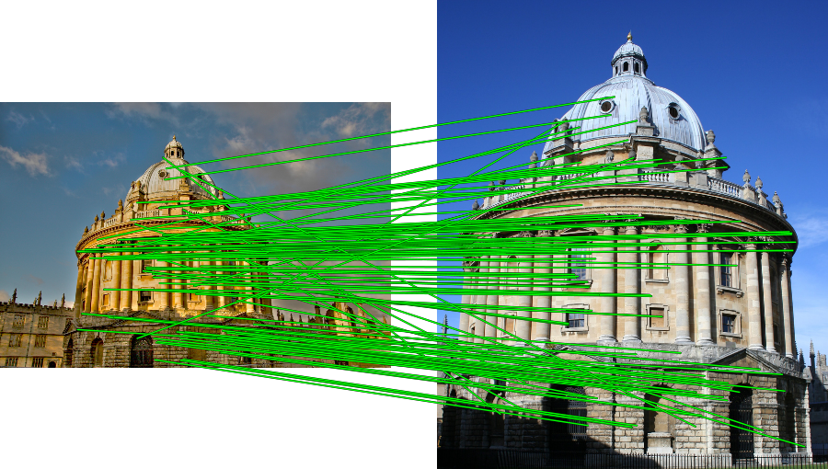
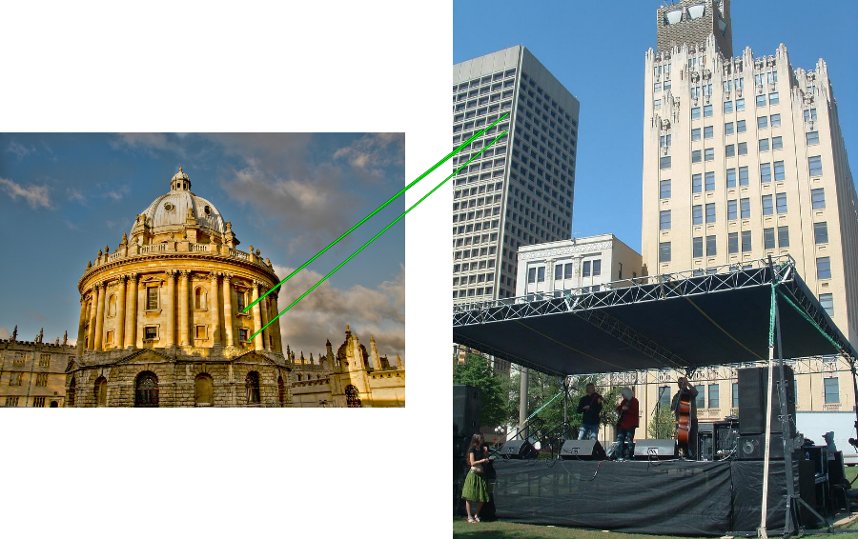
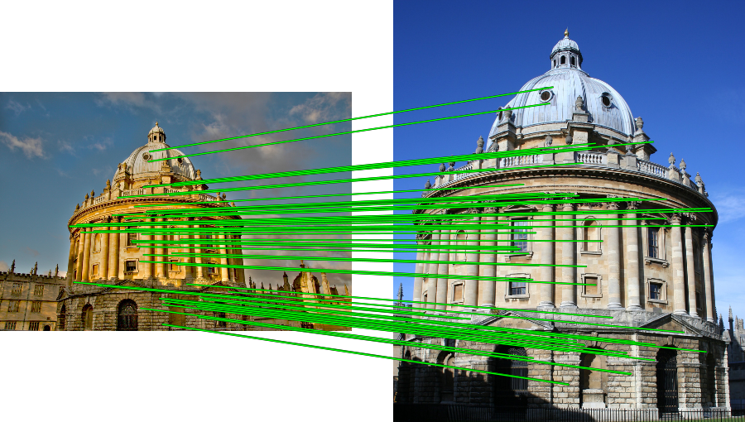
RANSAC verification

Slide 12
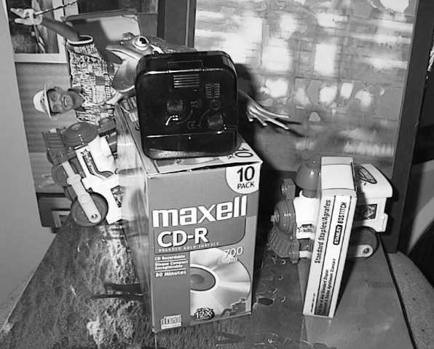
Voting: Generalized Hough Transform
If we use scale, rotation, and translation invariant local features, then each feature match gives an alignment hypothesis (for scale, translation, and orientation of model in image).
Model
Novel image
Adapted from Lana Lazebnik

Slide 13
Voting: Generalized Hough Transform
A hypothesis generated by a single match may be unreliable,
So let each match vote for a hypothesis in Hough space
Model
Novel image

Slide 14
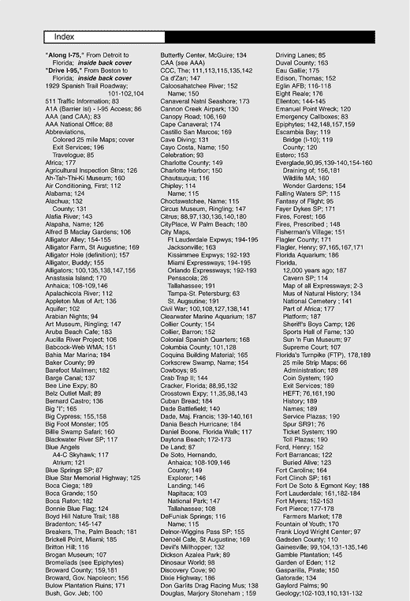

What else can we borrow from text retrieval?
China is forecasting a trade surplus of $90bn (£51bn) to $100bn this year, a threefold increase on 2004's $32bn. The Commerce Ministry said the surplus would be created by a predicted 30% jump in exports to $750bn, compared with a 18% rise in imports to $660bn. The figures are likely to further annoy the US, which has long argued that China's exports are unfairly helped by a deliberately undervalued yuan. Beijing agrees the surplus is too high, but says the yuan is only one factor. Bank of China governor Zhou Xiaochuan said the country also needed to do more to boost domestic demand so more goods stayed within the country. China increased the value of the yuan against the dollar by 2.1% in July and permitted it to trade within a narrow band, but the US wants the yuan to be allowed to trade freely. However, Beijing has made it clear that it will take its time and tread carefully before allowing the yuan to rise further in value.
China, trade,
surplus, commerce,
exports, imports, US,
yuan, bank, domestic,
foreign, increase,
trade, value

Slide 15
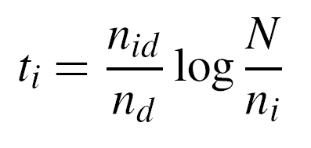
tf-idf weighting
Term frequency – inverse document frequency
Describe frame by frequency of each word within it, downweight words that appear often in the database
(Standard weighting for text retrieval)
Number of occurrences of word i in document d
Total number of documents in database
Number of documents word i occurs in, in whole database
Number of words in document d
Kristen Grauman

Slide 16
Query expansion
Query: golf green
Results:
- How can the grass on the greens at a golf course be so perfect?
For example, a skilled golfer expects to reach the green on a par-four hole in ...
- Manufactures and sells synthetic golf putting greens and mats.
Irrelevant result can cause a `topic drift’:
Volkswagen Golf, 1999, Green, 2000cc, petrol, manual, , hatchback, 94000miles, 2.0 GTi, 2 Registered Keepers, HPI Checked, Air-Conditioning, Front and Rear Parking Sensors, ABS, Alarm, Alloy
Slide credit: Ondrej Chum

Slide 17
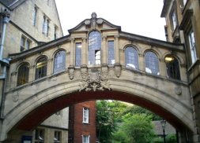
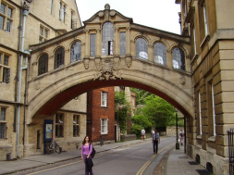
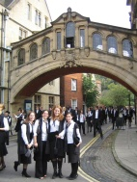
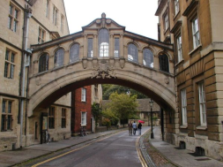
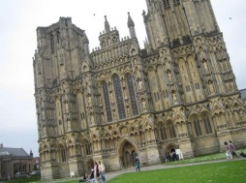
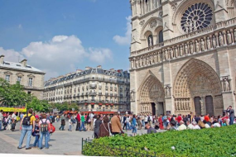
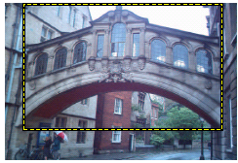
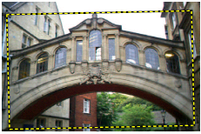
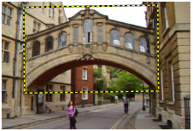
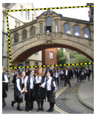
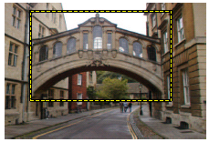
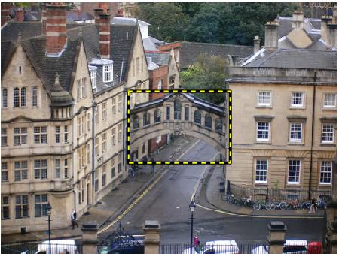
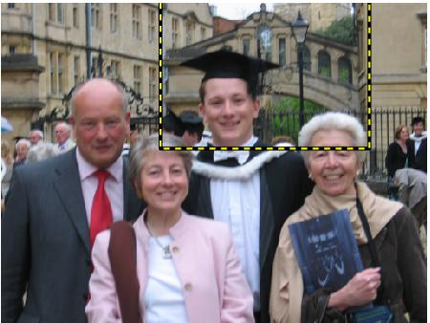
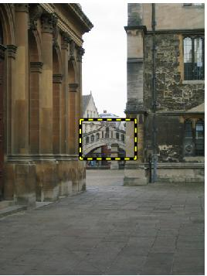
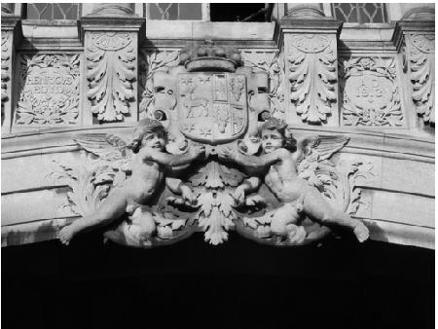
Query expansion
Results
…
Spatial verification
Query image
New results
New query
Chum, Philbin, Sivic, Isard, Zisserman: Total Recall…, ICCV 2007
Slide credit: Ondrej Chum

Slide 18
Recognition via local-feature based alignment
  Pros:
    Effective when we are able to find reliable features within clutter
    Great results for matching specific instances
  Cons:
    Scaling with number of models
    Spatial verification as post-processing – not seamless, expensive for large-scale problems
    Not suited for generic category recognition
Kristen Grauman

Slide 19
Summary
Matching local invariant features
  Useful to find objects and scenes
Bag of words representation: quantize feature space to make discrete set of visual words
  Summarize image by distribution of words
  Index individual words
Inverted index: pre-compute index to enable faster search at query time
Recognition of instances via alignment: matching local features followed by spatial verification
  Robust fitting : RANSAC, GHT
Kristen Grauman

Slide 20


Making the Sky Searchable:
Fast Geometric Hashing for Automated Astrometry
Sam Roweis, Dustin Lang & Keir Mierle
University of Toronto
David Hogg & Michael Blanton
New York University
20

Slide 21
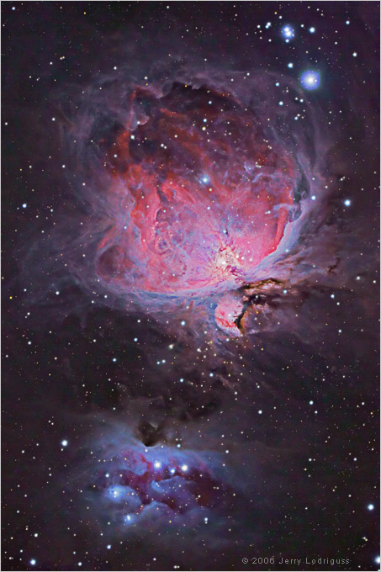
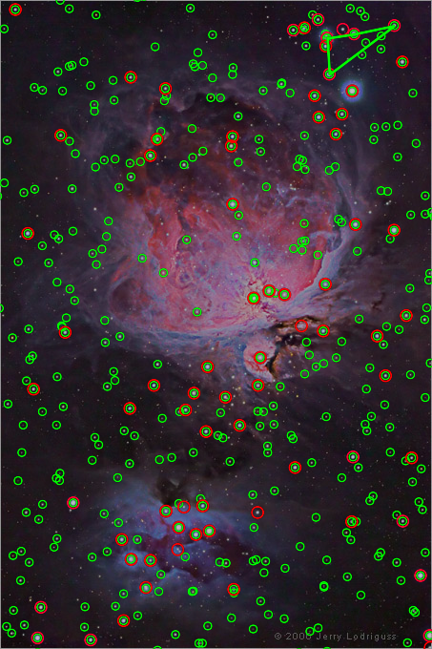
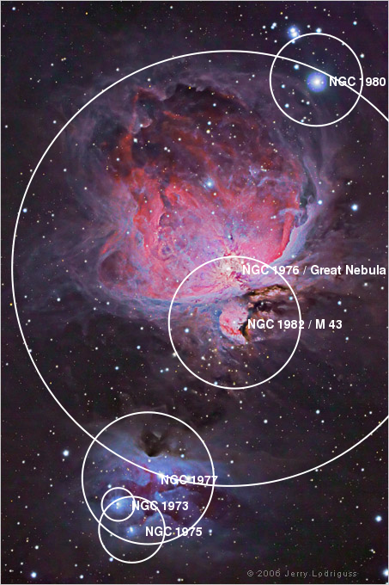
Example
A shot of the Great Nebula, by Jerry Lodriguss (c.2006), from astropix.com
http://astrometry.net/gallery.html
Notes:
http://cosmo.nyu.edu/hogg/research/2006/09/28/astrometry_google.pdf
The red circles are stars the algorithm automatically detects in the image, and the green circles are stars from the master index which appear in the query image.
Nebulae, constellations and other objects can be automatically overlayed on the image after it has been solved.
The features used are the relative positions of nearby quadruples of stars.

Slide 22
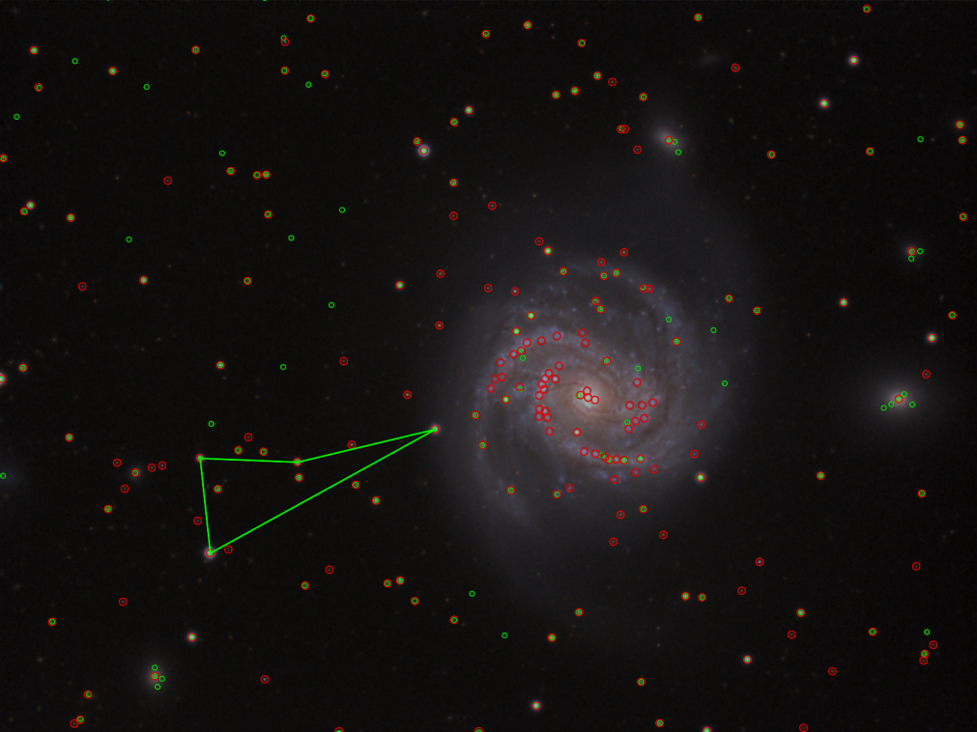
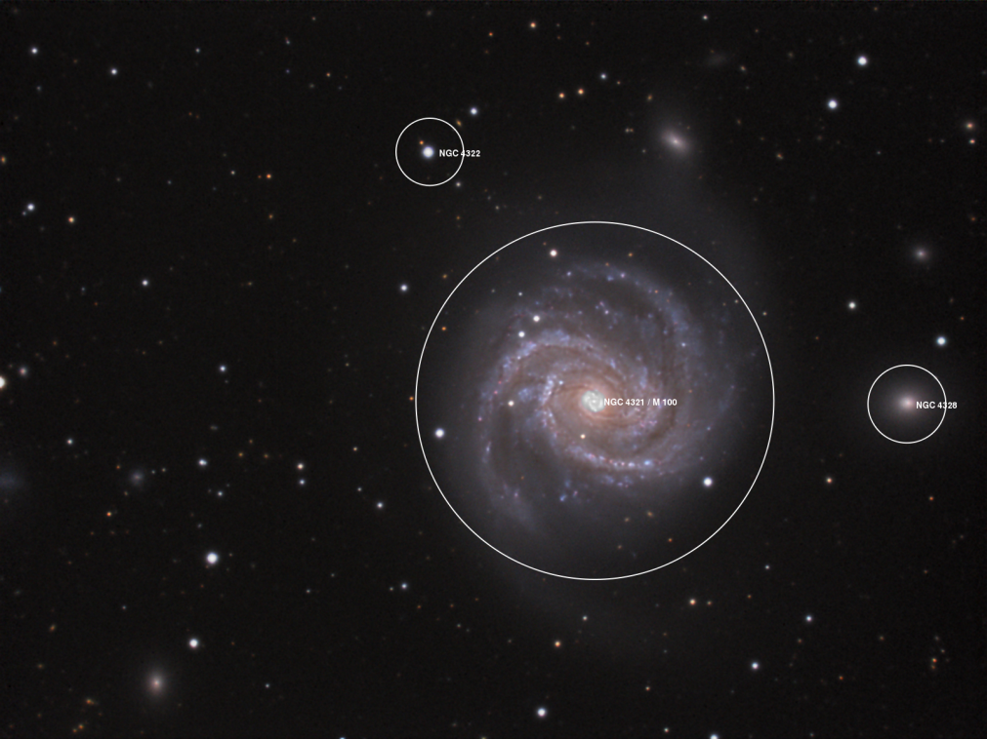
Example
An amateur shot of M100, by Filippo Ciferri (c.2007) from flickr.com
http://astrometry.net/gallery.html

Slide 23
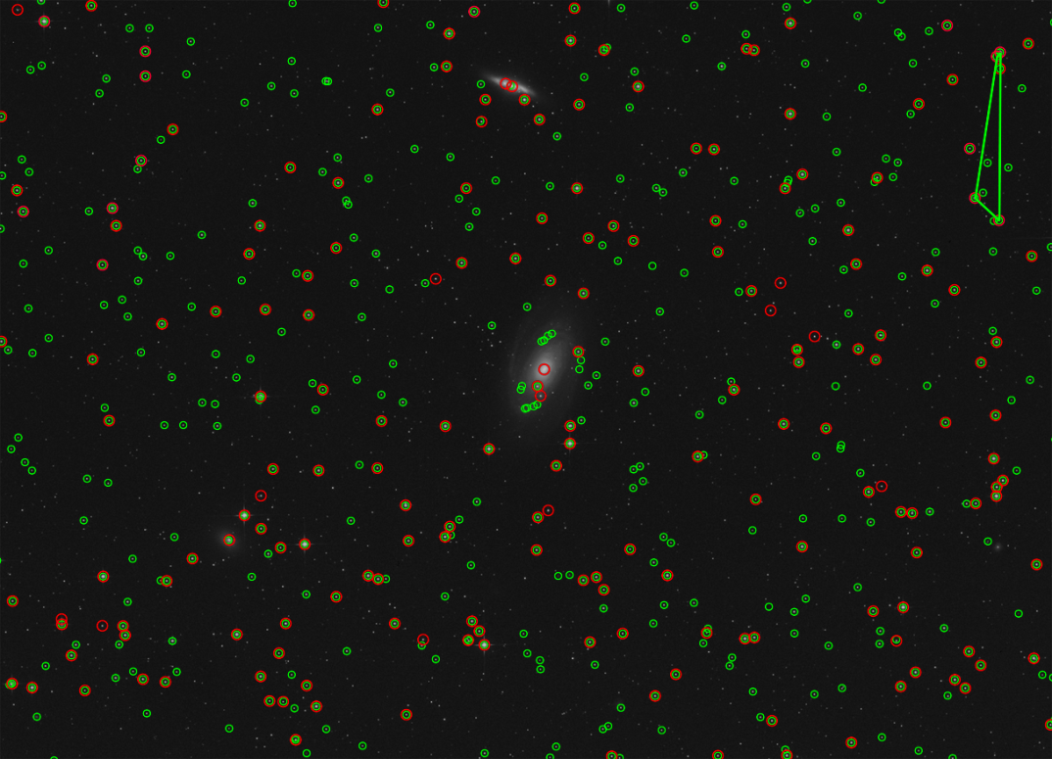
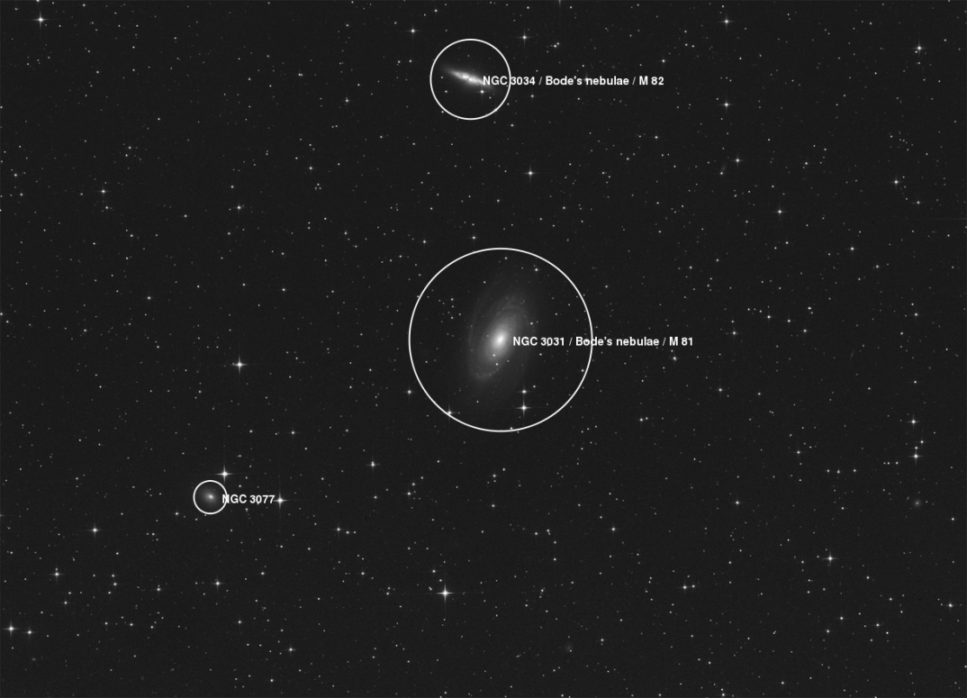
Example
A beautiful image of Bode's nebula (c.2007) by Peter Bresseler, from starlightfriend.de
http://astrometry.net/gallery.html

Slide 24
Today
Generic object recognition

Slide 25
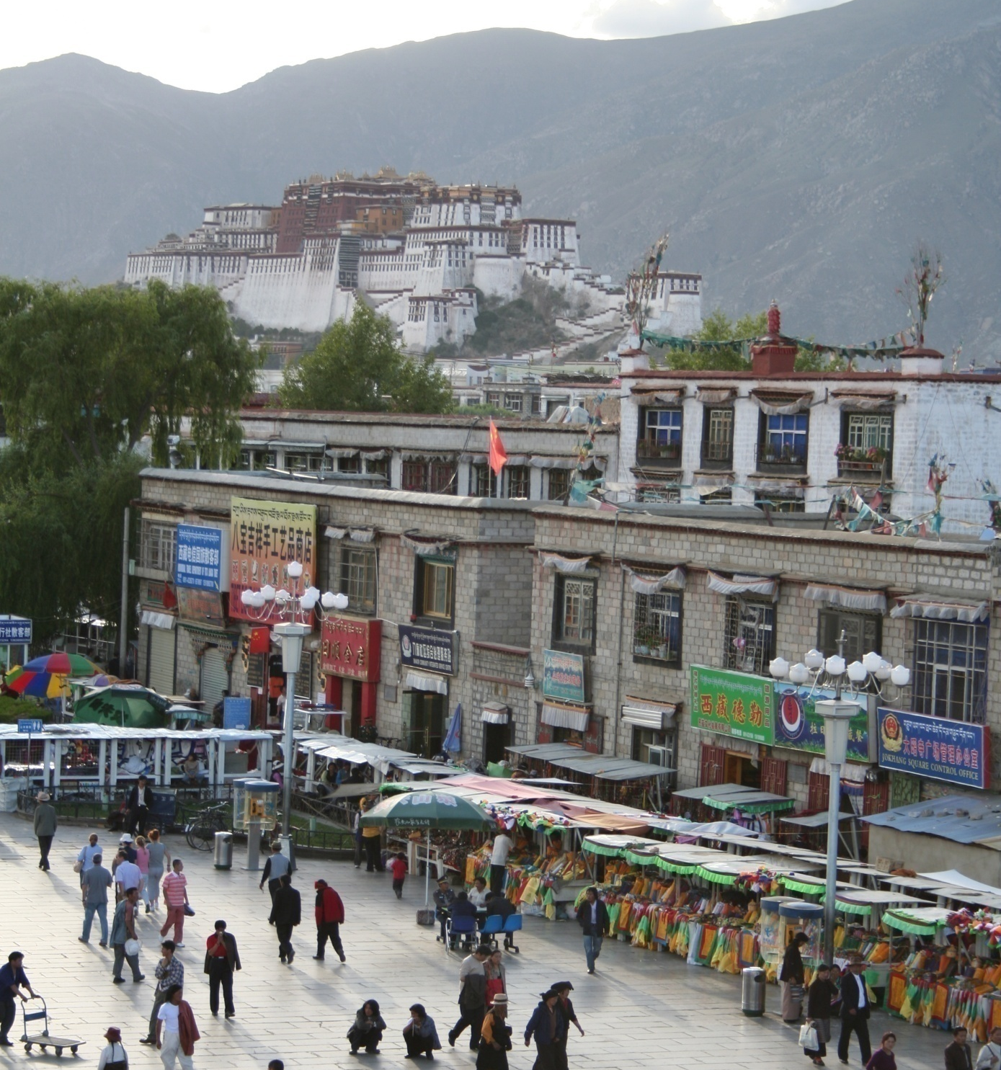
What does recognition involve?
Source: Fei-Fei Li, Rob Fergus, Antonio Torralba.

Slide 26
Verification: is that a lamp?
Source: Fei-Fei Li, Rob Fergus, Antonio Torralba.

Slide 27
Detection: are there people?
Source: Fei-Fei Li, Rob Fergus, Antonio Torralba.

Slide 28
Identification: is that Potala Palace?
Source: Fei-Fei Li, Rob Fergus, Antonio Torralba.

Slide 29
Object categorization
mountain
tree
building
banner
street lamp
vendor
people
Source: Fei-Fei Li, Rob Fergus, Antonio Torralba.

Slide 30
Scene and context categorization
outdoor
city
…
Source: Fei-Fei Li, Rob Fergus, Antonio Torralba.

Slide 31
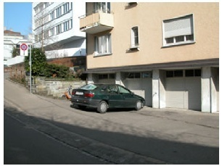
Instance-level recognition problem
John’s car

Slide 32
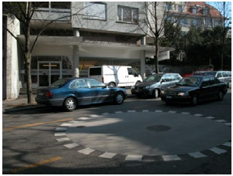
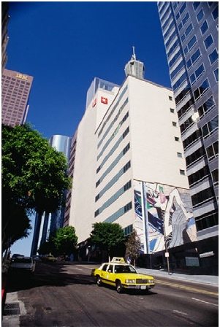
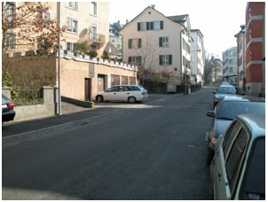
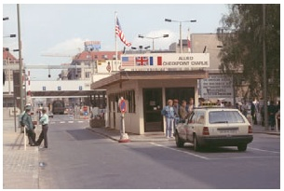
Generic categorization problem

Slide 33
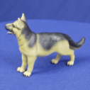
Object Categorization
“Fido”
German
shepherd
dog
animal
living
being
K. Grauman, B. Leibe
Task Description
  “Given a small number of training images of a category, recognize a-priori unknown instances of that category and assign the correct category label.”
Which categories are feasible visually?

Slide 34
Visual Object Categories
Basic Level Categories in human categorization
[Rosch 76, Lakoff 87]
  The highest level at which category members have similar perceived shape
  The highest level at which a single mental image reflects the entire category
  The level at which human subjects are usually fastest at identifying category members
  The first level named and understood by children
  The highest level at which a person uses similar motor actions for interaction with category members
K. Grauman, B. Leibe

Slide 35
Visual Object Categories
…
animal
Abstract
levels
…
…
quadruped
…
Basic level
dog
cat
cow
German
shepherd
Doberman
Individual
level
…
“Fido”
…
K. Grauman, B. Leibe
Basic-level categories in humans seem to be defined predominantly visually.
There is evidence that humans (usually)
start with basic-level categorization
before doing identification.

Slide 36
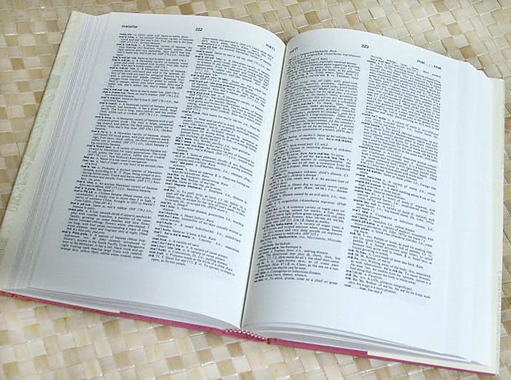

How many object categories are there?
~10,000 to 30,000
Biederman 1987
Source: Fei-Fei Li, Rob Fergus, Antonio Torralba.
Notes:
36

Slide 37
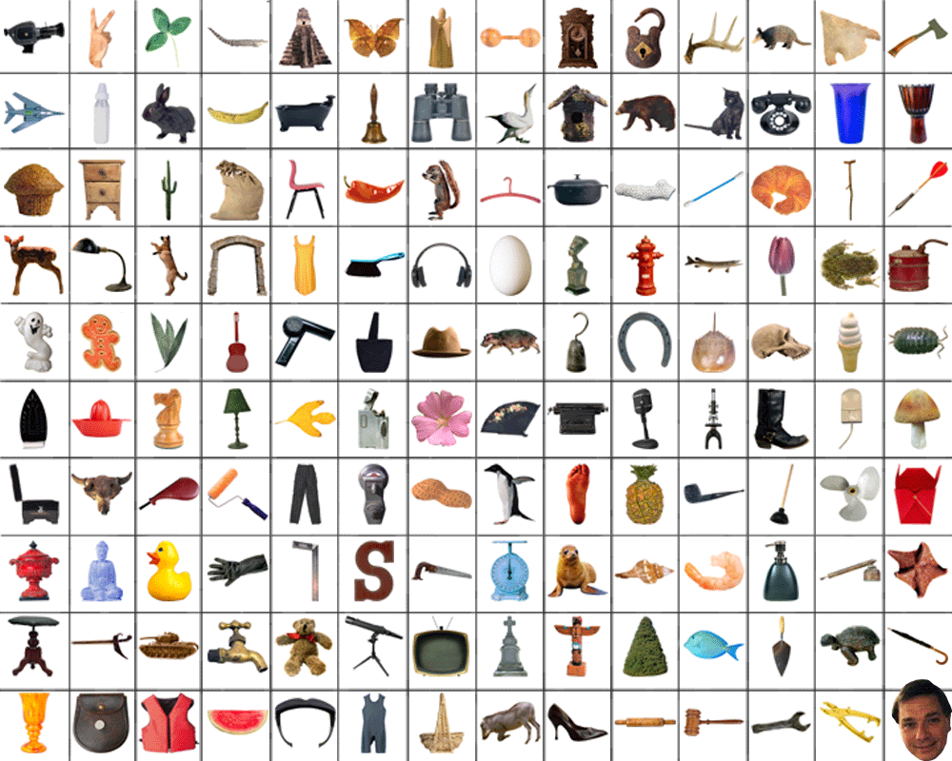
~10,000 to 30,000
Notes:
37

Slide 38







Other Types of Categories
K. Grauman, B. Leibe
Functional Categories
  e.g. chairs = “something you can sit on”

Slide 39






Other Types of Categories
K. Grauman, B. Leibe
Ad-hoc categories
  e.g. “something you can find in an office environment”

Slide 40
Why recognition?
  Recognition a fundamental part of perception
    e.g., robots, autonomous agents
  Organize and give access to visual content
    Connect to information
    Detect trends and themes
Notes:
40

Slide 41





Posing visual queries
Yeh et al., MIT
Belhumeur et al.
Kooaba, Bay & Quack et al.

Slide 42


Autonomous agents able to detect objects

Slide 43

Finding visually similar objects
Notes:
43

Slide 44



Discovering visual patterns
Objects
Sivic & Zisserman
Lee & Grauman
Categories
Actions
Wang et al.
Kristen Grauman

Slide 45


Auto-annotation
Gammeter et al.
T. Berg et al.
Kristen Grauman

Slide 46







Challenges: robustness
Illumination
Object pose
Clutter
Occlusions
Intra-class appearance
Viewpoint
Kristen Grauman

Slide 47
Challenges: robustness
Realistic scenes are crowded, cluttered, have overlapping objects.

Slide 48


Challenges: importance of context
slide credit: Fei-Fei, Fergus & Torralba

Slide 49

Challenges: importance of context

Slide 50






Challenges: complexity
10 billion images
250 billion images
1 billion images served daily
10 billion images
100 hours uploaded per minute
Almost 90% of web traffic is visual!

Slide 51
Challenges: complexity
Thousands to millions of pixels in an image
30+ degrees of freedom in the pose of articulated objects (humans)
About half of the cerebral cortex in primates is devoted to processing visual information [Felleman and van Essen 1991]
Kristen Grauman

Slide 52




























Challenges: learning with minimal supervision
Less
More
Unlabeled, multiple objects
Classes labeled, some clutter
Cropped to object, parts and classes labeled
Kristen Grauman

Slide 53

What works today
Reading license plates, zip codes, checks
Source: Lana Lazebnik
Notes:
53

Slide 54

What works today
Source: Lana Lazebnik
Reading license plates, zip codes, checks
Fingerprint recognition
Notes:
54

Slide 55


What works today
Source: Lana Lazebnik
Reading license plates, zip codes, checks
Fingerprint recognition
Face detection
Notes:
55

Slide 56
What works today
Reading license plates, zip codes, checks
Fingerprint recognition
Face detection
Recognition of flat textured objects (CD covers, book covers, etc.)
Source: Lana Lazebnik
Notes:
56

Slide 57



What works today
Reading license plates, zip codes, checks
Fingerprint recognition
Face detection
Recognition of flat textured objects (CD covers, book covers, etc.)
Recognition of generic categories(*)!
Notes:
57

Slide 58


Progress charted by datasets
Roberts 1963
COIL
1963
…
1996
Slide credit: Kristen Grauman

Slide 59





Progress charted by datasets
MIT-CMU Faces
INRIA Pedestrians
UIUC Cars
1963
…
1996
2000
Slide credit: Kristen Grauman

Slide 60


Progress charted by datasets
MSRC 21 Objects
Caltech-101
Caltech-256
1963
…
1996
2000
2005
Slide credit: Kristen Grauman

Slide 61







Progress charted by datasets
ImageNet
80M Tiny Images
PASCAL VOC
Birds-200
Faces in the Wild
…
1996
2000
2005
2007
2013
1963
2008
Slide credit: Kristen Grauman

Slide 62
Evolution of methods
Hand-crafted models
3D geometry
Hypothesize and align
Hand-crafted features
Learned models
Data-driven
“End-to-end” learning of features and models*,**
* Labeled data availability
** Architecture design decisions, parameters.
Kristen Grauman

Slide 63

Supervised classification
Given a collection of labeled examples, come up with a function that will predict the labels of new examples.
How good is the function we come up with to do the classification?
Depends on
  Mistakes made
  Cost associated with the mistakes
“four”
“nine”
?
Training examples
Novel input
Kristen Grauman

Slide 64
Supervised classification
Given a collection of labeled examples, come up with a function that will predict the labels of new examples.
Consider the two-class (binary) decision problem
  L(4→9): Loss of classifying a 4 as a 9
  L(9→4): Loss of classifying a 9 as a 4
Risk of a classifier s is expected loss:
We want to choose a classifier so as to minimize this total risk
Kristen Grauman

Slide 65
Supervised classification
Optimal classifier will minimize total risk.
At decision boundary, either choice of label yields same expected loss.
Feature value x
If we choose class “four” at boundary, expected loss is:
If we choose class “nine” at boundary, expected loss is:
Kristen Grauman

Slide 66
Supervised classification
Optimal classifier will minimize total risk.
At decision boundary, either choice of label yields same expected loss.
Feature value x
So, best decision boundary is at point x where
To classify a new point, choose class with lowest expected loss; i.e., choose “four” if
Kristen Grauman
Notes:
expected loss of classifying as 4 is less than expected loss of classifying as 9

Slide 67
Supervised classification
Optimal classifier will minimize total risk.
At decision boundary, either choice of label yields same expected loss.
P(4 | x)
P(9 | x)
Feature value x
So, best decision boundary is at point x where
To classify a new point, choose class with lowest expected loss; i.e., choose “four” if
How to evaluate these probabilities?
Kristen Grauman

Slide 68





Probability
Basic probability
  X is a random variable
  P(X) is the probability that X achieves a certain value
  or
  Conditional probability: P(X | Y)
    probability of X given that we already know Y
called a PDF
  probability distribution/density function
continuous X
discrete X
Source: Steve Seitz

Slide 69

Example: learning skin colors
We can represent a class-conditional density using a histogram (a “non-parametric” distribution)
Percentage of skin pixels in each bin
P(x|skin)
Feature x = Hue
P(x|not skin)
Feature x = Hue
Kristen Grauman

Slide 70

Example: learning skin colors
We can represent a class-conditional density using a histogram (a “non-parametric” distribution)
P(x|skin)
Feature x = Hue
Now we get a new image, and want to label each pixel as skin or non-skin.
What’s the probability we care about to do skin detection?
P(x|not skin)
Feature x = Hue
Kristen Grauman

Slide 71
Bayes rule
posterior
likelihood
prior
Where does the prior come from?
Why use a prior?

Slide 72


Example: classifying skin pixels
Now for every pixel in a new image, we can estimate probability that it is generated by skin.
Brighter pixels → higher probability of being skin
Classify pixels based on these probabilities

Slide 73

Example: classifying skin pixels
Gary Bradski, 1998

Slide 74


Example: classifying skin pixels
Using skin color-based face detection and pose estimation as a video-based interface
Gary Bradski, 1998

Slide 75
Supervised classification
Want to minimize the expected misclassification
Two general strategies
  Use the training data to build representative probability model; separately model class-conditional densities and priors (generative)
  Directly construct a good decision boundary, model the posterior (discriminative)

Slide 76
Coming up
Face detection
Categorization with local features and part-based models
Deep convolutional neural networks

Slide 77
Questions?
See you Tuesday!

