Slide 1

Part-based and local feature models for generic object recognition
May 30th, 2017
Yong Jae Lee
UC Davis

Slide 2
Support Vector Machines (SVMs)
Discriminative classifier based on optimal separating line (for 2d case)
Maximize the margin between the positive and negative training examples

Slide 3
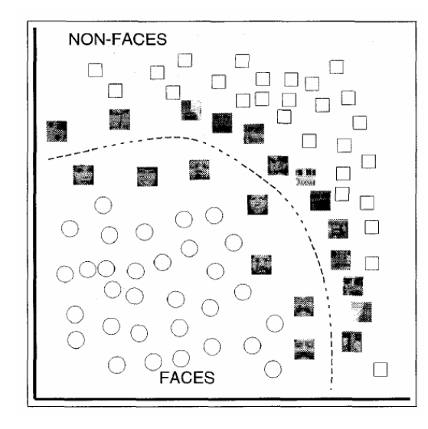
SVMs for recognition
Define your representation for each example.
Select a kernel function.
Compute pairwise kernel values between labeled examples
Use this “kernel matrix” to solve for SVM support vectors & weights.
To classify a new example: compute kernel values between new input and support vectors, apply weights, check sign of output.

Slide 4
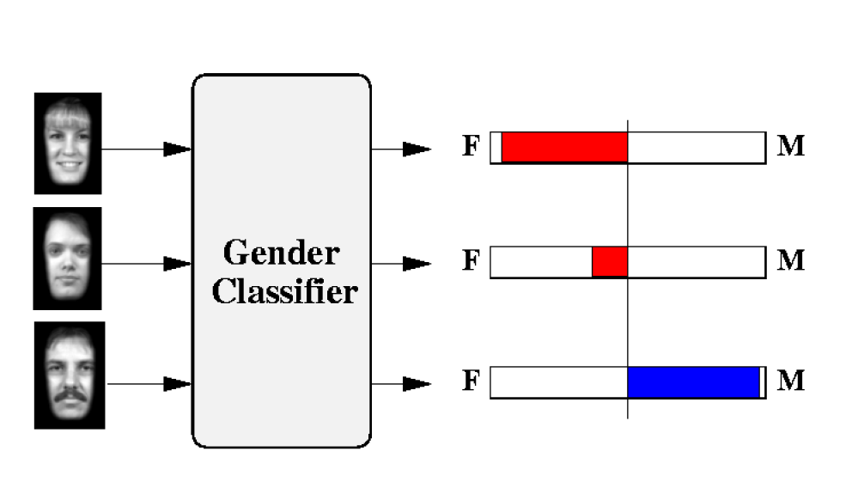
Example: learning gender with SVMs
Moghaddam and Yang, Learning Gender with Support Faces, TPAMI 2002.
Moghaddam and Yang, Face & Gesture 2000.

Slide 5
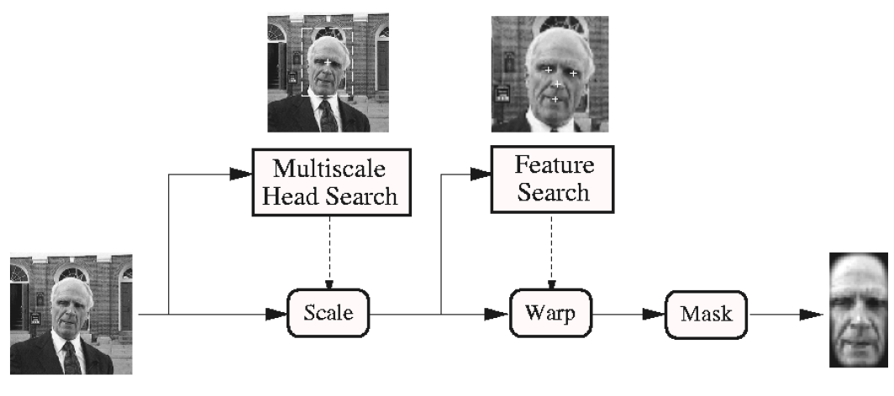
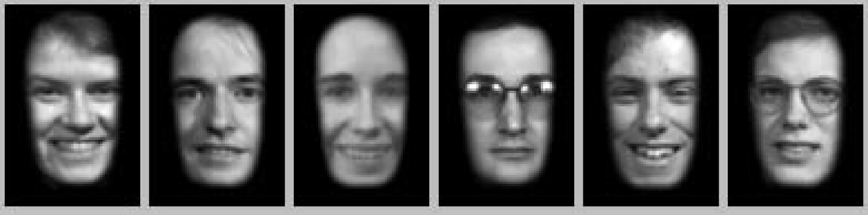
Face alignment processing
Processed faces
Moghaddam and Yang, Learning Gender with Support Faces, TPAMI 2002.

Slide 6
Learning gender with SVMs
Training examples:
  1044 males
  713 females
Experiment with various kernels, select Gaussian RBF

Slide 7
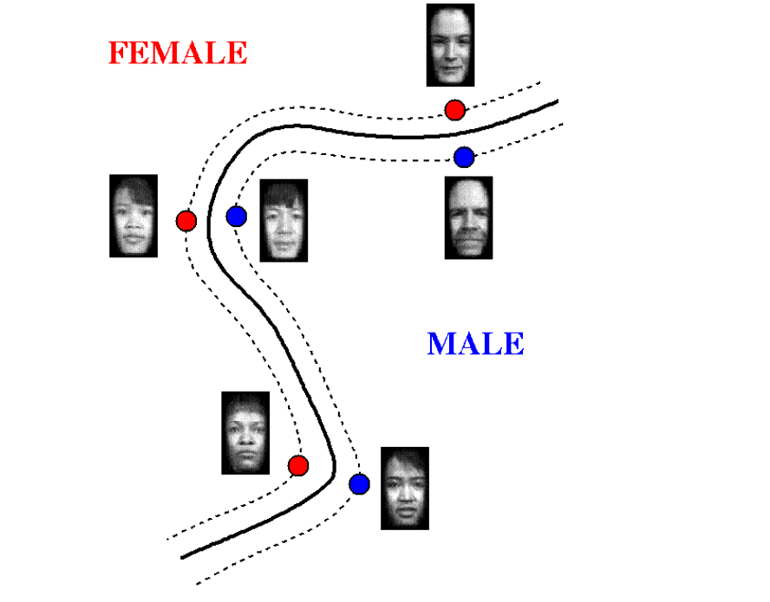
Support Faces
Moghaddam and Yang, Learning Gender with Support Faces, TPAMI 2002.

Slide 8
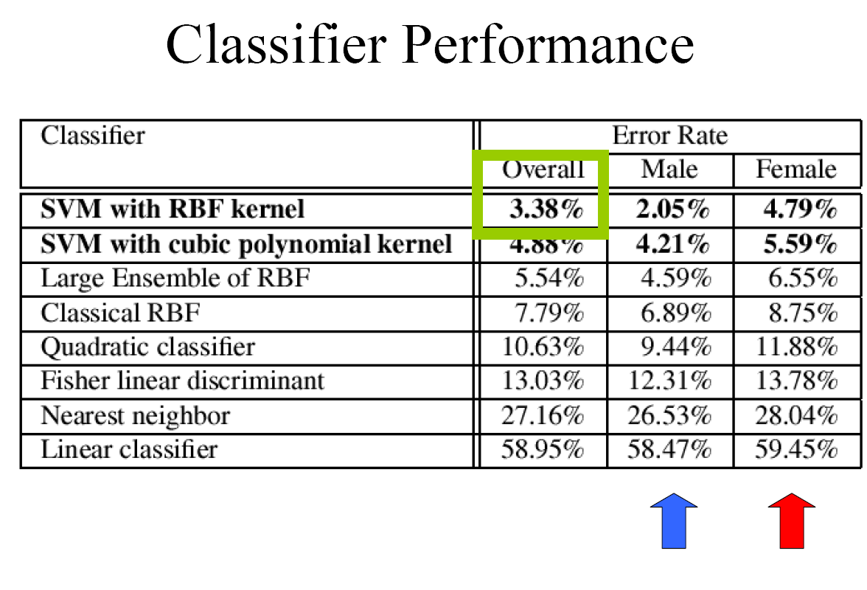
Moghaddam and Yang, Learning Gender with Support Faces, TPAMI 2002.

Slide 9
Gender perception experiment:
How well can humans do?
Subjects:
  30 people (22 male, 8 female)
  Ages mid-20’s to mid-40’s
Test data:
  254 face images
  Low res (6 males, 4 females)
  High res versions
Task:
  Classify as male or female, forced choice
  No time limit
Moghaddam and Yang, Face & Gesture 2000.

Slide 10
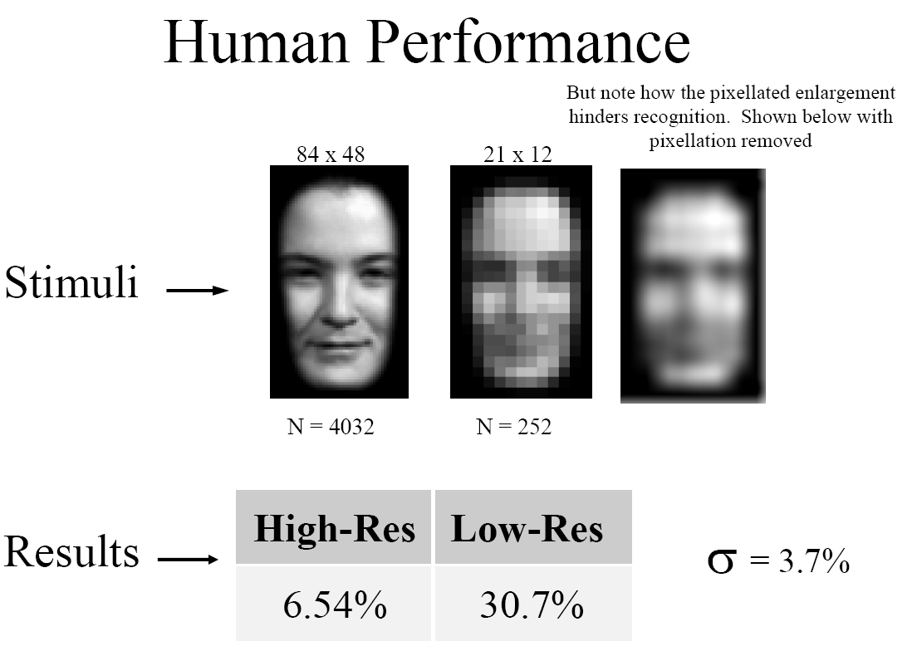
Gender perception experiment:
How well can humans do?
Error
Error
Moghaddam and Yang, Face & Gesture 2000.

Slide 11
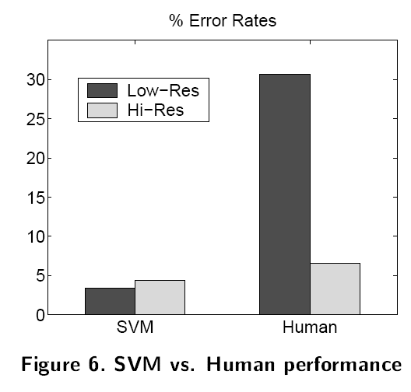
Human vs. Machine
SVMs performed better than any single human test subject, at either resolution

Slide 12
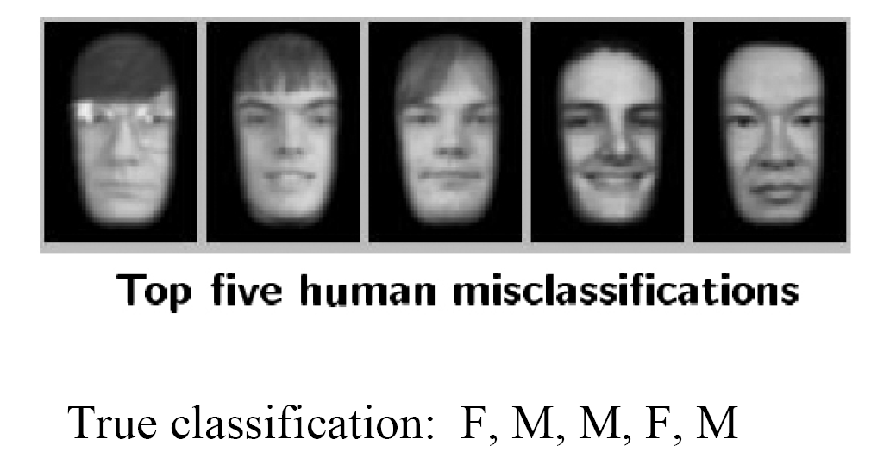
Hardest examples for humans
Moghaddam and Yang, Face & Gesture 2000.

Slide 13
Questions
What if the features are not 2d?
What if the data is not linearly separable?
What if we have more than just two categories?

Slide 14
Multi-class SVMs
Achieve multi-class classifier by combining a number of binary classifiers
One vs. all
  Training: learn an SVM for each class vs. the rest
  Testing: apply each SVM to test example and assign to it the class of the SVM that returns the highest decision value
One vs. one
  Training: learn an SVM for each pair of classes
  Testing: each learned SVM “votes” for a class to assign to the test example

Slide 15
SVMs: Pros and cons
Pros
  Many publicly available SVM packages:
  http://www.kernel-machines.org/software
  http://www.csie.ntu.edu.tw/~cjlin/libsvm/
  Kernel-based framework is very powerful, flexible
  Often a sparse set of support vectors – compact at test time
  Work very well in practice, even with very small training sample sizes
Cons
  No “direct” multi-class SVM, must combine two-class SVMs
  Can be tricky to select best kernel function for a problem
  Computation, memory
    During training time, must compute matrix of kernel values for every pair of examples
    Learning can take a very long time for large-scale problems
Adapted from Lana Lazebnik

Slide 16
Previously
Discriminative classifiers
  Boosting
  Nearest neighbors
  Support vector machines
Useful for object recognition when combined with “window-based” or holistic appearance descriptors

Slide 17
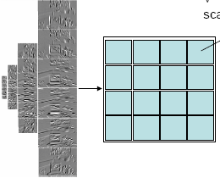
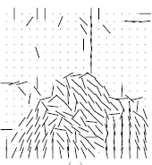

Global window-based appearance representations
Histograms of oriented gradients
Gist
Map of local orientations
These examples are truly global; each pixel in the window contributes to the representation.
Classifier can account for relative relevance…
When might this not be ideal?
Kristen Grauman

Slide 18
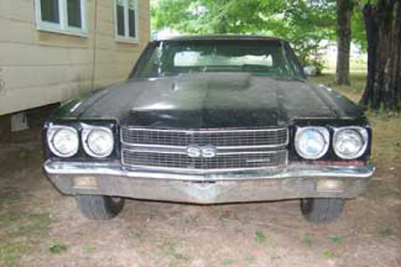
Part-based and local feature models for recognition
Main idea:
Rather than a representation based on holistic appearance, decompose the image into:
local parts or patches, and
their relative spatial relationships
Kristen Grauman
Notes:
While the global object appearance may undergo significant variation inside a category, the appearance and spatial relationship of local parts can often still give important cues. This provides a strong motivation for using part-based models

Slide 19
Part-based and local feature models for recognition
We’ll look at two forms:
Bag of words (no geometry)
Implicit shape model (star graph for spatial model)
Kristen Grauman

Slide 20

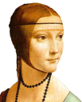



Bag-of-words model
Summarize entire image based on its distribution (histogram) of word occurrences.
  Total freedom on spatial positions, relative geometry.
  Vector representation easily usable by most classifiers.
Kristen Grauman
Notes:
20

Slide 21
Bag-of-words model
Csurka et al. Visual Categorization with Bags of Keypoints, 2004

Slide 22
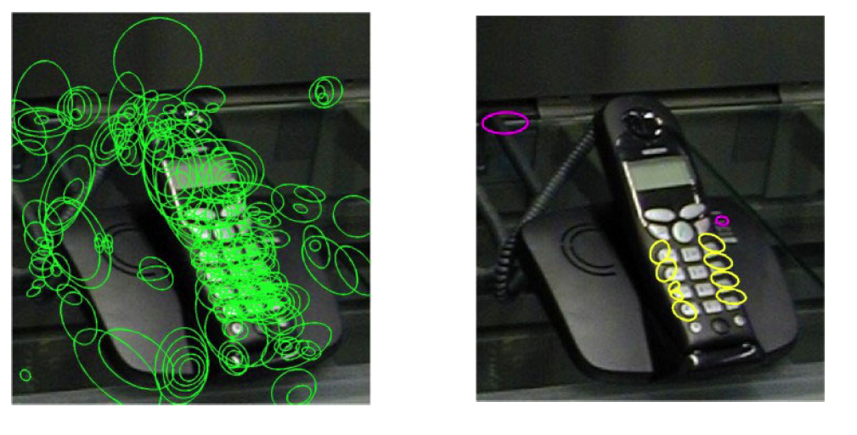
Words as parts
Local features from two selected clusters occurring in this image
All local features
Csurka et al. 2004

Slide 23
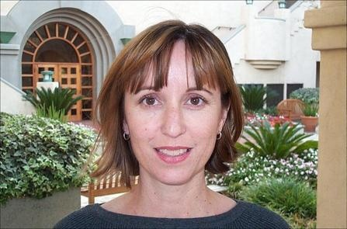
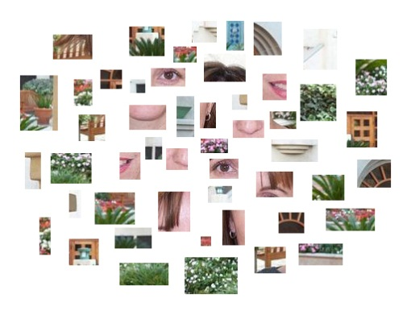

Naïve Bayes model for classification
patches
$$N$$
Object class
decision
Prior prob. of
the object classes
Image likelihood
given the class

Slide 24
Confusion matrix
Example bag of words + Naïve Bayes classification results for generic categorization of objects
Csurka et al. 2004

Slide 25
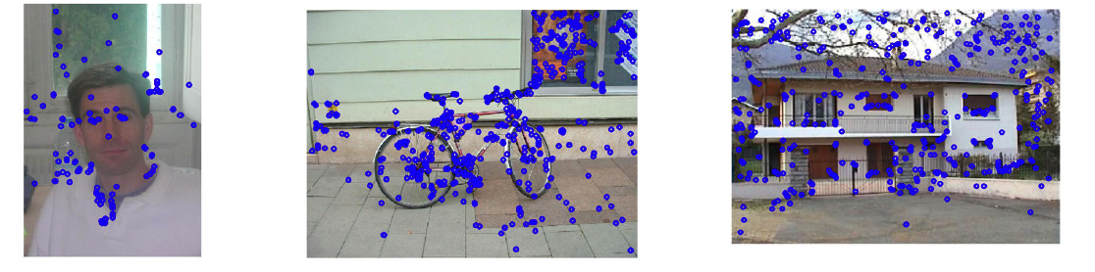
Clutter…or context?
Kristen Grauman

Slide 26
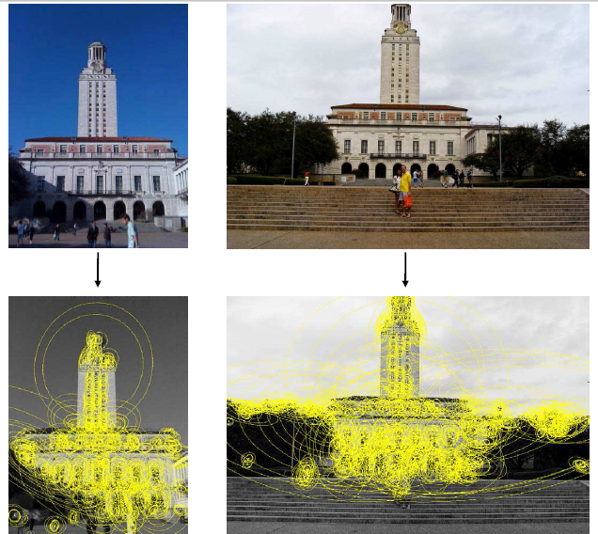
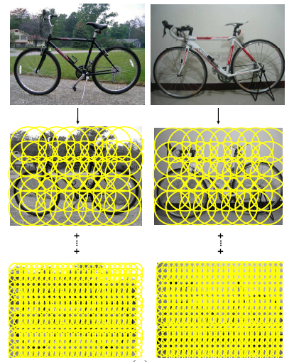
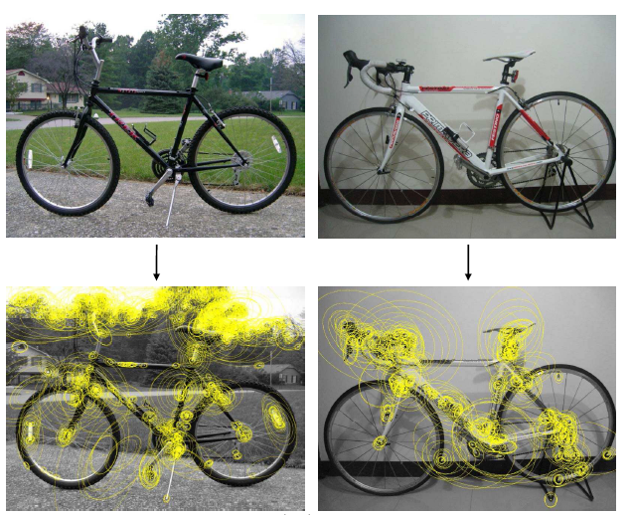
Sampling strategies
Specific object
Category
Kristen Grauman

Slide 27
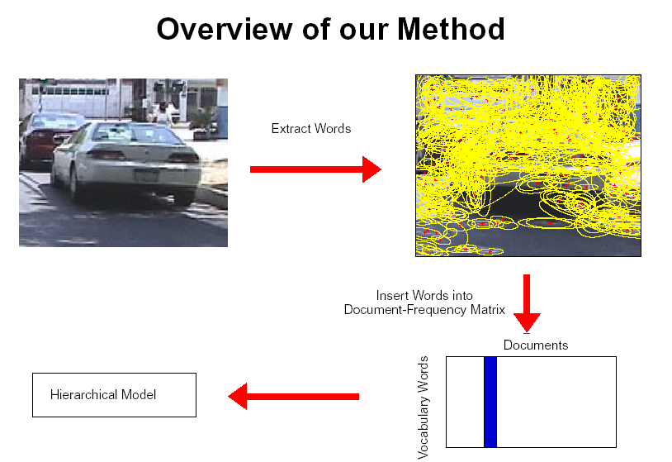
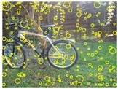
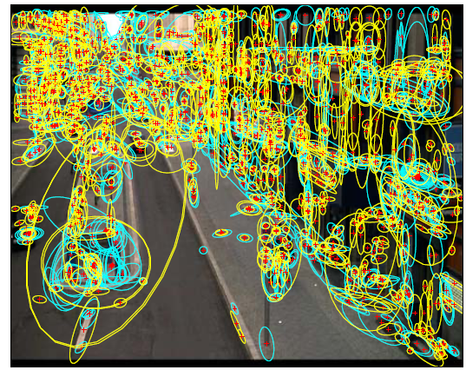
Sampling strategies
Sparse, at interest points
Dense, uniformly
Randomly
To find specific, textured objects, sparse sampling from interest points more reliable.
Multiple complementary interest operators offer more image coverage.
For object categorization, dense sampling offers better coverage.
[See Nowak, Jurie & Triggs, ECCV 2006]
Multiple interest operators
Image credits: F-F. Li, E. Nowak, J. Sivic
Kristen Grauman

Slide 28
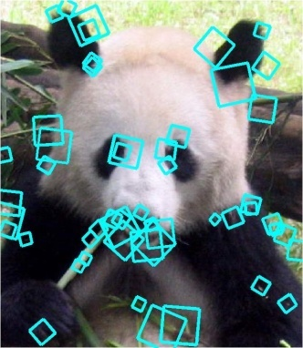
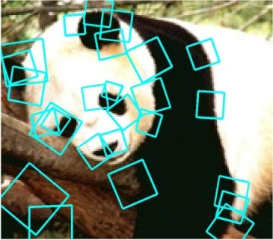


Local feature correspondence for generic object categories
Kristen Grauman

Slide 29
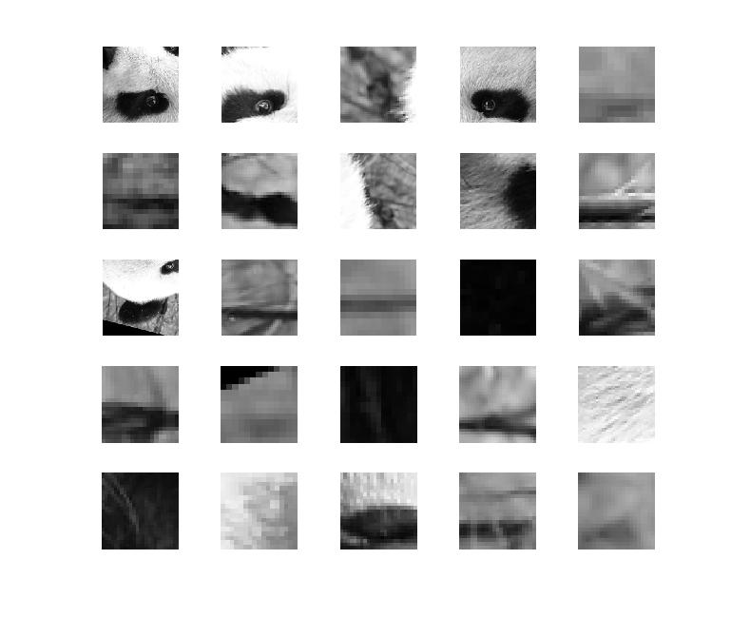
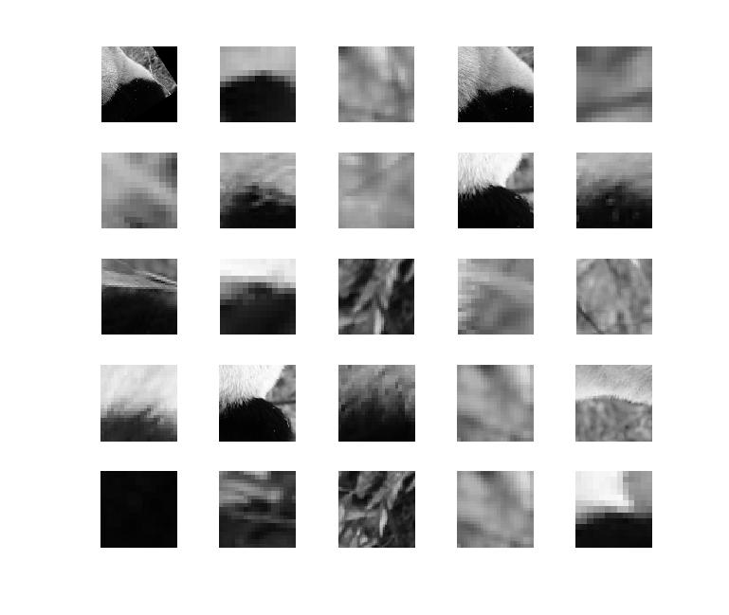
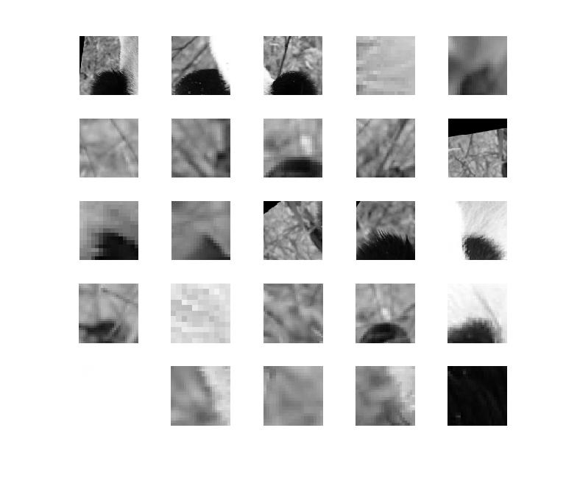
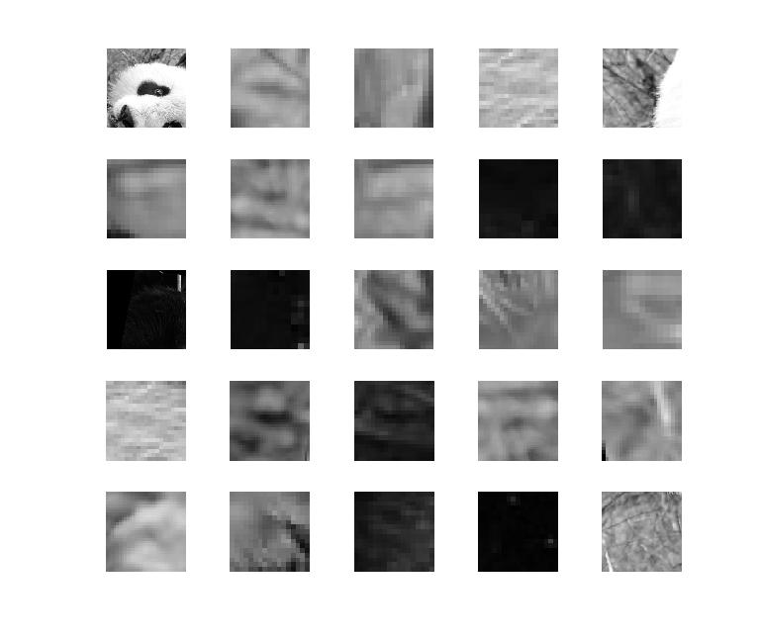
Local feature correspondence for generic object categories
Comparing bags of words histograms coarsely reflects agreement between local “parts” (patches, words).
But choice of quantization directly determines what we consider to be similar…
Kristen Grauman

Slide 30
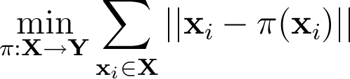
Partially matching sets of features
Optimal match: O(m³)
Greedy match: O(m² log m)
Pyramid match: O(m)
(m=num pts)
We introduce an approximate matching kernel that makes it practical to compare large sets of features based on their partial correspondences.
  [Previous work: Indyk & Thaper, Bartal, Charikar, Agarwal & Varadarajan, …]
Kristen Grauman
Notes:
the optimal partial matching π ∗ pairs each point in X to some unique point in Y such that the total distance between matched points is minimized
For sets with m features, the Hungarian algorithm computes the optimal match in O(m3), which severely limits the practicality of large input sizes

Slide 31
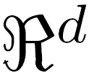
Pyramid match: main idea
Feature space partitions serve to “match” the local descriptors within successively wider regions.
descriptor space
[Grauman & Darrell, ICCV 2005]
Notes:
The key is that the pyramid makes it possible to extract a matching score without computing distances between any of the points in the input sets—the size of the bin that two points share indicates the farthest distance they could be from one another.

Slide 32


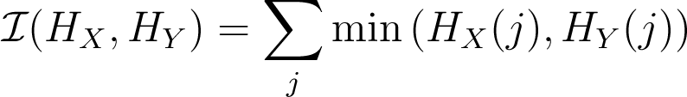

Pyramid match: main idea
Histogram intersection counts number of possible matches at a given partitioning.
[Grauman & Darrell, ICCV 2005]

Slide 33
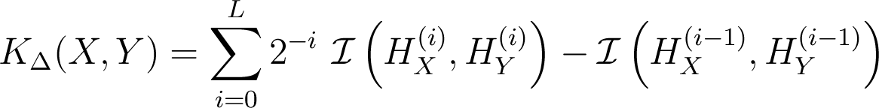
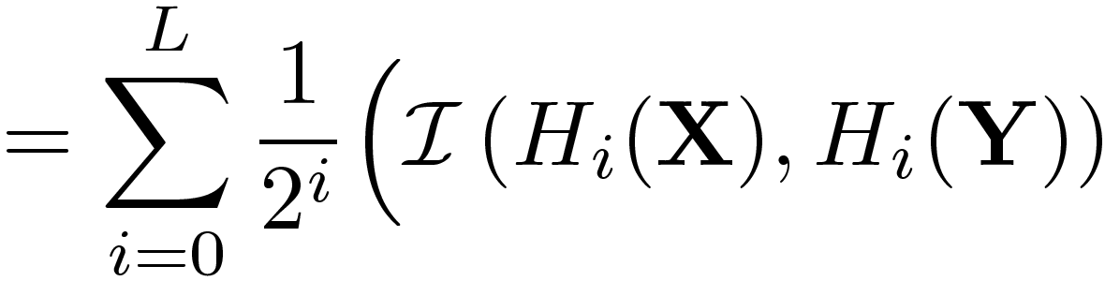
Pyramid match kernel
measures difficulty of a match at level
number of newly matched pairs at level
For similarity, weights inversely proportional to bin size (or may be learned)
[Grauman & Darrell, ICCV 2005]
Notes:
similarity between vectors at a finer resolution—where features are more distinct—is rewarded more heavily than similarity between vectors at a coarser level.
Normalize these kernel values to avoid favoring large sets

Slide 34
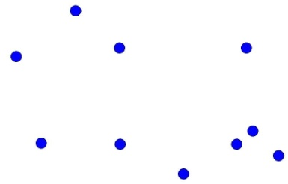






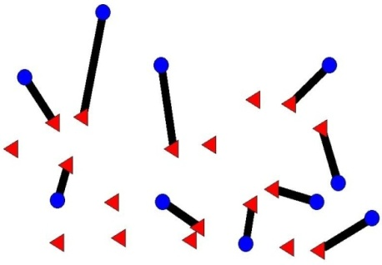

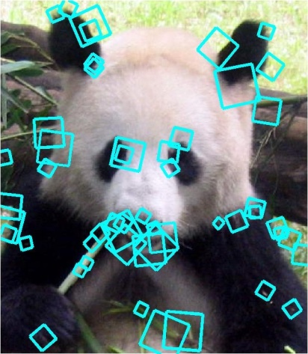
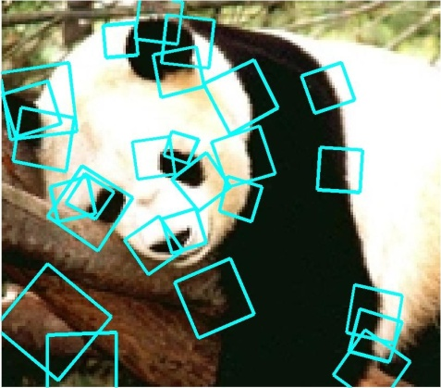


Pyramid match kernel
Optimal match: O(m³)
Pyramid match: O(mL)
optimal partial matching
[Grauman & Darrell, ICCV 2005]

Slide 35
Highlights of the pyramid match
Linear time complexity
Formal bounds on expected error
Mercer kernel: can be used in non-linear SVMs
Data-driven partitions allow accurate matches even in high-dim. feature spaces
Strong performance on benchmark object recognition datasets
Kristen Grauman
Notes:
can be used within a number of existing kernel-based machine learning methods, including SVMs.

Slide 36
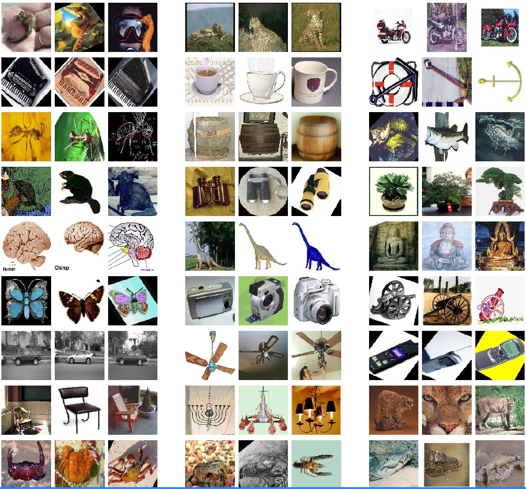
Example recognition results:
Caltech-101 dataset
101 categories 40-800 images per class
Data provided by Fei-Fei, Fergus, and Perona

Slide 37
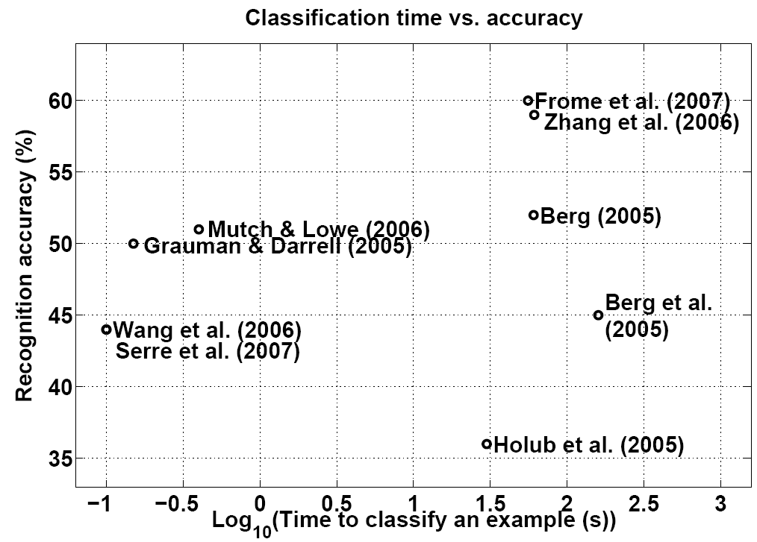
Recognition results:
Caltech-101 dataset
Jain, Huynh, & Grauman (2007)

Slide 38

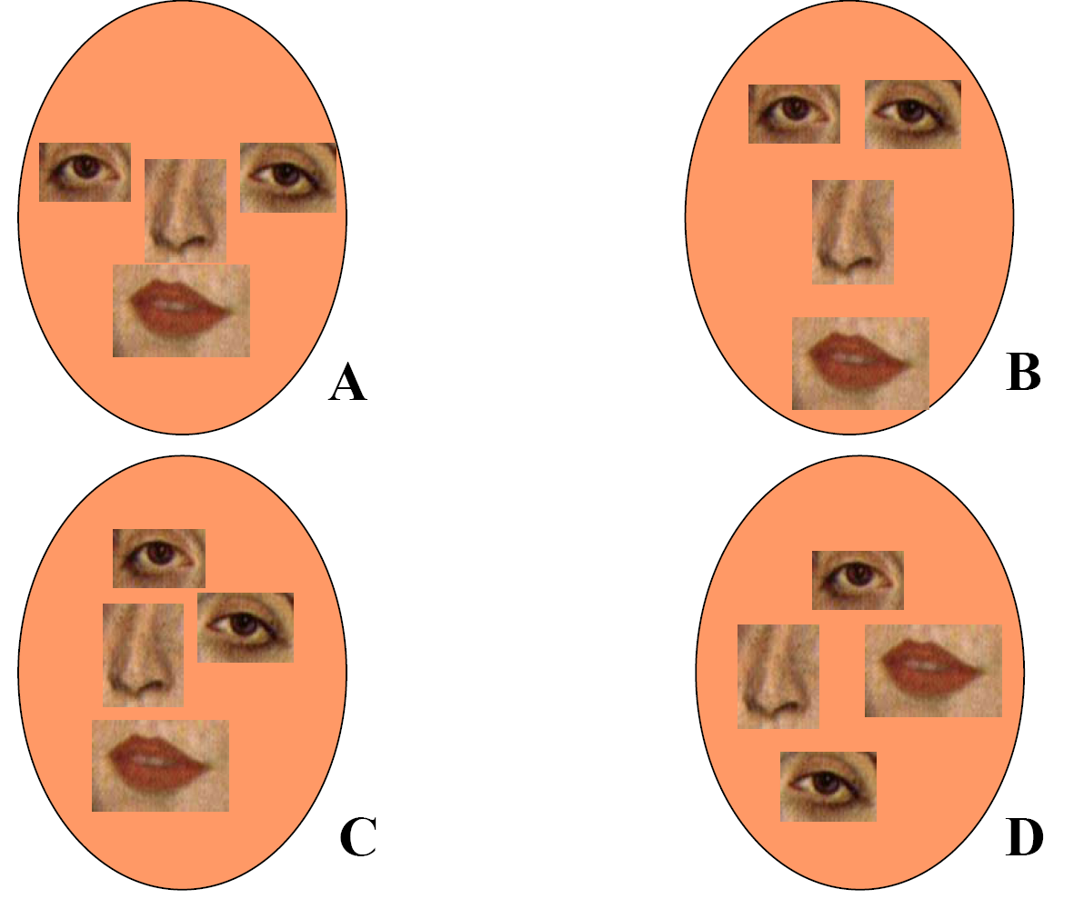
Unordered sets of local features:
No spatial layout preserved!
Too much?
Too little?

Slide 39
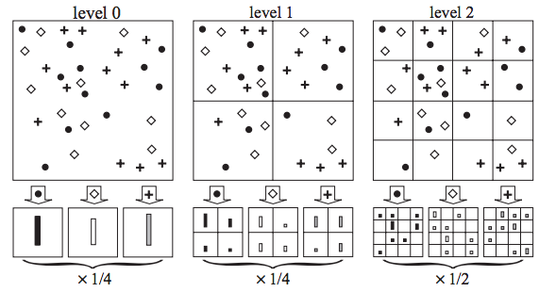
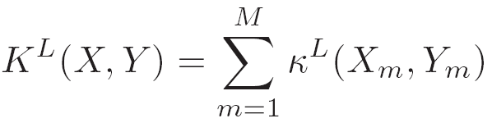
Spatial pyramid match
Make a pyramid of bag-of-words histograms.
Provides some loose (global) spatial layout information
Sum over PMKs computed in image coordinate space, one per word.
[Lazebnik, Schmid & Ponce, CVPR 2006]
Kristen Grauman

Slide 40
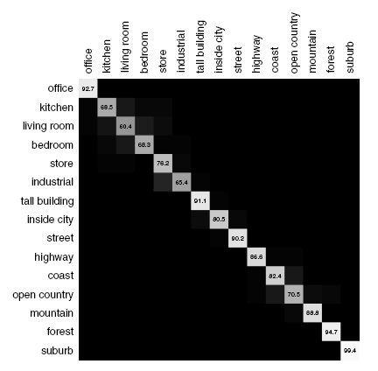
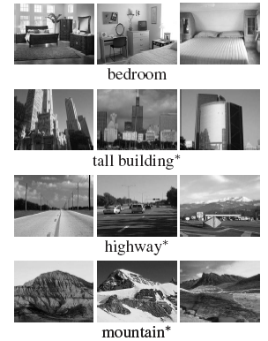
Spatial pyramid match
Captures scene categories well---texture-like patterns but with some variability in the positions of all the local pieces.
Confusion matrix
Kristen Grauman

Slide 41
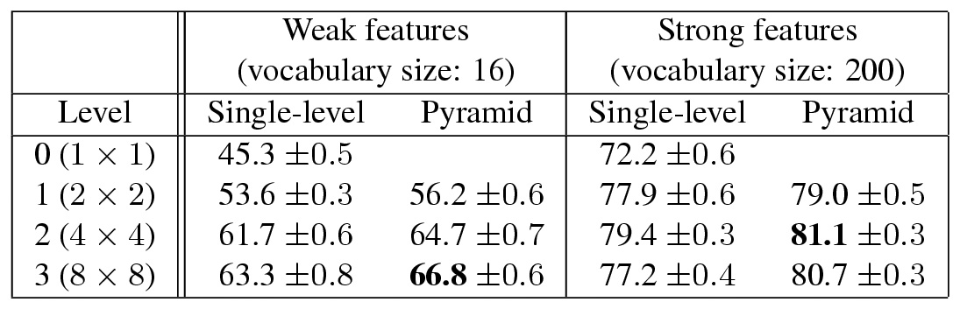
Spatial pyramid match
Captures scene categories well---texture-like patterns but with some variability in the positions of all the local pieces.
Kristen Grauman

Slide 42
Part-based and local feature models for recognition
We’ll look at two forms:
Bag of words (no geometry)
Implicit shape model (star graph for spatial model)
Kristen Grauman

Slide 43
Shape representation in part-based models
“Star” shape model
x₁
x₆
x₂
x₅
x₃
x₄
e.g. implicit shape model
Parts mutually independent
N image features, P parts in the model
Notes:
each part’s location only depends on a central reference part. Given this reference position, each part is treated independently of the others.
Since each feature is treated independently from all others given the position of the object center, we can learn separate relative location distributions for each of them.

Slide 44

Implicit shape models
Visual vocabulary is used to index votes for object position [a visual word = “part”]
visual codeword with
displacement vectors
training image annotated with object localization info
B. Leibe, A. Leonardis, and B. Schiele, Combined Object Categorization and Segmentation with an Implicit Shape Model, ECCV Workshop on Statistical Learning in Computer Vision 2004

Slide 45
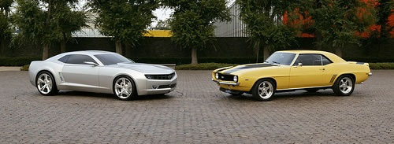
Implicit shape models
Visual vocabulary is used to index votes for object position [a visual word = “part”]
test image
B. Leibe, A. Leonardis, and B. Schiele, Combined Object Categorization and Segmentation with an Implicit Shape Model, ECCV Workshop on Statistical Learning in Computer Vision 2004

Slide 46
Implicit shape models: Training
Build vocabulary of patches around extracted interest points using clustering

Slide 47
Implicit shape models: Training
Build vocabulary of patches around extracted interest points using clustering
Map the patch around each interest point to closest visual word

Slide 48
Implicit shape models: Training
Build vocabulary of patches around extracted interest points using clustering
Map the patch around each interest point to closest visual word
For each visual word, store all positions it was found, relative to object center

Slide 49
Implicit shape models: Testing
Given new test image, extract patches, match to vocabulary words
Cast votes for possible positions of object center
Search for maxima in voting space
(Extract weighted segmentation mask based on stored masks for the codebook occurrences)
What is the dimension of the Hough space?

Slide 50
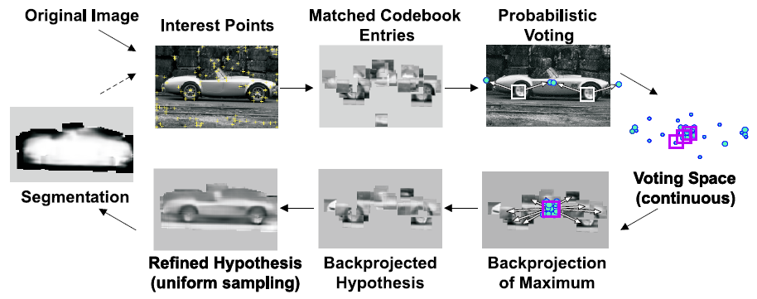
Implicit shape models: Testing
Notes:
we can refine the hypothesis by sampling all the image patches in its surroundings, not just those locations returned by the interest point detector.

Slide 51
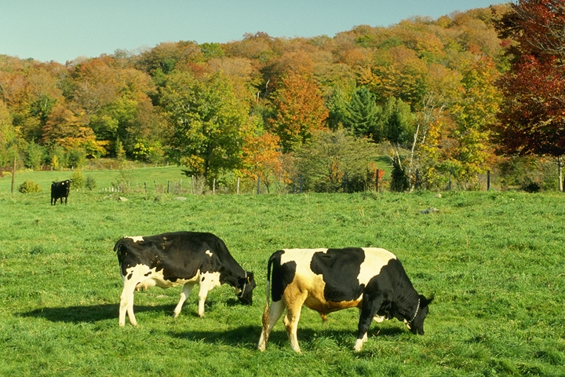
Example: Results on Cows
Original image

Slide 52
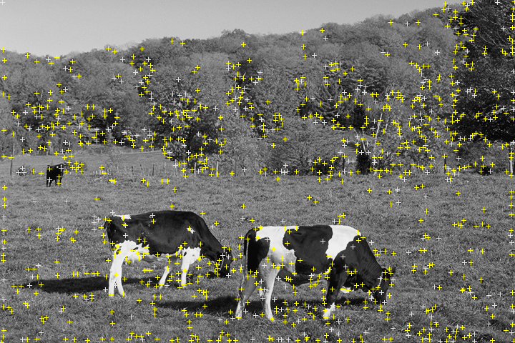
Example: Results on Cows
Original image
Interest points

Slide 53

Example: Results on Cows
Original image
Interest points
Matched patches

Slide 54

Example: Results on Cows
Original image
Interest points
Votes
Matched patches

Slide 55

Example: Results on Cows
1st hypothesis

Slide 56

Example: Results on Cows
2nd hypothesis

Slide 57

Example: Results on Cows
3rd hypothesis

Slide 58
Detection Results
Qualitative Performance
  Recognizes different kinds of objects
  Robust to clutter, occlusion, noise, low contrast

Slide 59
Scoring a sliding window detector
If prediction and ground truth are bounding boxes, when do we have a correct detection?
Kristen Grauman

Slide 60

Scoring a sliding window detector
We’ll say the detection is correct (a “true positive”) if the intersection of the bounding boxes, divided by their union, is > 50%.
Kristen Grauman

Slide 61

Scoring an object detector
If the detector can produce a confidence score on the detections, then we can plot its precision vs. recall as a threshold on the confidence is varied.
Average Precision (AP): mean precision across recall levels.

Slide 62
Shape representation in part-based models
“Star” shape model
Fully connected constellation model
x₁
x₁
x₆
x₂
x₆
x₂
x₅
x₃
x₅
x₃
x₄
x₄
e.g. implicit shape model
Parts mutually independent
Recognition complexity: O(NP)
Method: Gen. Hough Transform
e.g. Constellation Model
Parts fully connected
Recognition complexity: O(N^{P})
Method: Exhaustive search
N image features, P parts in the model
Slide credit: Rob Fergus

Slide 63
Summary: part-based and local feature models for generic object recognition
Histograms of visual words to capture global or local layout in the bag-of-words framework
  Pyramid match kernels
  Powerful in practice for image recognition
Part-based models encode category’s part appearance together with 2d layout and allow detection within cluttered image
  “implicit shape model”: shape based on layout of all parts relative to a reference part; Generalized Hough for detection

Slide 64





Recognition models
Instances:
recognition by alignment
Categories:
Holistic appearance models (and sliding window detection)
Categories:
Local feature and part-based models
Kristen Grauman

Slide 65
Questions?
See you Tuesday!

