Slide 1
Hide-and-Seek: Forcing a Network to be Meticulous for Weakly-supervised Object and Action Localization
Krishna Kumar Singh, Yong Jae Lee
University of California, Davis

Slide 2
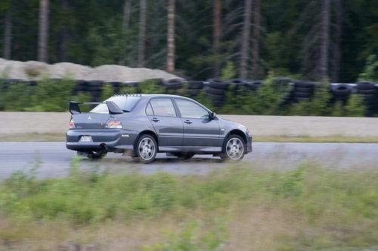
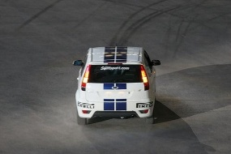
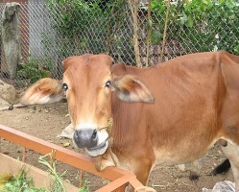
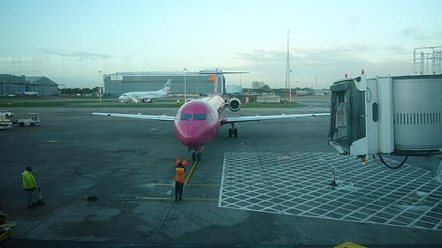
Standard supervised object detection
Detection models
car
Annotators
no car
[Felzenszwalb et al. PAMI 2010, Girshick et al. CVPR 2014, Girshick ICCV 2015, …]

Slide 3
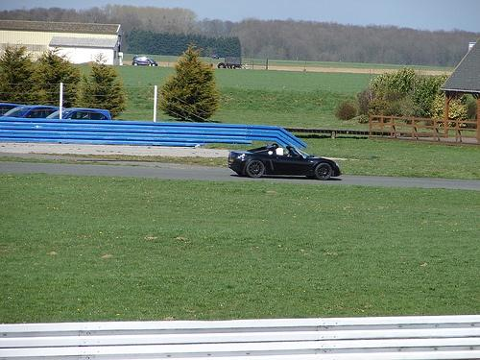
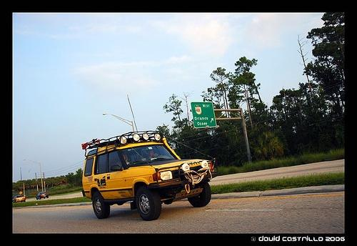
Standard supervised object detection
Detection models
car
Annotators
no car
Novel images
[Felzenszwalb et al. PAMI 2010, Girshick et al. CVPR 2014, Girshick ICCV 2015, …]

Slide 4
Standard supervised object detection
Detection models
car
Annotators
no car
Novel images
[Felzenszwalb et al. PAMI 2010, Girshick et al. CVPR 2014, Girshick ICCV 2015, …]

Slide 5
Standard supervised object detection
Detection models
car
Annotators
no car
Novel images
[Felzenszwalb et al. PAMI 2010, Girshick et al. CVPR 2014, Girshick ICCV 2015, …]
Huge advances in recent years

Slide 6
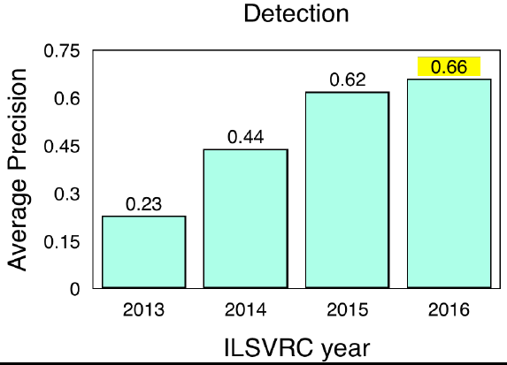
Standard supervised object detection
Detection models
car
Annotators
no car
Novel images
[Felzenszwalb et al. PAMI 2010, Girshick et al. CVPR 2014, Girshick ICCV 2015, …]
Huge advances in recent years

Slide 7
Standard supervised object detection
Detection models
car
Annotators
no car
Novel images
[Felzenszwalb et al. PAMI 2010, Girshick et al. CVPR 2014, Girshick ICCV 2015, …]
Huge advances in recent years
Requires expensive, error-prone bounding box annotations → not scalable!

Slide 8
Weakly-supervised object detection/localization
Mine discriminative patches
car
Annotators
no car
[Weber et al. 2000, Pandey & Lazebnik 2011, Deselaers et al. 2012, Song et al. 2014, …]

Slide 9
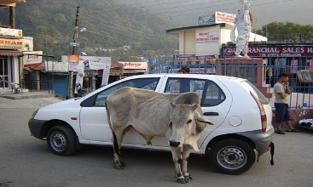
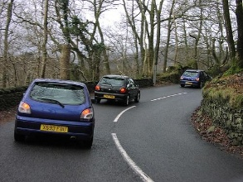
Weakly-supervised object detection/localization
Mine discriminative patches
car
Annotators
no car
Weakly-labeled training images
[Weber et al. 2000, Pandey & Lazebnik 2011, Deselaers et al. 2012, Song et al. 2014, …]

Slide 10
Weakly-supervised object detection/localization
Mine discriminative patches
car
Annotators
no car
Weakly-labeled training images
[Weber et al. 2000, Pandey & Lazebnik 2011, Deselaers et al. 2012, Song et al. 2014, …]

Slide 11
Weakly-supervised object detection/localization
Mine discriminative patches
car
Annotators
no car
Weakly-labeled training images
[Weber et al. 2000, Pandey & Lazebnik 2011, Deselaers et al. 2012, Song et al. 2014, …]
Supervision is provided at the image-level → scalable!

Slide 12
Weakly-supervised object detection/localization
Mine discriminative patches
car
Annotators
no car
Weakly-labeled training images
[Weber et al. 2000, Pandey & Lazebnik 2011, Deselaers et al. 2012, Song et al. 2014, …]
Supervision is provided at the image-level → scalable!
Due to intra-class appearance variations, occlusion, clutter, mined regions correspond to object-part or include background

Slide 13
Prior attempts to improve weak object localization

Slide 14
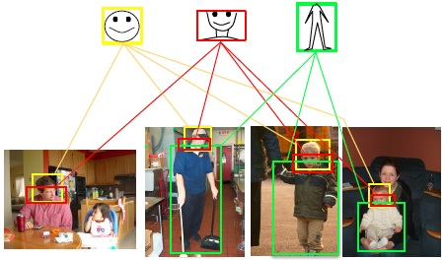
Prior attempts to improve weak object localization
Select multiple discriminative regions
[Song et al. NIPS 2014]

Slide 15
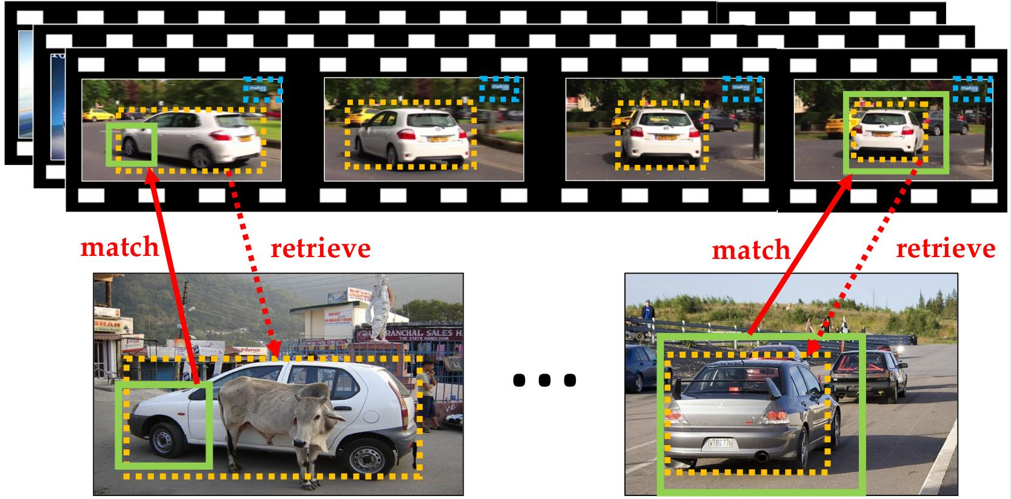
Prior attempts to improve weak object localization
Select multiple discriminative regions
Transfer tracked objects from videos to images
[Song et al. NIPS 2014]
[Singh et al. CVPR 2016]

Slide 16
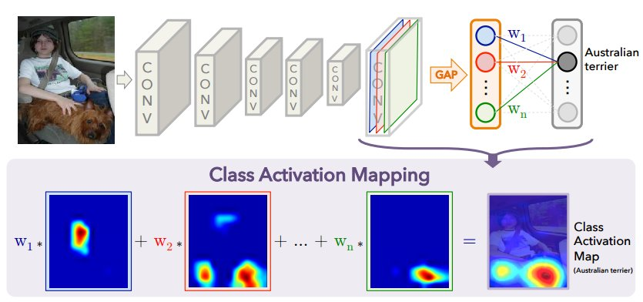
Prior attempts to improve weak object localization
Select multiple discriminative regions
Transfer tracked objects from videos to images
[Song et al. NIPS 2014]
[Singh et al. CVPR 2016]
Global average pooling to encourage network to look at all relevant parts
[Zhou et al. CVPR 2016]

Slide 17
Prior attempts to improve weak object localization
Select multiple discriminative regions
Transfer tracked objects from videos to images
Does not guarantee selection of less discriminative patches
[Song et al. NIPS 2014]
[Singh et al. CVPR 2016]
Global average pooling to encourage network to look at all relevant parts
[Zhou et al. CVPR 2016]

Slide 18
Prior attempts to improve weak object localization
Select multiple discriminative regions
Transfer tracked objects from videos to images
Does not guarantee selection of less discriminative patches
Requires additional labeled videos
[Song et al. NIPS 2014]
[Singh et al. CVPR 2016]
Global average pooling to encourage network to look at all relevant parts
[Zhou et al. CVPR 2016]

Slide 19
Prior attempts to improve weak object localization
Select multiple discriminative regions
Transfer tracked objects from videos to images
Does not guarantee selection of less discriminative patches
Requires additional labeled videos
[Song et al. NIPS 2014]
[Singh et al. CVPR 2016]
Global average pooling to encourage classification network to get all relevant parts
Localizing a few discriminative parts can be sufficient for classification
[Zhou et al. CVPR 2016]

Slide 20
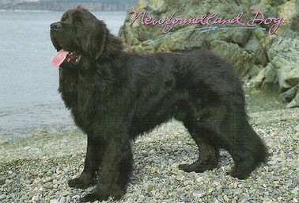
Intuition of our idea: Hide and Seek (HaS)
Training image
‘dog’
[In submission]

Slide 21
Intuition of our idea: Hide and Seek (HaS)
Training image
‘dog’
Image classification network
Global Average Pooling [Zhou et al. 2016]
[In submission]

Slide 22
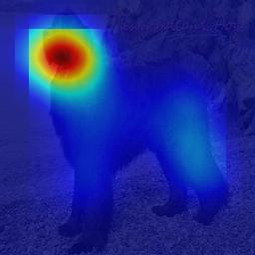
Intuition of our idea: Hide and Seek (HaS)
Training image
‘dog’
Image classification network
Global Average Pooling [Zhou et al. 2016]
[In submission]

Slide 23
Intuition of our idea: Hide and Seek (HaS)
Training image
‘dog’
Image classification network
Global Average Pooling [Zhou et al. 2016]
Network focuses on the most discriminative part (i.e. dog’s face) for image classification
→ Too Late
[In submission]

Slide 24
Intuition of our idea: Hide and Seek (HaS)
Training image
‘dog’
[In submission]

Slide 25
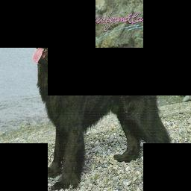
Intuition of our idea: Hide and Seek (HaS)
Training image
‘dog’
[In submission]

Slide 26
Intuition of our idea: Hide and Seek (HaS)
Training image
‘dog’
Image classification network
Global Average Pooling [Zhou et al. 2016]
[In submission]

Slide 27
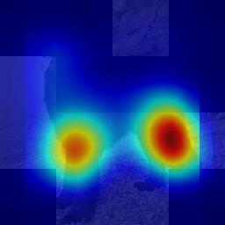
Intuition of our idea: Hide and Seek (HaS)
Training image
‘dog’
Image classification network
Global Average Pooling [Zhou et al. 2016]
[In submission]

Slide 28
Intuition of our idea: Hide and Seek (HaS)
Training image
‘dog’
Image classification network
Global Average Pooling [Zhou et al. 2016]
Hide patches to force the network to seek other relevant parts
[In submission]

Slide 29
Outline
Hide-and-Seek (HaS) for:
Weakly-supervised object localization in images
Weakly-supervised temporal action localization in videos

Slide 30
Outline
Hide-and-Seek (HaS) for:
Weakly-supervised object localization in images
Weakly-supervised temporal action localization in videos

Slide 31
Approach

Slide 32
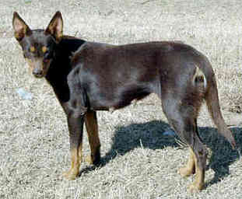
Divide the training image into a grid of patch size S x S
Training image with label ‘dog’

Slide 33
Divide the training image into a grid of patch size S x S
S
S
Training image with label ‘dog’

Slide 34
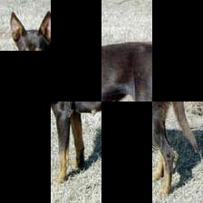
Randomly hide patches
S
S
Epoch 1
Training image with label ‘dog’

Slide 35
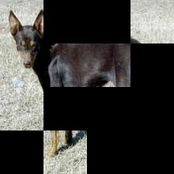
Randomly hide patches
S
S
Epoch 1
Epoch 2
Training image with label ‘dog’

Slide 36
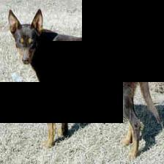
Randomly hide patches
S
S
Epoch 1
Epoch 2
Training image with label ‘dog’
Epoch N

Slide 37
Feed each hidden image to image classification CNN
S
S
Epoch 1
Epoch 2
CNN
Training image with label ‘dog’
Epoch N

Slide 38
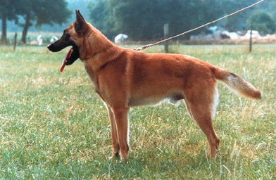
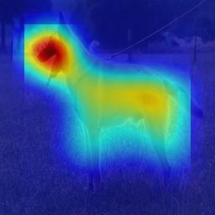
During testing feed full image into trained network
Trained CNN
Test image
Class Activation Map (CAM)
Predicted label: ‘dog’

Slide 39
Generating a Class Activation Map (CAM)
[Zhou et al. “Learning Deep Features for Discriminative Localization” CVPR 2016]

Slide 40
Setting the hidden pixel values
Patches are hidden only during training; during testing full image is given as input
Activations of 1st conv layer will have different distribution during training and testing
Inside visible patch
Inside hidden patch
Partially in hidden patch
Notes:
There are three possible activations as shown in left.
Assigning mean RGB value to the pixels ensure activation remain same during training and testing for all the three cases.

Slide 41
Setting the hidden pixel values
Let conv filter of size k x k with weights W = {w₁, w₂, …, w_{kxk}} applied on patch X = {x₁, x₂, …, x_{kxk}}, then output is:
which is same during training and testing
Inside visible patch
Inside hidden patch
Partially in hidden patch
Notes:
Convolutional filter is completely Inside the visible patch

Slide 42
Setting the hidden pixel values
Assigning µ (mean RGB value of all pixels in dataset) to each hidden pixel ensures same activation (in expectation) during training and testing:
i.e. expected output of a patch is equal to output of an average-valued patch
Inside visible patch
Inside hidden patch
Partially in hidden patch
Notes:
Convolutional filter is either completely or partially inside the hidden patch.

Slide 43
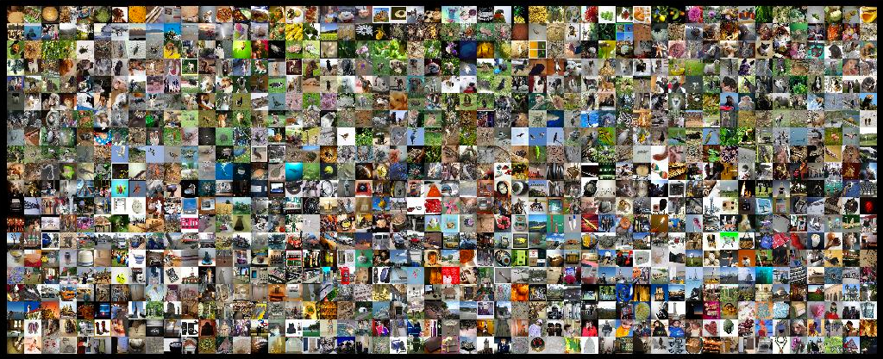
Results
ILSVRC 2016 dataset for localization
1000 categories
1.2 million training images, 50 thousands validation and test images

Slide 44
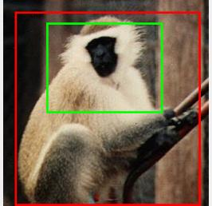
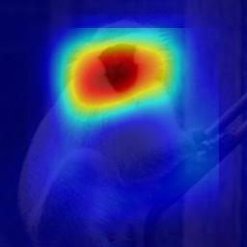
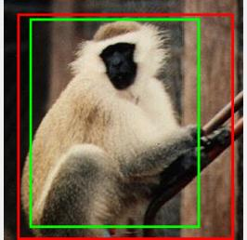
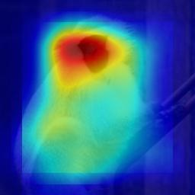
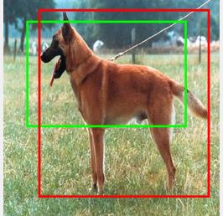
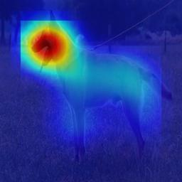
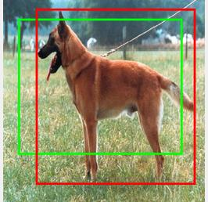
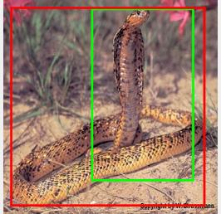
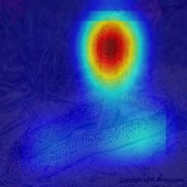
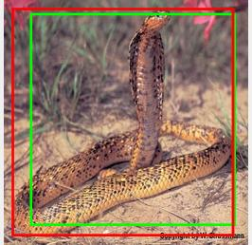
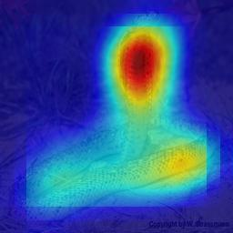
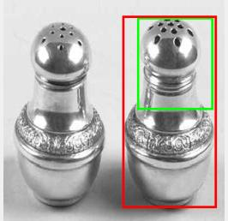
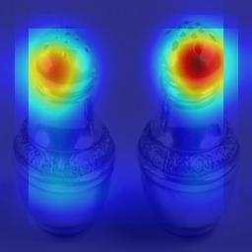
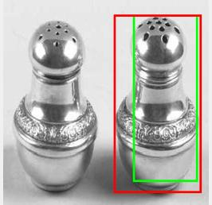
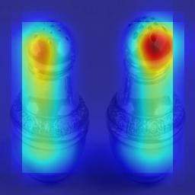
Our approach localizes the object more fully
Bounding Box
(AlexNet-GAP)
Heatmap
(AlexNet-GAP)
Bounding Box
(Ours)
Heatmap
(Ours)
[AlexNet-GAP: Zhou et al. CVPR 2016]

Slide 45
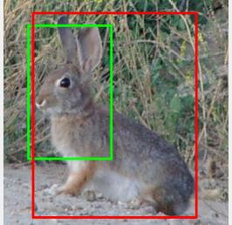
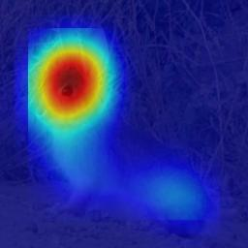
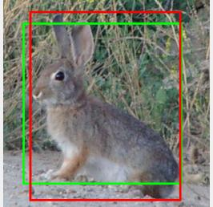
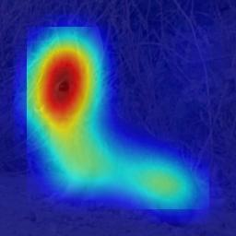
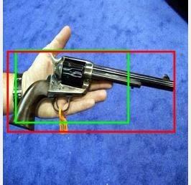
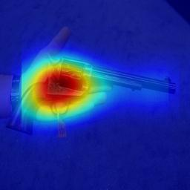
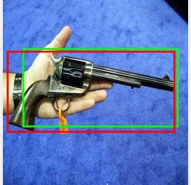
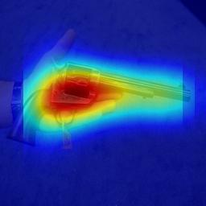
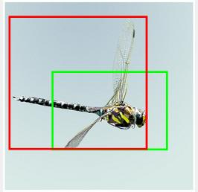
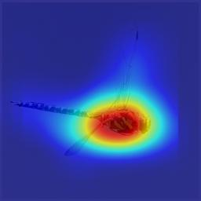
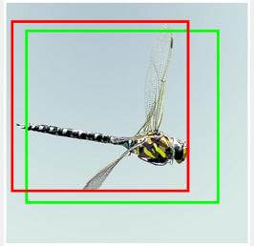
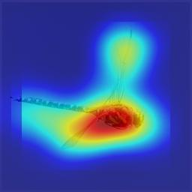
Our approach localizes the object more fully
Bounding Box
(AlexNet-GAP)
Heatmap
(AlexNet-GAP)
Bounding Box
(Ours)
Heatmap
(Ours)
[AlexNet-GAP: Zhou et al. CVPR 2016]

Slide 46
Our approach outperforms all previous methods
Methods | GT-known Loc | Top-1 Loc
Backprop on Alexnet [Simonyan 2014] | - | 34.83
AlexNet-GAP [Zhou 2016] | 54.99 | 36.25
Ours | 58.74 | 37.71
AlexNet-GAP-ensemble [Zhou 2016] | 57.02 | 38.69
Ours-ensemble | 60.33 | 40.57
Evaluation metrics:
GT-known Loc: Class label known, predicted box > 50% IoU w/ GT
Top-1 Loc: Predicted label is correct and predicted box > 50% IoU w/ GT
Notes:
Our method performs 3.75% and 1.46% points better than AlexNet-GAP on GT-known Loc and Top-1 Loc, respectively.
Our ensemble method performs 3.31% and 1.88% points better than AlexNet-GAP-ensemble on GT-known Loc and Top-1 Loc, respectively.

Slide 47
Our approach outperforms all previous methods
Methods | GT-known Loc | Top-1 Loc
Backprop on GoogLeNet [Simonyan 2014] | - | 38.69
GoogLeNet-GAP [Zhou 2016] | 58.66 | 43.60
Ours | 60.57 | 45.47
Since we only change the input image, our approach works with any image classification network
Notes:
Our model gets a boost of 1.91% and 1.87% points compared to GoogLenet-GAP for GT-known Loc and Top-1 Loc accuracy, respectively.

Slide 48
Our approach improves image classification when objects are partially-visible
Ground-truth: African Crocodile
AlexNet-GAP: Trilobite
Ours: African Crocodile
Ground-truth: Electric Guitar
AlexNet-GAP: Banjo
Ours: Electric Guitar
Ground-truth: Notebook
AlexNet-GAP: Waffle Iron
Ours: Notebook
Ground-truth: Ostrich
AlexNet-GAP: Border Collie
Ours: Ostrich

Slide 49
Failure cases
Bounding Box
(AlexNet-GAP)
Heatmap
(AlexNet-GAP)
Bounding Box
(Ours)
Heatmap
(Ours)
Notes:
Multiple instances of the objects cause localization to merge and give incorrect bounding boxes.
Frequent co-occurrences of context objects with the object of interest lead to incorrect localization.

Slide 50
Failure cases
Bounding Box
(AlexNet-GAP)
Heatmap
(AlexNet-GAP)
Bounding Box
(Ours)
Heatmap
(Ours)
Merging spatially-close instances together
Notes:
Multiple instances of the objects cause localization to merge and give incorrect bounding boxes.
Frequent co-occurrences of context objects with the object of interest lead to incorrect localization.

Slide 51
Failure cases
Bounding Box
(AlexNet-GAP)
Heatmap
(AlexNet-GAP)
Bounding Box
(Ours)
Heatmap
(Ours)
Merging spatially-close instances together
Localizing co-occurring context
Notes:
Multiple instances of the objects cause localization to merge and give incorrect bounding boxes.
Frequent co-occurrences of context objects with the object of interest lead to incorrect localization.

Slide 52
Outline
Hide-and-Seek (HaS) for:
Weakly-supervised object localization in images
Weakly-supervised temporal action localization in videos

Slide 53
Divide training video into contiguous frame segments of size S
time
Training video `high-jump’

Slide 54
Divide training video into contiguous frame segments of size S
S
Training video `high-jump’

Slide 55
Randomly hide contiguous frame segments of video
Epoch 1
Epoch 2
Training video `high-jump’
Epoch N

Slide 56
Feed each hidden video to action classification CNN
Epoch 1
Epoch 2
CNN
Training video `high-jump’
Epoch N

Slide 57
During testing feed full video into trained network
Trained CNN
Test video
Predicted label `high-jump’

Slide 58
Results
THUMOS 14 dataset
101 classes, 1010 videos for training
20 classes, 200 untrimmed videos with temporal annotation for evaluation
Each frame represented using C3D fc7 features obtained by a model pre-trained on Sports 1 million dataset

Slide 59
Our method localizes the action more fully
Ground-
truth
….
….
….
….
….
….
….
Video-
full
….
….
….
….
….
….
….
Video-
HaS
….
….
….
….
….
….
….

Slide 60
Our method localizes the action more fully
Ground-
truth
….
….
….
….
….
….
….
Video-
full
….
….
….
….
….
….
….
Video-
HaS
….
….
….
….
….
….
….
Ground-
truth
….
….
….
….
….
….
….
Video-
full
….
….
….
….
….
….
….
Video-
HaS
….
….
….
….
….
….
….

Slide 61
Our method localizes the action more fully
Ground-
truth
….
….
….
….
….
….
….
Video-
full
….
….
….
….
….
….
….
Video-
HaS
….
….
….
….
….
….
….
Ground-
truth
….
….
….
….
….
….
….
Video-
full
….
….
….
….
….
….
….
Video-
HaS
….
….
….
….
….
….
….

Slide 62
Quantitative temporal action localization results
Methods | IOU thresh = 0.1 | 0.2 | 0.3 | 0.4 | 0.5
Video-GAP | 34.23 | 25.68 | 17.72 | 11.00 | 6.11
Ours | 36.44 | 27.84 | 19.49 | 12.66 | 6.84
Our approach outperforms the Video-GAP baseline

Slide 63
Failure cases
Ground-
truth
….
….
….
….
….
…
….
Video-
full
….
….
….
….
….
…
….
….
….
….
….
….
…
….
Video-
HaS
Our approach can fail by localizing co-occurring context
Notes:
Video-HaS incorrectly localizes beyond the temporal extent of diving (last 2 frames)
Frames containing a swimming pool follow the diving action frequently
When the diving frames are hidden the network starts focusing on the context frames containing swimming pool to classify the action as diving.

Slide 64
Conclusions
Simple idea of Hide-and-Seek to improve weakly-supervised object and action localization
→ only change the input and not the network
State-of-the-art results on object localization in images
Generalizes to multiple network architectures, input data, tasks

Slide 65
Thank you!

