Slide 1
Interspecies Knowledge Transfer
for
Facial Keypoint Detection
Maheen Rashid, Xiuye Gu, Yong Jae Lee
CVPR 2017
UC Davis
Notes:
Name
2nd year phd student at uc davis
research in computer vision and machine learning
Species in interspecies are either humans and horses, or humans and sheep

Slide 2
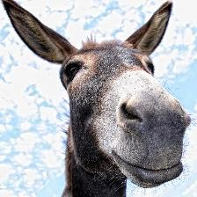
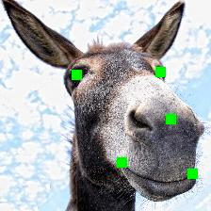
The Problem
Input
Output
Notes:
Keypoint detection. Sticking with these 5 keypoints. extendible tomore key points. example of other key points used

Slide 3
Outline
Pain Detection in Animals and Humans
Interspecies Transfer Learning for Keypoint Detection
Results and Discussion

Slide 4
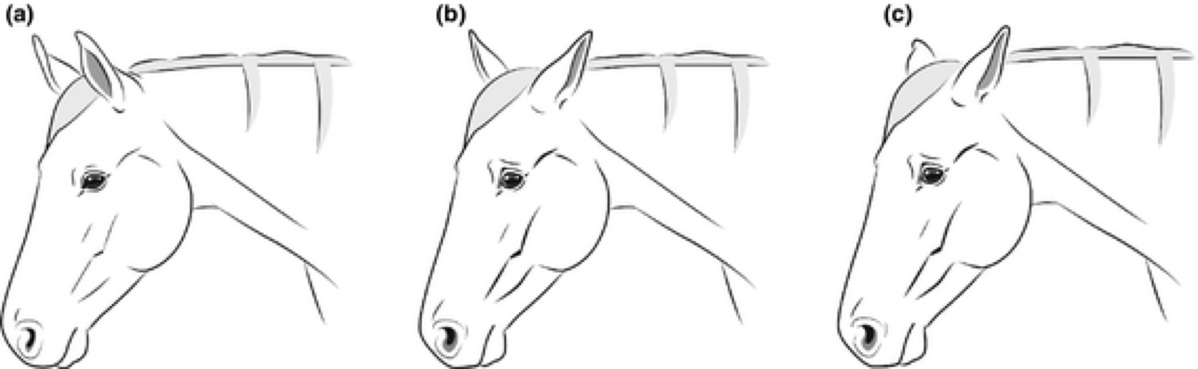
Motivation
Facial expressions are a good indicator of pain.
Veterinary research has found expressions of pain for horses, sheep, and cows.
Figure from [1]
[1]K. B. Gleerup, B. Forkman, C. Lindegaard, and P. H. Andersen. An equine pain face. Veterinary anesthesia and analgesia, 42(1):103–114, 2015
[2] K. M. McLennan, C. J. Rebelo, M. J. Corke, M. A. Holmes, M. C. Leach, and F. Constantino-Casas. Development of a facial expression scale using footrot and mastitis as models of pain in sheep. Applied Animal Behaviour Science , 176:19–26, 2016.
[3] . B. Gleerup, P. H. Andersen, L. Munksgaard, and B. Forkman. Pain evaluation in dairy cattle. Applied Animal Behaviour Science, 171:25–32, 2015.
Notes:
tensing oribtal muscles
nostrils expanded
mouth and jaw tightened
tensed facial muscles
ear positions

Slide 5
Motivation
Automatic detection of pain can have a big impact on animal welfare
  $0.5 billion spent annually in the US to treat lameness in horses, and less acute levels are difficult to detect [1].
Human detection of animal pain is limited
  Humans need to be trained to detect pain [2].
  Horses may hide expressions of pain near humans [3].
[1] Lameness and laminitis in U.S. horses. In USDA:APHIS:VS, National Animal Health Monitoring System. USDA, 2000.
[2] K. B. Gleerup, B. Forkman, C. Lindegaard, and P. H. Andersen. Facial expressions as a tool for pain recognition in horses. In The 10th International Equitation Science Conference, 2014.
[3] Britt Alice Coles. "No pain, more gain? Evaluating pain alleviation post equine orthopedic surgery using subjective and objective measurements." (2016).
Notes:
It can help save money by early diagnosis and treatment. 65% of swedish horse owners want pain prevention and early diagnosis tools rather than better pain treatment.

Slide 6
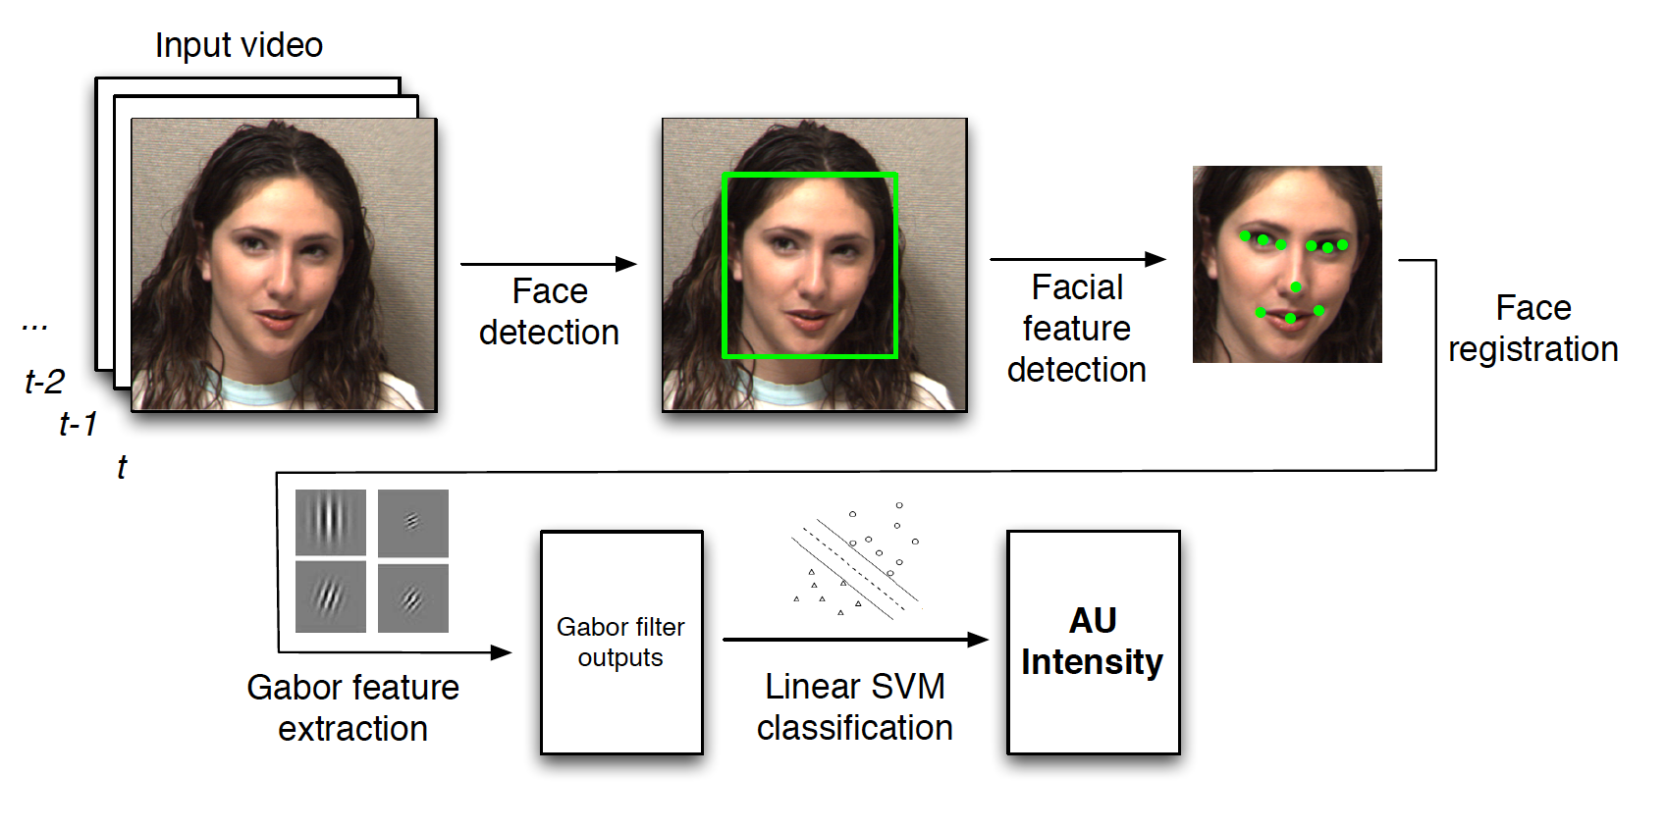
Human Pain Detection
Automatic expression detection in humans is well explored
Computer vision system outperforms humans 85% accuracy to 55% on distinguishing fake and real pain [2]
Pain detection is at 91.3% in [3]
Figure from [1]
[1]G. Littlewort, J. Whitehill, T. Wu, I. Fasel, M. Frank, J. Movellan, and M. Bartlett. The computer expression recognition toolbox (cert). In Automatic Face & Gesture Recognition and Workshops (FG 2011), 2011 IEEE International Conference on, pages 298–305. IEEE, 2011.
[2]G. C. Littlewort, M. S. Bartlett, and K. Lee. Faces of pain: automated measurement of spontaneous facial expressions of genuine and posed pain. In Proceedings of the 9th international conference on Multimodal interfaces, pages 15–21. ACM, 2007.
[3] P. Rodriguez, G. Cucurull, J. Gonzalez, J. M. Gonfaus, K. Nasrollahi, T. B. Moeslund, and F. X. Roca. Deep pain: Exploiting long short-term memory networks for facial expression classification. IEEE Transactions on Cybernetics, 2017

Slide 7
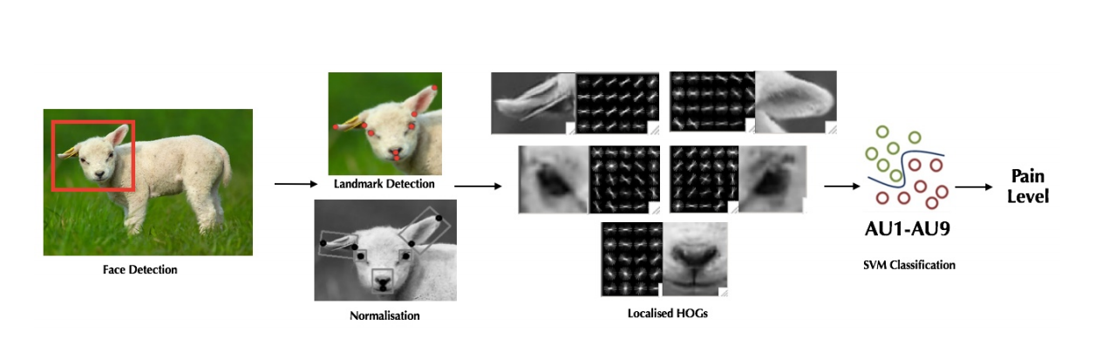
Animal Pain Detection
Predict three levels of pain.
Average accuracy of 64%
[1] Y. Lu, M. Mahmoud, and P. Robinson. Estimating sheep pain level using facial action unit detection. In FG, 2017

Slide 8
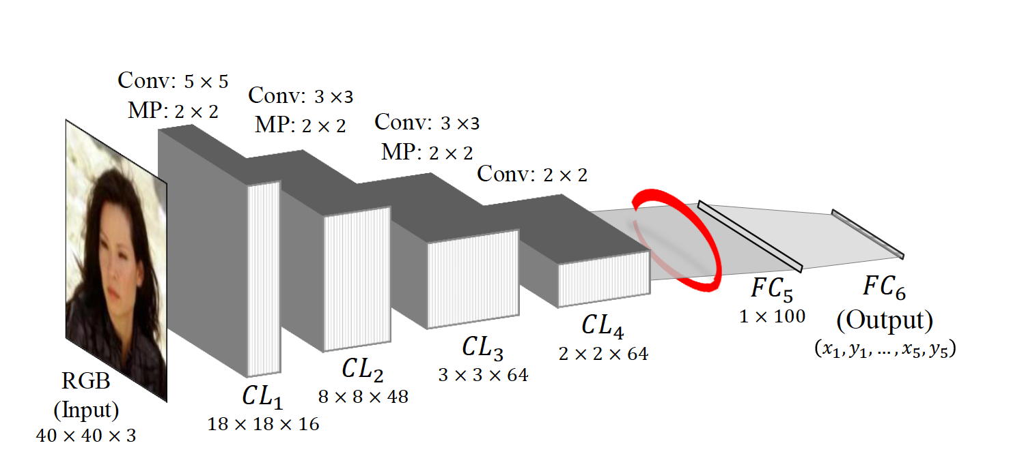
Keypoint Detection
Keypoint detection on human faces is well explored
Typical CNN based approach:
Figure from [1]
[1] Y. Wu and T. Hassner. Facial landmark detection with tweaked convolutional neural networks. arXiv preprint arXiv:1511.04031, 2015.

Slide 9
Keypoint Detection in Animals
Collecting large animal keypoint datasets is problematic.
Human keypoint datasets are large
Fine-tuning is a suboptimal solution
Figure from [1]
[1] Y. Wu and T. Hassner. Facial landmark detection with tweaked convolutional neural networks. arXiv preprint arXiv:1511.04031, 2015.
Notes:
time and effort needed to make big datasets - 2 years and $100,000 to collect a million image dataset that is used to train Alexnet
26000 in AFLW
So technical challenge we’re addressing is transferring knowledge between loosely related datasets more effectively

Slide 10
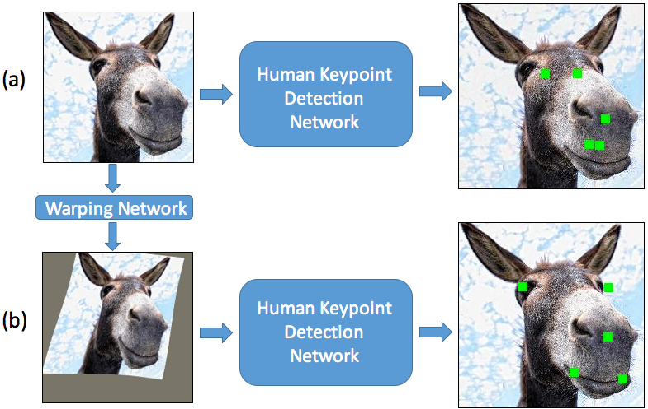
Approach
Key Idea - Rather than bring the network closer to the data, bring the data closer to the network first
Warp animal faces to structurally look more human like before fine-tuning
Notes:
Correct for structural difference so the network need only learn texture based differences

Slide 11
Datasets
Created the Horse Facial Keypoint Dataset
  3531 Training Images. 186 Testing Images
Sheep Keypoint Dataset from [1]
  Manually annotated 531 images with same set of keypoints
  432 Training Images. 99 Testing Images.
[1] H. Yang, R. Zhang, and P. Robinson. Human and sheep facial landmarks localisation by triplet interpolated features. In WACV, 2016
Notes:
Each image has bounding box around animal face (includes ears), and pixel locations for 5 keypoints. Left and right eyes, nose, left and right mouth corners.

Slide 12
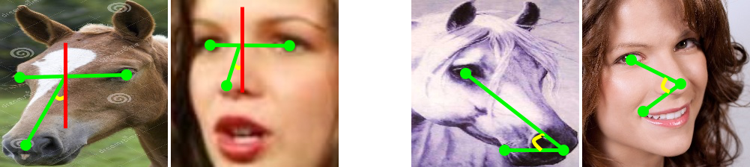
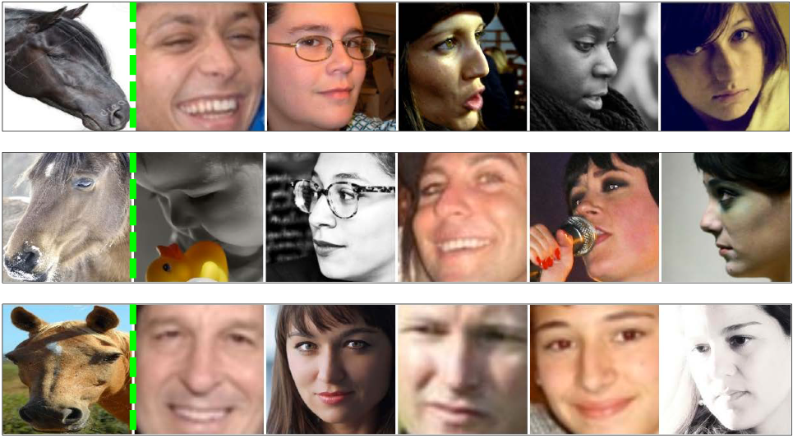
Human-Animal Pairs
Used to train the warping network
Angular difference used for nearest nearest pairing
Notes:
requirements - same key points are annotated in both datasets
Simple heuristic method

Slide 13
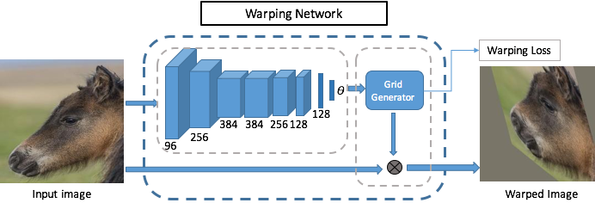
Warping Network
Uses a Thin Plate Spline tranformer
Uses Euclidean loss for training
Notes:
the network takes in an image and outputs the parameters for a transformation. We use a thin plate spline transformer - which allows for non-linear transformations.
human animal pairs are used to train the warper.

Slide 14
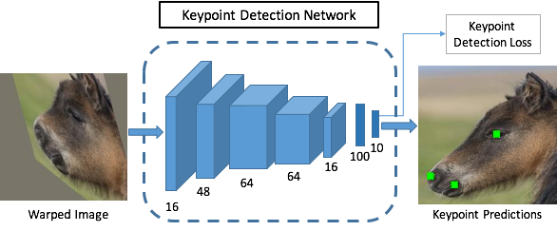
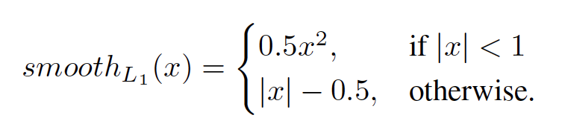
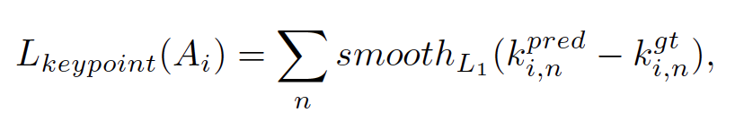
Keypoint Detection Network
Variation of Vanilla CNN network from [1]
Pretrained with human keypoint training images
[1] Y. Wu and T. Hassner. Facial landmark detection with tweaked convolutional neural networks. arXiv preprint arXiv:1511.04031, 2015.

Slide 15
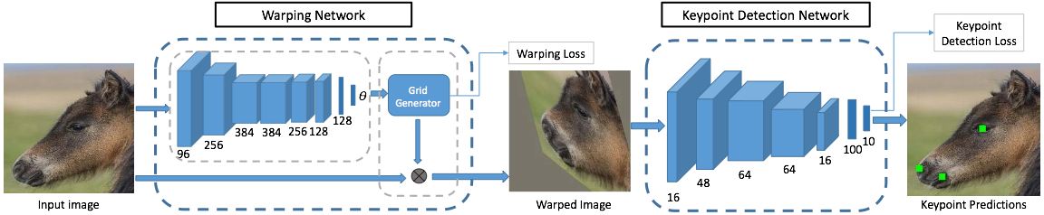
Putting it all together
Warping network is pretrained on animal-human pairs
Keypoint network is pretrained on human keypoints
Both losses are used during training

Slide 16
Baselines
Simple finetuning (BL Finetune)
Warping without human-animal pairs (BL TPS)
Scratch
Notes:
BL finetune tests whether warping is even necessary
BL tps tests if human-animal pairs for supervising the warper is necessary.

Slide 17
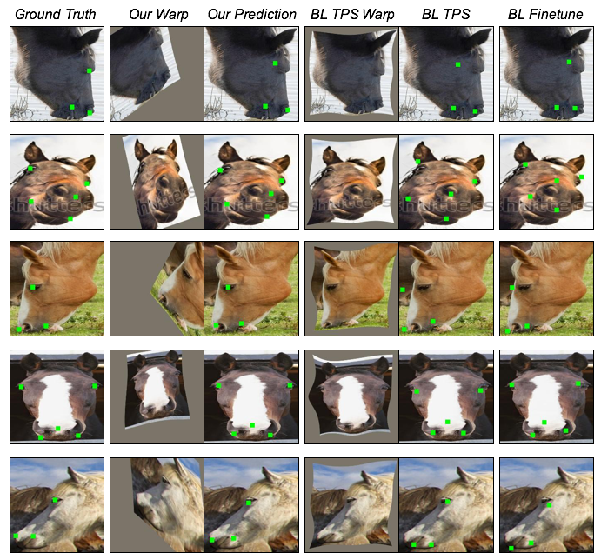
Results - Qualitative
Notes:
range of horse poses, and color, are handled.

Slide 18
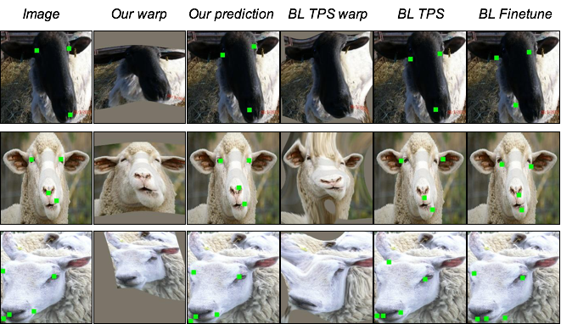
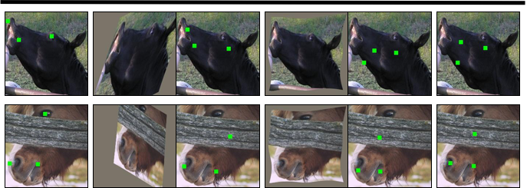
Results - Qualitative
Notes:
even with bad texture we do well. sheep results are generally better. BL TPS warps are not as weird.

Slide 19
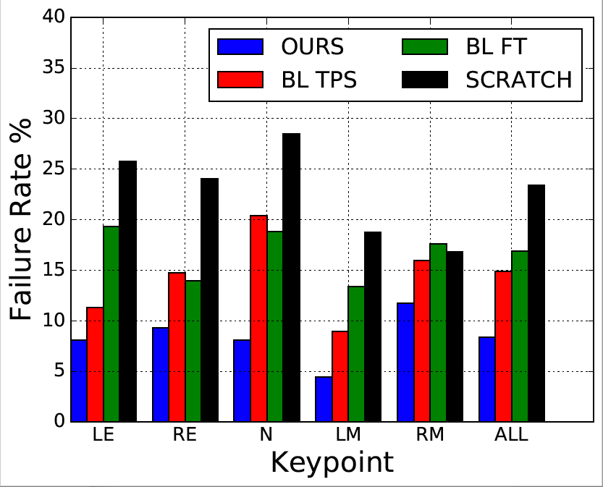
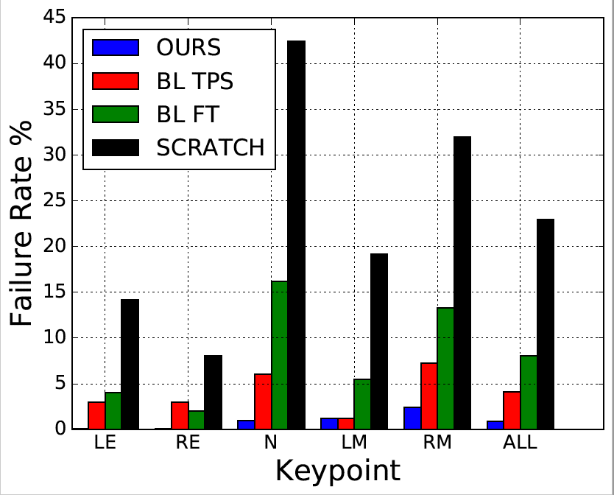
Results - Error Rates
Failure is distance of >10% of head size
Horse Dataset
Sheep Dataset
Notes:
Sheep faces are structurally closer to human faces, so problem is easier to bl tps to work

Slide 20
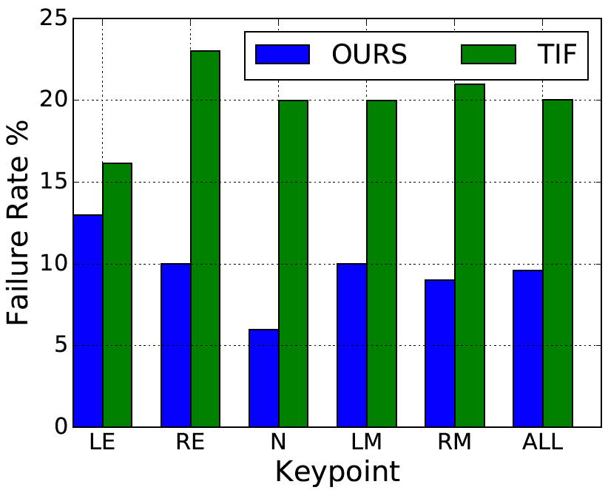
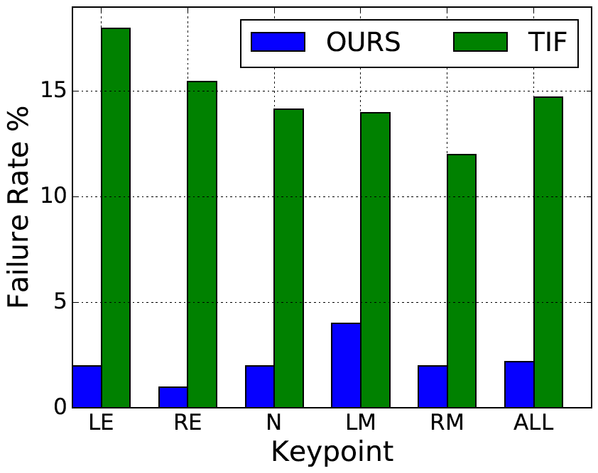
Results - Comparison with TIF
Triplet Interpolated Features [1] developed for facial keypoint detection in sheep
Horses
Sheep
[1] H. Yang, R. Zhang, and P. Robinson. Human and sheep facial landmarks localisation by triplet interpolated features. In WACV, 2016
Notes:
Other people’s research.

Slide 21
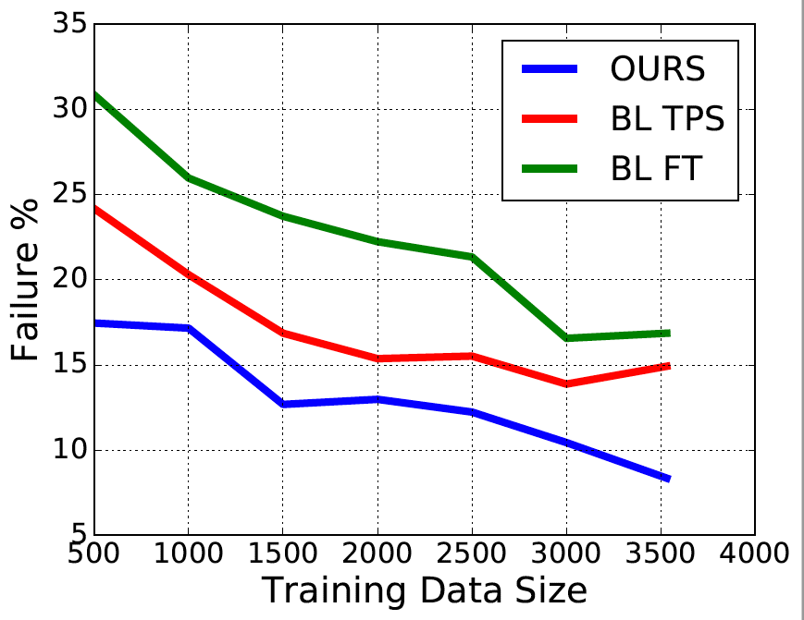
Results - Dataset Size
6.72% point lower failure rate than the TPS baseline for 500 Images

Slide 22
Conclusion
Present a novel approach for transferring knowledge between loosely related data domains
Correct for shape difference between datasets

Slide 23
Questions

Slide 25
Enter Deep Networks
Deep Convolutional Neural Networks have shown impressive performance on a range of computer vision tasks
Close to human performance in ImageNet Challenge - 5.1% (Human) vs. 6.8% (GoogleNet) [1]
State of the art in human key point detection is 4.14% error rate [2]
[1] http://karpathy.github.io/2014/09/02/what-i-learned-from-competing-against-a-convnet-on-imagenet/
[2] S. Xiao, J. Feng, J. Xing, H. Lai, S. Yan, and A. Kassim. Robust facial landmark detection via recurrent attentive refinement networks. In ECCV, 2016.

Slide 26
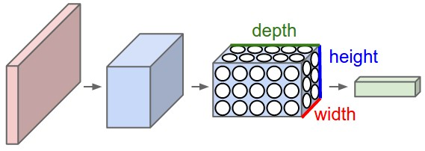
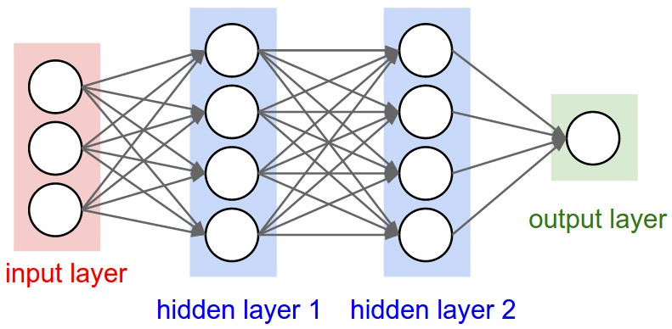
Deep Convolutional Networks
Cascade of linear and non-linear processing units
Features are learned implicitly
Typically require large datasets for training
Neural Net
Convolutional Neural Net
Figure from http://cs231n.github.io/convolutional-networks/

