Slide 1

ECS 174: Computer Vision
April 2nd, 2019
Yong Jae Lee
Assistant Professor
CS, UC Davis

Slide 2
Plan for today
Course overview
Introduction to computer vision research
Logistics and requirements
Notes:
Please interrupt at any time with questions or comments

Slide 3
Introductions
Instructor
  Yong Jae Lee
  yongjaelee@ucdavis.edu
  Assistant Professor in CS, UC Davis since July 2014
  Research areas: Computer vision and machine learning
    Visual Recognition

Slide 4
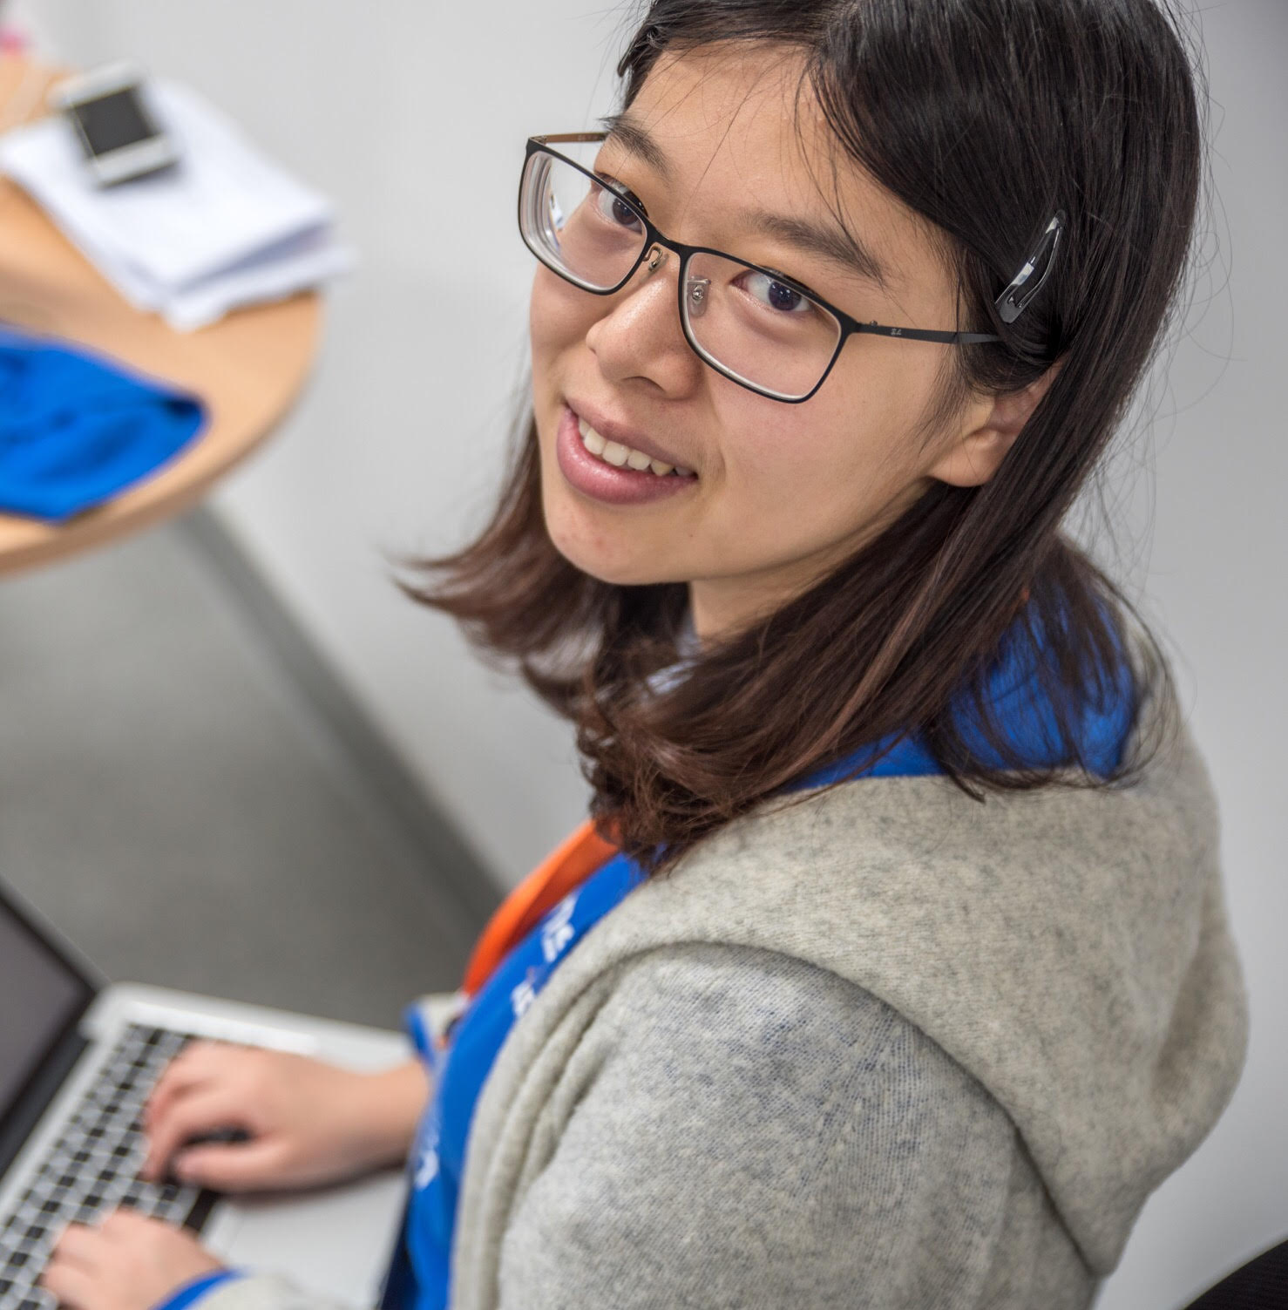
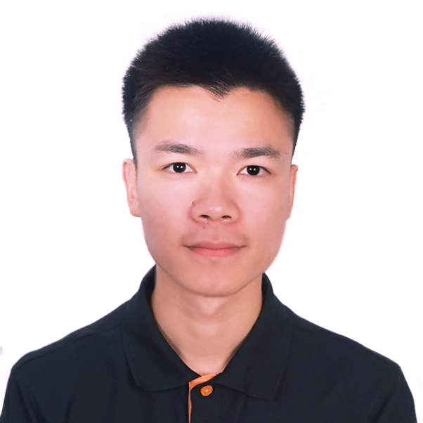
Introductions
TAs:
  Xueyan Zou
  zxyzou@ucdavis.edu
  PhD student in CS
  Yangming Wen
  ymnwen@ucdavis.edu
  MS student in CS

Slide 5
This course
ECS 174 (4-units)
Lecture: Tues & Thurs 4:40-6:00 pm, Giedt Hall 1001
Discussion section: Mon 12:10-1pm, Hunt 100
Office hours: Academic Surge 1044/2075
  Yangming: Wed 11 am - 1 pm (AS 1044)
  Xueyan: Thurs 11 am- 1 pm (AS 1044)
  Yong Jae: Fri 3-5 pm (AS 2075)
Notes:
5
Google me → My homepage → Teaching

Slide 6
This course
Course webpage
  https://sites.google.com/a/ucdavis.edu/ecs-174-computer-vision---spring-2019/
Canvas (assignment submission, grades)https://canvas.ucdavis.edu/courses/349152
Piazza
  piazza.com/uc_davis/spring2019/ecs174
Notes:
6
Google me → My homepage → Teaching

Slide 7
Goals of this course
Introduction to primary topics in Computer Vision
Basics and fundamentals
Practical experience through assignments
Views of computer vision as a research area
Notes:
7

Slide 8
Prerequisites
Upper-division undergrad course
Basic knowledge of probability and linear algebra
Data structures, algorithms
Programming experience
Experience with image processing or Matlab will help but is not necessary
Notes:
8
(ECS 060 or ECS 032B or ECS 036C); (STA 032 or STA 131A or MAT 135A or EEC 161 or ECS 132 recommended); (MAT 022A or MAT 067 recommended)

Slide 9
Topics overview
Features and filters
Grouping and fitting
Recognition and learning
Focus is on algorithms, rather than specific systems

Slide 10
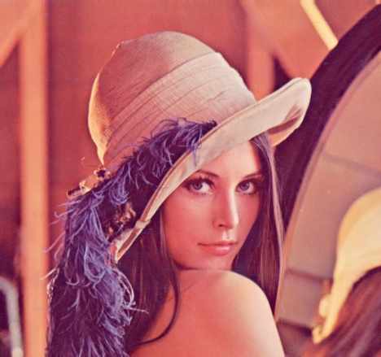
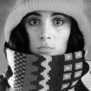

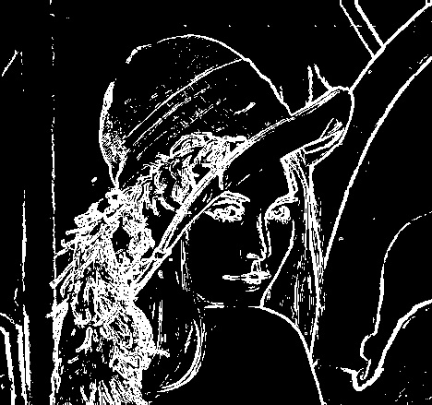
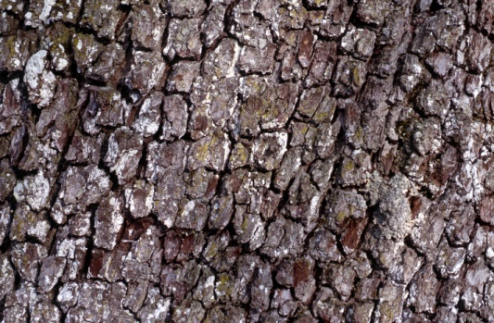
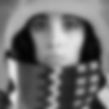
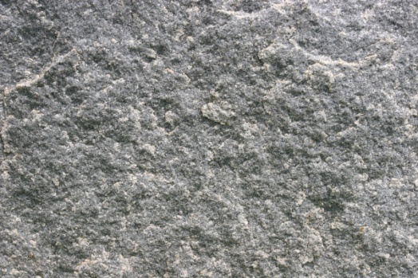
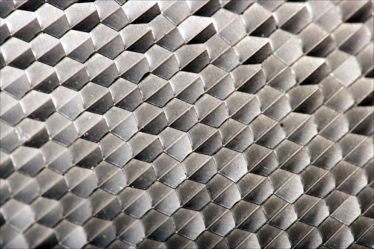
Features and filters
Transforming and describing images; textures, edges
Slide credit: Kristen Grauman

Slide 11
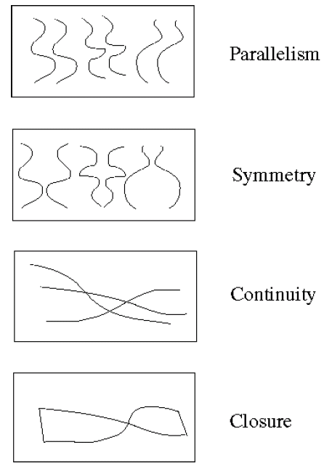
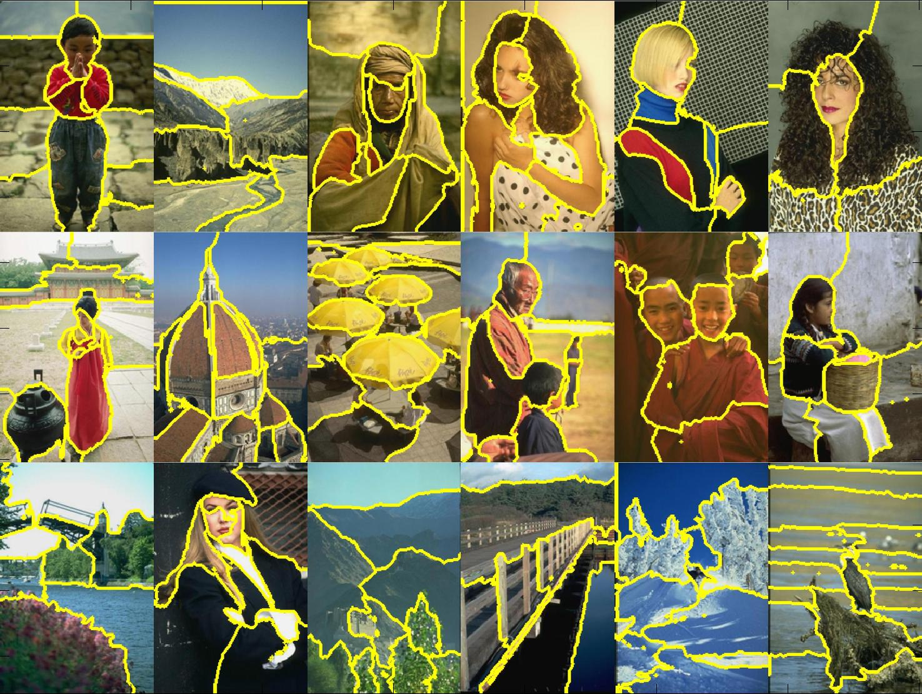
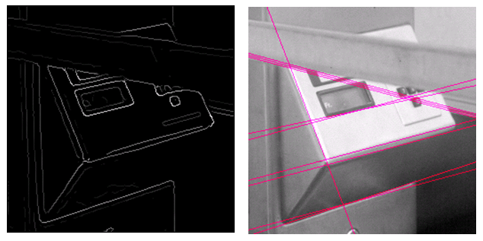
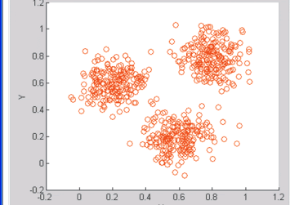
Grouping and fitting
Clustering, segmentation, fitting; what parts belong together?
[fig from Shi et al]
Slide credit: Kristen Grauman

Slide 12
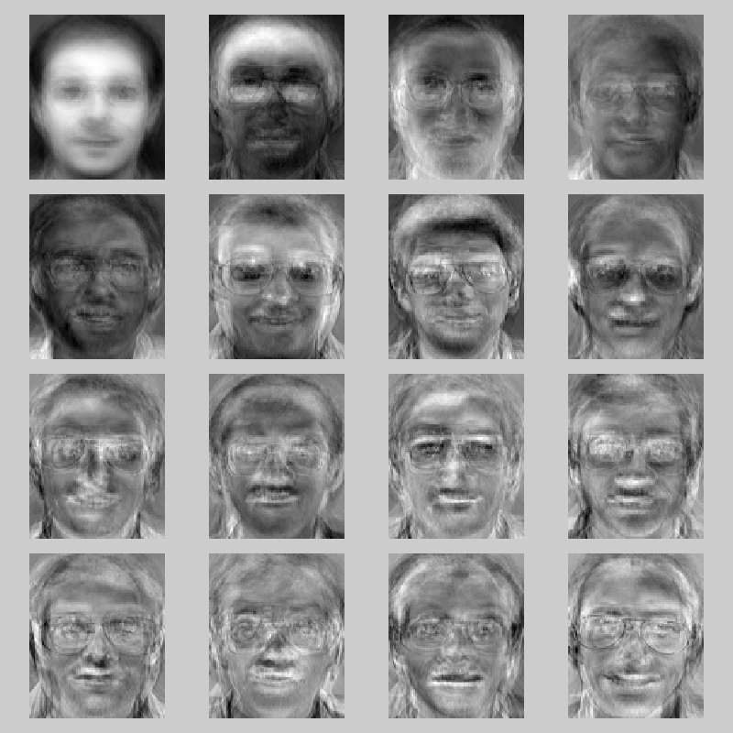
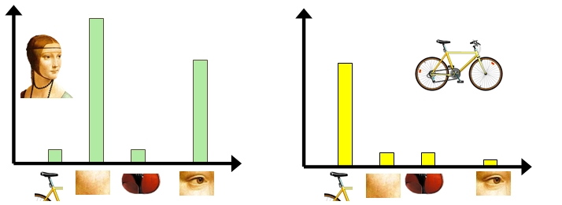

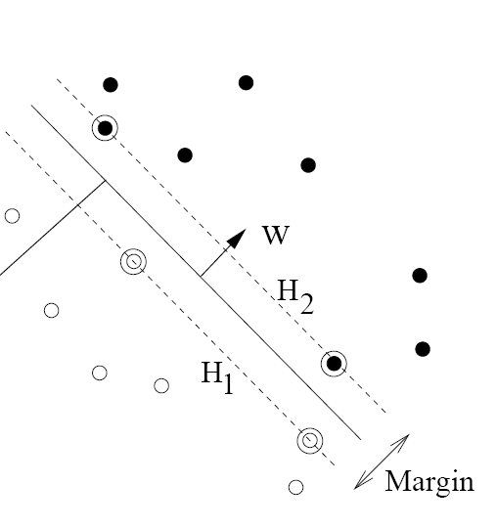
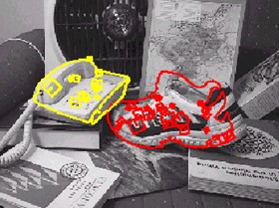
Recognition and learning
Recognizing objects and categories, learning techniques
Slide credit: Kristen Grauman

Slide 13
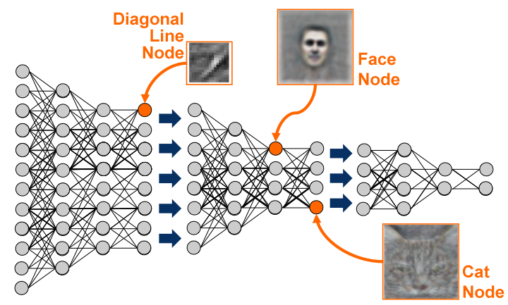
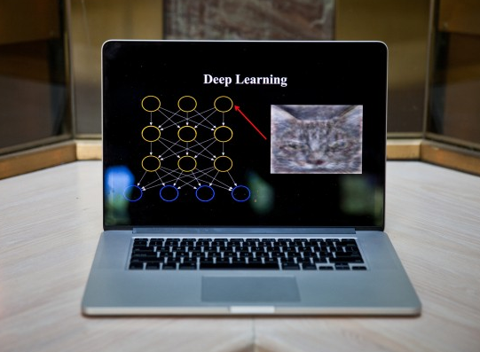
Recognition and learning
Deep learning

Slide 14
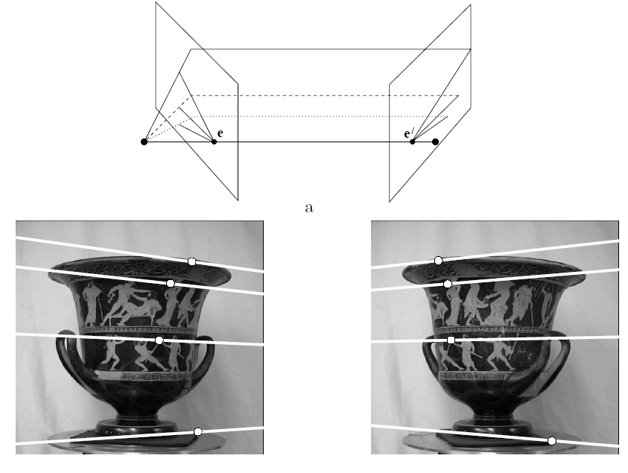
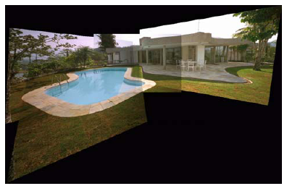
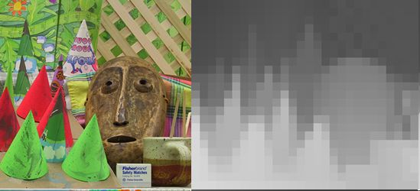
Not covered: Multiple views and motion
Multi-view geometry, stereo vision
Lowe
Hartley and Zisserman
Fei-Fei Li
Slide credit: Kristen Grauman

Slide 15
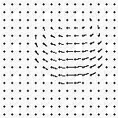
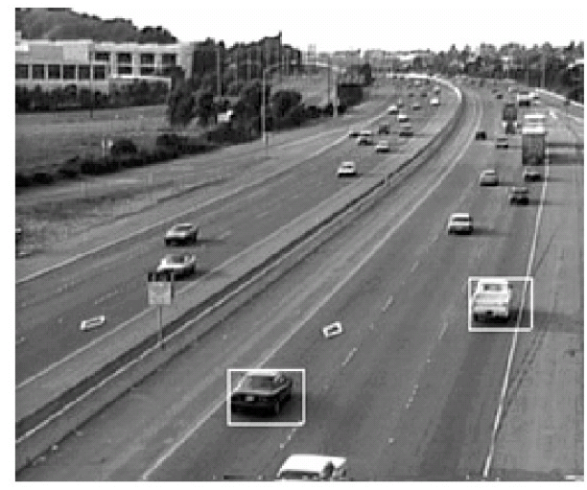
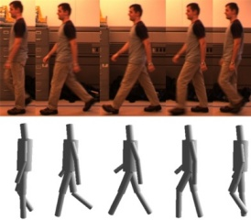
Not covered: Video processing
Tracking objects, video analysis, low level motion, optical flow
Tomas Izo
Slide credit: Kristen Grauman

Slide 16
Plan for today
Course overview
Introduction to computer vision research
Logistics and requirements
Notes:
Please interrupt at any time with questions or comments

Slide 17
Plan for today
Course overview
Introduction to computer vision research
Logistics and requirements
Notes:
Please interrupt at any time with questions or comments

Slide 18


Textbooks
  By Rick Szeliski
  http://szeliski.org/Book/
  By Kristen Grauman, Bastian Leibe
  Visual Object Recognition
Notes:
Lectures will be posted online

Slide 19
Requirements / Grading
Problem sets (60%)
Final exam (37%)
  comprehensive (cover all topics learned in class)
Class and Piazza participation (3%)
  Piazza: participation points for posting (sensible) questions and answers

Slide 20
Problem sets
Some short answer concept questions
Matlab programming problems
  Implementation
  Explanation, results
Follow instructions; points will be deducted if we can’t run your code out of the box
Ask questions on Piazza first
Submit to Canvas
The assignments will take significant time to do
Start early
TA will go over problem set during discussion sections after release (others will be used as extra office hours)

Slide 21
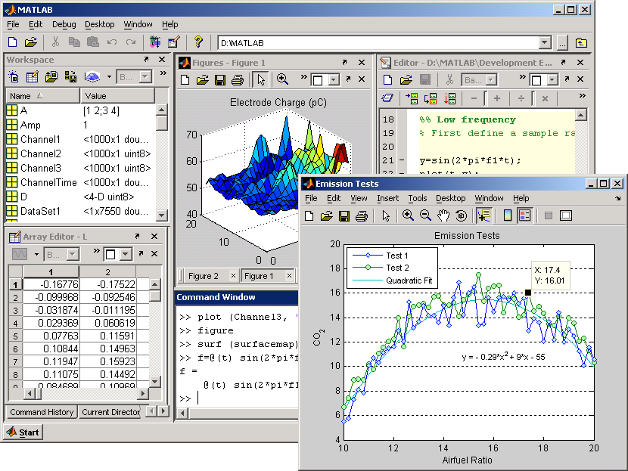
Matlab
Built-in toolboxes for low-level image processing, visualization
Compact programs
Intuitive interactive debugging
Widely used in engineering
Slide credit: Kristen Grauman

Slide 22
Matlab
CSIF labs 67, 71, 75 (pc1-pc60)
Academic Surge 1044 and 1116
Lab schedule (reservations) and remote access info found on class website
Matlab available for free from campus software site

Slide 23
Problem Set 0
Matlab warmup
Basic image manipulation
Out tonight, due 4/12

Slide 24
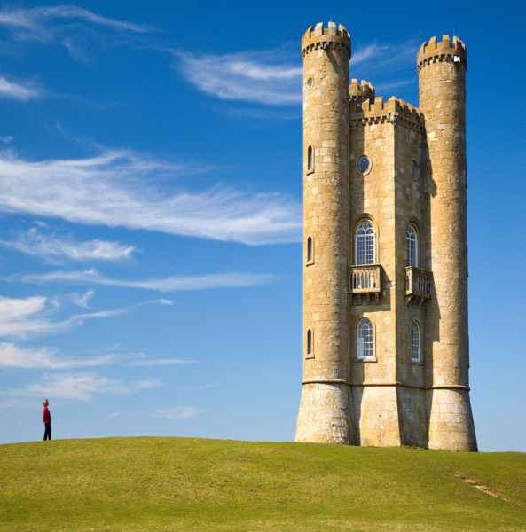
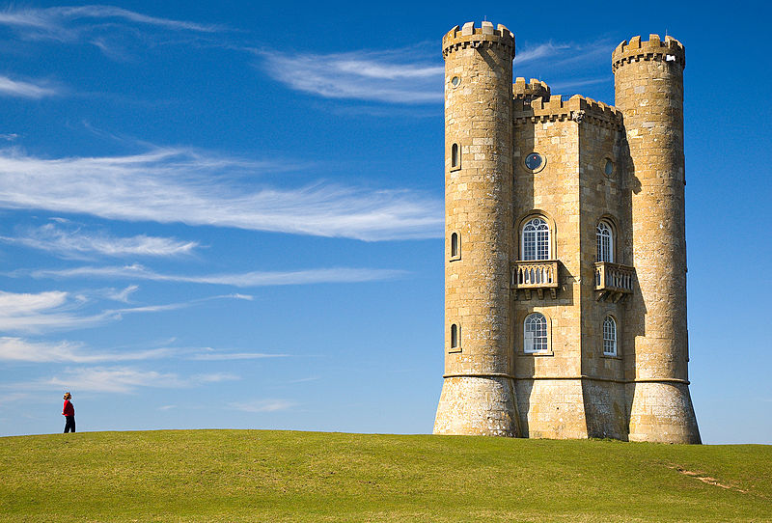
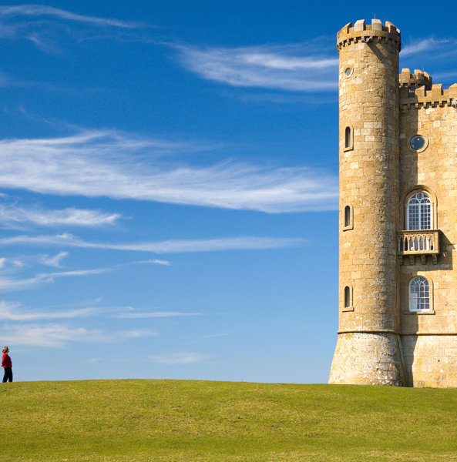
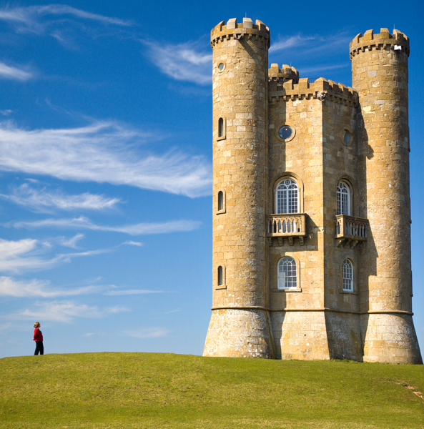
Preview of some problem sets
resize: castle squished
crop: castle cropped
content aware resizing:
seam carving

Slide 25
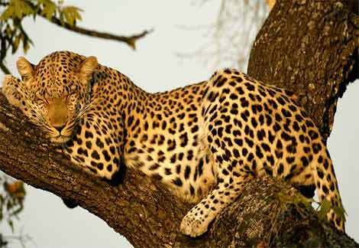
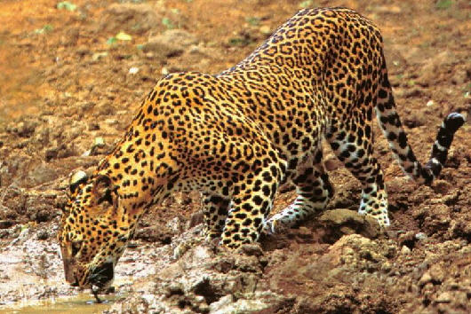
Preview of some problem sets
Grouping

Slide 26
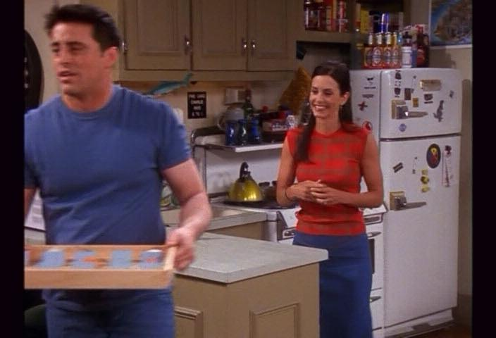
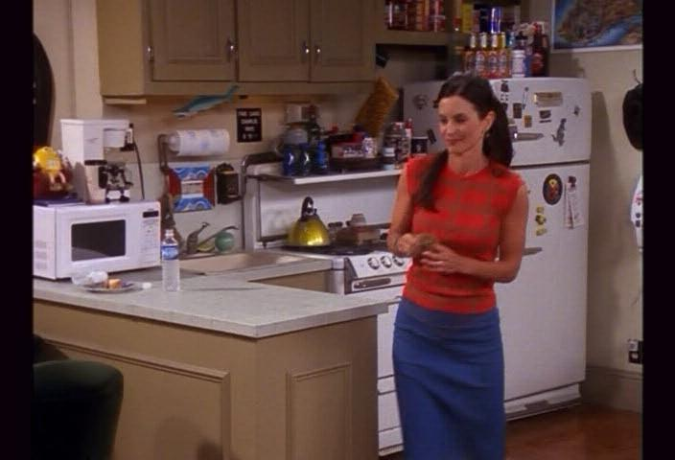
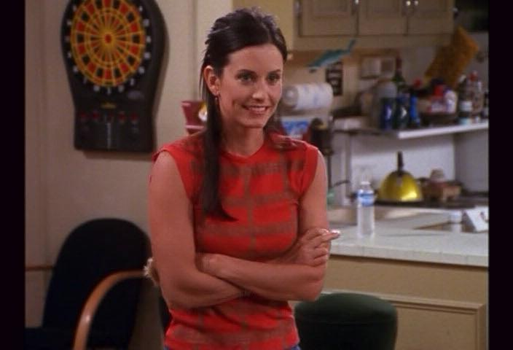
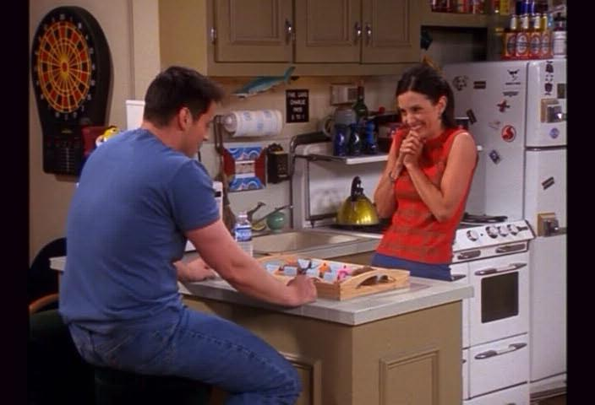
Preview of some problem sets
Object search and recognition
Notes:
26

Slide 27
Problem set deadlines
Problem sets due 11:59 PM
  Follow submission instructions given in assignment
  Submit to Canvas; no hard copy submissions
  Deadlines are firm. We’ll use Canvas timestamp. Even 1 minute late is late.
Late submissions: 1 point deduction for every hour after the deadline up to 72 hours; after 72 hours, you will receive a 0
If your program doesn’t work, clean up the code, comment it well, explain what you have, and still submit. Draw our attention to this in your answer sheet.

Slide 28
Collaboration policy
All responses and code must be written individually or in pairs (a group of 2)
Students submitting answers or code found to be identical or substantially similar (due to inappropriate collaboration) risk failing the course
  We will be using MOSS to check for cheating!
  Copying online solutions also counts as cheating!
  Please don’t cheat… you are going to get caught!
Read and follow UC Davis code of conduct

Slide 29
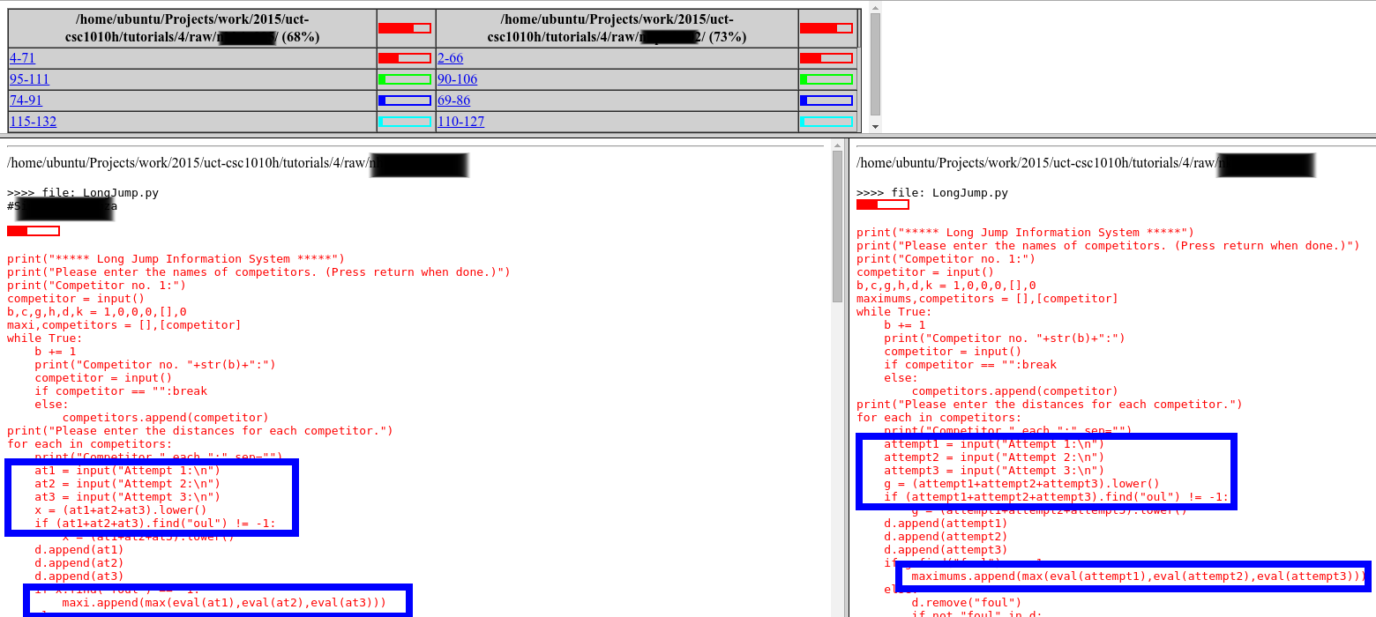
MOSS

Slide 30
Miscellaneous
Check class website regularly for assignment files, notes, announcements, etc.
Come to lecture on time
No laptops, phones, tablets, etc. in class please
Please interrupt with questions at any time

Slide 31
Coming up
Read the class webpage carefully
Next class (Thurs): Matlab tutorial
PS0 out tonight, due 4/12
No office hours on Friday

