Slide 1
Local features and image matching May 5th, 2020
Yong Jae Lee
UC Davis

Slide 2
Last time
RANSAC for robust fitting
Lines, translation
Image mosaics
Fitting a 2D transformation
Homography

Slide 3
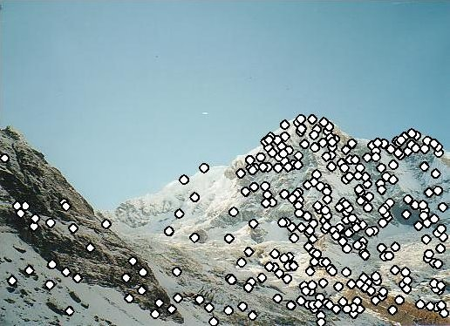
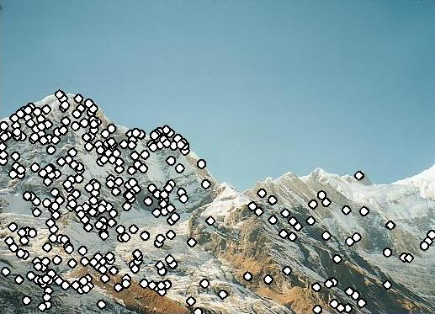
Today
Mosaics recap:
How to warp one image to the other, given H?
How to detect which features to match?

Slide 4
How to stitch together a panorama (a.k.a. mosaic)?
Basic Procedure
Take a sequence of images from the same position
Rotate the camera about its optical center
Compute transformation between second image and first
Transform the second image to overlap with the first
Blend the two together to create a mosaic
(If there are more images, repeat)
Source: Steve Seitz

Slide 5
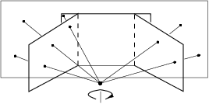
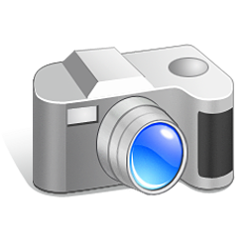
Mosaics
. . .
image from S. Seitz
Obtain a wider angle view by combining multiple images.

Slide 6
Homography
…
…
To compute the homography given pairs of corresponding points in the images, we need to set up an equation where the parameters of H are the unknowns…

Slide 7
Solving for homographies
p’ = Hp
Defined up to a scale factor.
Constrain Frobenius norm of H to be 1.
Problem to be solved:
where vector of unknowns h = [h₀₀,h₀₁,h₀₂,h₁₀,h₁₁,h₁₂,h₂₀,h₂₁,h₂₂]^{T}
Adapted from Devi Parikh
Notes:
There is a whole set of solution homographies with variation across scale that represent the same geometrical transformation

Slide 8
Solving for homographies
There are 9 variables h₀₀,…,h₂₂.
Are there 9 degrees of freedom?
No. We can multiply all h_{ij} by nonzero scalar k without changing the equations:
Notes:
There is a whole set of solution homographies with variation across scale that represent the same geometrical transformation
DOF: number of variables that are free to vary

Slide 9
Enforcing 8 DOF
Impose unit vector constraint
Subject to:
Notes:
However, if h_22=0 this approach fails
Also poor results if h_22 close to zero; thus, not recommended

Slide 10
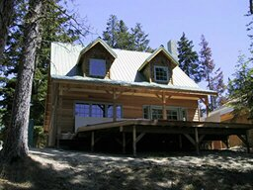
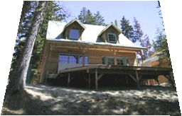
Projective: # correspondences?
?
T(x,y)
y
y’
x
x’
How many correspondences needed for projective?
Source: Alyosha Efros

Slide 11
RANSAC for estimating homography
RANSAC loop:
1. Select four feature pairs (at random)
2. Compute homography H (exact)
3. Compute inliers where SSD(p_{i}’, Hp_{i})< ε
4. Keep largest set of inliers
5. Re-compute least-squares H estimate on all of the inliers
Slide credit: Steve Seitz

Slide 12
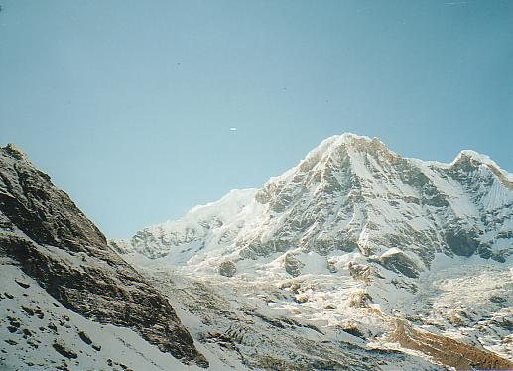
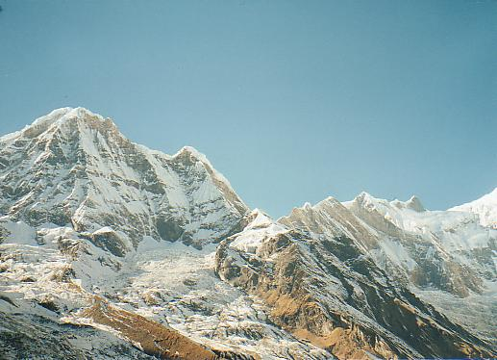
Robust feature-based alignment
Source: L. Lazebnik

Slide 13
Robust feature-based alignment
Extract features
Source: L. Lazebnik

Slide 14
Robust feature-based alignment
Extract features
Compute putative matches
Source: L. Lazebnik

Slide 15
Robust feature-based alignment
Extract features
Compute putative matches
Loop:
Hypothesize transformation T (small group of putative matches that are related by T)
Source: L. Lazebnik

Slide 16
Robust feature-based alignment
Extract features
Compute putative matches
Loop:
Hypothesize transformation T (small group of putative matches that are related by T)
Verify transformation (search for other matches consistent with T)
Source: L. Lazebnik

Slide 17
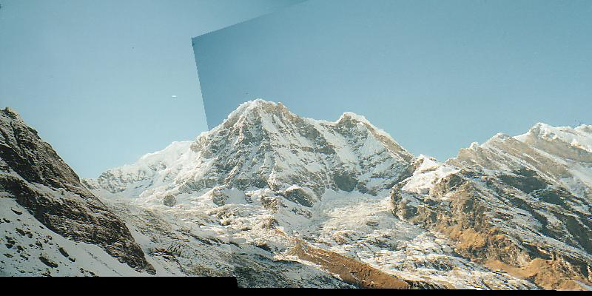
Robust feature-based alignment
Extract features
Compute putative matches
Loop:
Hypothesize transformation T (small group of putative matches that are related by T)
Verify transformation (search for other matches consistent with T)
Source: L. Lazebnik

Slide 18
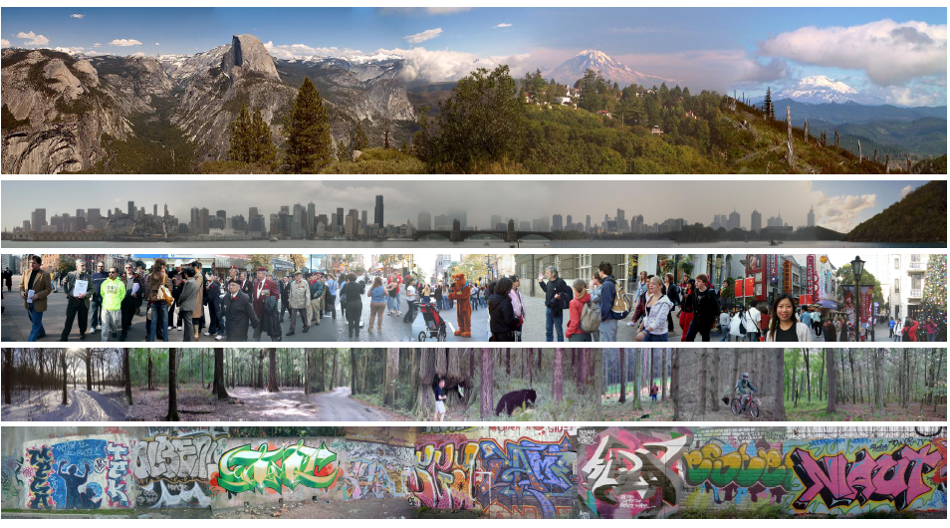
Creating and Exploring a Large Photorealistic Virtual Space
Josef Sivic, Biliana Kaneva, Antonio Torralba, Shai Avidan and William T. Freeman, Internet Vision Workshop, CVPR 2008.
http://www.youtube.com/watch?v=E0rboU10rPo
Notes:
a collection of several million images downloaded from Flickr
broken into themes that consist of a few hundred thousand images each

Slide 19
Creating and Exploring a Large Photorealistic Virtual Space
Current view, and desired view in green
Synthesized view from new camera
Induced camera motion
Notes:
Scene matching with camera view transformations.
First row: The input image with the desired camera view overlaid in green.
Second row: The synthesized view from the new camera. The goal is to find images which can fill-in the unseen portion of the image (shown in black) while matching the visible portion.
Third row: the top matching image found in the dataset of street scenes for each motion.
Fourth row: induced camera motion between the two pictures.
Final row: composite after Poisson blending

Slide 20
Today
Mosaics recap:
How to warp one image to the other, given H?
How to detect which features to match?

Slide 21
Detecting local invariant features
Detection of interest points
Harris corner detection
(Scale invariant blob detection: LoG)
(Next time: description of local patches)

Slide 22
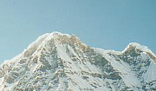
Local features: main components
Detection: Identify the interest points
Description: Extract vector feature descriptor surrounding each interest point.
Matching: Determine correspondence between descriptors in two views
Kristen Grauman
Notes:
3 main components

Slide 23
Local features: desired properties
Repeatability
The same feature can be found in several images despite geometric and photometric transformations
Saliency
Each feature has a distinctive description
Compactness and efficiency
Many fewer features than image pixels
Locality
A feature occupies a relatively small area of the image; robust to clutter and occlusion
Notes:
4 desired properties

Slide 24
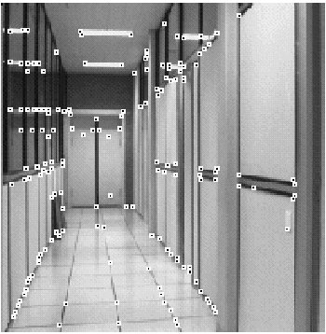
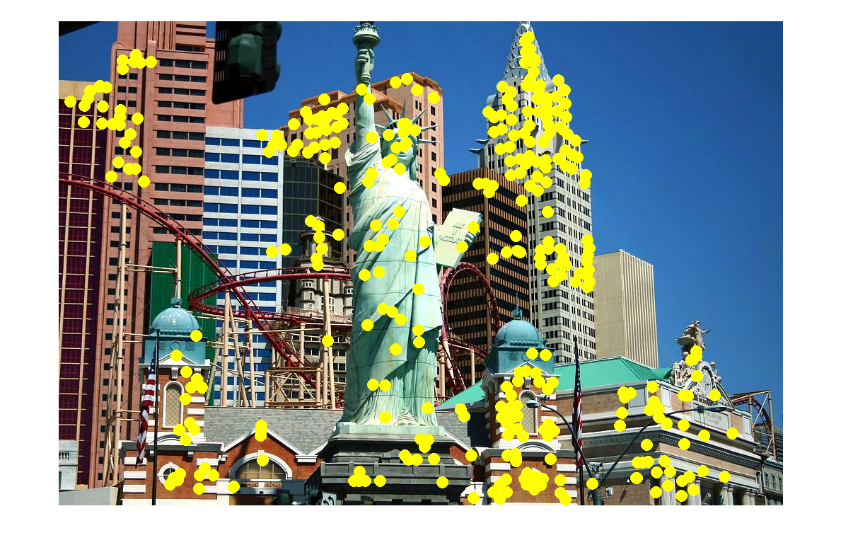
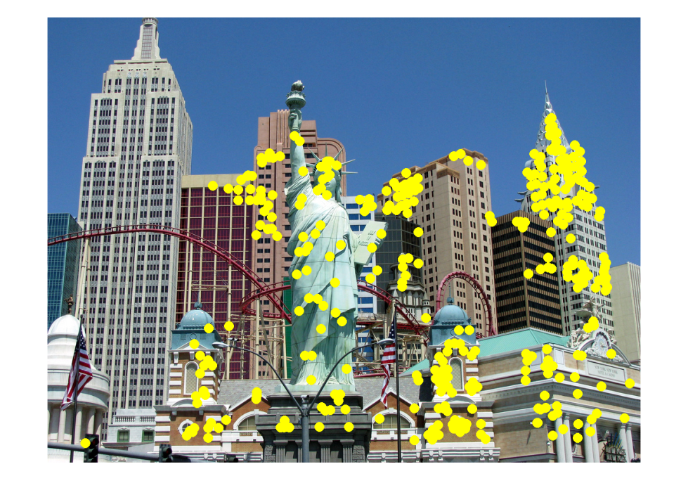
Applications
Local features have be used for:
Image alignment
3D reconstruction
Motion tracking
Robot navigation
Indexing and database retrieval
Object recognition
Lana Lazebnik

Slide 25
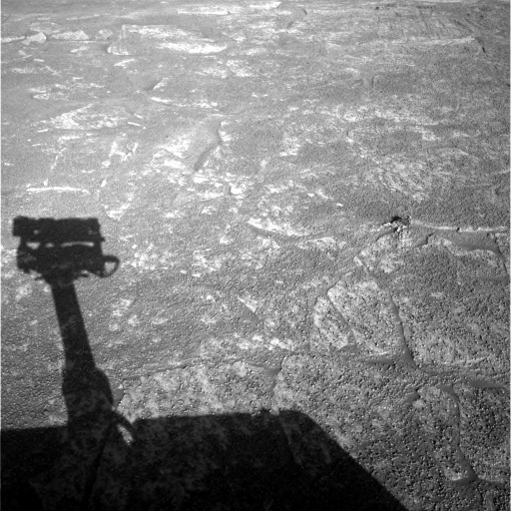
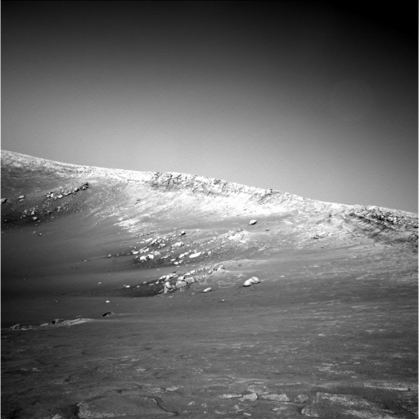
A hard feature matching problem
NASA Mars Rover images

Slide 26
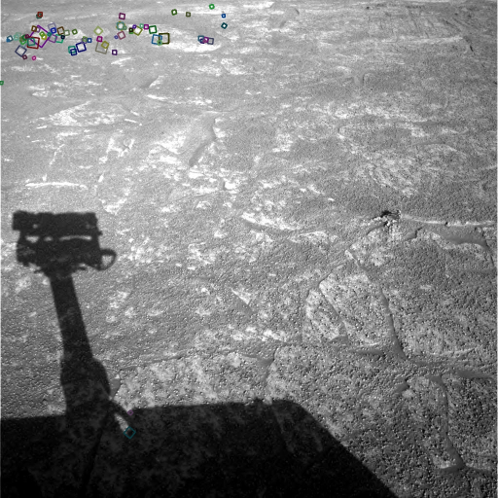
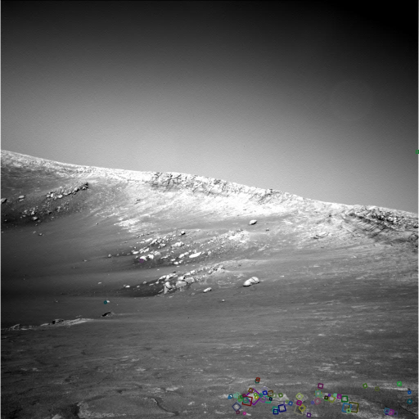
Answer below (look for tiny colored squares…)
NASA Mars Rover images
with SIFT feature matches Figure by Noah Snavely

Slide 27
Goal: interest operator repeatability
We want to detect (at least some of) the same points in both images.
Yet we have to be able to run the detection procedure independently per image.
No chance to find true matches!
Notes:
27

Slide 28
Goal: descriptor distinctiveness
We want to be able to reliably determine which point goes with which.
Must provide some invariance to geometric and photometric differences between the two views.
?

Slide 29
Local features: main components
Detection: Identify the interest points
Description:Extract vector feature descriptor surrounding each interest point.
Matching: Determine correspondence between descriptors in two views

Slide 30
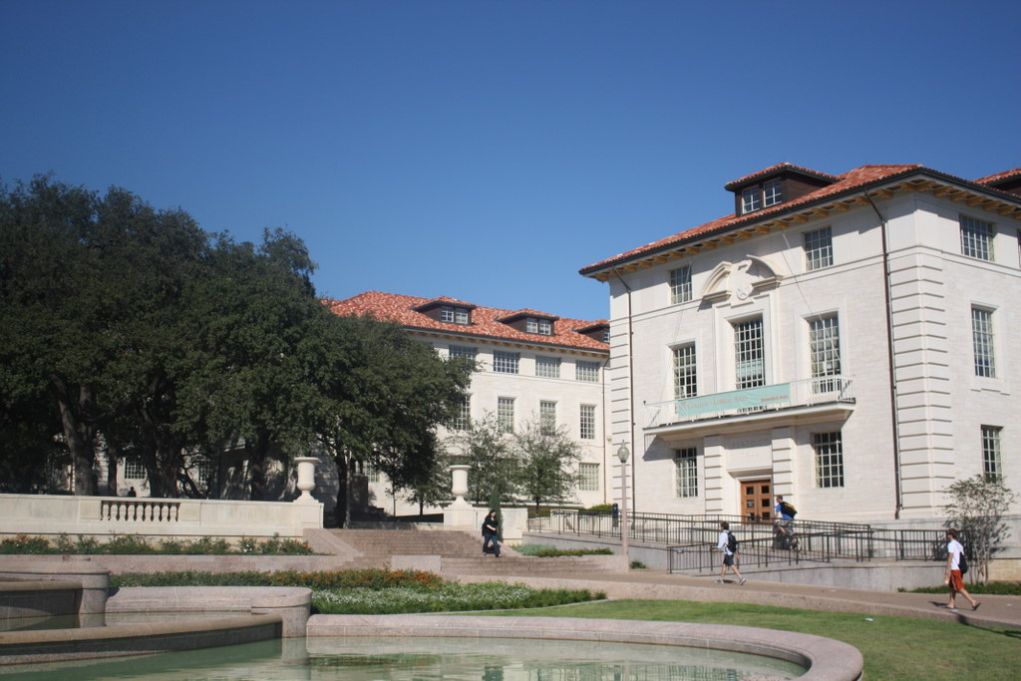
What points would you choose (for repeatability, distinctiveness)?
Notes:
For repeatability, distinctiveness

Slide 31
Corners as distinctive interest points
We should easily recognize the point by looking through a small window
Shifting a window in any direction should give a large change in intensity
“flat” region: no change in all directions
“edge”: no change along the edge direction
“corner”: significant change in all directions
Slide credit: Alyosha Efros, Darya Frolova, Denis Simakov

Slide 32
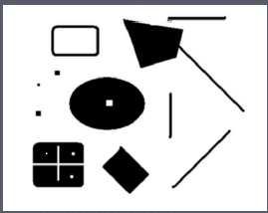
Corners as distinctive interest points
2 x 2 matrix of image derivatives (averaged in neighborhood of a point).
Notation:

Slide 33
What does this matrix reveal?
First, consider an axis-aligned corner:

Slide 34
What does this matrix reveal?
First, consider an axis-aligned corner:
This means dominant gradient directions align with x or y axis
Look for locations where both λ’s are large.
If either λ is close to 0, then this is not corner-like.
What if we have a corner that is not aligned with the image axes?

Slide 35
What does this matrix reveal?
Since M is symmetric, we have
(Eigenvalue decomposition)
The eigenvalues of M reveal the amount of intensity change in the two principal orthogonal gradient directions in the window.
Notes:
rotation

Slide 36
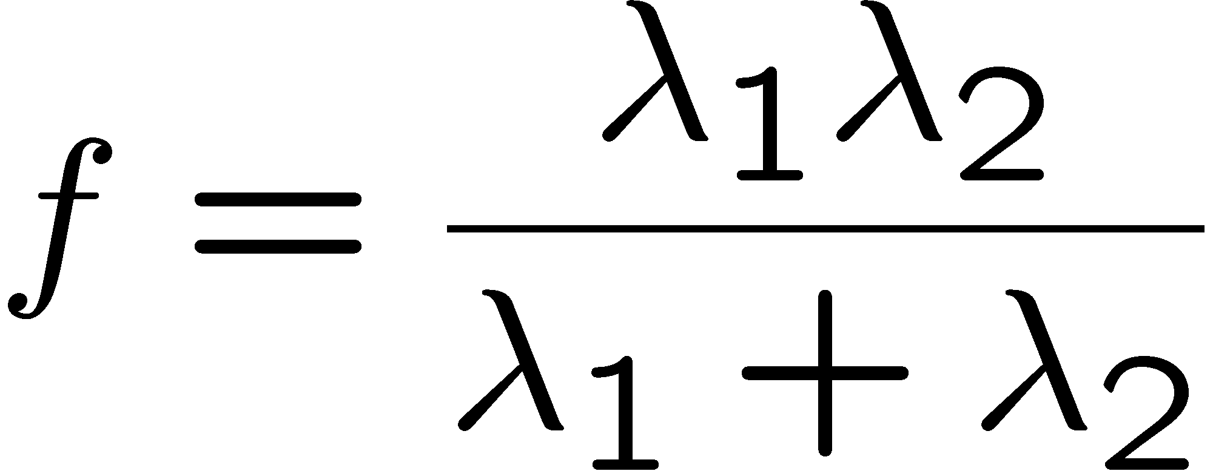
Corner response function
“edge”:
“corner”:
“flat” region
λ₁ >> λ₂
λ₁ and λ₂ are large, λ₁ ~ λ₂;
λ₁ and λ₂ are small;
λ₂ >> λ₁

Slide 37
Harris corner detector
Compute M matrix for each image window to get their cornerness scores.
Find points whose surrounding window gave large corner response (f > threshold)
Take the points of local maxima, i.e., perform non-maximum suppression
Notes:
37

Slide 38
Example of Harris application
Kristen Grauman

Slide 39
Example of Harris application
Compute corner response at every pixel.
Kristen Grauman

Slide 40
Example of Harris application
Kristen Grauman
Notes:
Only non-maxes exceeding average (thresholded)

Slide 41
Properties of the Harris corner detector
Rotation invariant?
Yes

Slide 42
Properties of the Harris corner detector
Rotation invariant?
Translation invariant?
Yes
Yes

Slide 43
Properties of the Harris corner detector
Rotation invariant?
Translation invariant?
Scale invariant?
Yes
Yes
No
All points will be classified as edges
Corner !

Slide 44
Summary
Image warping to create mosaic, given homography
Interest point detection
Harris corner detector
Next time:
Laplacian of Gaussian, automatic scale selection

