Slide 1

Fitting:
Voting and the Hough Transform
April 23rd, 2020
Yong Jae Lee
UC Davis

Slide 2
Last time: Grouping
Bottom-up segmentation via clustering
  To find mid-level regions, tokens
  General choices -- features, affinity functions, and clustering algorithms
  Example clustering algorithms
    Mean shift and mode finding: K-means, Mean shift
    Graph theoretic: Graph cut, normalized cuts
Grouping also useful for quantization
  Texton histograms for texture within local region
Slide credit: Kristen Grauman

Slide 3
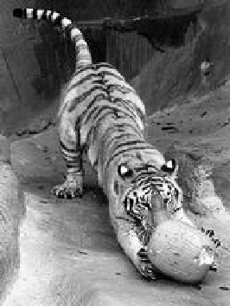
Recall: Images as graphs
q
w_{pq}
w
p
Fully-connected graph
  node for every pixel
  link between every pair of pixels, p,q
  similarity w_{pq} for each link
      similarity is inversely proportional to difference in color and position
Slide by Steve Seitz

Slide 4
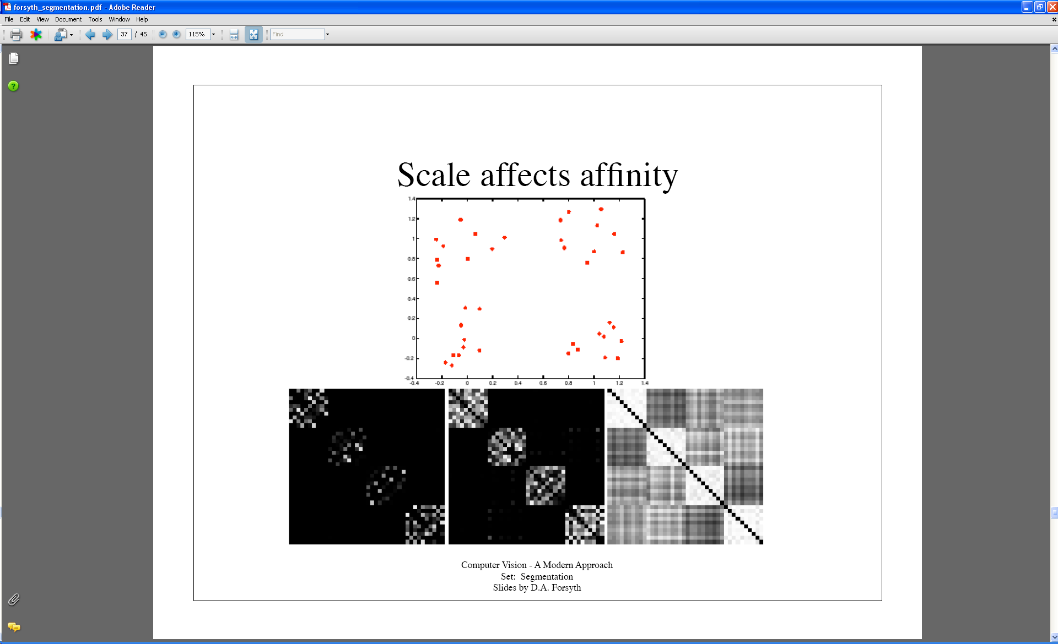
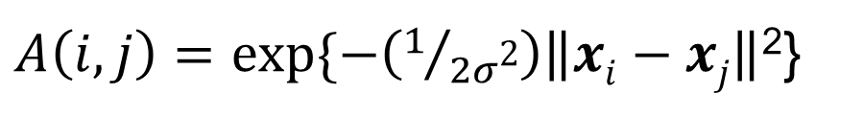
Last time: Measuring affinity
Points x₁…x₁₀
40 data points
40 x 40 affinity matrix A
x₁
.
.
.
x₄₀
Points x₃₁…x₄₀
x_{1 . . .} x₄₀
$A\left(i,j\right)=exp⁡\{−\left(1/{2σ\text{2}}\right)\left\|xi−xj\right\|$²}
What do the blocks signify?
What does the symmetry of the matrix signify?
How would the matrix change with larger value of σ?
Slide credit: Kristen Grauman

Slide 5
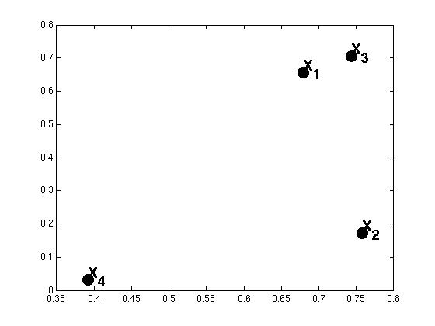
Example: weighted graphs
Suppose we have a 4-pixel image
(i.e., a 2 x 2 matrix)
Each pixel described by 2 features
Feature dimension 2
Feature dimension 1
Dimension of data points : d = 2
Number of data points : N = 4
Kristen Grauman

Slide 6
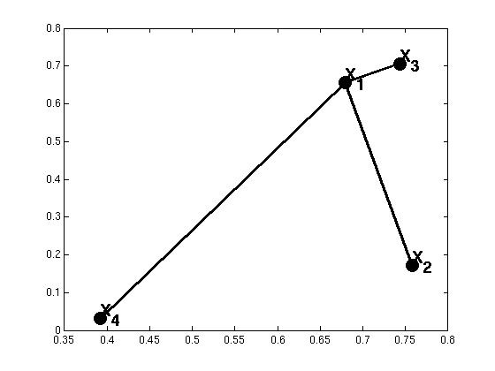

Example: weighted graphs
Computing the distance matrix:
D(:,1)=
0.01
D(1,:)=
(0)
0.24
0.01
0.47
0.24
0.47
for i=1:N
for j=1:N
D(i,j) = ||x_{i}- x_{j}||²
end
end
Kristen Grauman

Slide 7
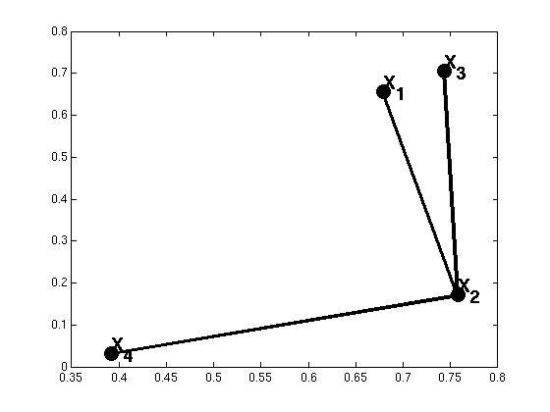
Example: weighted graphs
Computing the distance matrix:
D(:,1)=
D(1,:)=
(0)
0.24
0.01
0.47
0.29
0.24
(0)
0.29
0.15
0.24
0.15
for i=1:N
for j=1:N
D(i,j) = ||x_{i}- x_{j}||²
end
end
Kristen Grauman

Slide 8
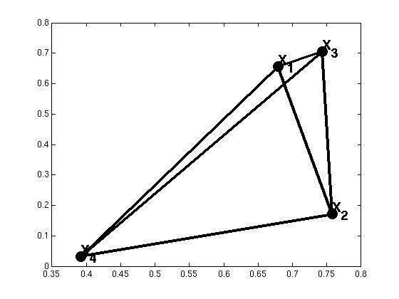
Example: weighted graphs
Computing the distance matrix:
for i=1:N
for j=1:N
D(i,j) = ||x_{i}- x_{j}||²
end
end
N x N matrix
Kristen Grauman

Slide 9
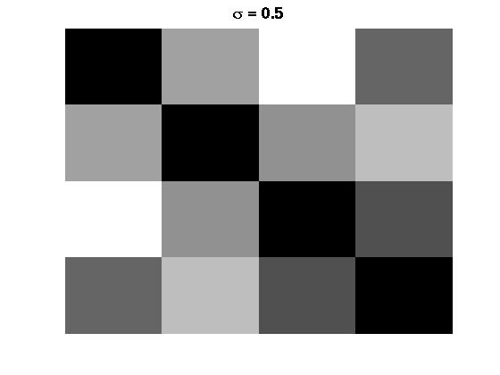
Distances→affinities
Example: weighted graphs
D
A
for i=1:N
for j=i+1:N
A(i,j) = exp(-1/(2*σ^2)*||x_{i}- x_{j}||²);
A(j,i) = A(i,j);
end
end
for i=1:N
for j=1:N
D(i,j) = ||x_{i}- x_{j}||²
end
end
Kristen Grauman

Slide 10

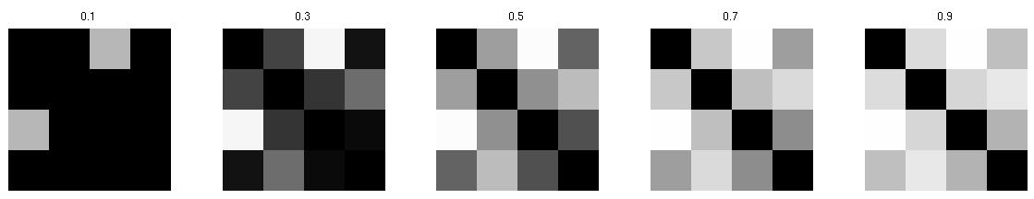
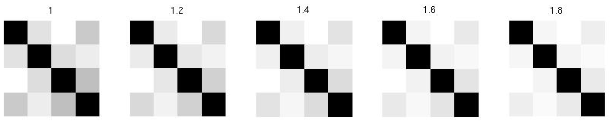
Scale parameter σ affects affinity
Distance matrix
D=
Affinity matrix with increasing σ:
Kristen Grauman

Slide 11

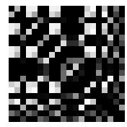
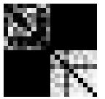
Visualizing a shuffled affinity matrix
If we permute the order of the vertices as they are referred to in the affinity matrix, we see different patterns:
Kristen Grauman

Slide 12
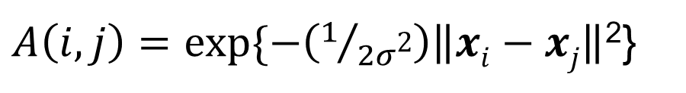
Putting these two aspects together
Points x₁…x₁₀
Data points
Points x₃₁…x₄₀
σ=.1 σ=.2 σ=1
Affinity matrices
$A\left(i,j\right)=exp⁡\{−\left(1/{2σ\text{2}}\right)\left\|xi−xj\right\|$²}
Kristen Grauman

Slide 13
Goal: Segmentation by Graph Cuts
w
A
B
C
Break graph into segments
Delete links that cross between segments
  Easiest to break links that have low similarity
    similar pixels should be in the same segments
    dissimilar pixels should be in different segments
Slide credit: Kristen Grauman

Slide 14
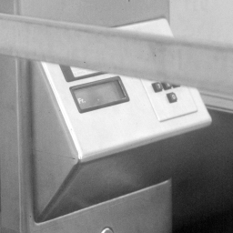
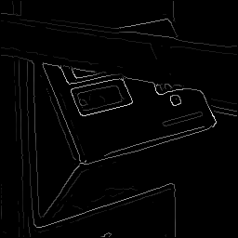
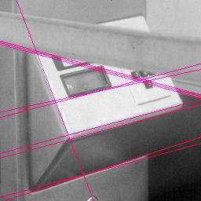
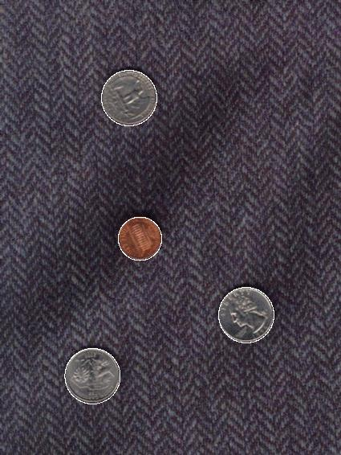
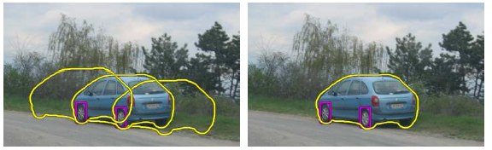
Now: Fitting
Want to associate a model with multiple observed features
[Fig from Marszalek & Schmid, 2007]
For example, the model could be a line, a circle, or an arbitrary shape.
Notes:
We want to form a higher-level, more compact representation of the features in the image by grouping multiple features according to a simple model

Slide 15
Fitting: Main idea
Choose a parametric model that best represents a set of features
Membership criterion is not local
  Can’t tell whether a point belongs to a given model just by looking at that point
Three main questions:
  What model represents this set of features best?
  Which of several model instances gets which feature?
  How many model instances are there?
Computational complexity is important
  It is infeasible to examine every possible set of parameters and every possible combination of features
Slide credit: L. Lazebnik

Slide 16
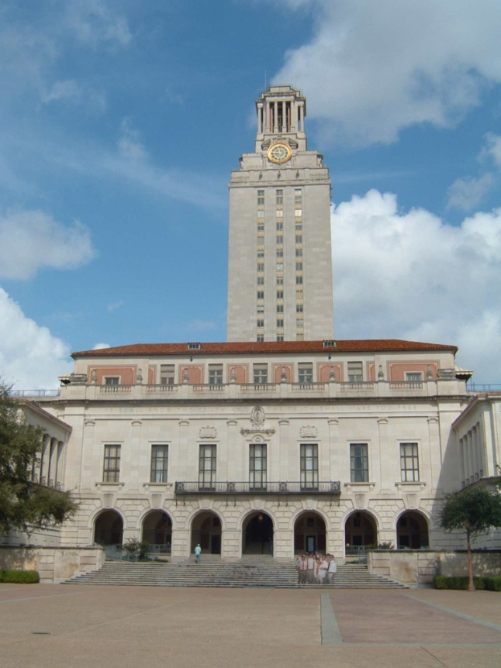
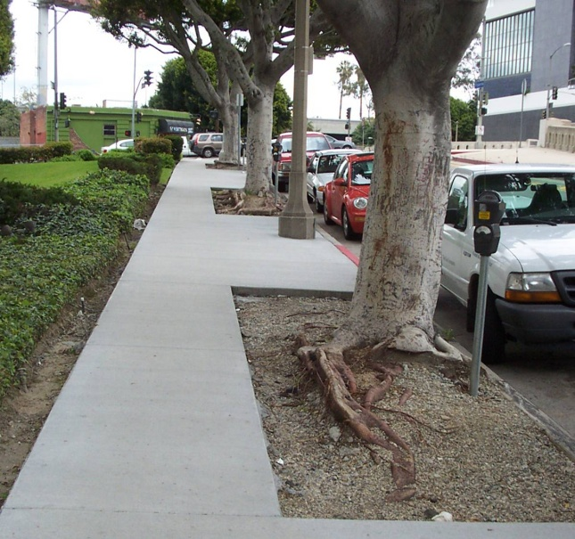
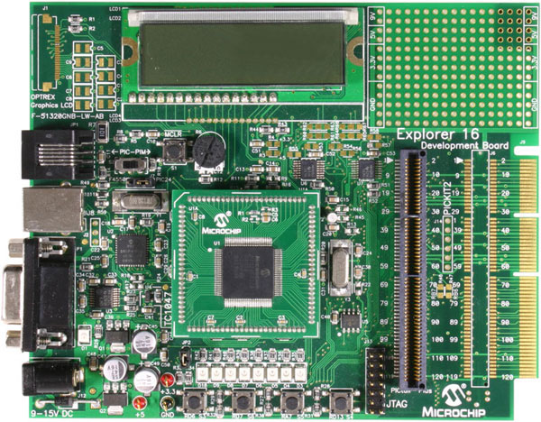
Example: Line fitting
Why fit lines?
Many objects characterized by presence of straight lines
Wait, why aren’t we done just by running edge detection?
Kristen Grauman

Slide 17
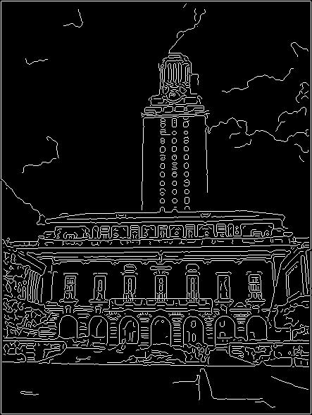
Difficulty of line fitting
Extra edge points (clutter), multiple models:
  which points go with which line, if any?
Only some parts of each line detected, and some parts are missing:
  how to find a line that bridges missing evidence?
Noise in measured edge points, orientations:
  how to detect true underlying parameters?
Kristen Grauman

Slide 18
Voting
It’s not feasible to check all combinations of features by fitting a model to each possible subset.
Voting is a general technique where we let each feature vote for all models that are compatible with it.
  Cycle through features, cast votes for model parameters.
  Look for model parameters that receive a lot of votes.
Noise & clutter features will cast votes too, but typically their votes should be inconsistent with the majority of “good” features.
Kristen Grauman

Slide 19
Fitting lines: Hough transform
Given points that belong to a line, what is the line?
How many lines are there?
Which points belong to which lines?
Hough Transform is a voting technique that can be used to answer all of these questions.
  Main idea:
  1. Record vote for each possible line on which each edge point lies.
  2. Look for lines that get many votes.
Kristen Grauman

Slide 20

Finding lines in an image: Hough space
Equation of a line?
y = mx + b
y
b
b₀
x
m₀
m
image space
Hough (parameter) space
Connection between image (x,y) and Hough (m,b) spaces
  A line in the image corresponds to a point in Hough space
  To go from image space to Hough space:
    given a set of points (x,y), find all (m,b) such that y = mx + b
Slide credit: Steve Seitz

Slide 21

Finding lines in an image: Hough space
y
b
y₀
x₀
x
m
image space
Hough (parameter) space
Connection between image (x,y) and Hough (m,b) spaces
  A line in the image corresponds to a point in Hough space
  To go from image space to Hough space:
    given a set of points (x,y), find all (m,b) such that y = mx + b
  What does a point (x₀, y₀) in the image space map to?
    Answer: the solutions of b = -x₀m + y₀
    this is a line in Hough space
Slide credit: Steve Seitz

Slide 22
Finding lines in an image: Hough space
y
b
(x₁, y₁)
y₀
(x₀, y₀)
b = –x₁m + y₁
x₀
x
m
image space
Hough (parameter) space
What are the line parameters for the line that contains both (x₀, y₀) and (x₁, y₁)?
  It is the intersection of the lines b = –x₀m + y₀ and
  b = –x₁m + y₁
Slide credit: Kristen Grauman

Slide 23
Finding lines in an image: Hough algorithm
y
b
x
m
image space
Hough (parameter) space
How can we use this to find the most likely parameters (m,b) for the most prominent line in the image space?
Let each edge point in image space vote for a set of possible parameters in Hough space
Accumulate votes in discrete set of bins; parameters with the most votes indicate line in image space.
Slide credit: Kristen Grauman

Slide 24
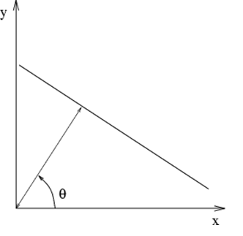
Polar representation for lines
Issues with usual (m,b) parameter space: can take on infinite values, undefined for vertical lines.
: perpendicular distance from line to origin
: angle the perpendicular makes with the x-axis
Point in image space → sinusoid segment in Hough space
Adapted from Kristen Grauman

Slide 25
Hough line demo

Slide 26
Hough transform algorithm
Using the polar parameterization:
Basic Hough transform algorithm
  Initialize H[d, θ]=0
  for each edge point I[x,y] in the image
    for θ = [θ_{min} to θ_{max} ] // some quantization
      H[d, θ] += 1
  Find the value(s) of (d, θ) where H[d, θ] is maximum
  The detected line in the image is given by
H: accumulator array (votes)
d
θ
Time complexity (in terms of number of votes per pt)?
Source: Steve Seitz
Notes:
Num_edge_pts * num_theta

Slide 27
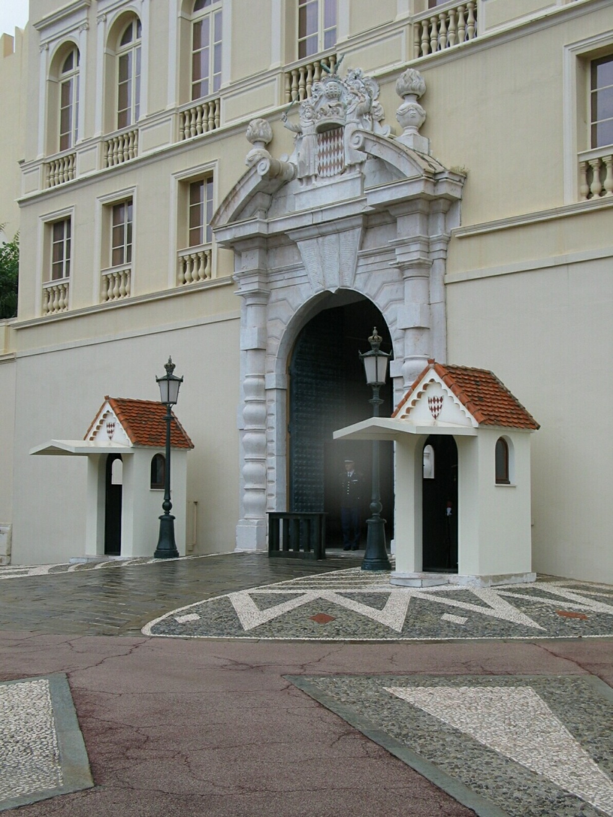
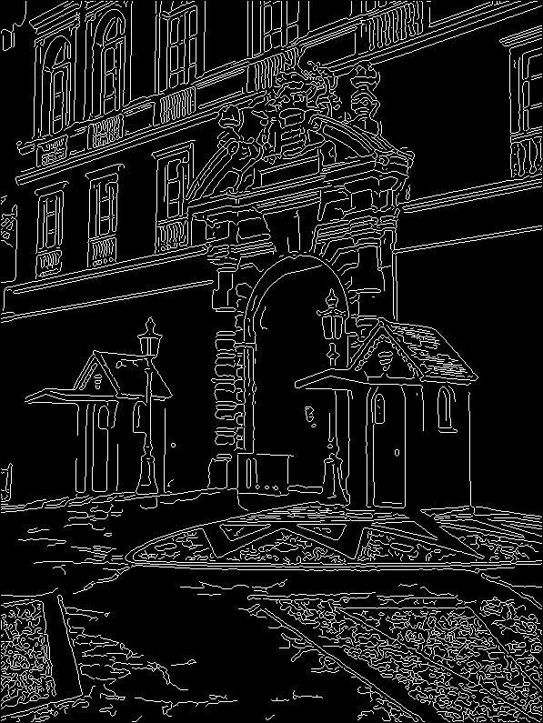
1. Image → Canny
Derek Hoiem

Slide 28
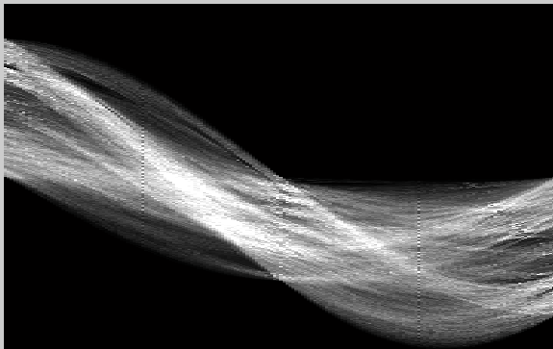
2. Canny → Hough votes
Derek Hoiem

Slide 29
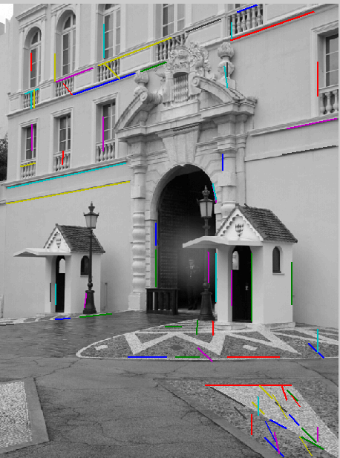
3. Hough votes → Edges
Find peaks
Derek Hoiem

Slide 30
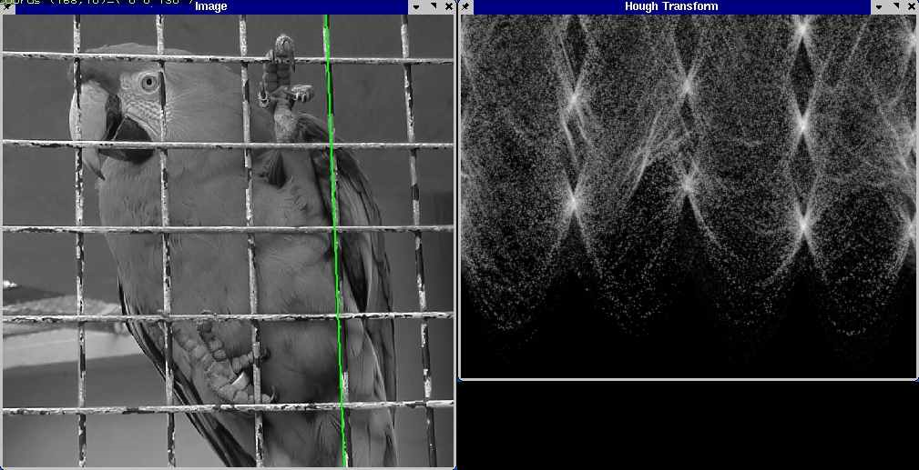
Hough transform example
Derek Hoiem
http://ostatic.com/files/images/ss_hough.jpg

Slide 31
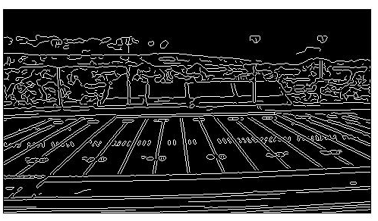
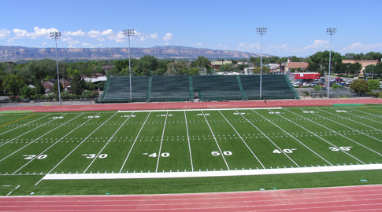
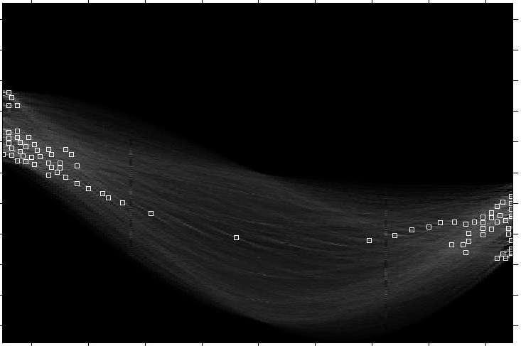
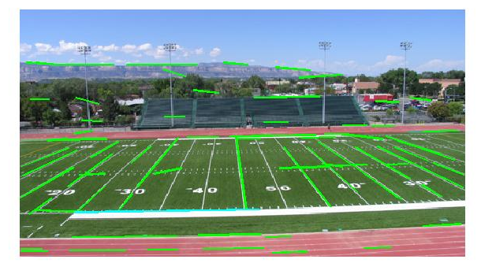
Original image
Canny edges
Vote space and top peaks
Showing longest segments found
Kristen Grauman

Slide 32
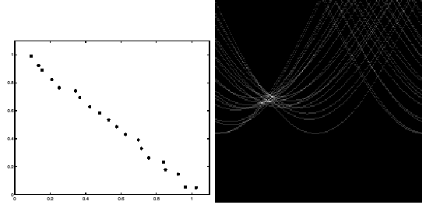
Impact of noise on Hough
y
d
x
θ
Image space
edge coordinates
Votes
What difficulty does this present for an implementation?
Notes:
Quantization errors: an appropriate grid size is difficult to pick.
Need to adjust grid size or smooth

Slide 33
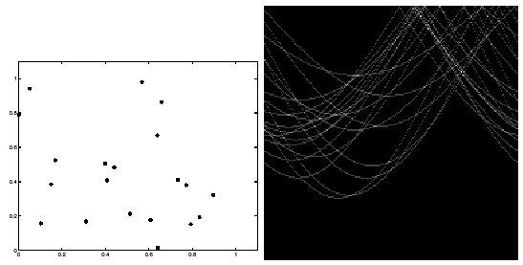
Impact of noise on Hough
Image space
edge coordinates
Votes
Here, everything appears to be “noise”, or random edge points, but we still see peaks in the vote space.
Slide credit: Kristen Grauman
Notes:
possible to find phantom lines

Slide 34


Extensions
Recall: when we detect an edge point, we also know its gradient direction
Extension 1: Use the image gradient
  same
  for each edge point I[x,y] in the image
    θ = gradient at (x,y)
    H[d, θ] += 1
  same
  same
(Reduces degrees of freedom)
Extension 2
  give more votes for stronger edges
Extension 3
  change the sampling of (d, θ) to give more/less resolution
Extension 4
  The same procedure can be used with circles, squares, or any other shape
Slide credit: Kristen Grauman

Slide 35
Extensions
Extension 1: Use the image gradient
  same
  for each edge point I[x,y] in the image
    compute unique (d, θ) based on image gradient at (x,y)
      H[d, θ] += 1
  same
  same
(Reduces degrees of freedom)
Extension 2
  give more votes for stronger edges (use magnitude of gradient)
Extension 3
  change the sampling of (d, θ) to give more/less resolution
Extension 4
  The same procedure can be used with circles, squares, or any other shape…
Source: Steve Seitz

Slide 36
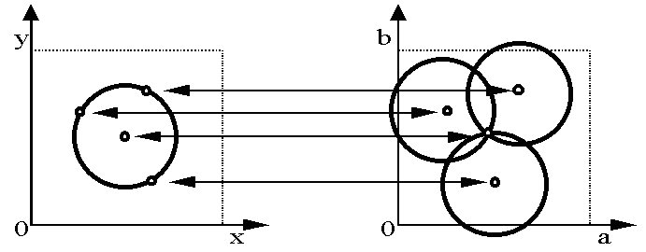
Hough transform for circles
Circle: center (a,b) and radius r
Equation of circle?
For a fixed radius r
Equation of set of circles that all pass through a point?
Image space
Hough space
Adapted by Devi Parikh from: Kristen Grauman

Slide 37
Hough transform for circles
Circle: center (a,b) and radius r
For a fixed radius r
Intersection: most votes for center occur here.
Image space
Hough space
Kristen Grauman

Slide 38
Hough transform for circles
Circle: center (a,b) and radius r
For an unknown radius r
r
?
b
a
Image space
Hough space
Kristen Grauman

Slide 39
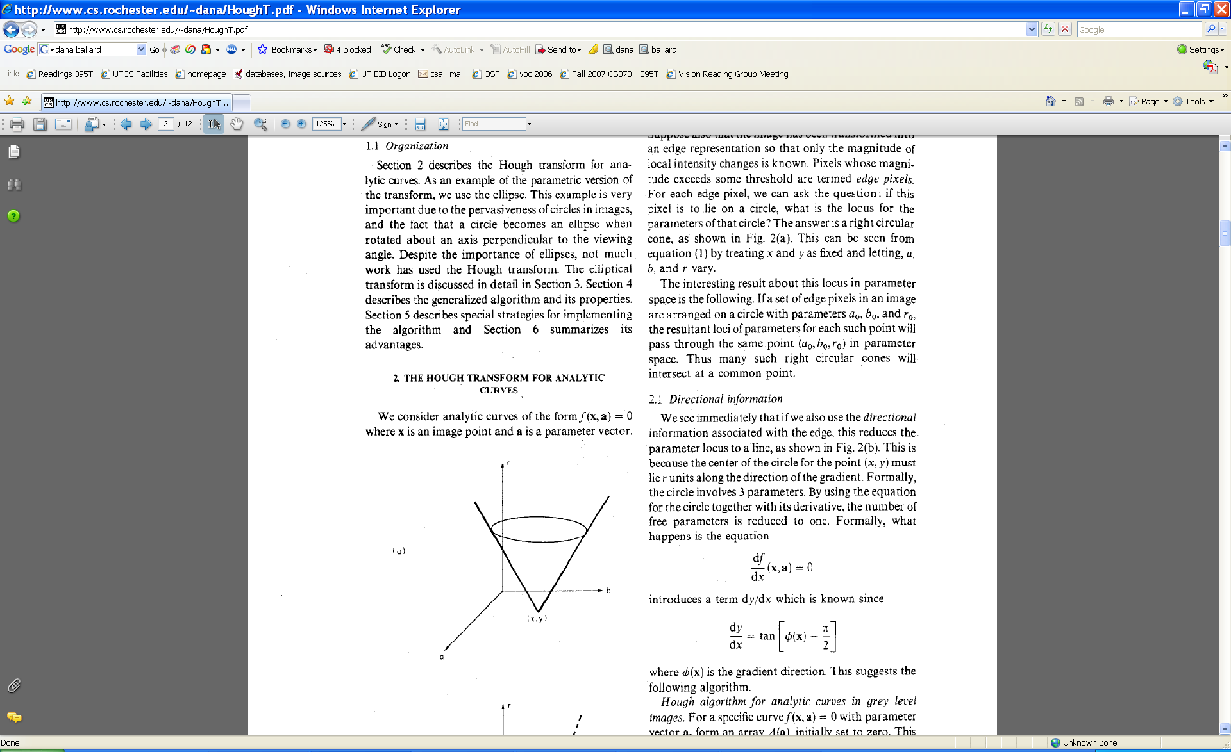
Hough transform for circles
Circle: center (a,b) and radius r
For an unknown radius r
r
b
a
Image space
Hough space
Kristen Grauman

Slide 40
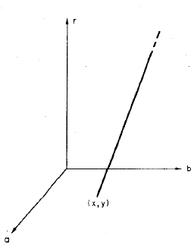
Hough transform for circles
Circle: center (a,b) and radius r
For an unknown radius r, known gradient direction
x
θ
Image space
Hough space
Kristen Grauman

Slide 41
Hough transform for circles
For every edge pixel (x,y) :
For each possible radius value r:
For each possible gradient direction θ:
// or use estimated gradient at (x,y)
a = x – r cos(θ) // column
b = y + r sin(θ) // row
H[a,b,r] += 1
end
end
Time complexity per edge pixel?
Check out online demo : http://www.markschulze.net/java/hough/
Kristen Grauman
Notes:
r*theta
a, b: polar coordinate for circle center

Slide 42
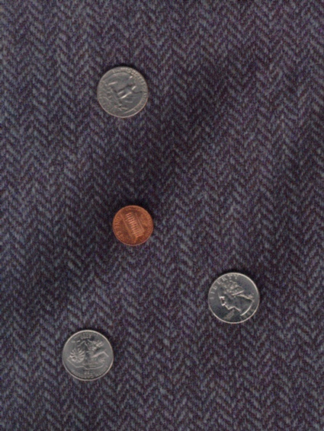
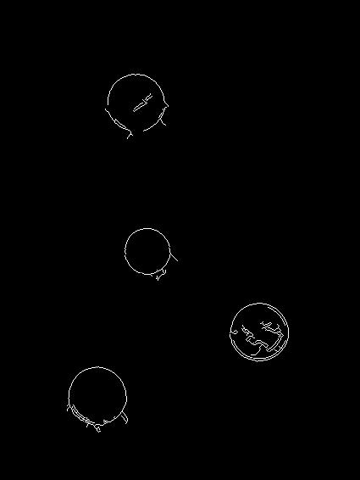
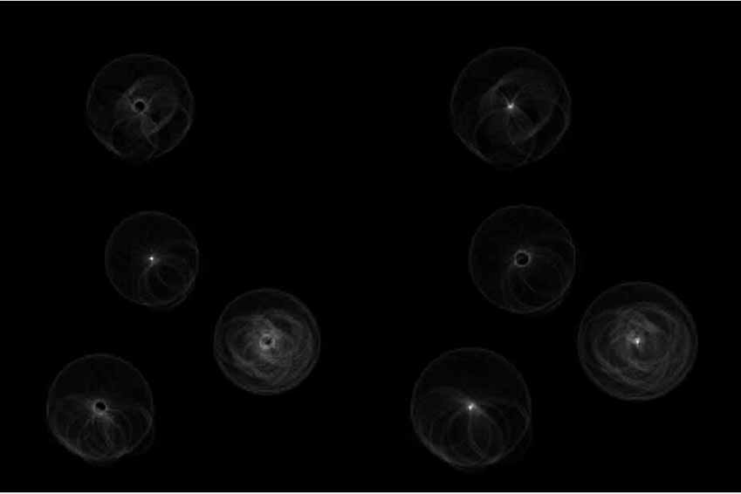
Example: detecting circles with Hough
Original
Edges
Votes: Penny
Note: a different Hough transform (with separate accumulators) was used for each circle radius (quarters vs. penny).
Coin finding sample images from: Vivek Kwatra

Slide 43
Example: detecting circles with Hough
Original
Combined detections
Edges
Votes: Quarter
Coin finding sample images from: Vivek Kwatra

Slide 44
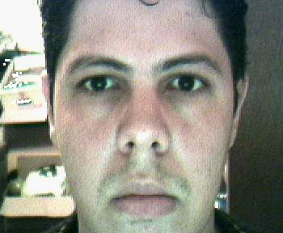
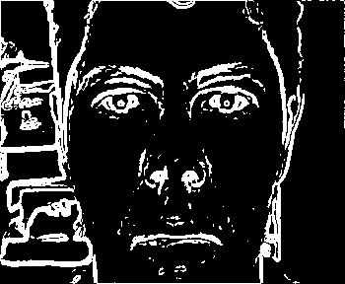
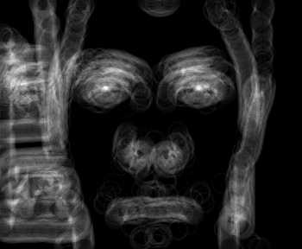

Example: iris detection
Gradient+threshold
Hough space (fixed radius)
Max detections
Hemerson Pistori and Eduardo Rocha Costa http://rsbweb.nih.gov/ij/plugins/hough-circles.html
Kristen Grauman

Slide 45
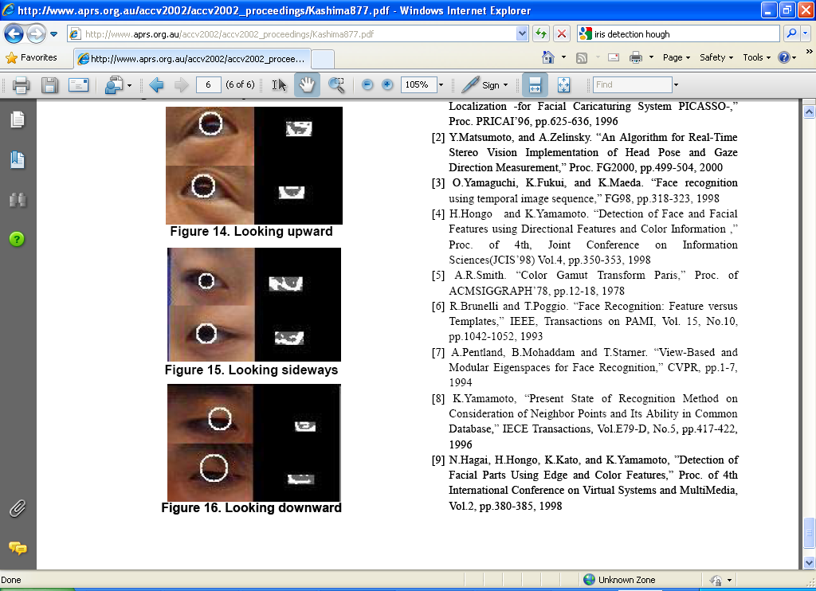
Example: iris detection
An Iris Detection Method Using the Hough Transform and Its Evaluation for Facial and Eye Movement, by Hideki Kashima, Hitoshi Hongo, Kunihito Kato, Kazuhiko Yamamoto, ACCV 2002.

Slide 46
Voting: practical tips
Minimize irrelevant tokens first
Choose a good grid / discretization
Vote for neighbors, also (smoothing in accumulator array)
Use direction of edge to reduce parameters by 1
Too fine
?
Too coarse
Kristen Grauman

Slide 47
Hough transform: pros and cons
Pros
All points are processed independently, so can cope with occlusion, gaps
Some robustness to noise: noise points unlikely to contribute consistently to any single bin
Can detect multiple instances of a model in a single pass
Cons
Complexity of search time increases exponentially with the number of model parameters
Non-target shapes can produce spurious peaks in parameter space
Quantization: can be tricky to pick a good grid size
Kristen Grauman

Slide 48
Generalized Hough Transform
What if we want to detect arbitrary shapes?
Intuition:
Displacement vectors
x
x
x
Ref. point
x
x
Model image
Novel image
Vote space
Now suppose those colors encode gradient directions…
Kristen Grauman

Slide 49
Generalized Hough Transform
Define a model shape by its boundary points and a reference point.
Offline procedure:
x
a
At each boundary point, compute displacement vector: r = a – p_{i}.
Store these vectors in a table indexed by gradient orientation θ.
θ
θ
p₁
p₂
Model shape
θ
…
θ
…
…
[Dana H. Ballard, Generalizing the Hough Transform to Detect Arbitrary Shapes, 1980]

Slide 50
Generalized Hough Transform
Detection procedure:
x
For each edge point:
Use its gradient orientation θ to index into stored table
Use retrieved r vectors to vote for reference point
x
θ
x
x
x
θ
θ
p₁
θ
θ
Novel image
θ
…
θ
…
…
Assuming translation is the only transformation here, i.e., orientation and scale are fixed.

Slide 51

Generalized Hough for object detection
Instead of indexing displacements by gradient orientation, index by matched local patterns.
“visual codeword” with
displacement vectors
training image
B. Leibe, A. Leonardis, and B. Schiele, Combined Object Categorization and Segmentation with an Implicit Shape Model, ECCV Workshop on Statistical Learning in Computer Vision 2004
Source: L. Lazebnik

Slide 52
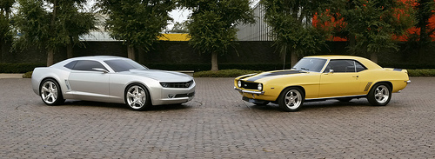
Generalized Hough for object detection
Instead of indexing displacements by gradient orientation, index by “visual codeword”
test image
B. Leibe, A. Leonardis, and B. Schiele, Combined Object Categorization and Segmentation with an Implicit Shape Model, ECCV Workshop on Statistical Learning in Computer Vision 2004
Source: L. Lazebnik

Slide 53
Summary
Fitting problems require finding any supporting evidence for a model, even within clutter and missing features
  associate features with an explicit model
Voting approaches, such as the Hough transform, make it possible to find likely model parameters without searching all combinations of features
  Hough transform approach for lines, circles, …, arbitrary shapes defined by a set of boundary points, recognition from patches

Slide 54
Questions?
See you Tuesday!

