Slide 1

Fitting a transformation:
Feature-based alignment
April 28th, 2020
Yong Jae Lee
UC Davis

Slide 2
Generalized Hough Transform
What if we want to detect arbitrary shapes?
Intuition:
Displacement vectors
x
x
x
Ref. point
x
x
Model image
Novel image
Vote space
Now suppose those colors encode gradient directions…
Kristen Grauman

Slide 3
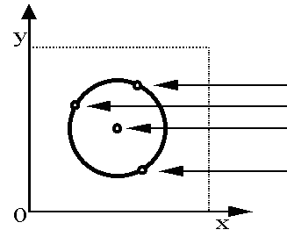
Generalized Hough Transform
Define a model shape by its boundary points and a reference point.
Offline procedure:
x
a
At each boundary point, compute displacement vector: r = a – p_{i}.
Store these vectors in a table indexed by gradient orientation θ.
θ
θ
p₁
p₂
Model shape
θ
…
θ
…
…
[Dana H. Ballard, Generalizing the Hough Transform to Detect Arbitrary Shapes, 1980]

Slide 4
Generalized Hough Transform
Detection procedure:
x
For each edge point:
Use its gradient orientation θ to index into stored table
Use retrieved r vectors to vote for reference point
x
θ
x
x
x
θ
θ
p₁
θ
θ
Novel image
θ
…
θ
…
…
Assuming translation is the only transformation here, i.e., orientation and scale are fixed.

Slide 5

Generalized Hough for object detection
Instead of indexing displacements by gradient orientation, index by matched local patterns.
“visual codeword” with
displacement vectors
training image
B. Leibe, A. Leonardis, and B. Schiele, Combined Object Categorization and Segmentation with an Implicit Shape Model, ECCV Workshop on Statistical Learning in Computer Vision 2004
Source: L. Lazebnik

Slide 6
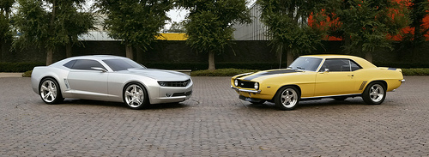
Generalized Hough for object detection
Instead of indexing displacements by gradient orientation, index by “visual codeword”
test image
B. Leibe, A. Leonardis, and B. Schiele, Combined Object Categorization and Segmentation with an Implicit Shape Model, ECCV Workshop on Statistical Learning in Computer Vision 2004
Source: L. Lazebnik

Slide 7
Summary
Fitting problems require finding any supporting evidence for a model, even within clutter and missing features
  associate features with an explicit model
Voting approaches, such as the Hough transform, make it possible to find likely model parameters without searching all combinations of features
  Hough transform approach for lines, circles, …, arbitrary shapes defined by a set of boundary points, recognition from patches

Slide 8
Today
Feature-based alignment
  2D transformations
  Affine fit
  RANSAC

Slide 9
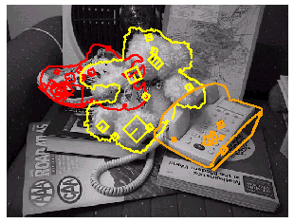
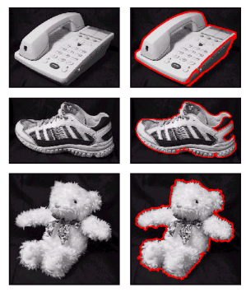
Motivation: Recognition
Figures from David Lowe

Slide 10
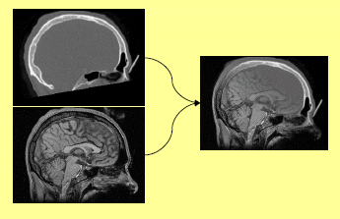
Motivation: medical image registration
Slide credit: Kristen Grauman

Slide 11

Motivation: mosaics
(In detail next week)
Image from http://graphics.cs.cmu.edu/courses/15-463/2010_fall/

Slide 12
Alignment problem
We have previously considered how to fit a model to image evidence
  e.g., a line to edge points
In alignment, we will fit the parameters of some transformation according to a set of matching feature pairs (“correspondences”).
x_{i}
x_{i}
'
T
Slide credit: Kristen Grauman

Slide 13




Parametric (global) warping
Examples of parametric warps:
translation
rotation
aspect
perspective
affine
Source: Alyosha Efros

Slide 14
Parametric (global) warping
T
p = (x,y)
p’ = (x’,y’)
Transformation T is a coordinate-changing machine:
p’ = T(p)
What does it mean that T is global?
  Is the same for any point p
  can be described by just a few numbers (parameters)
Let’s represent T as a matrix:
p’ = Mp
Source: Alyosha Efros

Slide 15
Scaling
Scaling a coordinate means multiplying each of its components by a scalar
Uniform scaling means this scalar is the same for all components:
× 2
Source: Alyosha Efros

Slide 16
Scaling
Non-uniform scaling: different scalars per component:
X × 2,
Y × 0.5
Source: Alyosha Efros

Slide 17
Scaling
Scaling operation:
Or, in matrix form:
scaling matrix S
Source: Alyosha Efros

Slide 18
What transformations can be represented with a 2x2 matrix?
2D Scaling?
2D Rotate around (0,0)?
2D Shear?
Source: Alyosha Efros

Slide 19
What transformations can be represented with a 2x2 matrix?
2D Mirror about Y axis?
2D Mirror over (0,0)?
2D Translation?
NO!
Source: Alyosha Efros

Slide 20
2D Linear Transformations
Only linear 2D transformations can be represented with a 2x2 matrix.
Linear transformations are combinations of …
  Scale,
  Rotation,
  Shear, and
  Mirror
Source: Alyosha Efros

Slide 21
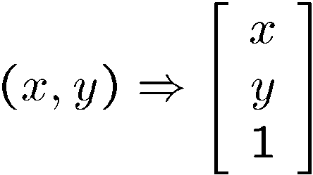
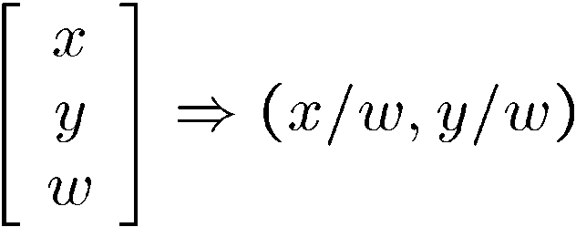
Homogeneous coordinates
Convenient coordinate system to represent many useful transformations
To convert to homogeneous coordinates:
homogeneous image
coordinates
Converting from homogeneous coordinates:
Slide credit: Kristen Grauman
Notes:
coordinates used in projective geometry.
Homogeneous coordinates have an extra dimension called W, which scales the X, Y dimensions.
Can model points at infinity (when w = 0)

Slide 22
Homogeneous Coordinates
Q: How can we represent 2d translation as a 3x3 matrix using homogeneous coordinates?
A: Using the rightmost column:
Source: Alyosha Efros

Slide 23
Translation
Homogeneous Coordinates
t_{x} = 2
t_{y} = 1
Source: Alyosha Efros

Slide 24
Basic 2D Transformations
Basic 2D transformations as 3x3 matrices
Translate
Scale
Rotate
Shear
Source: Alyosha Efros

Slide 25
2D Affine Transformations
Affine transformations are combinations of …
  Linear transformations, and
  Translations
Parallel lines remain parallel
Slide credit: Kristen Grauman

Slide 26
Today
Feature-based alignment
  2D transformations
  Affine fit
  RANSAC

Slide 27
Alignment problem
We have previously considered how to fit a model to image evidence
  e.g., a line to edge points
In alignment, we will fit the parameters of some transformation according to a set of matching feature pairs (“correspondences”).
x_{i}
x_{i}
'
T
Kristen Grauman

Slide 28
Image alignment
Two broad approaches:
  Direct (pixel-based) alignment
    Search for alignment where most pixels agree
  Feature-based alignment
    Search for alignment where extracted features agree
    Can be verified using pixel-based alignment
Slide credit: Kristen Grauman

Slide 29
Fitting an affine transformation
Assuming we know the correspondences, how do we get the transformation?
Slide credit: Kristen Grauman

Slide 30
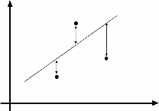
An aside: Least Squares Example
Say we have a set of data points (X1,X1’), (X2,X2’), (X3,X3’), etc. (e.g. person’s height vs. weight)
We want a nice compact formula (a line) to predict X’s from Xs: Xa + b = X’
We want to find a and b
How many (X,X’) pairs do we need?
What if the data is noisy?
Ax=B
overconstrained
Source: Alyosha Efros

Slide 31
Fitting an affine transformation
Assuming we know the correspondences, how do we get the transformation?
Slide credit: Kristen Grauman

Slide 32
Fitting an affine transformation
How many matches (correspondence pairs) do we need to solve for the transformation parameters?
Kristen Grauman

Slide 33
Affine: # correspondences?
?
T(x,y)
y
y’
x
x’
How many correspondences needed for affine?
Alyosha Efros
Notes:
3

Slide 34
Fitting an affine transformation
How many matches (correspondence pairs) do we need to solve for the transformation parameters?
Once we have solved for the parameters, how do we compute the coordinates of the corresponding point for ?
Where do the matches come from?
Kristen Grauman

Slide 35
What are the correspondences?
?
Compare content in local patches, find best matches.
  e.g., simplest approach: scan with template, and compute SSD or correlation between list of pixel intensities in the patch
Later in the course: how to select regions using more robust descriptors.
Kristen Grauman

Slide 36
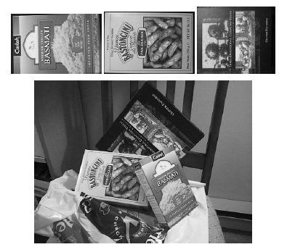
Fitting an affine transformation
Figures from David Lowe, ICCV 1999

Slide 37
Fitting an affine transformation

Slide 38
Fitting an affine transformation

Slide 39
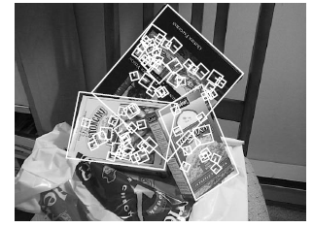
Fitting an affine transformation
Figures from David Lowe, ICCV 1999

Slide 40
Today
Feature-based alignment
  2D transformations
  Affine fit
  RANSAC

Slide 41
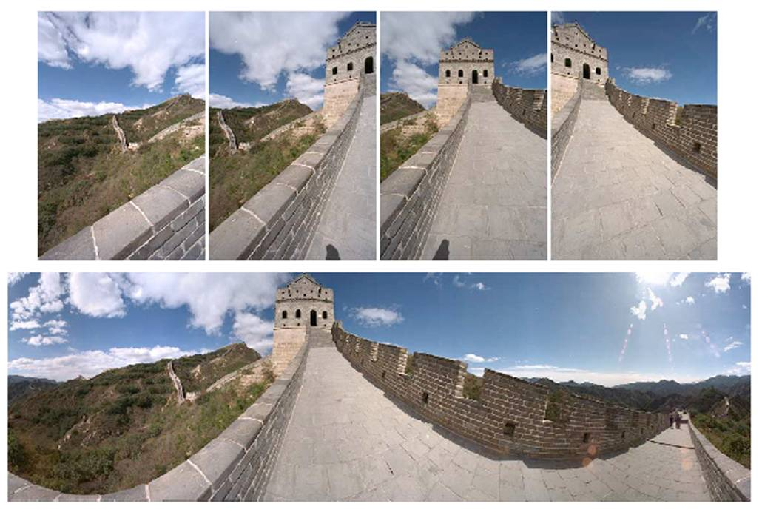
Outliers
Outliers can hurt the quality of our parameter estimates, e.g.,
  an erroneous pair of matching points from two images
  an edge point that is noise, or doesn’t belong to the line we are fitting.
Kristen Grauman

Slide 42
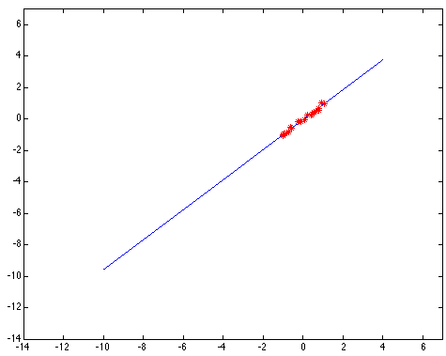
Outliers affect least squares fit
Slide credit: Kristen Grauman
Notes:
42

Slide 43
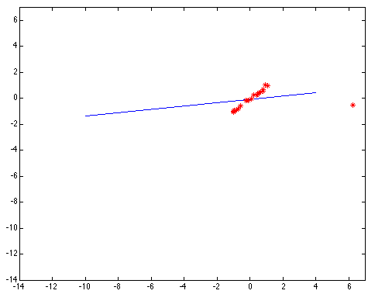
Outliers affect least squares fit
Slide credit: Kristen Grauman
Notes:
43

Slide 44
RANSAC
RANdom Sample Consensus
Approach: we want to avoid the impact of outliers, so let’s look for “inliers”, and use those only.
Intuition: if an outlier is chosen to compute the current fit, then the resulting line won’t have much support from rest of the points.
Slide credit: Kristen Grauman

Slide 45
RANSAC: General form
RANSAC loop:
Randomly select a seed group of points on which to base transformation estimate
Compute transformation from seed group
Find inliers to this transformation
If the number of inliers is sufficiently large, re-compute estimate of transformation on all of the inliers
Keep the transformation with the largest number of inliers
Slide credit: Kristen Grauman

Slide 46
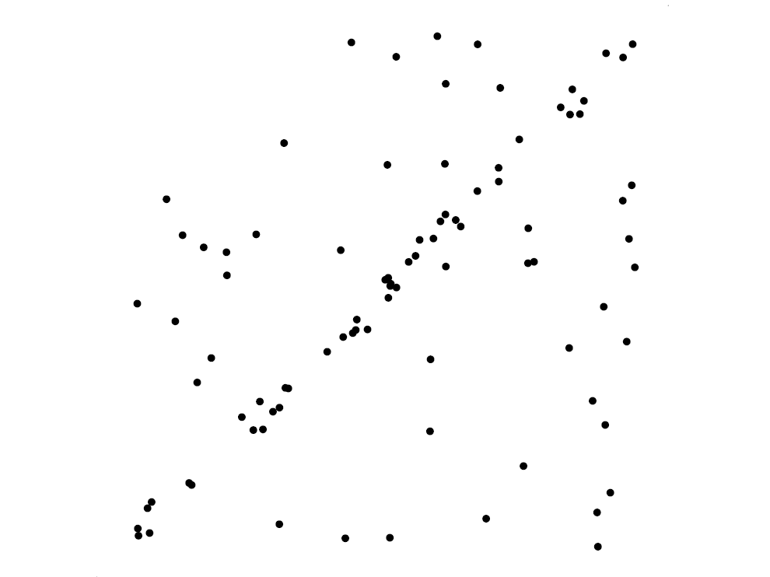
RANSAC for line fitting example
Source: R. Raguram
Lana Lazebnik

Slide 47
RANSAC for line fitting example
Least-squares fit
Source: R. Raguram
Lana Lazebnik

Slide 48
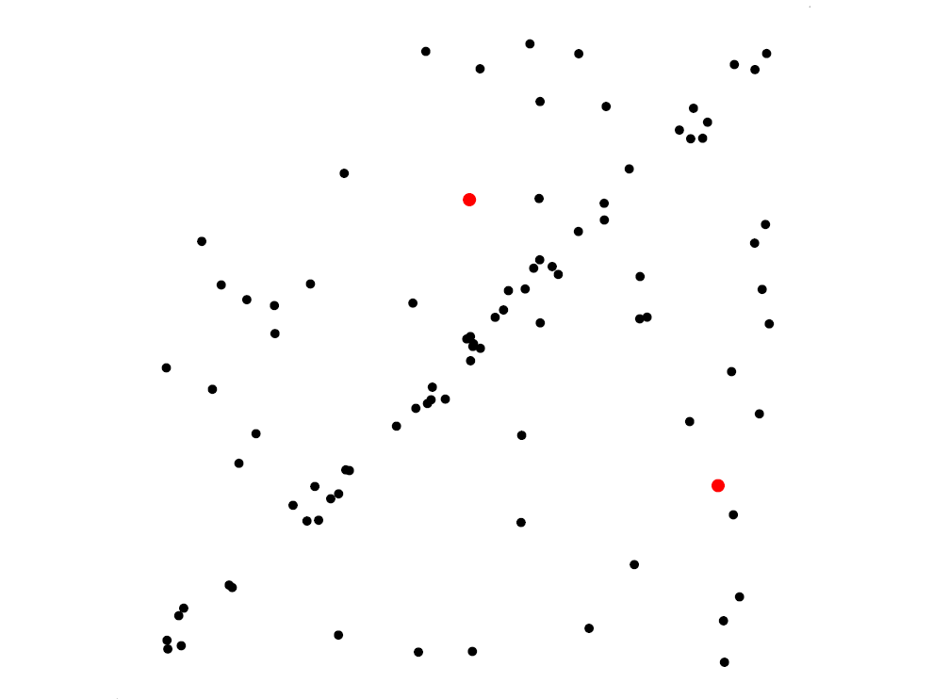
RANSAC for line fitting example
Randomly select minimal subset of points
Source: R. Raguram
Lana Lazebnik

Slide 49
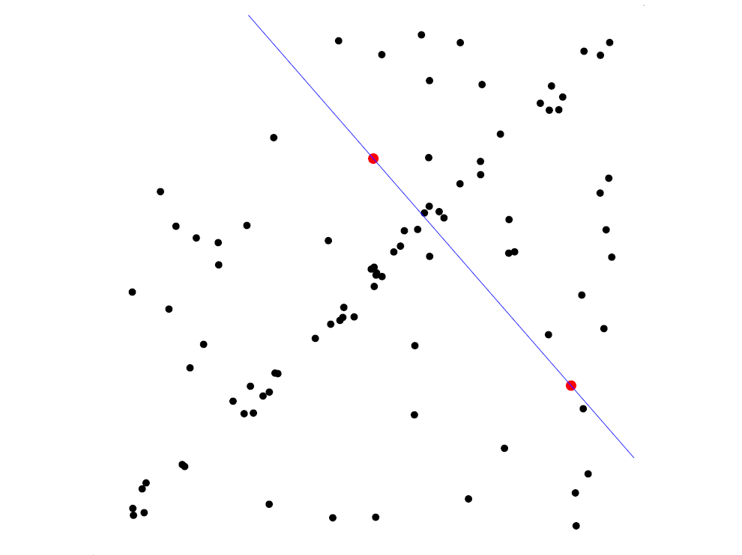
RANSAC for line fitting example
Randomly select minimal subset of points
Hypothesize a model
Source: R. Raguram
Lana Lazebnik

Slide 50
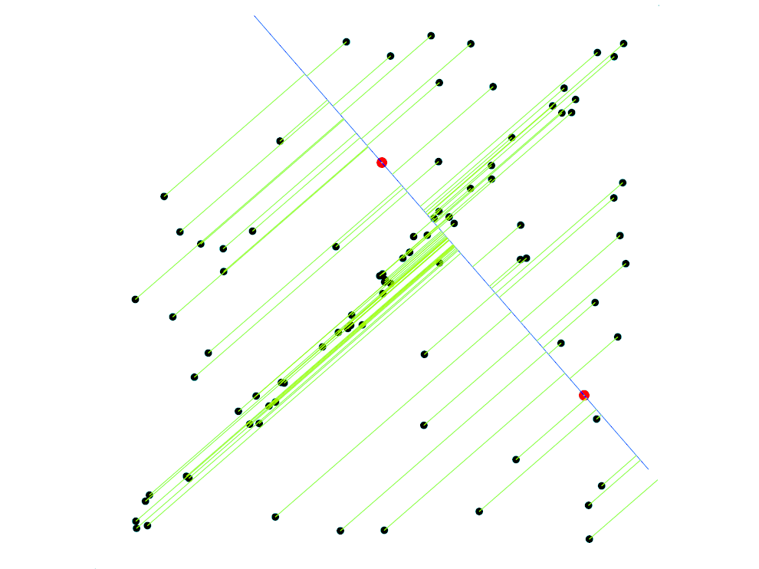
RANSAC for line fitting example
Randomly select minimal subset of points
Hypothesize a model
Compute error function
Source: R. Raguram
Lana Lazebnik

Slide 51
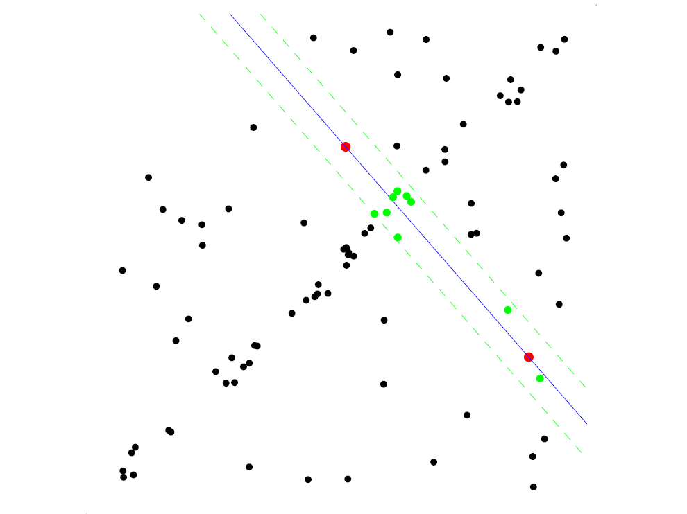
RANSAC for line fitting example
Randomly select minimal subset of points
Hypothesize a model
Compute error function
Select points consistent with model
Source: R. Raguram
Lana Lazebnik

Slide 52
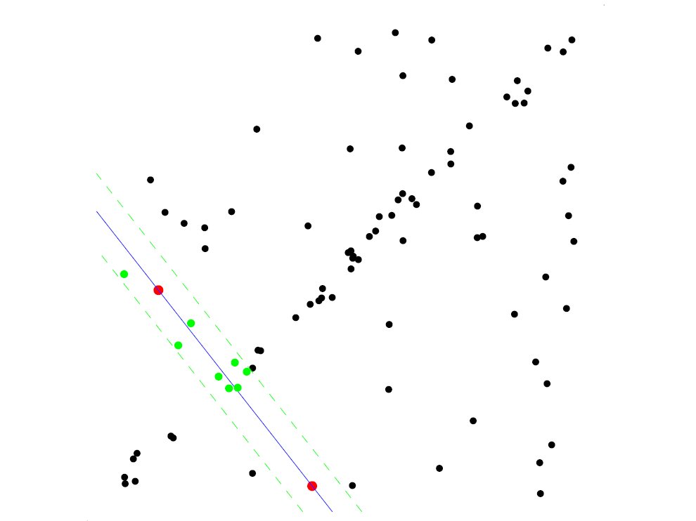
RANSAC for line fitting example
Randomly select minimal subset of points
Hypothesize a model
Compute error function
Select points consistent with model
Repeat hypothesize-and-verify loop
Source: R. Raguram
Lana Lazebnik

Slide 53
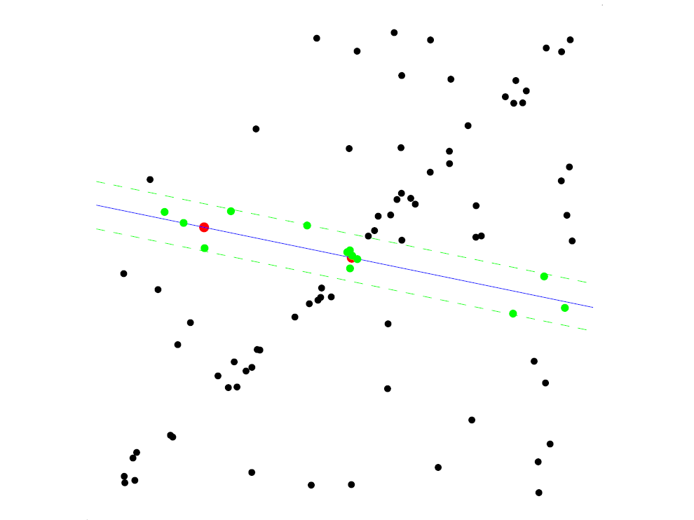
RANSAC for line fitting example
Randomly select minimal subset of points
Hypothesize a model
Compute error function
Select points consistent with model
Repeat hypothesize-and-verify loop
Source: R. Raguram
Lana Lazebnik

Slide 54
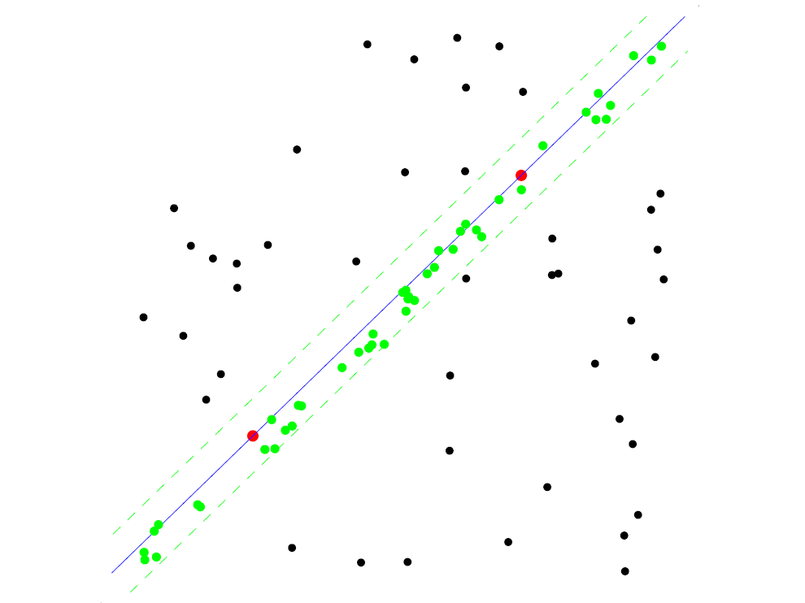
RANSAC for line fitting example
Randomly select minimal subset of points
Hypothesize a model
Compute error function
Select points consistent with model
Repeat hypothesize-and-verify loop
Source: R. Raguram
Lana Lazebnik

Slide 55
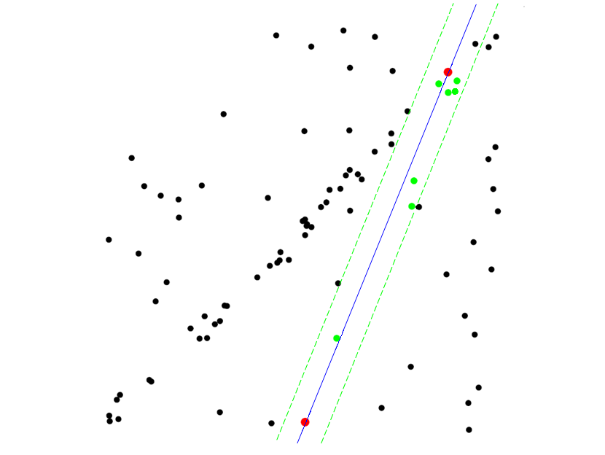
RANSAC for line fitting example
Randomly select minimal subset of points
Hypothesize a model
Compute error function
Select points consistent with model
Repeat hypothesize-and-verify loop
Source: R. Raguram
Lana Lazebnik
Notes:
55

Slide 56
RANSAC for line fitting
Repeat N times:
Draw s points uniformly at random
Fit line to these s points
Find inliers to this line among the remaining points (i.e., points whose distance from the line is less than t)
If there are d or more inliers, accept the line and refit using all inliers
Lana Lazebnik

Slide 57
RANSAC pros and cons
Pros
  Simple and general
  Applicable to many different problems
  Often works well in practice
Cons
  Lots of parameters to tune
  Doesn’t work well for low inlier ratios (too many iterations,
  or can fail completely)
Lana Lazebnik

Slide 58
Today
Feature-based alignment
  2D transformations
  Affine fit
  RANSAC

Slide 59
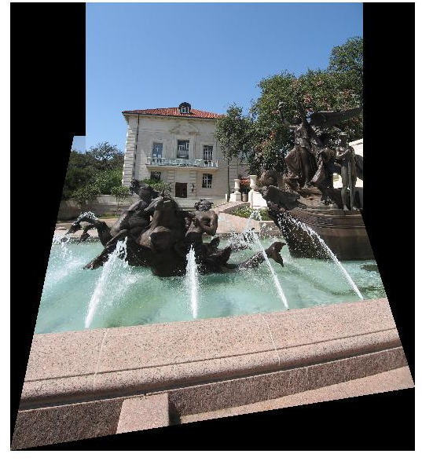
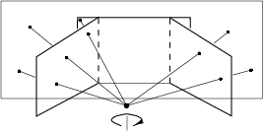
Coming up: alignment and image stitching

Slide 60
Questions?
See you Thursday!

