Slide 1

Texture
April 14th, 2015
Yong Jae Lee
UC Davis

Slide 2
Announcements
PS1 out today
  due 4/29th, 11:59 pm
  start early!

Slide 3
Review: last time
Edge detection:
  Filter for gradient
  Threshold gradient magnitude, thin
Chamfer matching to compare shapes (in terms of edge points)
Binary image analysis
  Thresholding
  Morphological operators to “clean up”
  Connected components to find regions

Slide 4
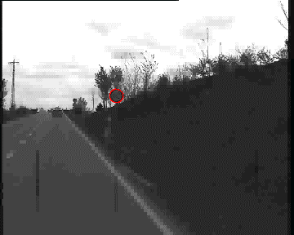
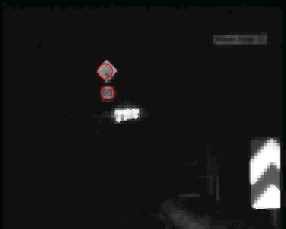
Chamfer matching system
Gavrila et al. http://gavrila.net/Research/Chamfer_System/chamfer_system.html
Slide credit: Kristen Grauman

Slide 5
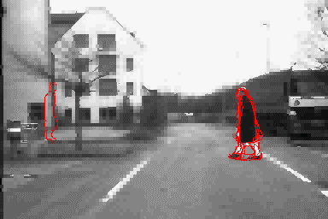
Chamfer matching system
Gavrila et al. http://gavrila.net/Research/Chamfer_System/chamfer_system.html
Slide credit: Kristen Grauman

Slide 6
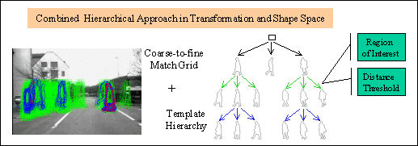
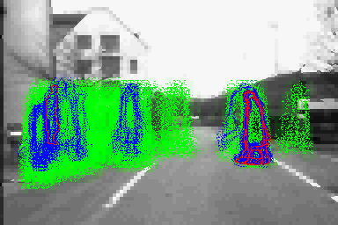
Chamfer matching system
Gavrila et al. http://gavrila.net/Research/Chamfer_System/chamfer_system.html
Slide credit: Kristen Grauman

Slide 7
ShadowDraw
video

Slide 8
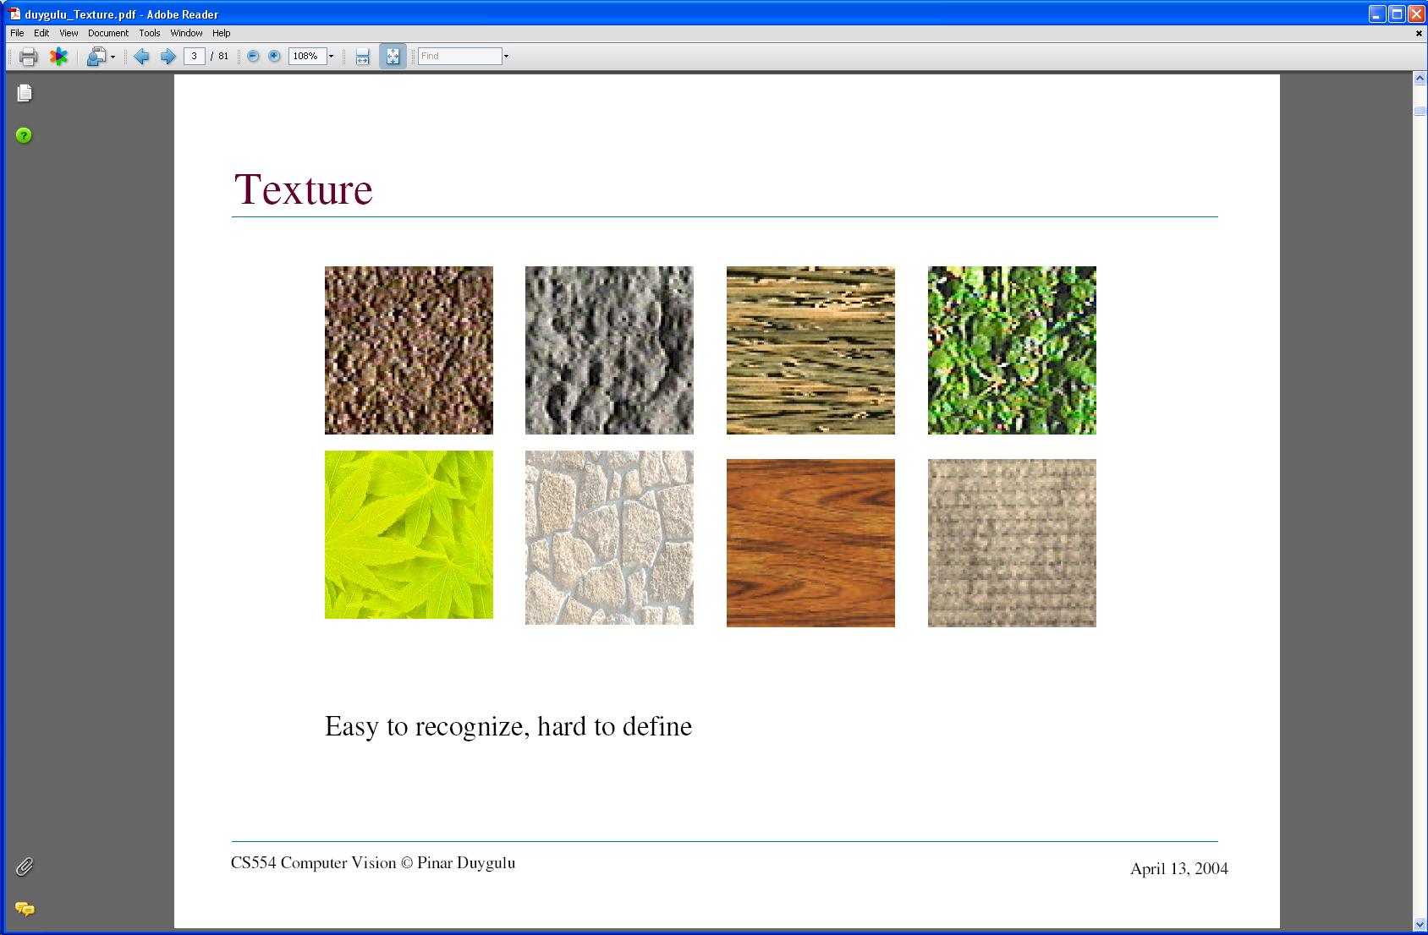
Today: Texture
What defines a texture?
Slide credit: Kristen Grauman
Notes:
Texture is a phenomenon that is widespread, easy to recognize and hard to define.
views of large numbers of small objects are often best thought of as textures: grass, foliage, brush, pebbles and hair
many surfaces are marked with orderly patterns that look like large numbers of small objects: the spots of animals like leopards or cheetahs; the stripes of
animals like tigers or zebras; the patterns on bark, wood and skin.

Slide 9


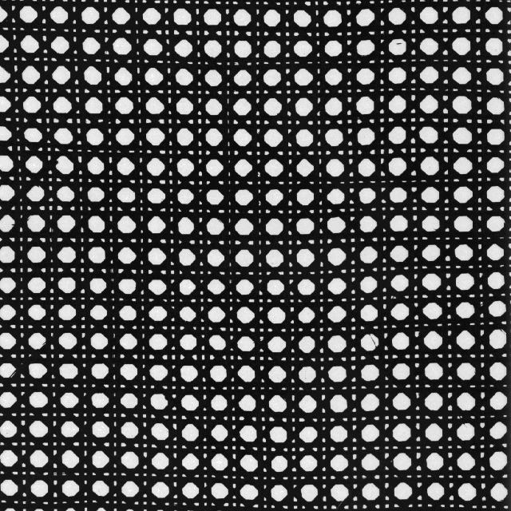
Includes: more regular patterns
Slide credit: Kristen Grauman

Slide 10
Includes: more random patterns
Slide credit: Kristen Grauman

Slide 11
Texture-related tasks
Shape from texture
  Estimate surface orientation or shape from image texture
Slide credit: Kristen Grauman

Slide 12
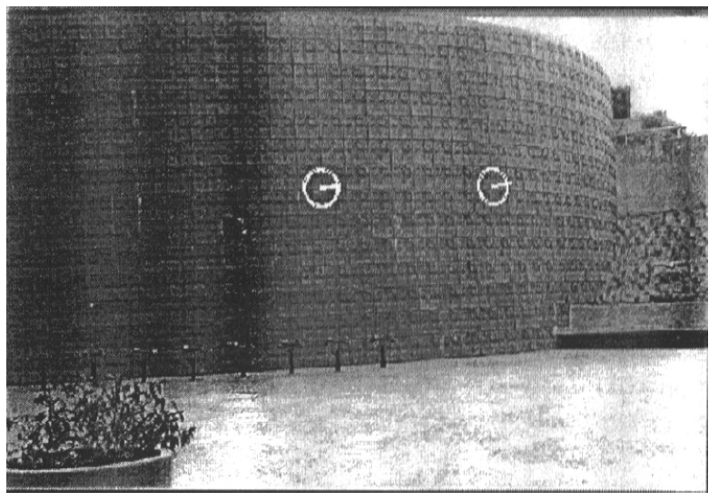
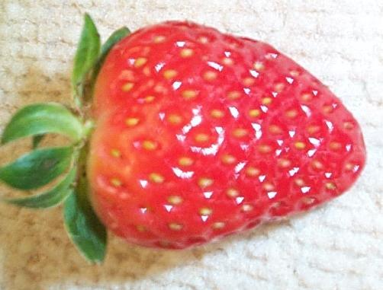
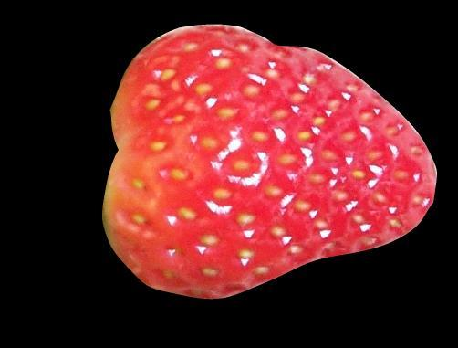
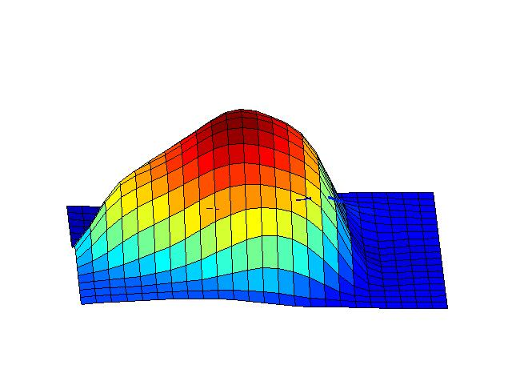
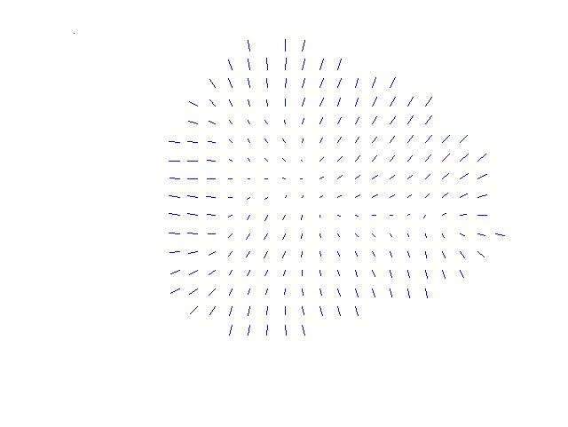
Shape from texture
Use deformation of texture from point to point to estimate surface shape
Pics from A. Loh: http://www.csse.uwa.edu.au/~angie/phdpics1.html
Slide credit: Kristen Grauman
Notes:
We do this by assuming that texture “looks the same” at different points on a surface; this means that the deformation of the texture from point to point is a cue to the shape of the surface

Slide 13
Texture-related tasks
Shape from texture
  Estimate surface orientation or shape from image texture
Classification/segmentation from texture cues
  Analyze, represent texture
  Group image regions with consistent texture
Synthesis
  Generate new texture patches/images given some examples
Slide credit: Kristen Grauman

Slide 14
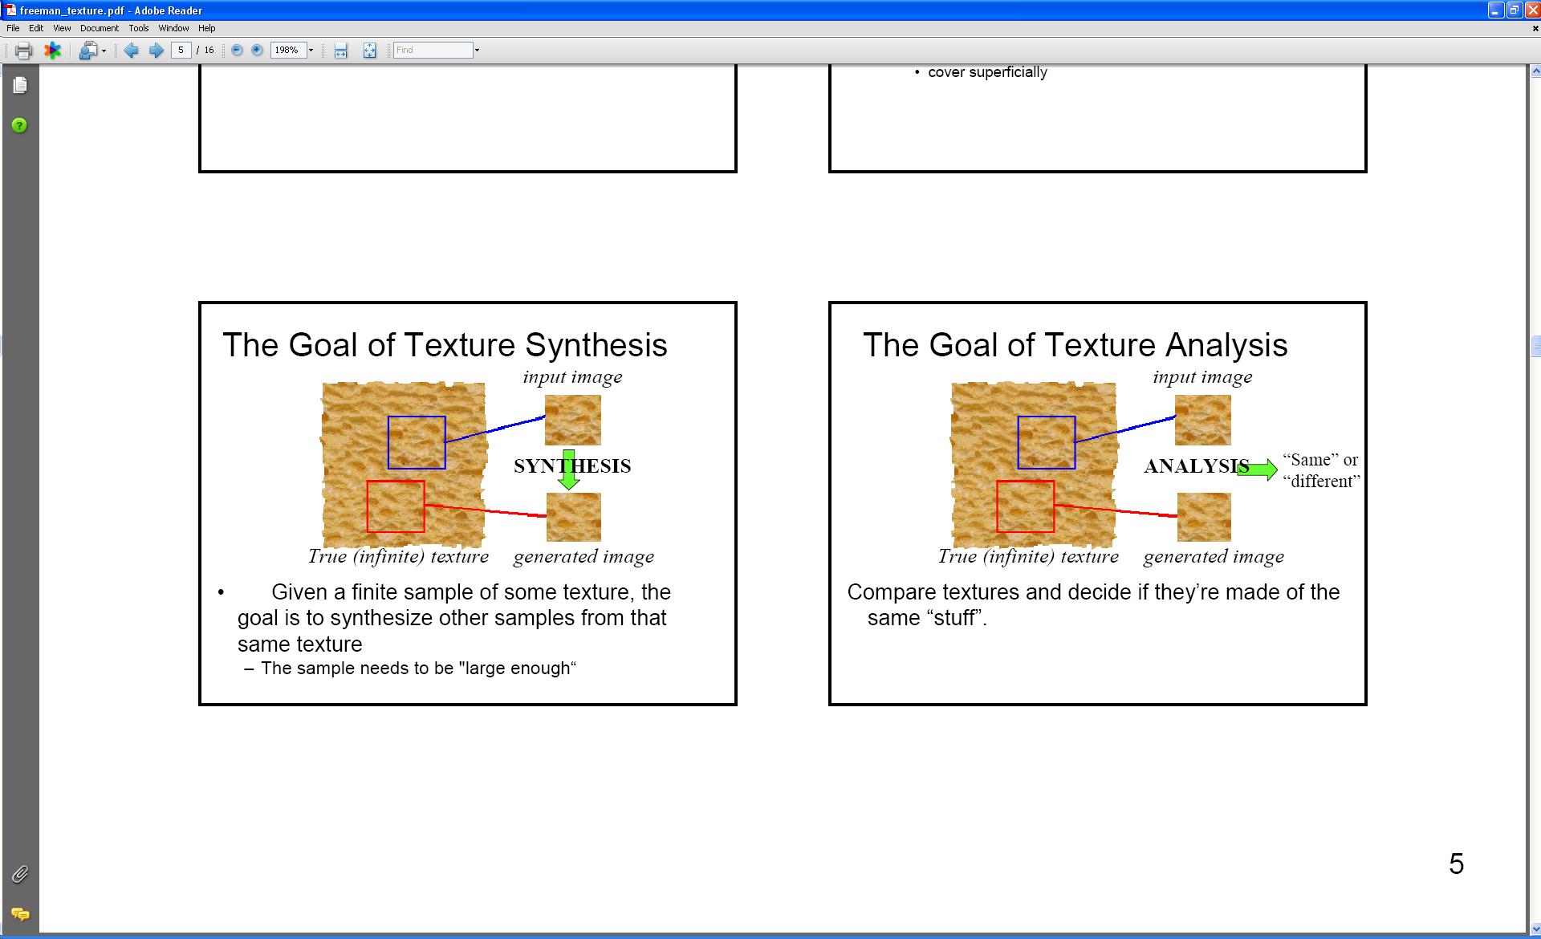
Analysis vs. Synthesis
Why analyze texture?
Slide credit: Kristen Grauman
Images:Bill Freeman, A. Efros

Slide 15
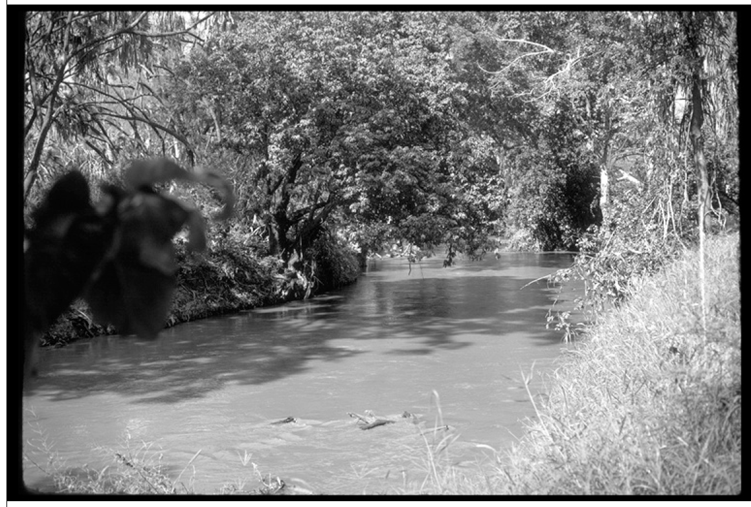
Image credit: D. Forsyth
Notes:
Material recognition.
Segmentation.

Slide 16
Why analyze texture?
Importance to perception:
Often indicative of a material’s properties
Slide credit: Kristen Grauman

Slide 17
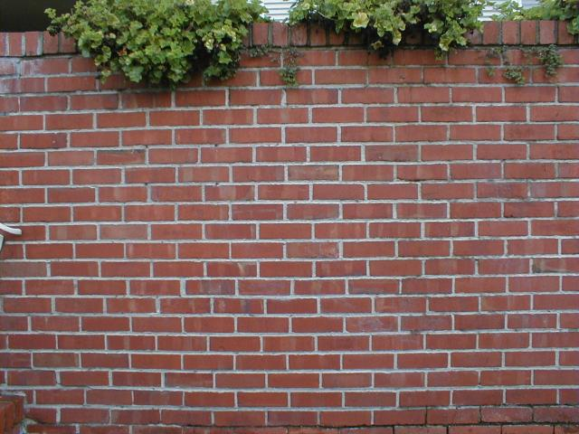
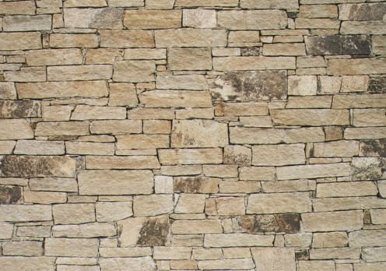
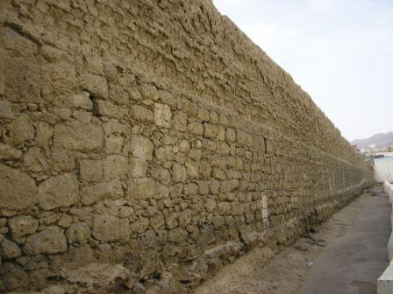
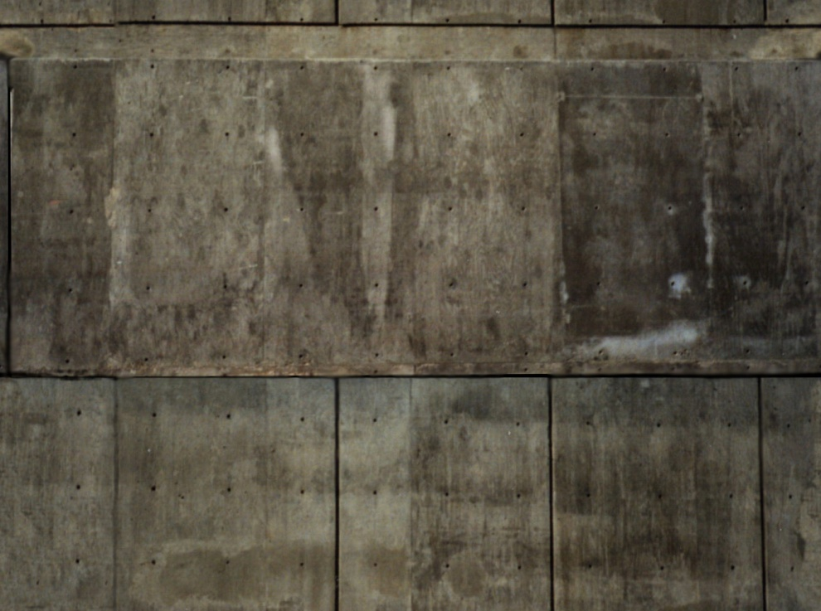
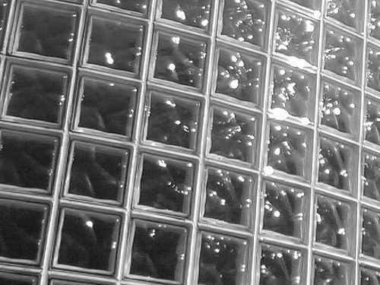
Slide credit: Kristen Grauman
Notes:
Texture is indicative of material

Slide 18
Why analyze texture?
Importance to perception:
Often indicative of a material’s properties
Can be important appearance cue, especially if shape is similar across objects
Slide credit: Kristen Grauman

Slide 19
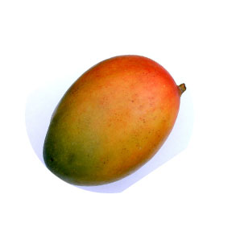
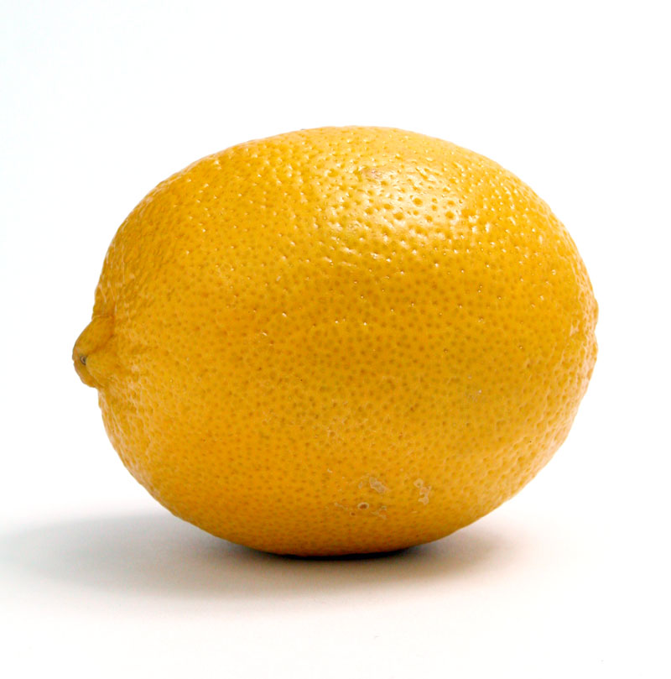
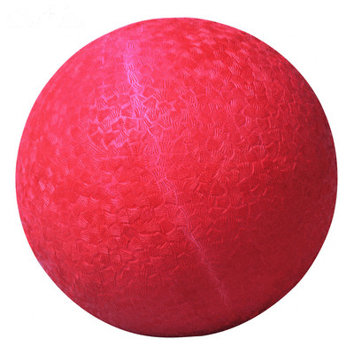
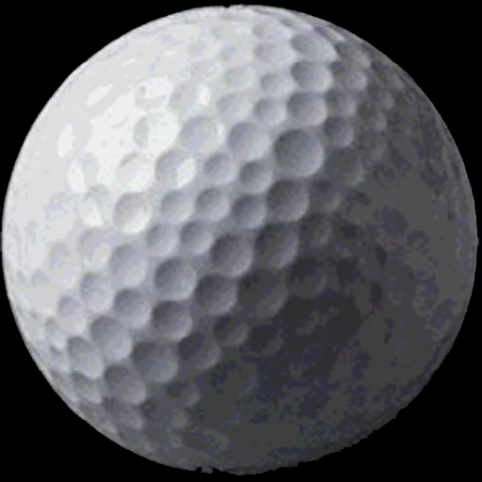
Slide credit: Kristen Grauman
Notes:
Texture is indicative of object type, especially when shape information is not useful

Slide 20
Why analyze texture?
Importance to perception:
Often indicative of a material’s properties
Can be important appearance cue, especially if shape is similar across objects
Aim to distinguish between boundaries and texture
Slide credit: Kristen Grauman

Slide 21
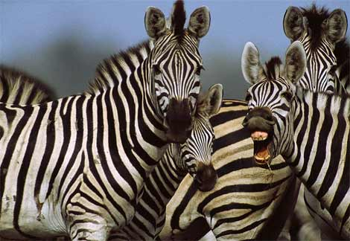
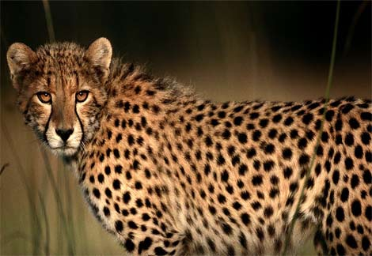
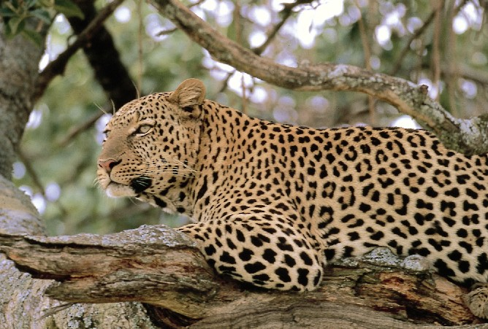
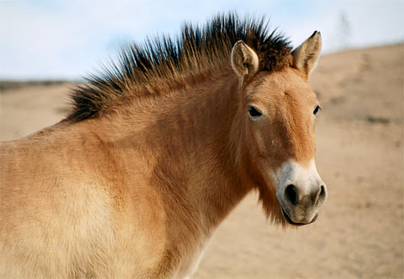
Slide credit: Kristen Grauman
http://animals.nationalgeographic.com/
Notes:
Texture is indicative of object type, especially when shape information is not useful

Slide 22
Why analyze texture?
Importance to perception:
Often indicative of a material’s properties
Can be important appearance cue, especially if shape is similar across objects
Aim to distinguish between boundaries and texture
Technically:
Representation-wise, we want a feature one step above “building blocks” of filters, edges.
Slide credit: Kristen Grauman

Slide 23
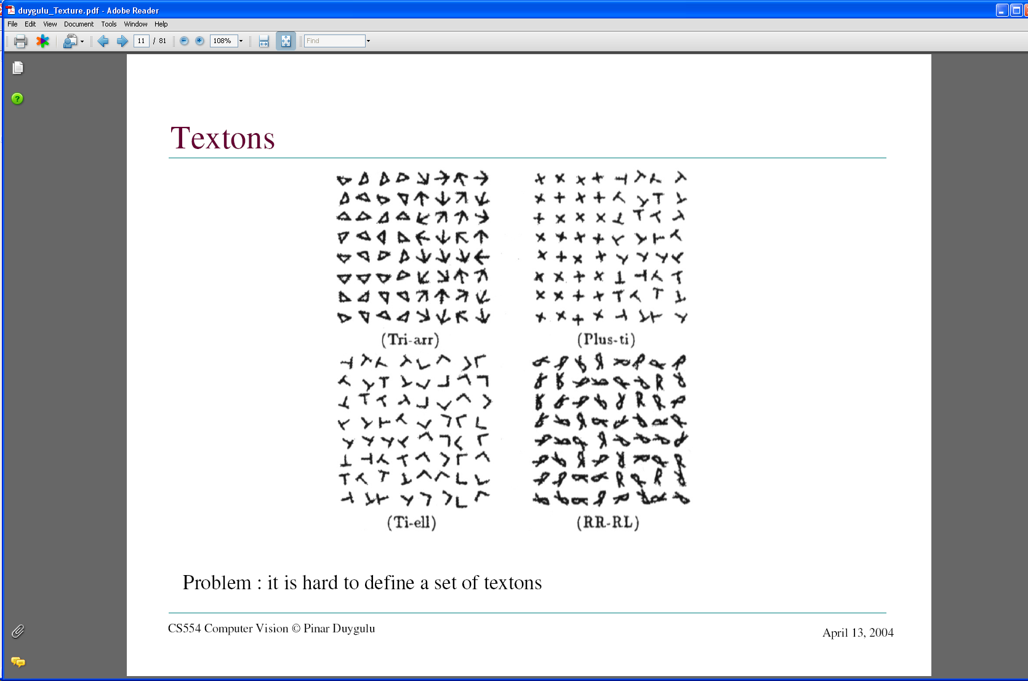
Images from Malik and Perona, 1990

Slide 24
Psychophysics of texture
Some textures distinguishable with preattentive perception – without scrutiny, eye movements [Julesz 1975]
Same or different?
Slide credit: Kristen Grauman

Slide 25
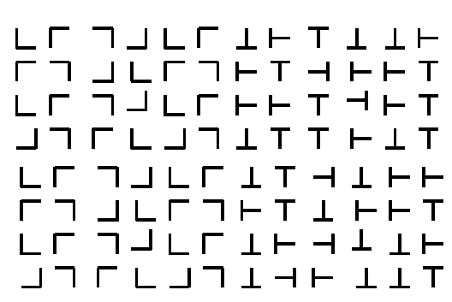
Slide credit: Kristen Grauman

Slide 26
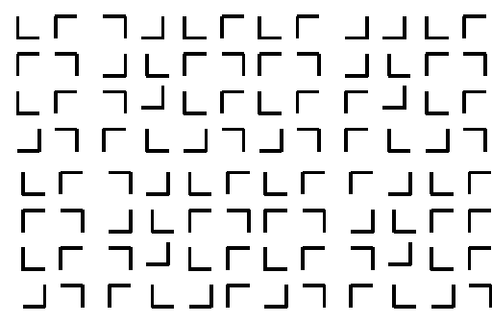
Slide credit: Kristen Grauman

Slide 27
Slide credit: Kristen Grauman

Slide 28
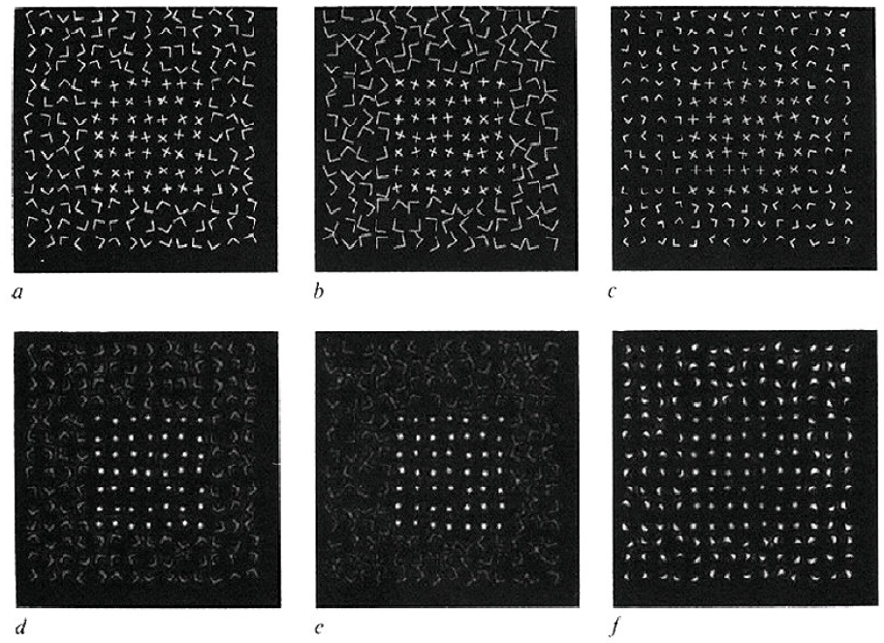
Capturing the local patterns with image measurements
[Bergen & Adelson, Nature 1988]
Scale of patterns influences discriminability
Size-tuned linear filters
Slide credit: Kristen Grauman
Notes:
texture discriminability can depend on scale

Slide 29
Texture representation
Textures are made up of repeated local patterns, so:
  Find the patterns
    Use filters that look like patterns (spots, bars, raw patches…)
    Consider magnitude of response
  Describe their statistics within each local window
    Mean, standard deviation
    Histogram of “prototypical” feature occurrences
Slide credit: Kristen Grauman
Notes:
Instead of looking for patterns at the level of arrowheads and triangles, we could look for even simpler pattern elements — dots and bars, say — and then reason about their spatial layout.
The advantage of this approach is that it is easy to look for simple pattern elements by filtering an image

Slide 30
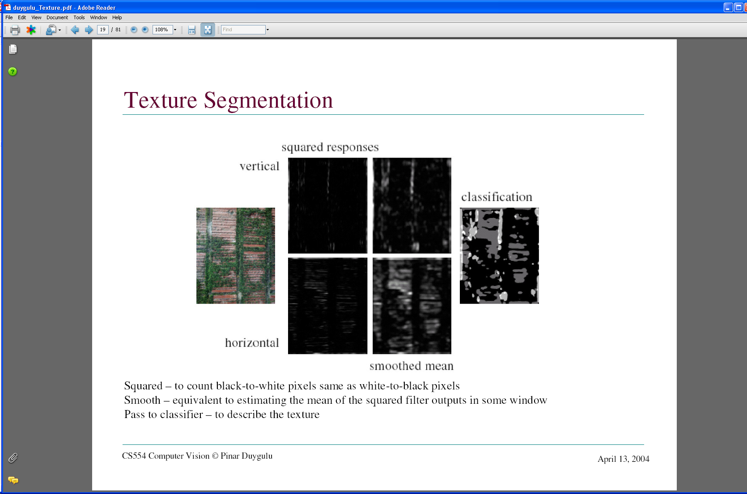
Texture representation: example
 | mean d/dx value | mean d/dy value
Win. #1 | 4 | 10
original image
…
statistics to summarize patterns in small windows
derivative filter responses, squared
Slide credit: Kristen Grauman

Slide 31
Texture representation: example
 | mean d/dx value | mean d/dy value
Win. #1 | 4 | 10
Win.#2 | 18 | 7
original image
…
statistics to summarize patterns in small windows
derivative filter responses, squared
Slide credit: Kristen Grauman

Slide 32
Texture representation: example
 | mean d/dx value | mean d/dy value
Win. #1 | 4 | 10
Win.#2 | 18 | 7
Win.#9 | 20 | 20
original image
…
…
statistics to summarize patterns in small windows
derivative filter responses, squared
Slide credit: Kristen Grauman

Slide 33
Texture representation: example
 | mean d/dx value | mean d/dy value
Win. #1 | 4 | 10
Win.#2 | 18 | 7
Win.#9 | 20 | 20
Dimension 2 (mean d/dy value)
Dimension 1 (mean d/dx value)
…
…
statistics to summarize patterns in small windows
Slide credit: Kristen Grauman

Slide 34
Texture representation: example
Windows with primarily horizontal edges
Both
 | mean d/dx value | mean d/dy value
Win. #1 | 4 | 10
Win.#2 | 18 | 7
Win.#9 | 20 | 20
Dimension 2 (mean d/dy value)
Dimension 1 (mean d/dx value)
…
…
Windows with small gradient in both directions
Windows with primarily vertical edges
statistics to summarize patterns in small windows
Slide credit: Kristen Grauman

Slide 35
Texture representation: example
original image
visualization of the assignment to texture “types”
derivative filter responses, squared
Slide credit: Kristen Grauman

Slide 36
Texture representation: example
 | mean d/dx value | mean d/dy value
Win. #1 | 4 | 10
Win.#2 | 18 | 7
Win.#9 | 20 | 20
Dimension 2 (mean d/dy value)
Far: dissimilar textures
Close: similar textures
Dimension 1 (mean d/dx value)
…
…
statistics to summarize patterns in small windows
Slide credit: Kristen Grauman

Slide 37
Texture representation: example
Dimension 2
Dimension 1
Slide credit: Kristen Grauman
Notes:
37

Slide 38
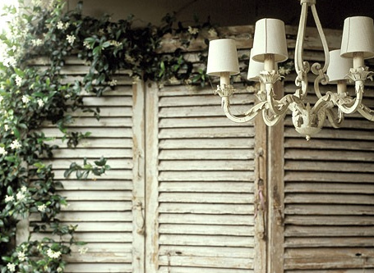
Texture representation: example
Dimension 2
Dimension 1
Distance reveals how dissimilar texture from window a is from texture in window b.
Slide credit: Kristen Grauman
Notes:
38

Slide 39
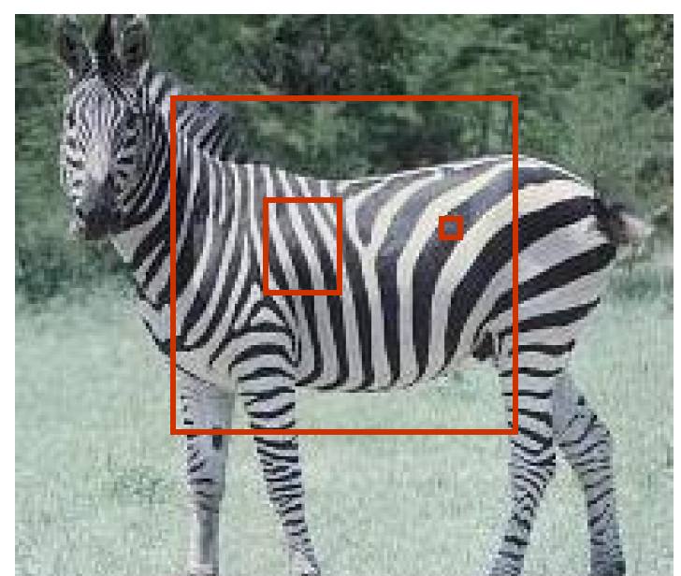
Texture representation: window scale
We’re assuming we know the relevant window size for which we collect these statistics.
Possible to perform scale selection by looking for window scale where texture description not changing.
Slide credit: Kristen Grauman
Notes:
The choice of scale is important for description

Slide 40
Filter banks
Our previous example used two filters, and resulted in a 2-dimensional feature vector to describe texture in a window
  x and y derivatives revealed something about local structure
We can generalize to apply a collection of multiple (d) filters: a “filter bank”
Then our feature vectors will be d-dimensional
  still can think of nearness, farness in feature space
Slide credit: Kristen Grauman

Slide 41
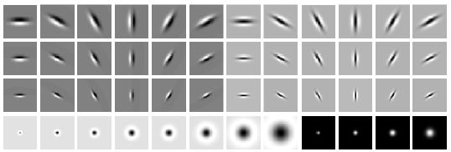
Filter banks
orientations
scales
“Edges”
“Bars”
“Spots”
What filters to put in the bank?
  Typically we want a combination of scales and orientations, different types of patterns.
Matlab code available for these examples: http://www.robots.ox.ac.uk/~vgg/research/texclass/filters.html
Slide credit: Kristen Grauman
Notes:
By analogy with the human visual cortex, it is usual to use at least one spot filter and a collection of oriented bar filters at different orientations, scales and phases

Slide 42
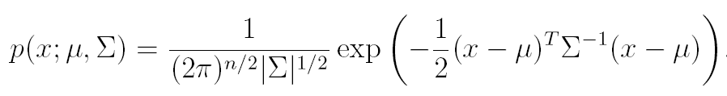
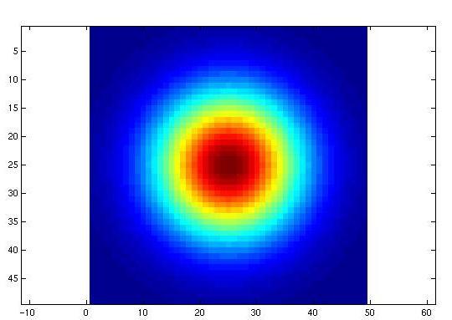
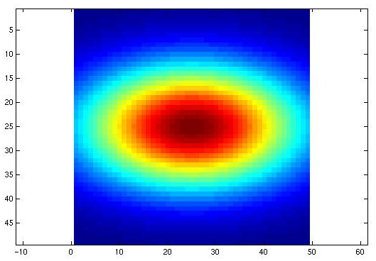
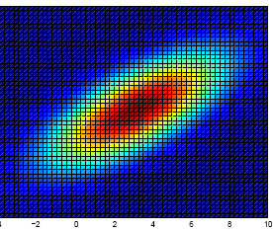
Multivariate Gaussian
Slide credit: Kristen Grauman

Slide 43
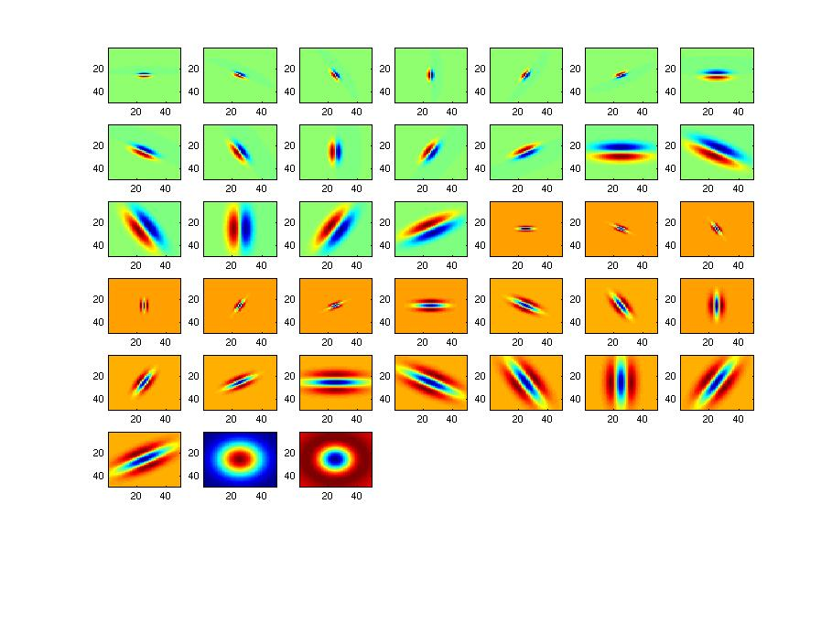
Filter bank
Slide credit: Kristen Grauman

Slide 44

Image from http://www.texasexplorer.com/austincap2.jpg
Slide credit: Kristen Grauman

Slide 45
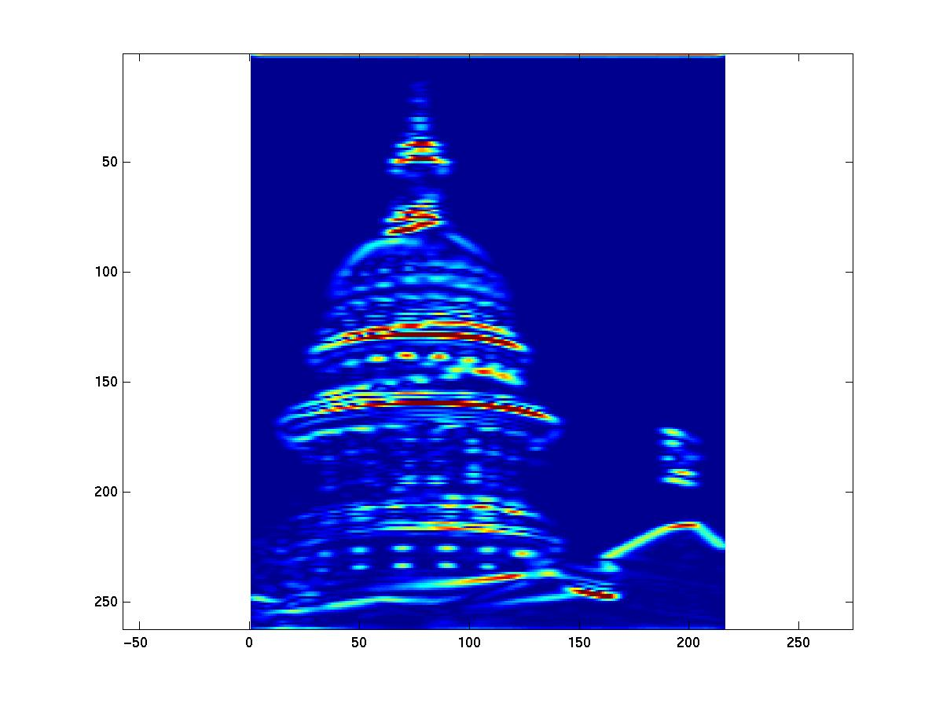
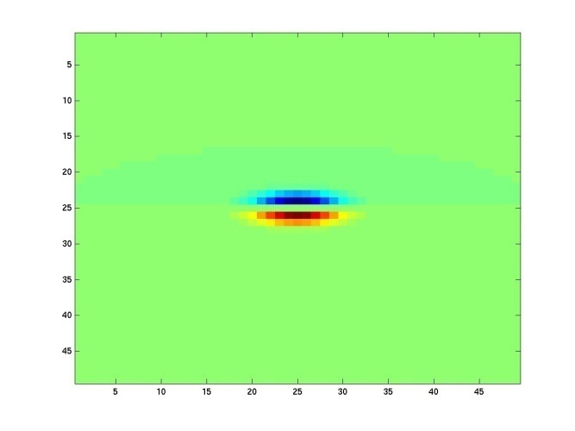
Showing magnitude of responses
Slide credit: Kristen Grauman

Slide 46
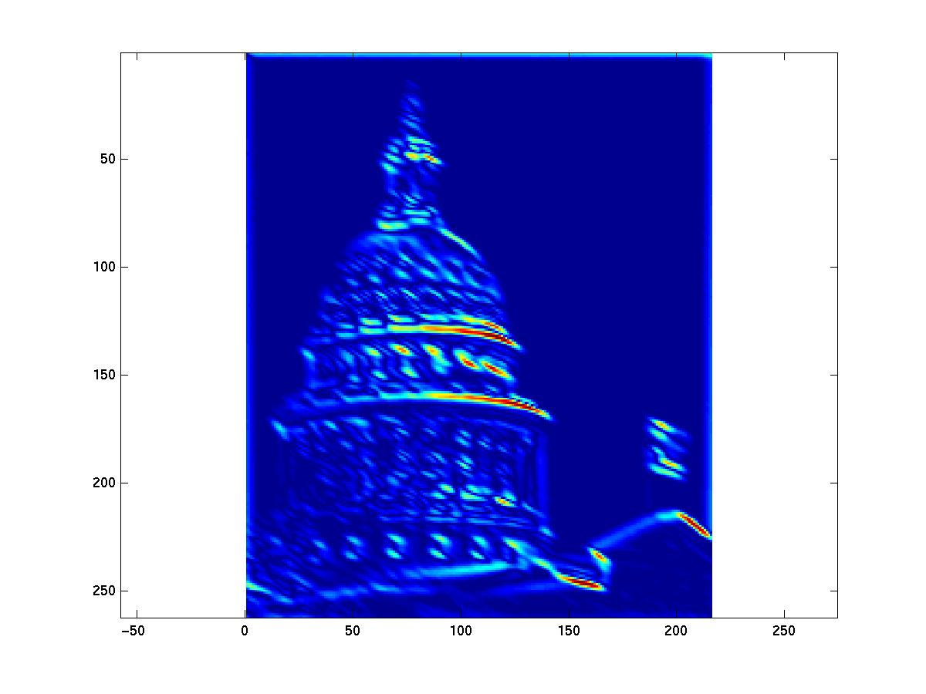
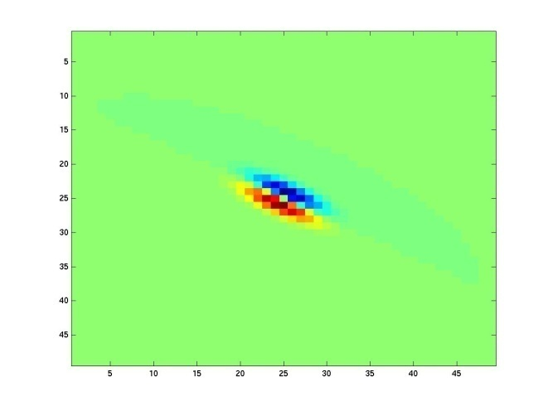
Slide credit: Kristen Grauman
Notes:
2

Slide 47
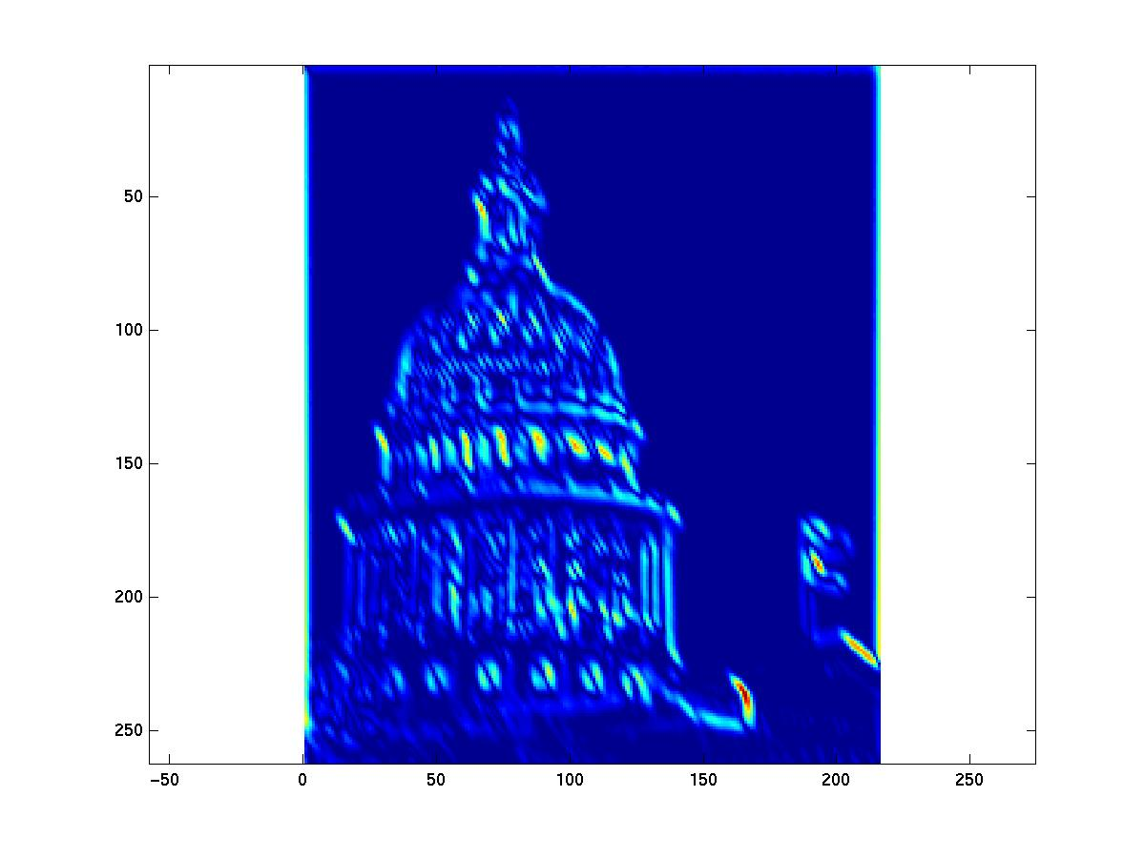
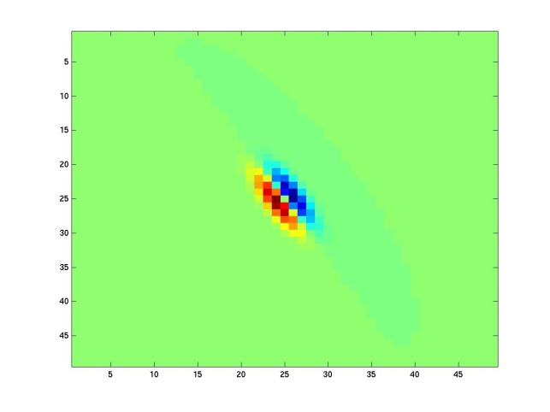
Slide credit: Kristen Grauman
Notes:
3

Slide 48
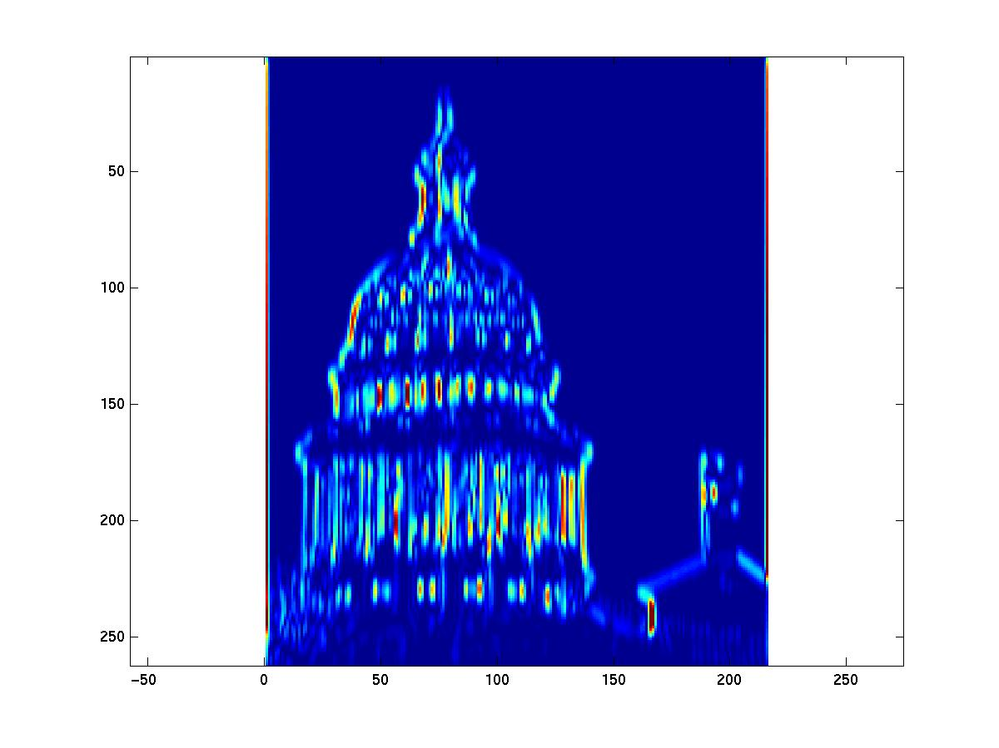
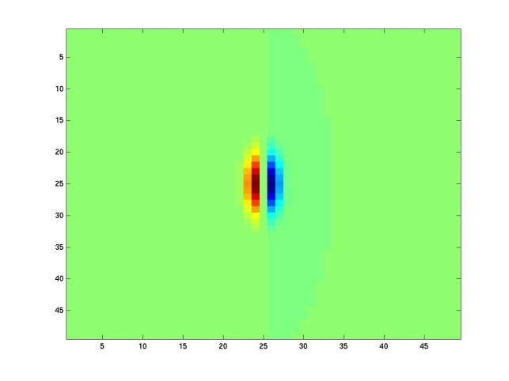
Slide credit: Kristen Grauman
Notes:
4

Slide 49
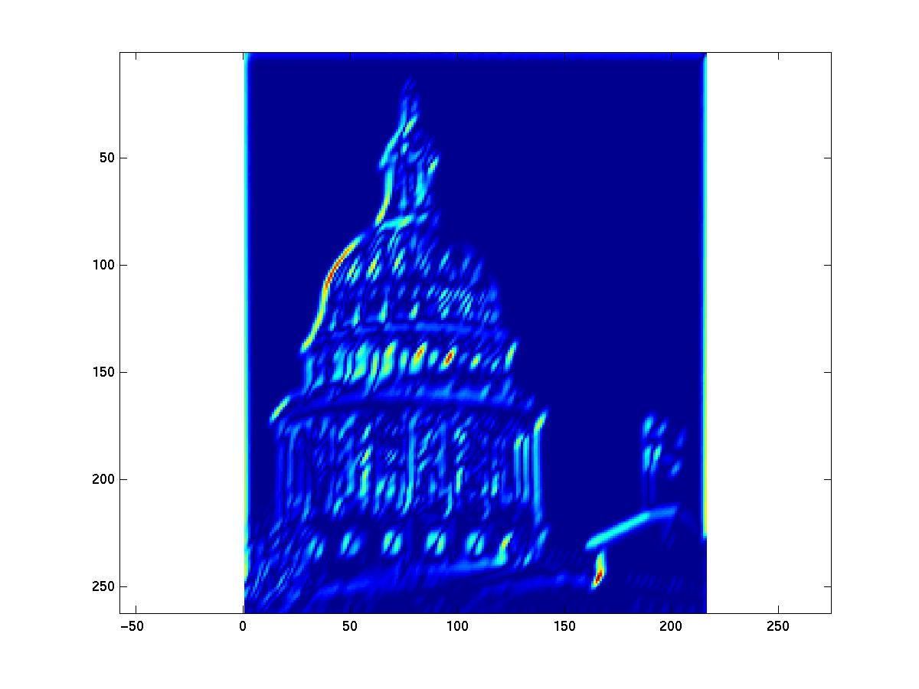
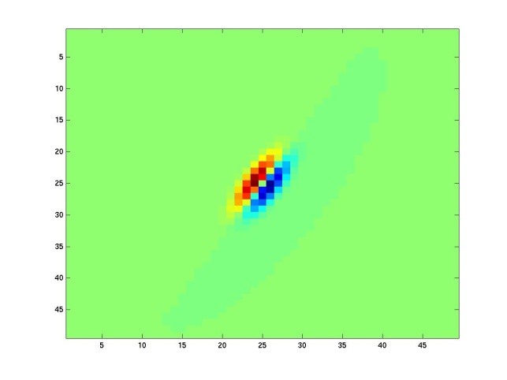
Slide credit: Kristen Grauman

Slide 50


Slide credit: Kristen Grauman
Notes:
6

Slide 51


Slide credit: Kristen Grauman
Notes:
7

Slide 52


Slide credit: Kristen Grauman
Notes:
8

Slide 53


Slide credit: Kristen Grauman
Notes:
9

Slide 54


Slide credit: Kristen Grauman
Notes:
10

Slide 55


Slide credit: Kristen Grauman
Notes:
11

Slide 56


Slide credit: Kristen Grauman
Notes:
12

Slide 57


Slide credit: Kristen Grauman
Notes:
13

Slide 58


Slide credit: Kristen Grauman
Notes:
14

Slide 59


Slide credit: Kristen Grauman
Notes:
15

Slide 60


Slide credit: Kristen Grauman
Notes:
16

Slide 61


Slide credit: Kristen Grauman

Slide 62


Slide credit: Kristen Grauman
Notes:
18

Slide 63


Slide credit: Kristen Grauman

Slide 64






You try: Can you match the texture to the response?
Filters
A
B
1
2
C
3
Mean abs responses
Slide credit: Derek Hoiem

Slide 65

Representing texture by mean abs response
Filters
Slide credit: Derek Hoiem
Mean abs responses

Slide 66
[r1, r2, …, r38]
We can form a feature vector from the list of responses at each pixel.
Slide credit: Kristen Grauman

Slide 67
d-dimensional features
Euclidean distance (L₂)
. . .
2d
3d
Slide credit: Kristen Grauman

Slide 68
Example uses of texture in vision: analysis
Slide credit: Kristen Grauman

Slide 69

Classifying materials, “stuff”
Figure by Varma & Zisserman
Slide credit: Kristen Grauman

Slide 70

Texture features for image retrieval
Y. Rubner, C. Tomasi, and L. J. Guibas. The earth mover's distance as a metric for image retrieval. International Journal of Computer Vision, 40(2):99-121, November 2000,
Slide credit: Kristen Grauman

Slide 71


Characterizing scene categories by texture
L. W. Renninger and J. Malik. When is scene identification just texture recognition? Vision Research 44 (2004) 2301–2311
Slide credit: Kristen Grauman

Slide 72

Segmenting aerial imagery by textures
Slide credit: Kristen Grauman
http://www.airventure.org/2004/gallery/images/073104_satellite.jpg

Slide 73
Texture-related tasks
Shape from texture
  Estimate surface orientation or shape from image texture
Segmentation/classification from texture cues
  Analyze, represent texture
  Group image regions with consistent texture
Synthesis
  Generate new texture patches/images given some examples
Slide credit: Kristen Grauman

Slide 74
Texture synthesis
Goal: create new samples of a given texture
Many applications: virtual environments, hole-filling, texturing surfaces
Slide credit: Kristen Grauman

Slide 75


The Challenge
Need to model the whole spectrum: from repeated to stochastic texture
repeated
  Alexei A. Efros and Thomas K. Leung, “Texture Synthesis by Non-parametric Sampling,” Proc. International Conference on Computer Vision (ICCV), 1999.
stochastic
Both?
Slide credit: Kristen Grauman

Slide 76









Markov Chains
Markov Chain
  a sequence of random variables
  is the state of the model at time t
  Markov assumption: each state is dependent only on the previous one
    dependency given by a conditional probability:
  The above is actually a first-order Markov chain
  An N’th-order Markov chain:
Slide credit: Adapted by Devi Parikh from Kristen Grauman
Source S. Seitz

Slide 77

Markov Chain Example: Text
“A dog is a man’s best friend. It’s a dog eat dog world out there.”
a
dog
is
man’s
best
friend
it’s
eat
world
p(dog|a) = ?
out
there
.
a
dog
is
it’s
eat
out
.
best
friend
there
man’s
world
Slide credit: Adapted by Devi Parikh from Steve Seitz

Slide 78
Markov Chain Example: Text
“A dog is a man’s best friend. It’s a dog eat dog world out there.”
a
 | 2/3 |  | 1/3
 |  | 1/3 |  |  |  |  | 1/3 | 1/3
1
 |  |  |  | 1
 |  |  |  |  | 1
 |  |  |  |  |  |  |  |  |  |  | 1
1
 | 1
 |  |  |  |  |  |  |  |  | 1
 |  |  |  |  |  |  |  |  |  | 1
 |  |  |  |  |  |  |  |  |  |  | 1
 |  |  |  |  |  | 1
dog
is
man’s
best
friend
it’s
eat
world
out
there
.
a
dog
is
it’s
eat
out
.
best
friend
there
man’s
world
Slide credit: Steve Seitz

Slide 79



Text synthesis
Create plausible looking poetry, love letters, term papers, etc.
Most basic algorithm
  Build probability histogram
    find all blocks of N consecutive words/letters in training documents
    compute probability of occurrence
  Given words
    compute by sampling from
WE NEED
TO
EAT
CAKE
Slide credit: Steve Seitz

Slide 80
Text synthesis
Results:
  “As I've commented before, really relating to someone involves standing next to impossible.”
  "One morning I shot an elephant in my arms and kissed him.”
  "I spent an interesting evening recently with a grain of salt"
Dewdney, “A potpourri of programmed prose and prosody” Scientific American, 1989.
Slide from Alyosha Efros, ICCV 1999

Slide 81

Synthesizing Computer Vision text
What do we get if we extract the probabilities from a chapter on Linear Filters, and then synthesize new statements?
Check out Yisong Yue’s website implementing text generation: build your own text Markov Chain for a given text corpus. http://www.yisongyue.com/shaney/index.php
Slide credit: Kristen Grauman

Slide 82
Synthesized text
This means we cannot obtain a separate copy of the best studied regions in the sum.
All this activity will result in the primate visual system.
The response is also Gaussian, and hence isn’t bandlimited.
Instead, we need to know only its response to any data vector, we need to apply a low pass filter that strongly reduces the content of the Fourier transform of a very large standard deviation.
It is clear how this integral exist (it is sufficient for all pixels within a 2k +1 × 2k +1 × 2k +1 × 2k + 1 — required for the images separately.
Slide credit: Kristen Grauman

Slide 83

Markov Random Field
A Markov random field (MRF)
  generalization of Markov chains to two or more dimensions.
First-order MRF:
  probability that pixel X takes a certain value given the values of neighbors A, B, C, and D:
A
D
X
B
C
Slide credit: Steve Seitz

Slide 84




Texture Synthesis [Efros & Leung, ICCV 99]
Can apply 2D version of text synthesis
Texture corpus (sample)
Output
Slide from Alyosha Efros, ICCV 1999

Slide 85

Texture synthesis: intuition
Before, we inserted the next word based on existing nearby words…
Now we want to insert pixel intensities based on existing nearby pixel values.
Place we want to insert next
Sample of the texture
(“corpus”)
Distribution of a value of a pixel is conditioned on its neighbors alone.
Slide credit: Kristen Grauman

Slide 86


Synthesizing One Pixel
p
input image
synthesized image
  What is ?
  Find all the windows in the image that match the neighborhood
  To synthesize x
    pick one matching window at random
    assign x to be the center pixel of that window
  An exact neighbourhood match might not be present, so find the best matches using SSD error and randomly choose between them, preferring better matches with higher probability
Slide from Alyosha Efros, ICCV 1999

Slide 87




Neighborhood Window
input
Slide from Alyosha Efros, ICCV 1999

Slide 88









Varying Window Size
Increasing window size
Slide from Alyosha Efros, ICCV 1999

Slide 89



Growing Texture
  Starting from the initial image, “grow” the texture one pixel at a time
Slide from Alyosha Efros, ICCV 1999

Slide 90




Synthesis results
french canvas
rafia weave
Slide from Alyosha Efros, ICCV 1999

Slide 91


Synthesis results
white bread
brick wall
Slide from Alyosha Efros, ICCV 1999

Slide 92


Synthesis results
Slide from Alyosha Efros, ICCV 1999

Slide 93




Failure Cases
Growing garbage
Verbatim copying
Slide from Alyosha Efros, ICCV 1999

Slide 94






Hole Filling
Slide from Alyosha Efros, ICCV 1999

Slide 95




Extrapolation
Slide from Alyosha Efros, ICCV 1999

Slide 96
The Efros & Leung algorithm
  Simple
  Surprisingly good results
  Synthesis is easier than analysis!
  …but very slow

Slide 97
Image Quilting [Efros & Freeman 2001]
non-parametric
sampling
p
B
Input image
Synthesizing a block
Observation: neighbor pixels are highly correlated
Idea: unit of synthesis = block
  Exactly the same but now we want P(B|N(B))
  Much faster: synthesize all pixels in a block at once
Slide credit: Alyosha Efros

Slide 98







block
Input texture
B1
B2
B1
B2
B1
B2
Random placement
of blocks
Neighboring blocks
constrained by overlap
Minimal error
boundary cut
Slide credit: Alyosha Efros

Slide 99








Minimal error boundary
overlapping blocks
vertical boundary
2
_
=
overlap error
min. error boundary
Slide credit: Alyosha Efros

Slide 100




Slide credit: Alyosha Efros

Slide 101




Slide credit: Alyosha Efros

Slide 102
Slide credit: Alyosha Efros

Slide 103




Slide credit: Alyosha Efros

Slide 104


Slide credit: Alyosha Efros

Slide 105





Slide credit: Alyosha Efros

Slide 106
Failures
(Chernobyl
Harvest)
Slide credit: Alyosha Efros

Slide 107

Texture Transfer
Take the texture from one object and “paint” it onto another object
  This requires separating texture and shape
  That’s HARD, but we can cheat
  Assume we can capture shape by boundary and rough shading
Then, just add another constraint when sampling: similarity to underlying image at that spot
Slide credit: Alyosha Efros

Slide 108
parmesan
+
=
rice
+
=
Slide credit: Alyosha Efros

Slide 109



+
=
Slide credit: Alyosha Efros

Slide 110




+
=
Slide credit: Alyosha Efros

Slide 111

(Manual) texture synthesis in the media
Slide credit: Kristen Grauman

Slide 112
(Manual) texture synthesis in the media
Slide credit: Kristen Grauman

Slide 113

http://www.dailykos.com/story/2004/10/27/22442/878
Slide credit: Kristen Grauman

Slide 114
Summary
Texture is a useful property that is often indicative of materials, appearance cues
Texture representations attempt to summarize repeating patterns of local structure
Filter banks useful to measure redundant variety of structures in local neighborhood
  Feature spaces can be multi-dimensional
Neighborhood statistics can be exploited to “sample” or synthesize new texture regions
  Example-based technique
Slide credit: Kristen Grauman

Slide 115
Questions?
See you Thursday!

