Slide 1

Color
April 16th, 2015
Yong Jae Lee
UC Davis

Slide 2
Today
Measuring color
  Spectral power distributions
  Color mixing
  Color matching experiments
  Color spaces
    Uniform color spaces
Perception of color
  Human photoreceptors
  Environmental effects, adaptation
Using color in computer vision systems
Slide credit: Kristen Grauman

Slide 3
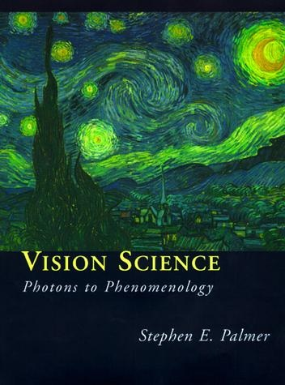
What is color?
The result of interaction between physical light in the environment and our visual system.
A psychological property of our visual experiences when we look at objects and lights, not a physical property of those objects or lights.
Slide credit: Lana Lazebnik

Slide 4
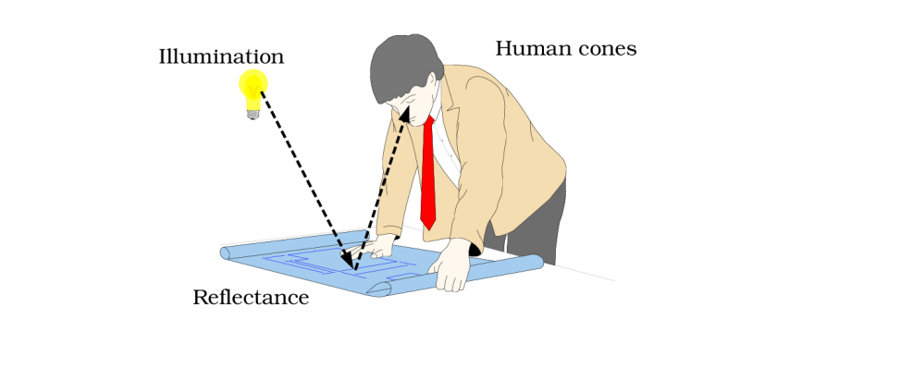
Color and light
Color of light arriving at camera depends on
  Spectral reflectance of the surface light is leaving
  Spectral radiance of light falling on that patch
Slide credit adapted from Kristen Grauman
Image from Foundations of Vision, B. Wandell

Slide 5
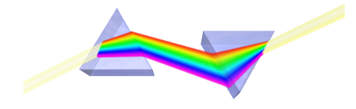
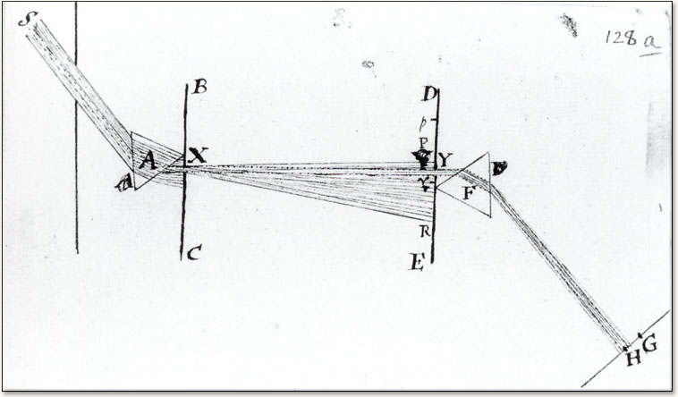
Color and light
White light: composed of about equal energy in all wavelengths of the visible spectrum
Newton 1665
Slide credit: Kristen Grauman
Image from http://micro.magnet.fsu.edu/
Notes:
Issac Newton discovered the fundamental decomposition of light into separate wavelength components

Slide 6
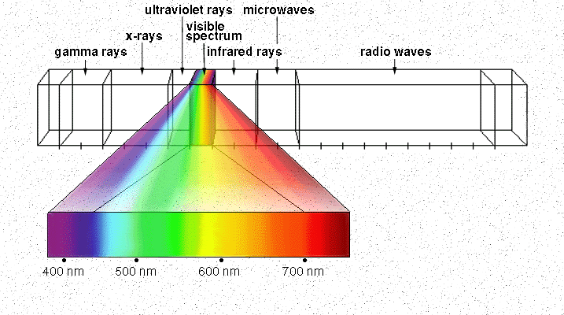

Electromagnetic spectrum
Human Luminance Sensitivity Function
Image credit: nasa.gov
Slide credit: Kristen Grauman
Notes:
High frequency (short wavelength) <-> low frequency (long wavelength)

Slide 7
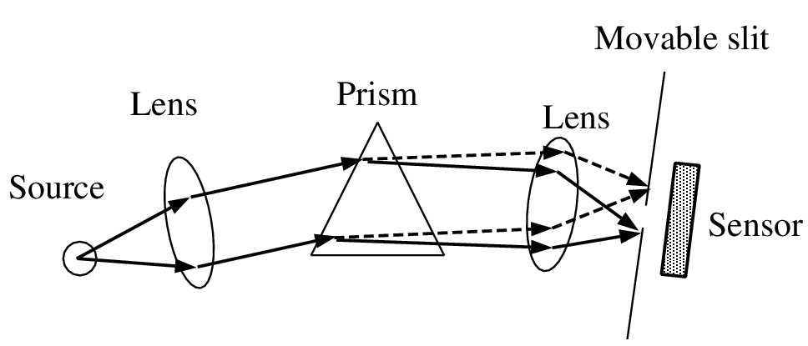
Measuring spectra
Spectroradiometer: separate input light into its different wavelengths, and measure the energy at each.
Slide adapted from Kristen Grauman
Foundations of Vision, B. Wandell

Slide 8
The Physics of Light
Any source of light can be completely described
physically by its spectrum: the amount of energy emitted
(per time unit) at each wavelength 400 - 700 nm.
Relative
spectral
power
© Stephen E. Palmer, 2002

Slide 9
Spectral power distributions
Some examples of the spectra of light sources
© Stephen E. Palmer, 2002

Slide 10
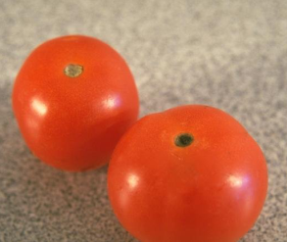
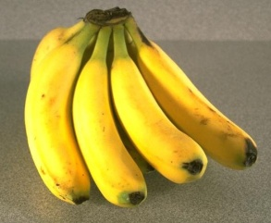
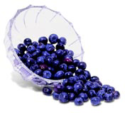
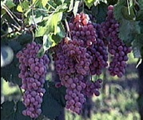
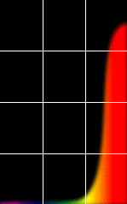
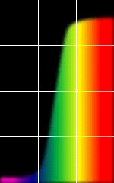
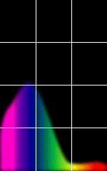
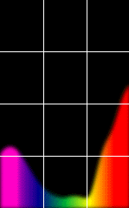
Surface reflectance spectra
Some examples of the reflectance spectra of surfaces
Red
Yellow
Blue
Purple
% Photons Reflected
400 700
400 700
400 700
400 700
Wavelength (nm)
© Stephen E. Palmer, 2002

Slide 11
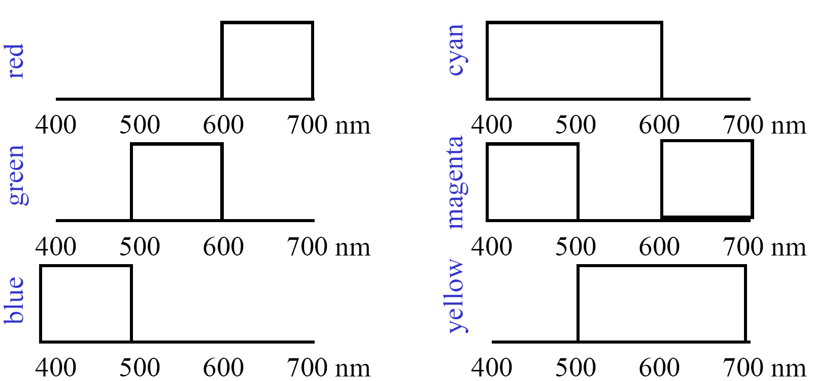
Color mixing
Cartoon spectra for color names:
Slide credit: Bill Freeman

Slide 12
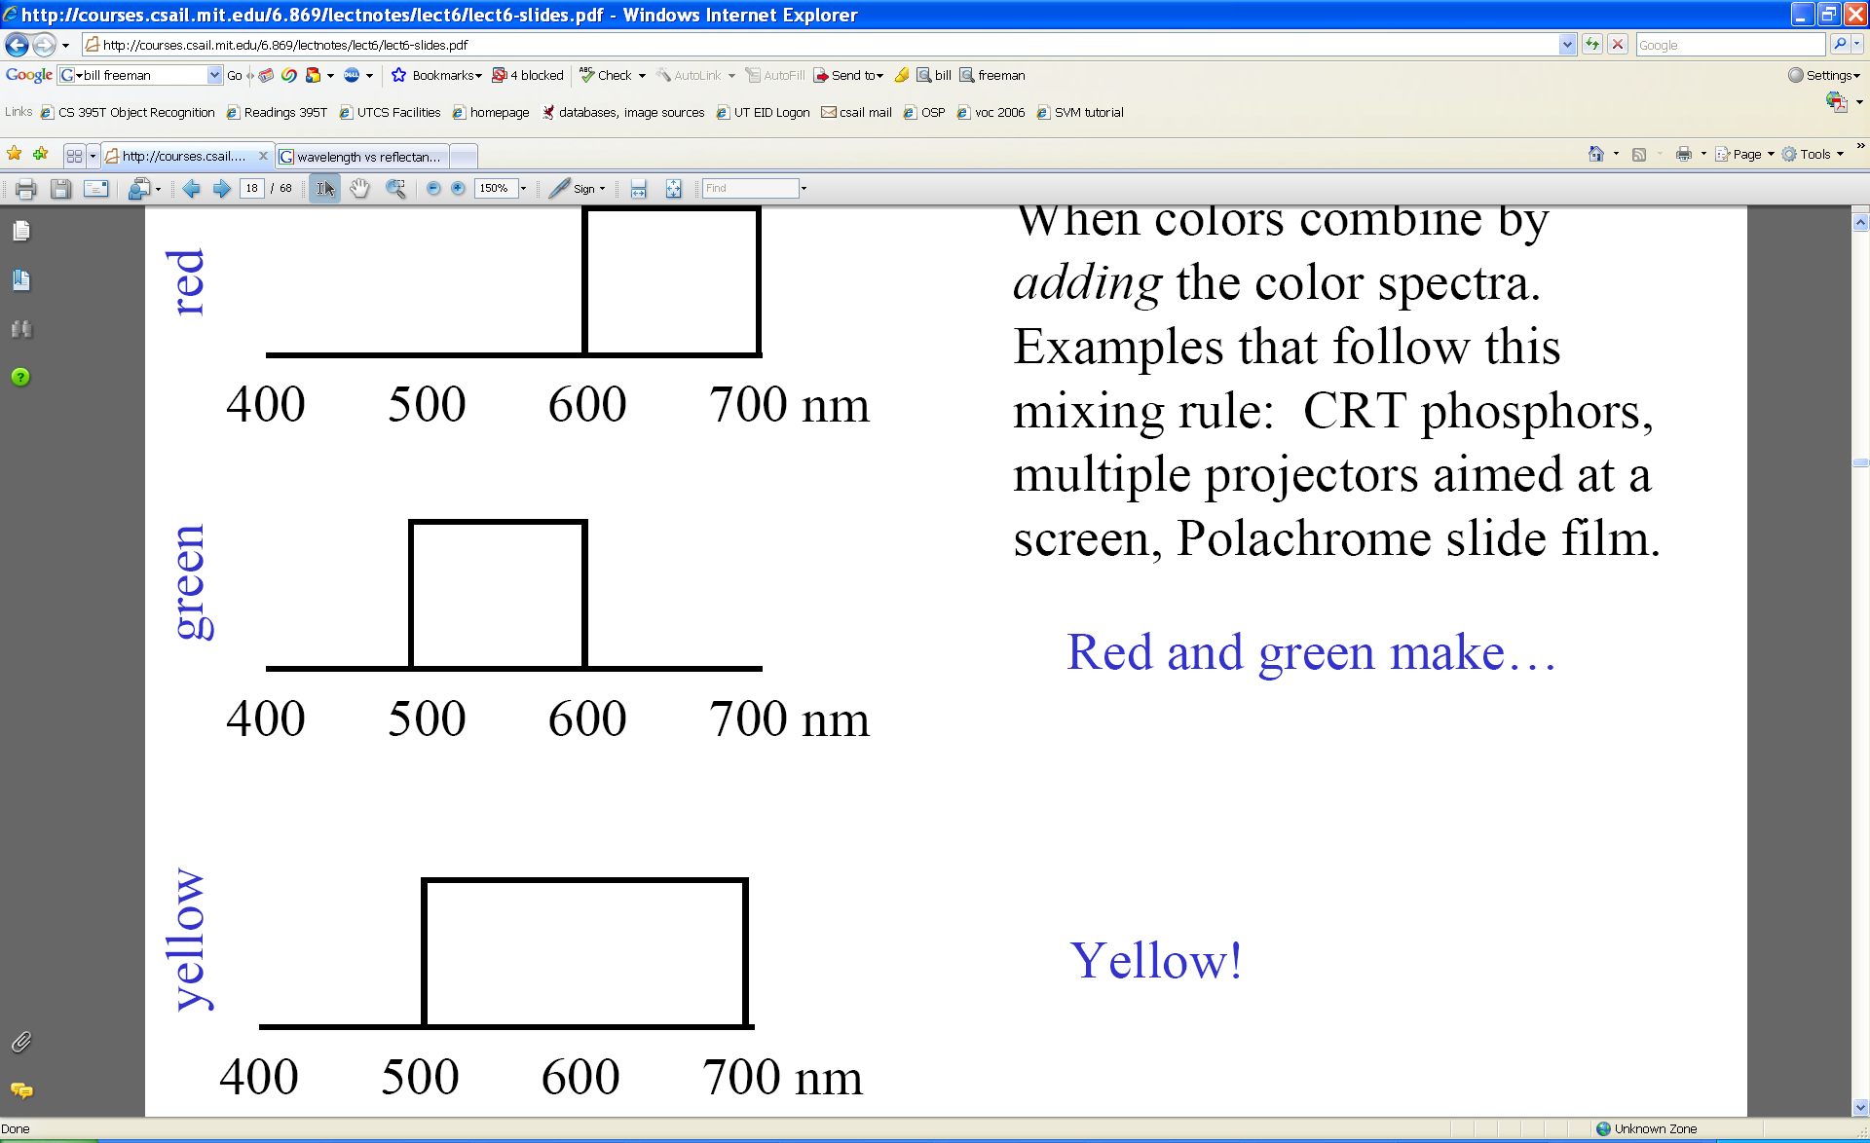
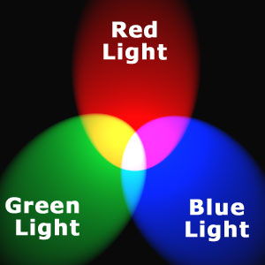
Additive color mixing
Colors combine by adding color spectra
Light adds to black.
Slide credit: Bill Freeman
Notes:
Additive color systems start with darkness. Light sources of various wavelengths are added in various proportions to produce a range of colors.

Slide 13
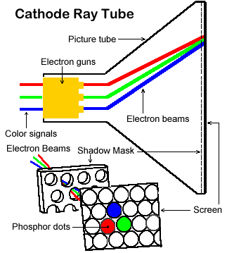
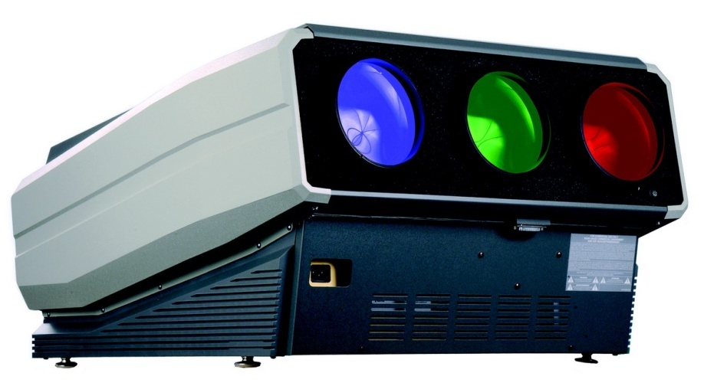
Examples of additive color systems
CRT phosphors
multiple projectors
Slide credit: Kristen Grauman

Slide 14
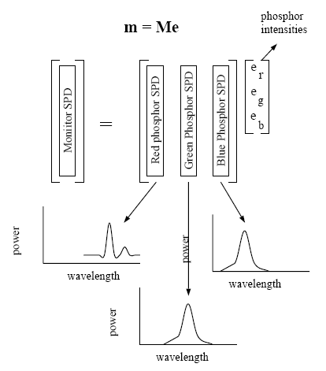
Superposition
Additive color mixing:
The spectral power distribution of the mixture is the sum of the spectral power distributions of the components.
Slide credit: Kristen Grauman
Figure from B. Wandell, 1996

Slide 15
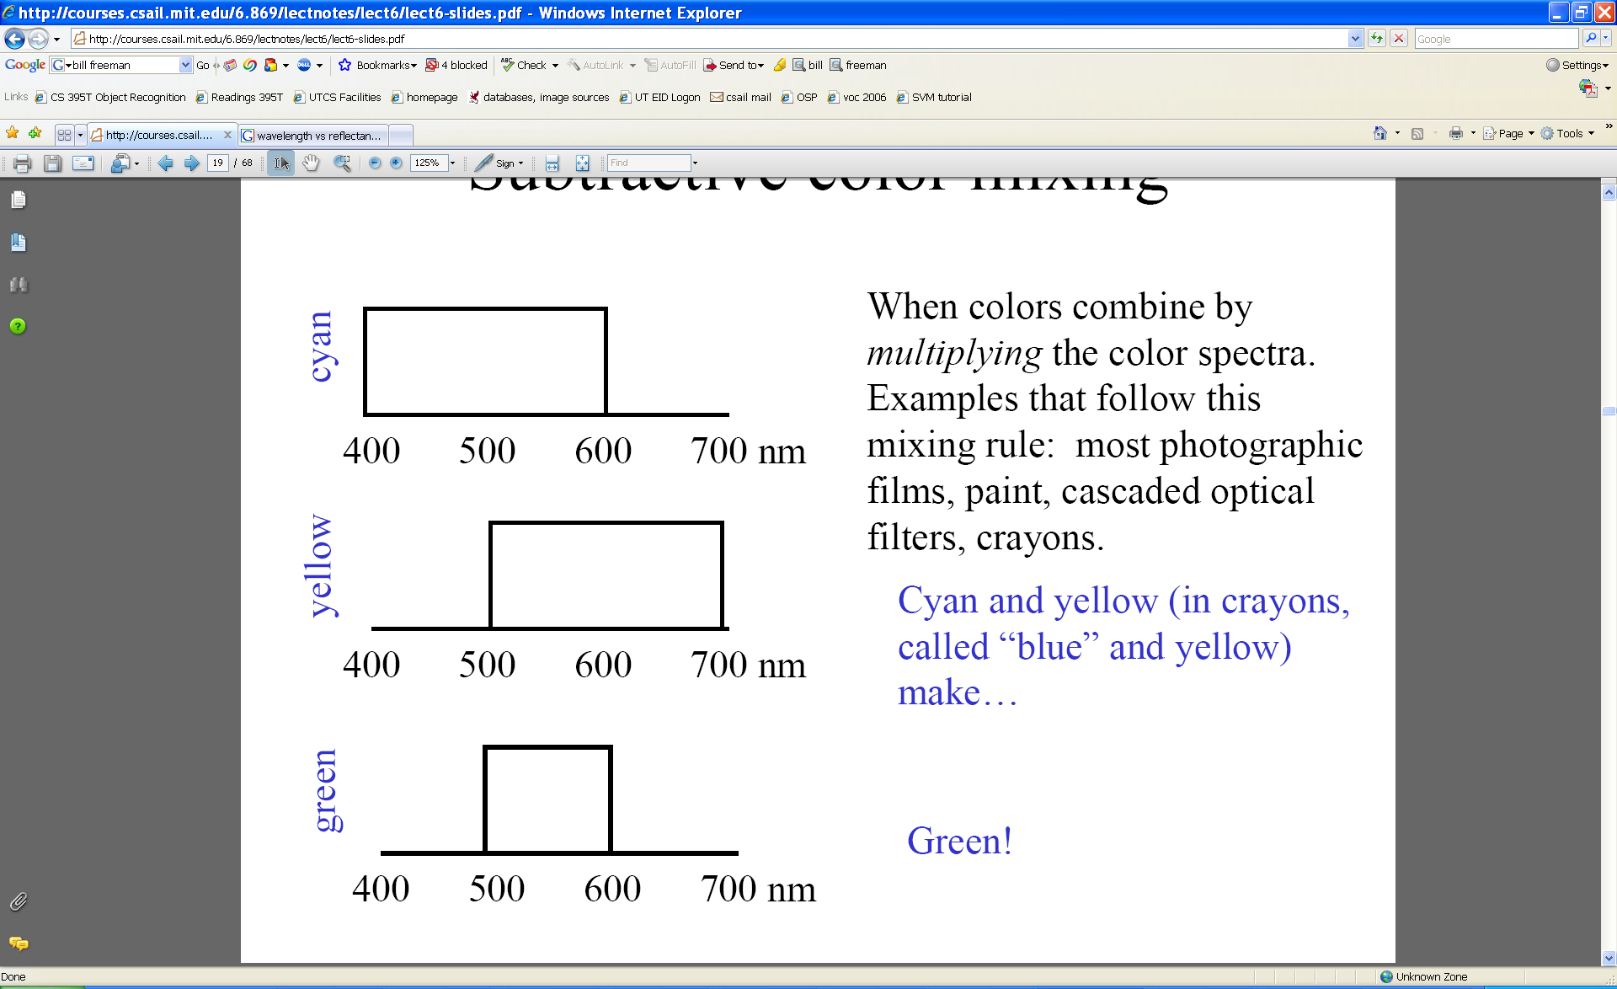
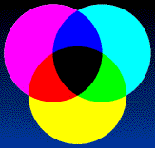
Subtractive color mixing
Colors combine by multiplying color spectra.
Pigments remove color from incident light (white).
Slide credit: Bill Freeman
Notes:
Subtractive color systems start with light, presumably white light. Colored inks, paints, or filters between the viewer and the light source or reflective surface subtract wavelengths from the light, giving it color.
Cyan absorbs red; yellow absorbs blue.

Slide 16
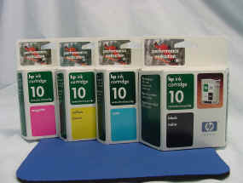
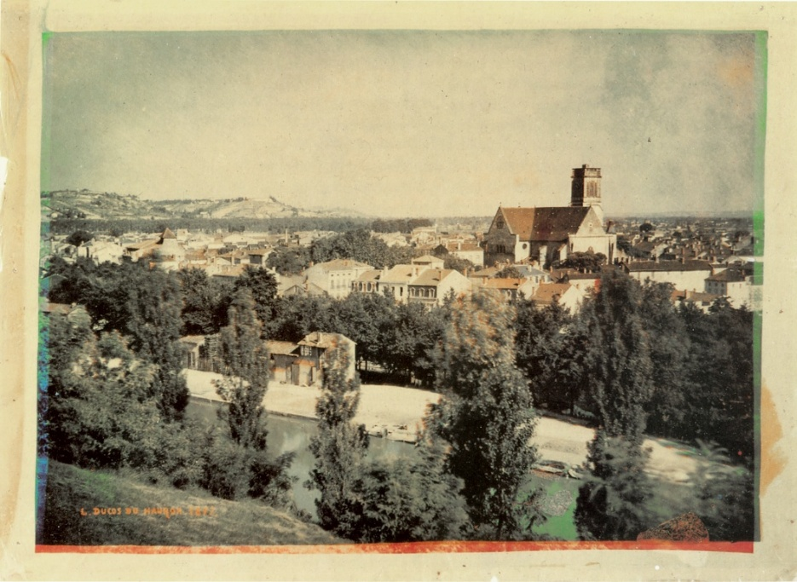
Examples of subtractive color systems
Printing on paper
Crayons
Photographic film
An 1877 color photo by Louis Ducos du Hauron, a French pioneer of color photography

Slide 17
Today: Color
Measuring color
  Spectral power distributions
  Color mixing
  Color matching experiments
  Color spaces
    Uniform color spaces
Perception of color
  Human photoreceptors
  Environmental effects, adaptation
Using color in computer vision systems
Slide credit: Kristen Grauman

Slide 18
How to know if people perceive the same color?
Important to reproduce color reliably
  Commercial products, digital imaging/art
Only a few color names recognized widely
  English ~11: black, blue, brown, grey, green, orange, pink, purple, red, white, and yellow
We need to specify numerically
  Question: What spectral radiances produce the same response from people under simple viewing conditions?
Slide credit: Kristen Grauman

Slide 19
Color matching experiments
Goal: find out what spectral radiances produce same response in human observers.
Slide credit: Kristen Grauman

Slide 20
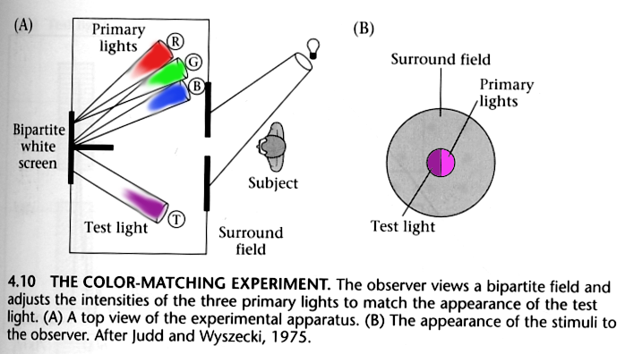
Color matching experiments
Observer adjusts weight (intensity) for primary lights (fixed SPD’s) to match appearance of test light.
Slide credit: Kristen Grauman
Foundations of Vision, by Brian Wandell, Sinauer Assoc., 1995
After Judd & Wyszecki.

Slide 21
Color matching experiments
Goal: find out what spectral radiances produce same response in human observers.
Assumption: simple viewing conditions, where we say test light alone affects perception
  Ignoring additional factors for now like adaptation, complex surrounding scenes, etc.
Slide credit: Kristen Grauman

Slide 22
Color matching experiment 1
Slide credit: Bill Freeman

Slide 23
Color matching experiment 1
p₁ p₂ p₃
Slide credit: Bill Freeman

Slide 24
Color matching experiment 1
p₁ p₂ p₃
Slide credit: Bill Freeman

Slide 25
Color matching experiment 1
The primary color amounts needed for a match
p₁ p₂ p₃
Slide credit: Bill Freeman

Slide 26
Color matching experiment 2
Slide credit: Bill Freeman

Slide 27
Color matching experiment 2
p₁ p₂ p₃
Slide credit: Bill Freeman

Slide 28
Color matching experiment 2
p₁ p₂ p₃
Slide credit: Bill Freeman

Slide 29
Color matching experiment 2
The primary color amounts needed for a match:
We say a “negative” amount of p₂ was needed to make the match, because we added it to the test color’s side.
p₁ p₂ p₃
p₁ p₂ p₃
p₁ p₂ p₃
Slide credit: Kristen Grauman

Slide 30
Color matching
  What must we require of the primary lights chosen?
  How are three numbers enough to represent entire spectrum?
Slide credit: Kristen Grauman

Slide 31
Metamers
If observer says a mixture is a match → receptor excitations of both stimuli must be equal.
But lights forming a perceptual match still may be physically different
  Match light: must be combination of primaries
  Test light: any light
Metamers: pairs of lights that match perceptually but not physically
Slide credit: Kristen Grauman

Slide 32
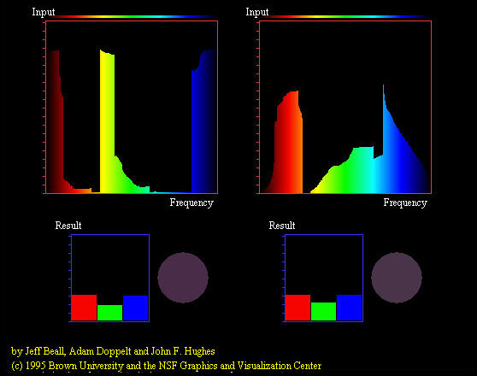
Metamers
Slide credit: Devi Parikh

Slide 33
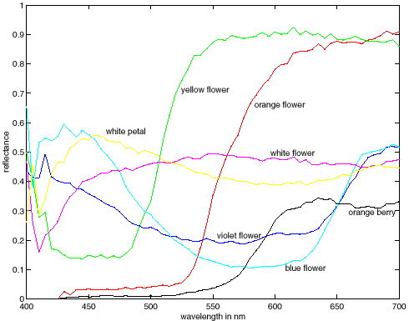
Metamers
Forsyth & Ponce, measurements by E. Koivisto
Slide credit: Kristen Grauman

Slide 34
Grassman’s laws
If two test lights can be matched with the same set of weights, then they match each other:
  Suppose A = u₁ P₁ + u₂ P₂ + u₃ P₃ and B = u₁ P₁ + u₂ P₂ + u₃ P₃. Then A = B.
If we scale the test light, then the matches get scaled by the same amount:
  Suppose A = u₁ P₁ + u₂ P₂ + u₃ P₃.
  Then kA = (ku₁) P₁ + (ku₂) P₂ + (ku₃) P_{3.}
If we mix two test lights, then mixing the matches will match the result (superposition):
  Suppose A = u₁ P₁ + u₂ P₂ + u₃ P₃ and B = v₁ P₁ + v₂ P₂ + v₃ P₃. Then A+B = (u₁+v₁) P₁ + (u₂+v₂) P₂ + (u₃+v₃) P₃.
Here “=“ means “matches”.
Slide credit: Kristen Grauman

Slide 35
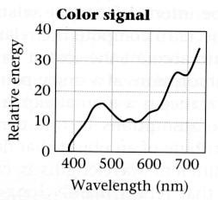
How to compute the weights of the primaries to match any new spectral signal?
Given: a choice of three primaries and a target color signal
Find: weights of the primaries needed to match the color signal
?
p₁ p₂ p₃
p₁ p₂ p₃
Slide credit: Kristen Grauman

Slide 36
Computing color matches
  Given primaries
  Estimate their color matching functions: observer matches series of monochromatic lights, one at each wavelength.
  To compute weights for new test light, multiply with matching functions.
…
…
…
Slide credit: Kristen Grauman

Slide 37
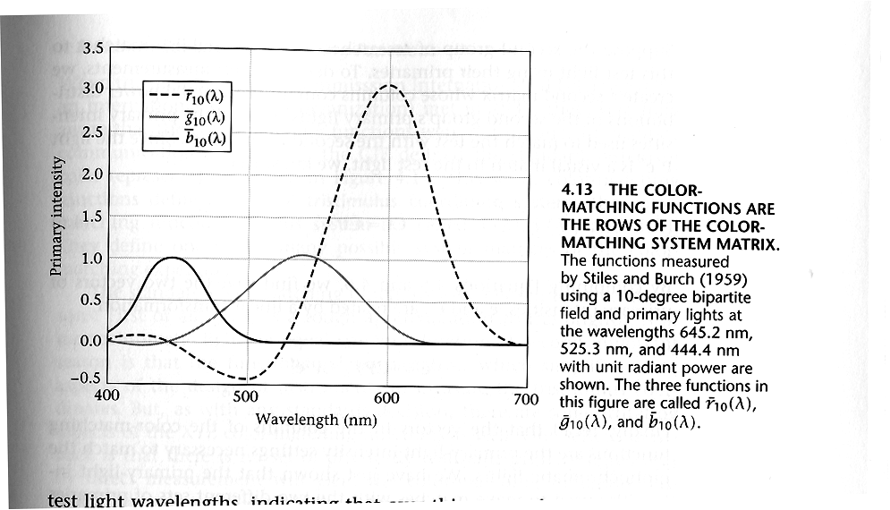
Computing color matches
Example: color matching functions for RGB
p₁ = 645.2 nm
p₂ = 525.3 nm
p₃ = 444.4 nm
Rows of matrix C
…
…
…
Foundations of Vision, by Brian Wandell, Sinauer Assoc., 1995
Slide credit: Bill Freeman

Slide 38
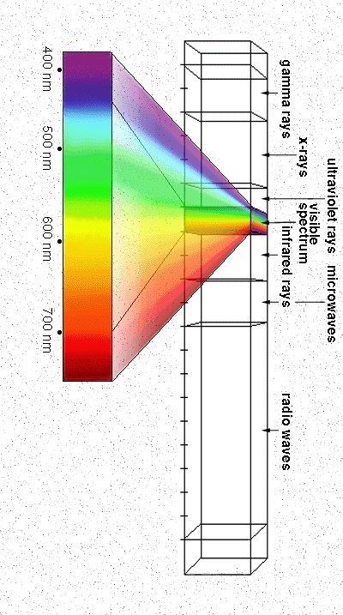
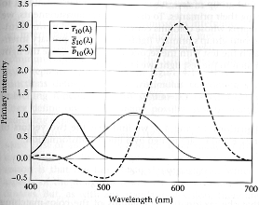
Computing color matches
Arbitrary new spectral signal is linear combination of the monochromatic sources.
t
…
Color matching functions specify how to match a unit of each wavelength, so:
Slide credit: Kristen Grauman

Slide 39
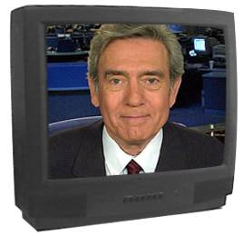
Computing color matches
Why is computing the color match for any color signal for a given set of primaries useful?
  Want to paint a carton of Kodak film with the Kodak yellow color.
  Want to match skin color of a person in a photograph printed on an ink jet printer to their true skin color.
  Want the colors in the world, on a monitor, and in a print format to all look the same.
Slide credit: Adapted from Bill Freeman by Kristen Grauman
Image credit: pbs.org

Slide 40
Today: Color
Measuring color
  Spectral power distributions
  Color mixing
  Color matching experiments
  Color spaces
    Uniform color spaces
Perception of color
  Human photoreceptors
  Environmental effects, adaptation
Using color in computer vision systems
Slide credit: Kristen Grauman

Slide 41
Standard color spaces
Use a common set of primaries/color matching functions
Linear color space examples
  RGB
  CIE XYZ
Non-linear color space
  HSV
Slide credit: Kristen Grauman

Slide 42
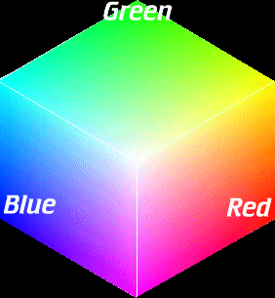
RGB color space
Single wavelength primaries
Good for devices (e.g., phosphors for monitor), but not for perception
RGB color matching functions
Slide credit: Kristen Grauman

Slide 43
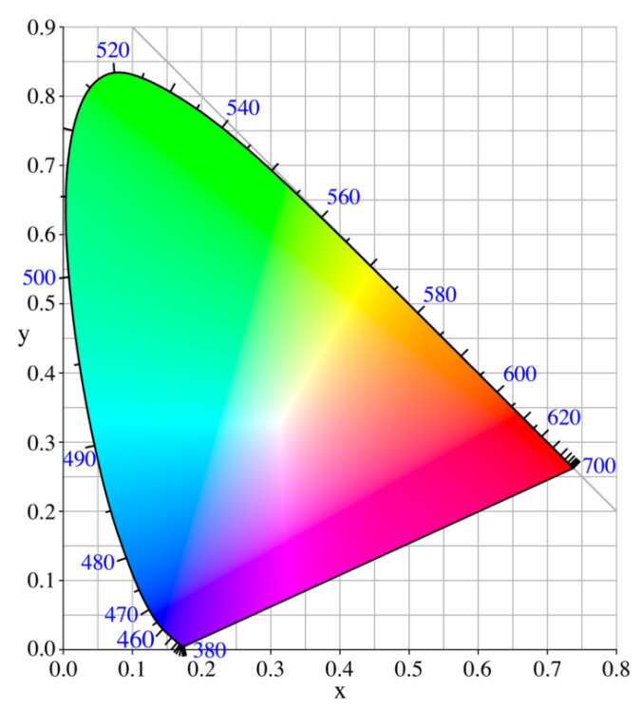
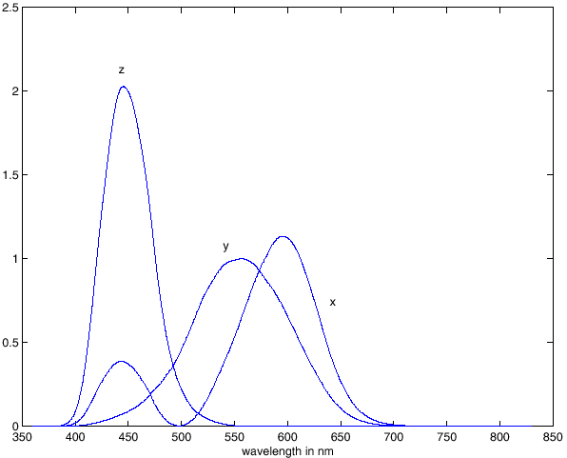
CIE XYZ color space
Established by the commission international d’eclairage (CIE), 1931
Y value approximates brightness
Usually projected to display:
(x,y) = (X/(X+Y+Z), Y/(X+Y+Z))
CIE XYZ Color matching functions
Slide credit: Kristen Grauman
Notes:
Chromaticity diagram

Slide 44
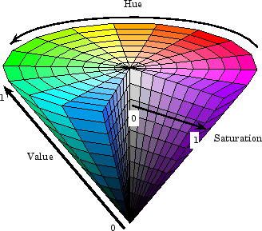
HSV color space
Hue, Saturation, Value
Nonlinear – reflects topology of colors by coding hue as an angle
Matlab: hsv2rgb, rgb2hsv.
Slide credit: Kristen Grauman
Image from mathworks.com
Notes:
Hue: color
Saturation: unsaturated (shades of gray) to fully saturated (no white component)
Value: brightness

Slide 45
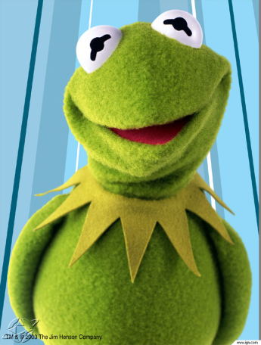
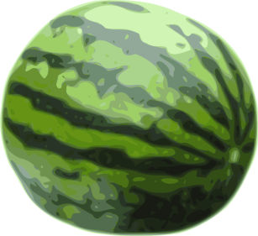
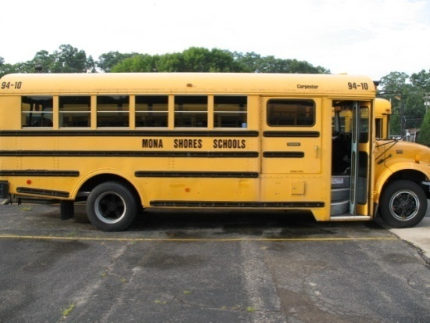
Distances in color space
Are distances between points in a color space perceptually meaningful?
Slide credit: Kristen Grauman

Slide 46
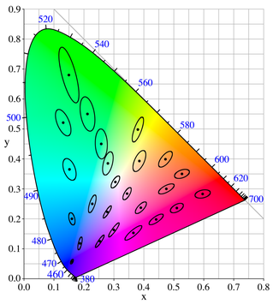
Distances in color space
Not necessarily: CIE XYZ is not a uniform color space, so magnitude of differences in coordinates are poor indicator of color “distance”.
McAdam ellipses:
Just noticeable differences in color
Slide credit: Kristen Grauman

Slide 47
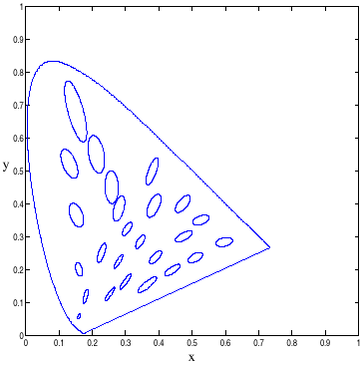
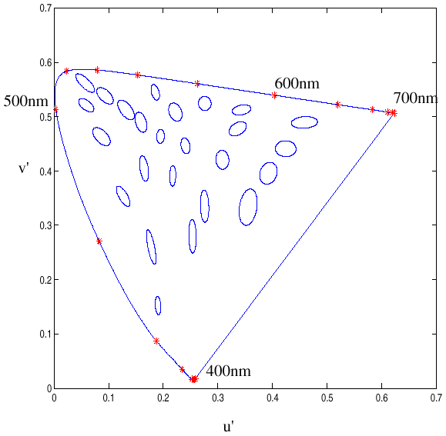
Uniform color spaces
Attempt to correct this limitation by remapping color space so that just-noticeable differences are contained by circles → distances more perceptually meaningful.
Examples:
  CIE u’v’
  CIE Lab
CIE XYZ
CIE u’v’
Slide credit: Kristen Grauman

Slide 48
Today: Color
Measuring color
  Spectral power distributions
  Color mixing
  Color matching experiments
  Color spaces
    Uniform color spaces
Perception of color
  Human photoreceptors
  Environmental effects, adaptation
Using color in computer vision systems
Slide credit: Kristen Grauman

Slide 49
Color and light
Color of light arriving at camera depends on
  Spectral reflectance of the surface light is leaving
  Spectral radiance of light falling on that patch
Color perceived depends on
  Physics of light
  Visual system receptors
  Brain processing, environment
Slide credit: Kristen Grauman

Slide 50
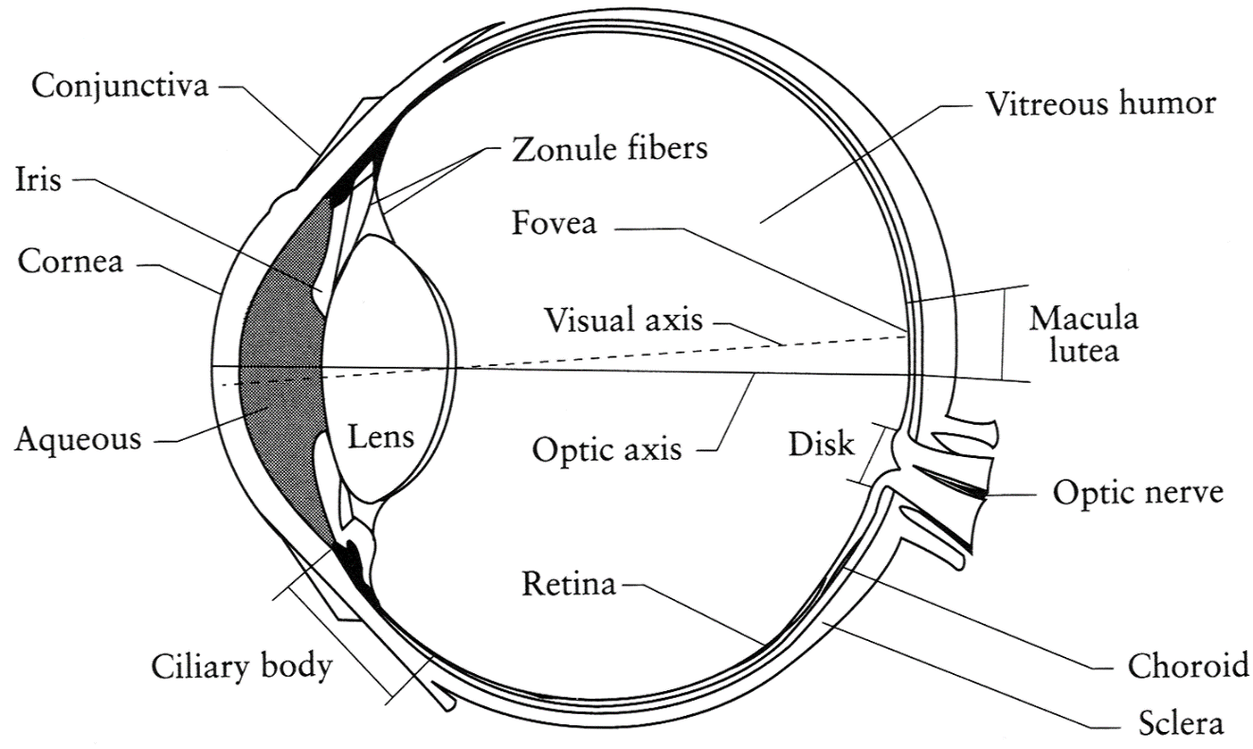
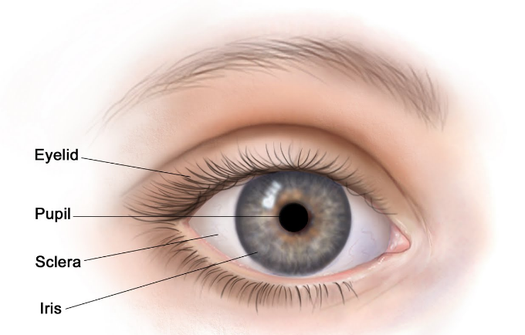
The Eye
The human eye is a camera!
  Iris - colored annulus with radial muscles
  Pupil - the hole (aperture) whose size is controlled by the iris
  Lens - changes shape by using ciliary muscles (to focus on objects at different distances)
  Retina - photoreceptor cells
Slide credit: Steve Seitz

Slide 51
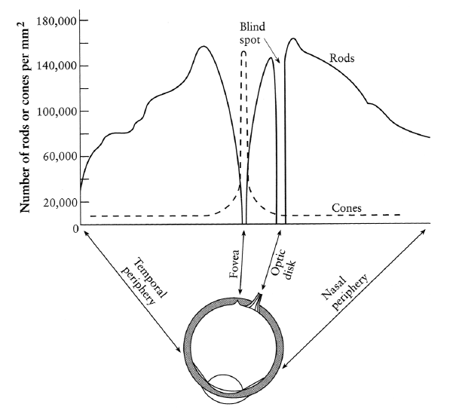
Types of light-sensitive receptors
Cones
cone-shaped
less sensitive
operate in high light
color vision
Rods
rod-shaped
highly sensitive
operate at night
gray-scale vision
© Stephen E. Palmer, 2002
Slide credit: Alyosha Efros

Slide 52
Types of cones
React only to some wavelengths, with different sensitivity (light fraction absorbed)
Brain fuses responses from local neighborhood of several cones for perceived color
Sensitivities vary per person, and with age
Color blindness: deficiency in at least one type of cone
Three kinds of cones
Slide credit: Kristen Grauman
Notes:
Short, medium, large

Slide 53
Physiology of Color Vision: Fun facts
“M” and “L” pigments are encoded on the
X-chromosome
  That’s why men are more likely to be color blind http://www.vischeck.com/vischeck/vischeckURL.php
Some animals have one (night animals), two (e.g., dogs), four (fish, birds), five (pigeons, some reptiles/amphibians), or even 12 (mantis shrimp) types of cones
  http://www.mezzmer.com/blog/how-animals-see-the-world/
http://en.wikipedia.org/wiki/Color_vision
Slide by D. Hoiem

Slide 54
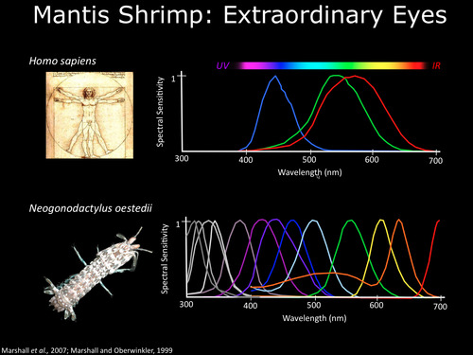

Slide 55
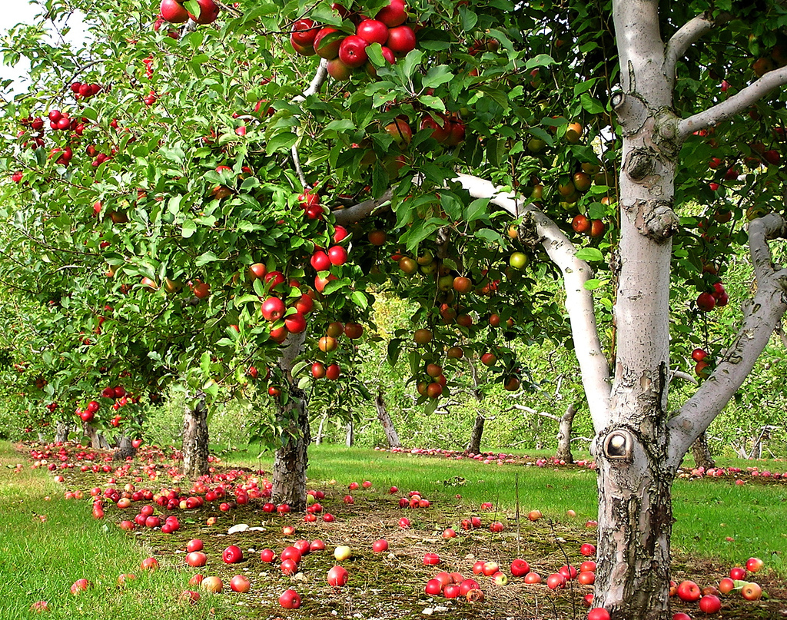
Types of cones
Possible evolutionary pressure for developing receptors for different wavelengths in primates
Osorio & Vorobyev, 1996
Slide adapted from Kristen Grauman

Slide 56
Trichromacy
Experimental facts:
  Three primaries will work for most people if we allow subtractive matching; “trichromatic” nature of the human visual system
  Most people make the same matches for a given set of primaries (i.e., select the same mixtures)
Slide credit: Kristen Grauman

Slide 57
Environmental effects & adaptation
Chromatic adaptation:
  We adapt to a particular illuminant
Assimilation, contrast effects, chromatic induction:
  Nearby colors affect what is perceived; receptor excitations interact across image and time
Afterimages
Slide credit: Kristen Grauman

Slide 58
Chromatic adaptation
If the visual system is exposed to a certain illuminant for a while, color system starts to adapt / skew
Adapting to different brightness levels
  Changing the size of the iris opening changes the amount of light that can enter the eye
Adapting to different color temperature
  For example: if there is an increased amount of red light, the cells receptive to red decrease their sensitivity until the scene looks white again

Slide 59
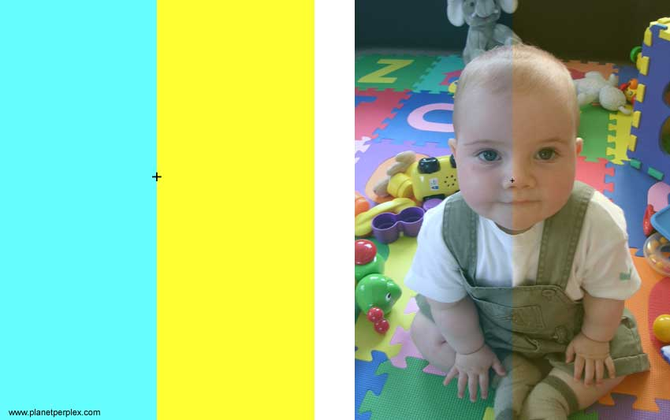
Chromatic adaptation
Slide credit: Kristen Grauman
http://www.planetperplex.com/en/color_illusions.html

Slide 60
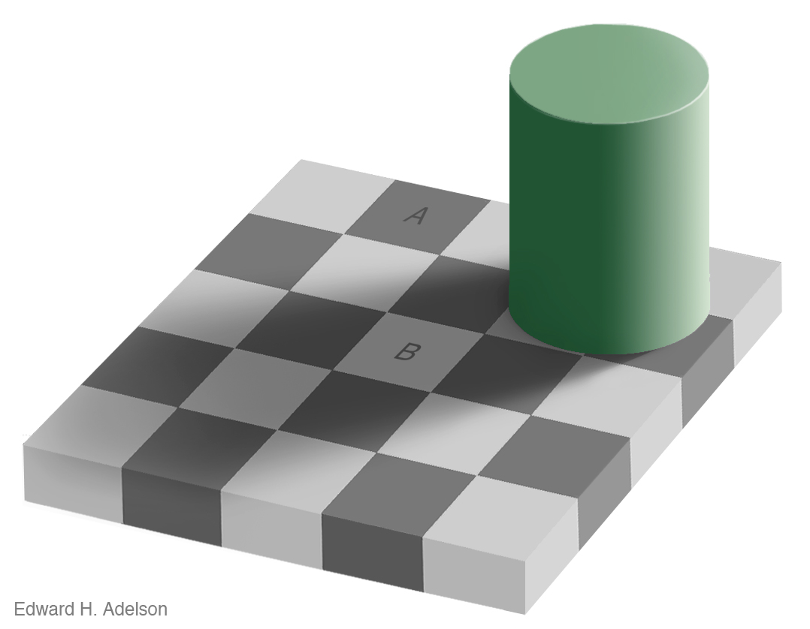
Brightness perception
Edward Adelson
http://web.mit.edu/persci/people/adelson/illusions_demos.html
Slide credit: Kristen Grauman

Slide 61
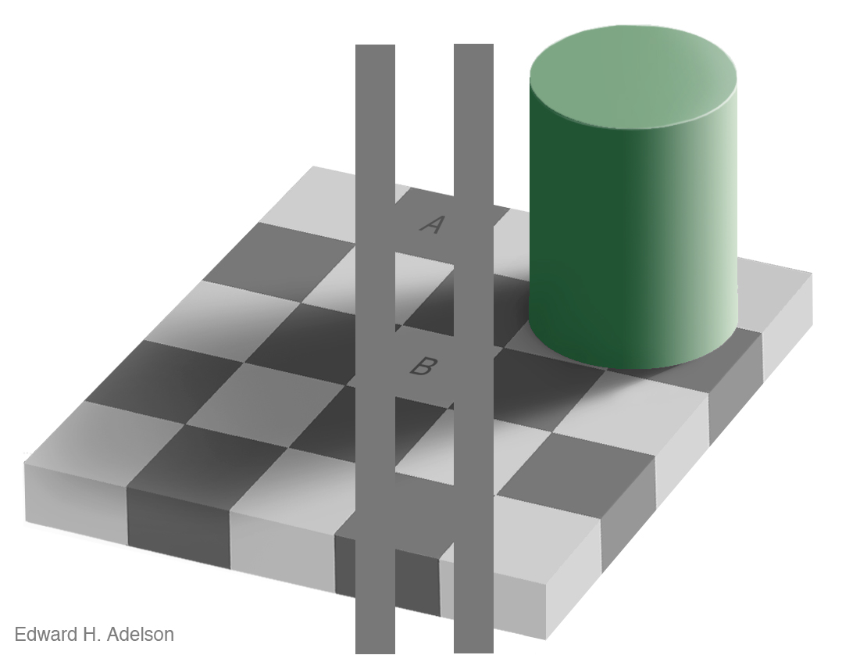
Edward Adelson
http://web.mit.edu/persci/people/adelson/illusions_demos.html
Slide credit: Kristen Grauman

Slide 62

Edward Adelson
http://web.mit.edu/persci/people/adelson/illusions_demos.html
Slide credit: Kristen Grauman

Slide 63

Look at blue squares
Look at yellow squares
Content © 2008 R.Beau Lotto
http://www.lottolab.org/articles/illusionsoflight.asp
Slide credit: Kristen Grauman

Slide 64

Content © 2008 R.Beau Lotto
http://www.lottolab.org/articles/illusionsoflight.asp
Slide credit: Kristen Grauman

Slide 65

Content © 2008 R.Beau Lotto
http://www.lottolab.org/articles/illusionsoflight.asp
Slide credit: Kristen Grauman

Slide 66

Content © 2008 R.Beau Lotto
http://www.lottolab.org/articles/illusionsoflight.asp
Slide credit: Kristen Grauman

Slide 67

Content © 2008 R.Beau Lotto
http://www.lottolab.org/articles/illusionsoflight.asp
Slide credit: Kristen Grauman

Slide 68

Content © 2008 R.Beau Lotto
http://www.lottolab.org/articles/illusionsoflight.asp
Slide credit: Kristen Grauman

Slide 69
Contrast effects
Slide credit: Kristen Grauman

Slide 70

After images
Tired photoreceptors send out negative response after a strong stimulus
http://www.sandlotscience.com/Aftereffects/Andrus_Spiral.htm
http://www.michaelbach.de/ot/mot_adaptSpiral/index.html
Slide credit: Steve Seitz

Slide 71

Name that color
High level interactions affect perception and processing.
Slide credit: Kristen Grauman

Slide 72
Today: Color
Measuring color
  Spectral power distributions
  Color mixing
  Color matching experiments
  Color spaces
    Uniform color spaces
Perception of color
  Human photoreceptors
  Environmental effects, adaptation
Using color in computer vision systems
Slide credit: Kristen Grauman

Slide 73

Color as a low-level cue for CBIR
Blobworld system
Carson et al, 1999
Swain and Ballard, Color Indexing, IJCV 1991
Slide credit: Kristen Grauman

Slide 74








Color as a low-level cue for CBIR
Pixel counts
R
G
B
Color histograms: Use distribution of colors to describe image
No spatial info – invariant to translation, rotation, scale
Color intensity
Slide credit: Kristen Grauman

Slide 75

Example database
Color-based image retrieval
Slide credit: Kristen Grauman

Slide 76





Example retrievals
Color-based image retrieval
Slide credit: Kristen Grauman

Slide 77


Example retrievals
Color-based image retrieval
Slide credit: Kristen Grauman

Slide 78
Color-based image retrieval
Given collection (database) of images:
  Extract and store one color histogram per image
Given new query image:
  Extract its color histogram
  For each database image:
    Compute intersection between query histogram and database histogram
  Sort intersection values (highest score = most similar)
  Rank database items relative to query based on this sorted order
Slide credit: Kristen Grauman

Slide 79


Slide 80

Color-based skin detection
M. Jones and J. Rehg, Statistical Color Models with Application to Skin Detection, IJCV 2002.
Slide credit: Kristen Grauman

Slide 81


Color-based segmentation for robot soccer
Towards Eliminating Manual Color Calibration at RoboCup. Mohan Sridharan and Peter Stone. RoboCup-2005: Robot Soccer World Cup IX, Springer Verlag, 2006
Slide credit: Kristen Grauman

Slide 82
Questions?
See you Tuesday!

